Slide 1

Sprocket Central Pty Ltd
Data analytics approach
Bodige Venkat Sai Goud - Junior Consultant (Intern)

Slide 2
Agenda
Introduction
Data Exploration
Model Development
Interpretation

Slide 3
Introduction
CUSTOMERS ANALYSIS
Age distributions
Number of bike purchases in 3 years/ percentages purchases
Job industry category.
Wealth segments
Number of cars own on each states

Slide 4
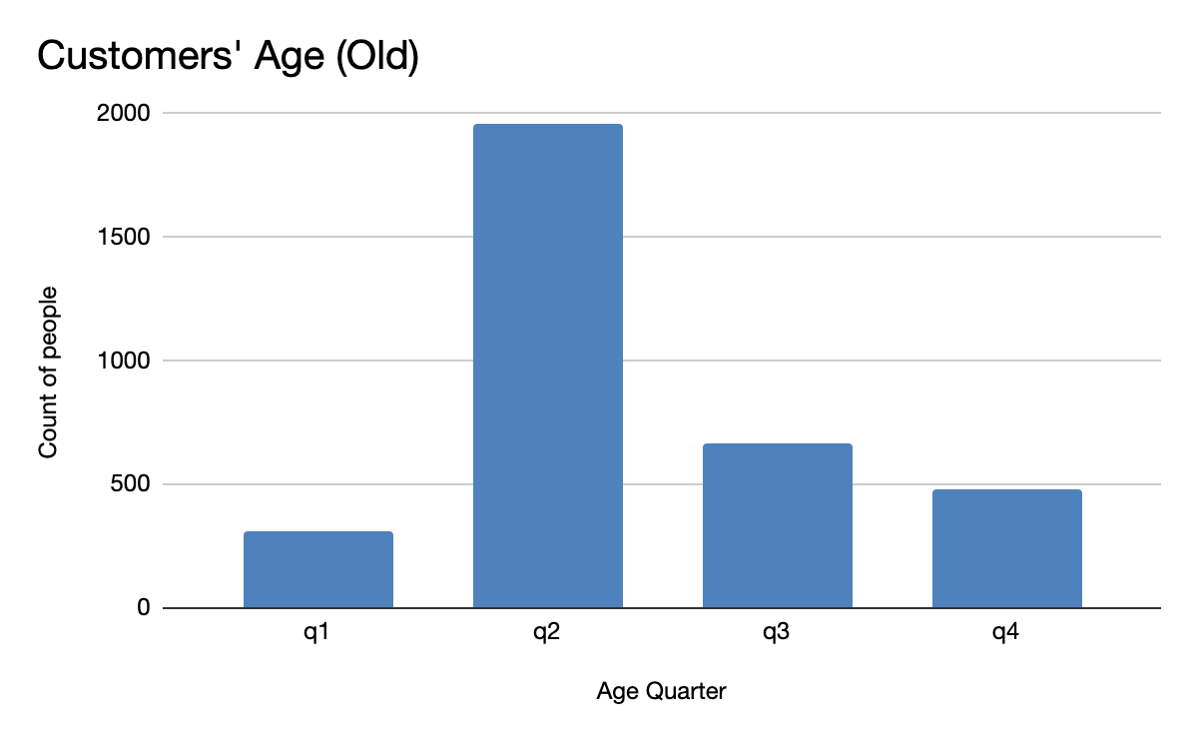
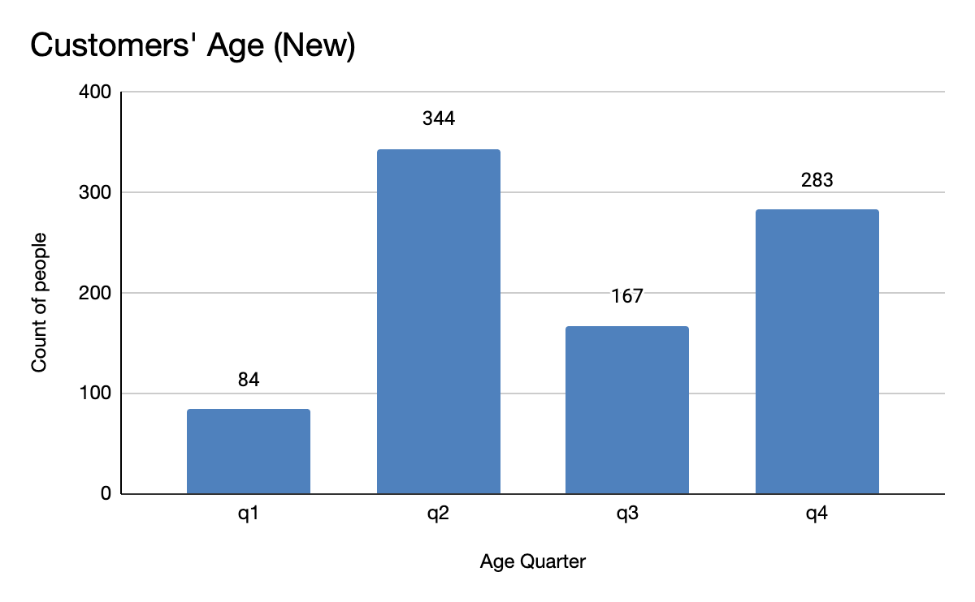
Data Exploration
Customers’ age distribution
As we can see, mostly our new customers are between 25 to 48 years old.
Number of customers from 48 to 59 years old has big drops on percentages.
There is a slightly increase in number of customers over 59 years old in term of percentages
It looks like the percentages of under 25 years old not really change.
q1 : 0 - 25 years
q2 : 26 - 48 years
q3 : 48 - 59 years
q4 : above 59 years

Slide 5
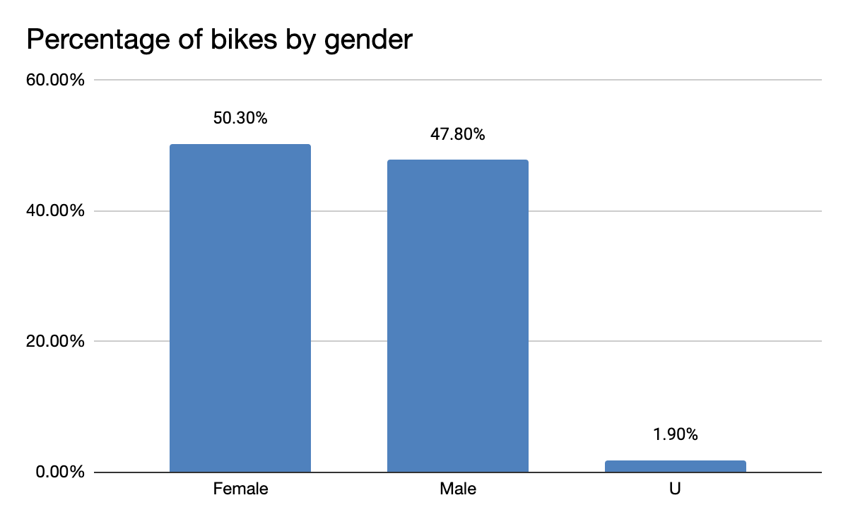
Model Development
BIKE PURCHASES LAST 3 YEARS
As we can see, our new customers mostly Female with 50.3% & Male contributed to 47.8% purchases.
So we should focus on advertises on Female customers than Male customers

Slide 6
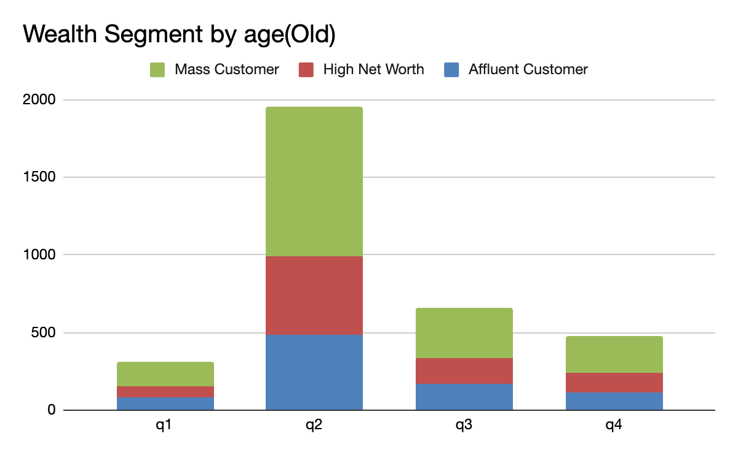
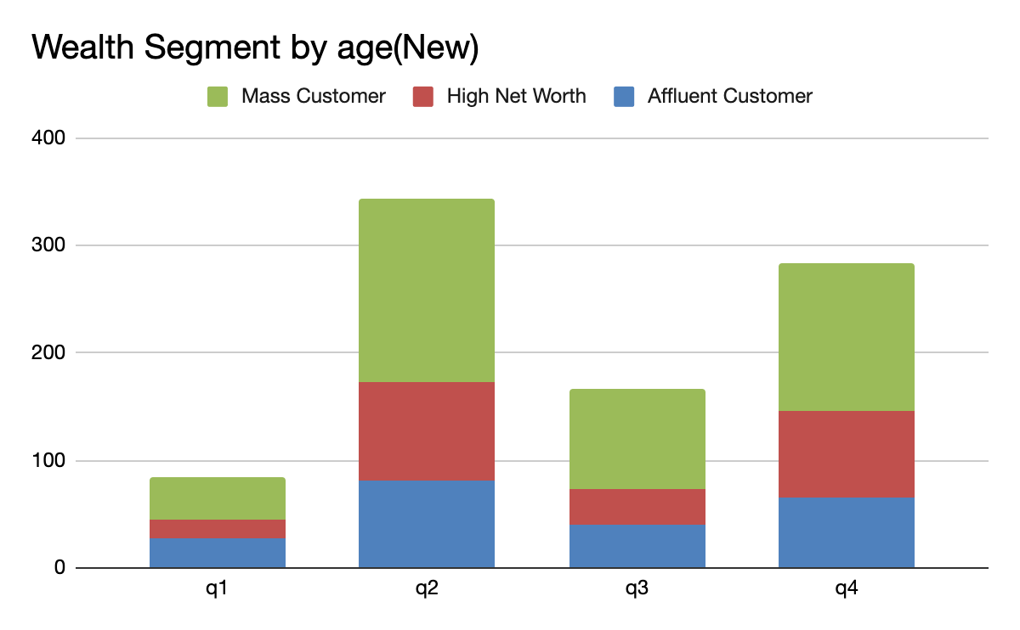
Interpretation
WEALTH SEGMENTS
In all ages, the number of Mass Customers is the highest so we should focus on this social class.
After that, we should focus on High Net Customer.
Then Affluent Customers but mostly second and third quadrant

Slide 7
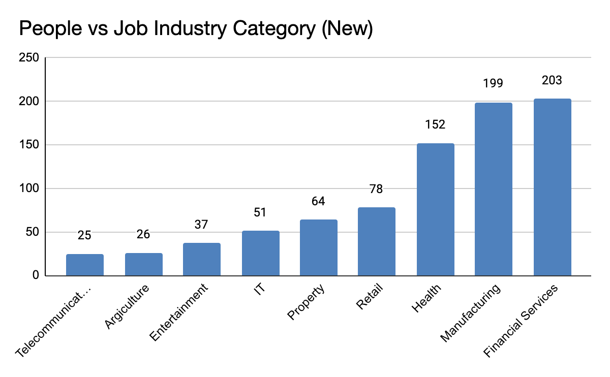
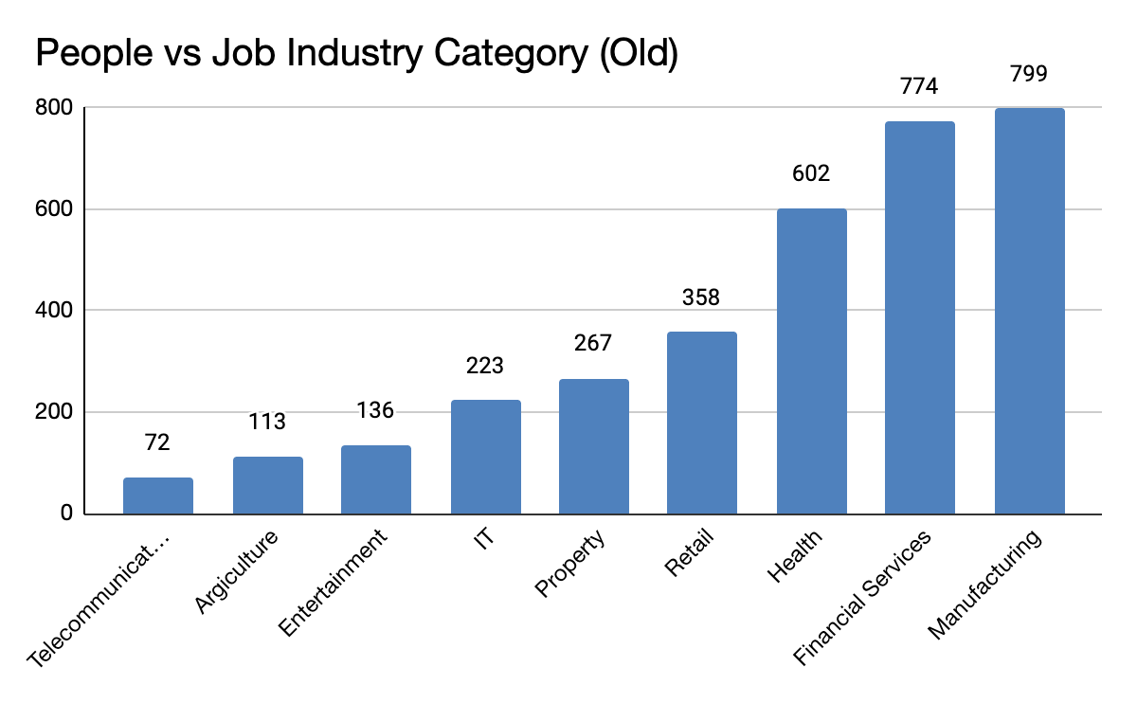
Interpretation
JOB INDUSTRY CATEGORY
Mostly our new customers are on Finance industry and our Manufacturing customers are still on top 2.
The rest industries is still same

Slide 8
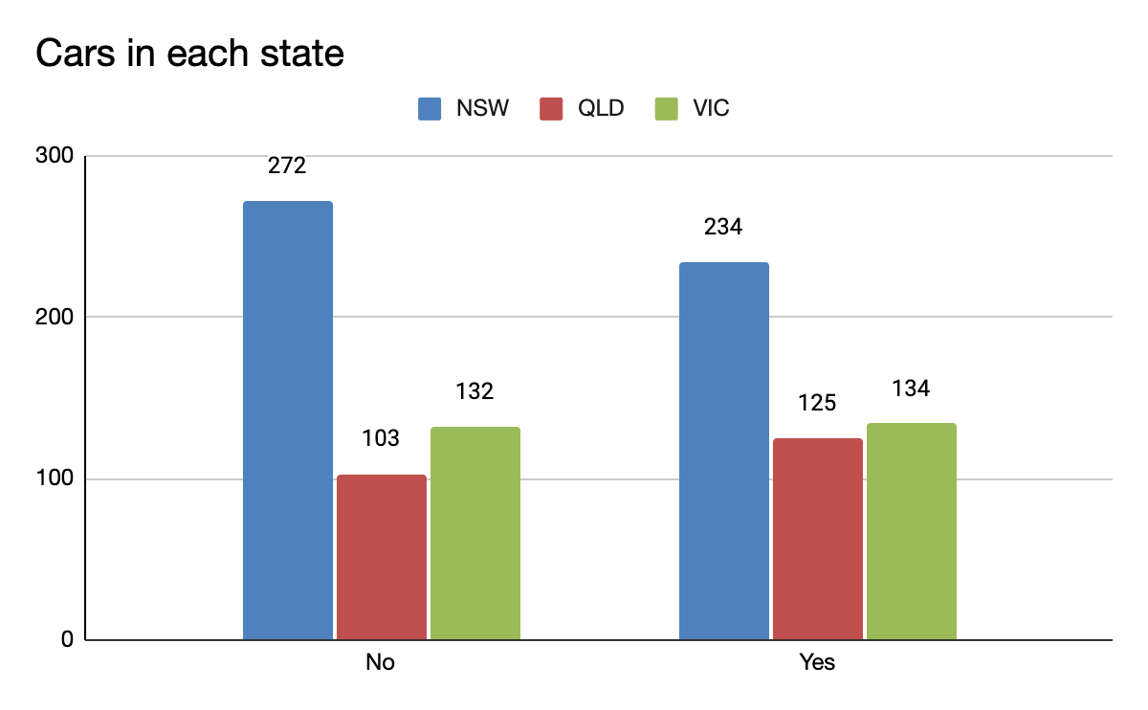
Interpretation
NUMBERS OF CARS OWNED
NSW should be considered the most since numbers of customers don’t own cars is significantly larger than that own.
VIC and QLD has more customers that own car that who don’t but we can try to have something so that those owns car will buy bikes.

Slide 9
Thank You

