Slide 1
PROJECT GLADIATOR
Ease My Trip

Slide 2
Team Details
Name | PS.NO
Venkat Sai | 10687758
Anjali Patil | 10687866
Rohit Athiya | 10687636
Shivani Vaidya | 10687843
Aishwarya Chourasia | 10687749

Slide 3
Contents
OBJECTIVE
TEST ACTIVITIES
TECHNICAL SPECIFICATIONS
FLOW
IN SCOPE
OUT OF SCOPE
RESULTS
REPORTS
CONCLUSION
REFERENCES

Slide 4
OBJECTIVE
Understanding the Functionality and flow of modules.
To validate system responsiveness. System should responsive enough.
To validate that the application correctly supports required processes and transactions. It should work as per user expectations.
To verify that actions and data are available only to those users with correct authorization.
To verify that the system supports the required service levels of the business
To reduce the level of risk of insufficient software quality. To find defects in the software product and solve it as per requirements.

Slide 5
Test Activities
1. Requirement Analysis
2. Test Analysis & Test Design(Test Case writing)
3. Test Scripts Writing
4. Test Execution
5. Report Generation & Defect Reporting

Slide 6
Technical Specifications
Tools
● Eclipse 2020-03
● JDK 1.8
● Selenium Java 3.1.141.59
● Microsoft Excel
Hardware configuration Software configuration
● Minimum Pentium 4 machine and maximum iCore 32/64
bits is recommended ● OS : Minimum Windows XP with Service Pack 2 (32bits)
● 1GB Memory Maximum- Windows 10(64 bits)
● Protocol – 802.111 ● Browser (Chrome and Firefox)
● Firewall – Port enabled – 1433 (TCP/IP)
● Protocol – 802.111
● Firewall – Port enabled – 1433 (TCP/IP)

Slide 7
Login Registration Flight booking Hotel booking
EaseMyTrip
One-Way Trip Round-Trip

Slide 8
In Scope
In Scope refers to the features that fall within the boundary of the scope statement. The Following is the in scope of our project
1. Registration /Sign up - To verify if a user is able to sign up successfully .
2. Login - To verify if a user is able to login without any problems.
3. Flight Booking - To test whether a user is able to book different types of flights including one way trip, round-trip and multi city trip with different credentials .
4. Hotel Booking – To verify if a user is able to book hotels at different locations based on various scenarios like hotel ratings, trip advisor ratings.

Slide 9
Out of Scope
It refers to the features that do not contribute to the project or fall out of the boundary
1.Payment Process
2.User Interfaces
3.Security and Performance Testing
4.Regression Testing

Slide 10
Results
Feature name | Total Test Cases | Test Cases passed | Test Cases failed | Passed Test Cases % | Failed test cases %
Login | 3 | 3 | 0 | 100 | 0
Sign-up | 4 | 4 | 0 | 100 | 0
Flight booking one way | 6 | 6 | 0 | 100 | 0
Flight booking Round-trip | 13 | 13 | 0 | 100 | 0
Hotel booking | 13 | 13 | 0 | 100 | 0

Slide 11
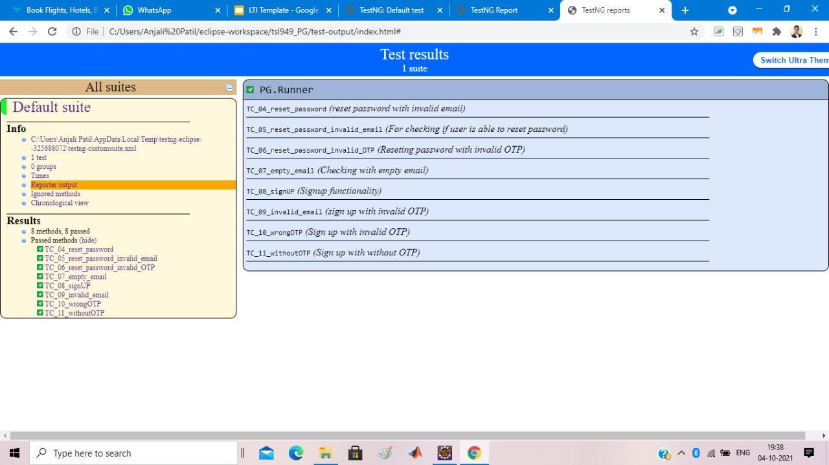
Reports
Login Page/Sign-up

Slide 12
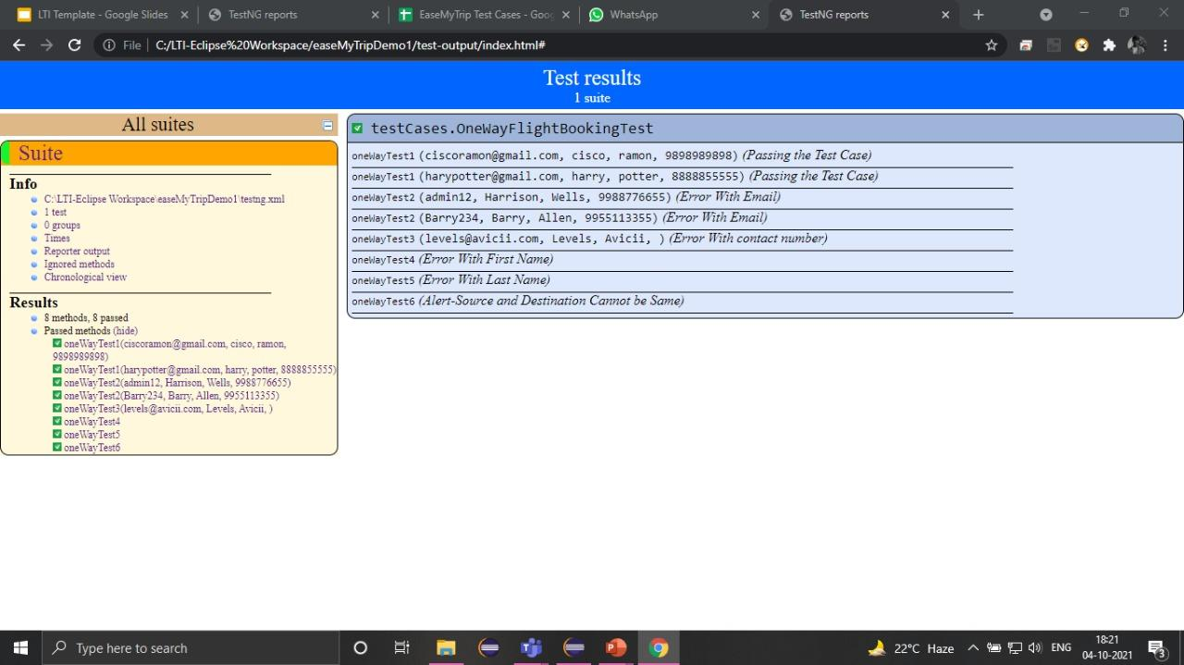
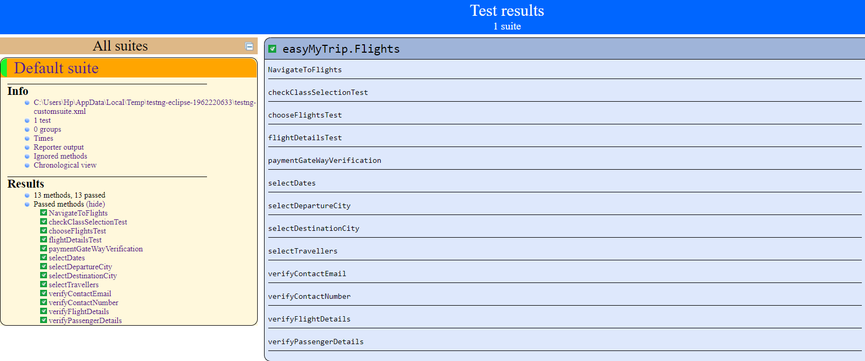
Reports
One Way Flight and Round-Trip

Slide 13
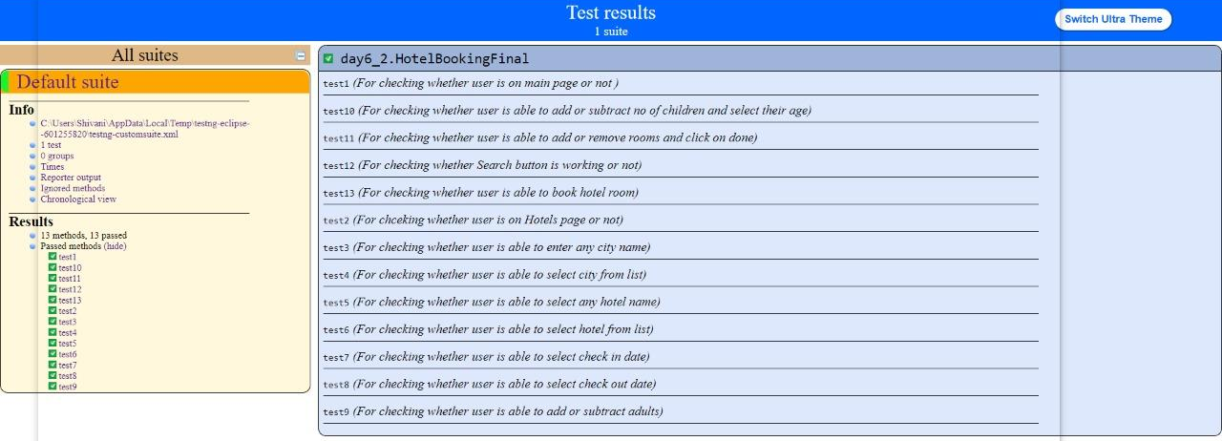
Reports
Hotels Booking

Slide 14
Challenges
OTP Issues
Website Loads slowly
Website changes Dynamically

Slide 15
Conclusion
Understanding the complete flow of tasks that needed to perform for efficient automation testing of EaseMyTrip web application using Selenium webdriver.
Writing detailed Test plan ,Test cases and RTM documents .
Detailed study of Page Object Model (POM) and Page Factory concepts in Selenium and using these methodologies for test scripting .
Understanding data driven framework and Keyword/Action driven framework thoroughly .
Performing functional testing and compatibility Testing (Cross browser Testing) on Login , Sign-up, Flight booking , Hotel booking features on EaseMyTrip web application.
.Generation and detailed analysis of Test Reports and Defect Reports.

Slide 16
References
https://standards.ieee.org/standard/829-2008.html
https://www.easemytrip.com/
https://www.guru99.com/software-testing.html

