Slide 1
Advanced Statistics and Techniques for Analytics (ASTA) Assignment
Author: Venkata Sai Bhargav Kakunuri
BITS ID #: 2018HT12007
Email: 2018HT12007@wilp.bits-pilani.ac.in

Slide 2
Linear Regression
Data set: heigt-weight.csv
Here the data was divided based on gender, as there might be a variation in weights based on gender. We predict weight for a given male or female height.
Independent variable – Height
Dependent variable – Weight
We can use Linear regression to detect weights based on height.
For the assignment I used the sklearn (Scikit learn), Seaborn (plotting package), Matplotlib, Pandas, Scipy.stats for pearson correlation coefficient.

Slide 3
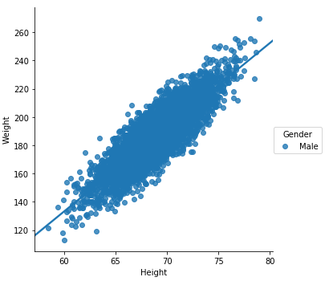
Linear Regression (contd..)
Graph for Male data with x=height, y=weight

Slide 4
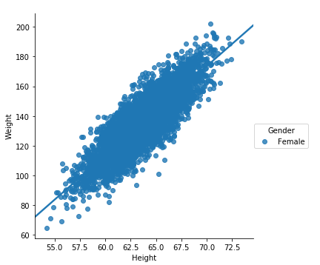
Linear Regression (contd..)
Graph for Female data with x=height, y=weight

Slide 5
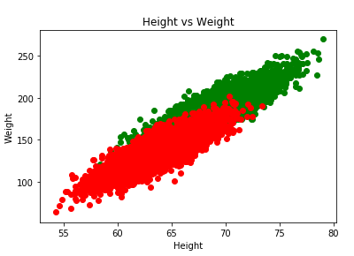
Linear Regression (Contd…)
Graphing Male and Female data (Height vs Weight)

Slide 6
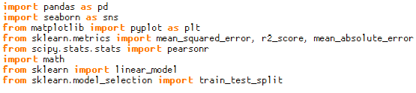

Linear Regression (Contd…)
Imports
Importing data using pandas
Dividing data into male and female

Slide 7
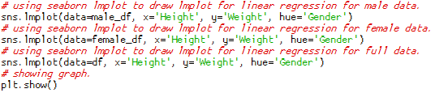

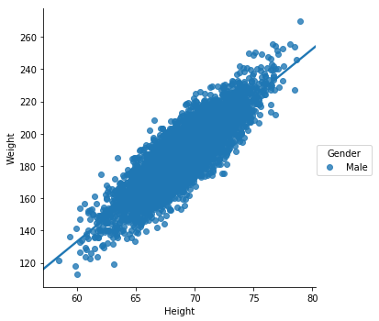
Linear Regression (Contd…)
Using seaborn lmplot to plot regression line of male and female data.

Slide 8



Linear Regression (Contd…)
Calculation of pearson correlation coefficient (r):
Data as independent and dependent variables

Slide 9
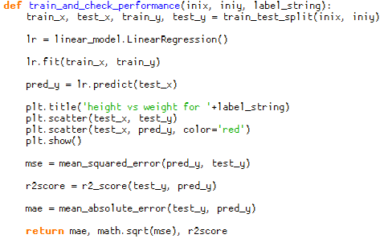
Linear Regression (Contd…)
Method to calculate Mean absolute error, Root mean squared error, R2 score.

Slide 10
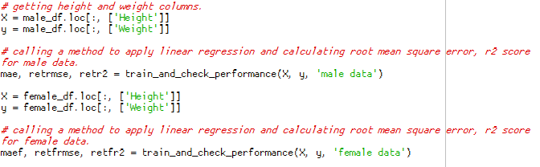
Linear Regression(Contd…)
Calculation:

Slide 11
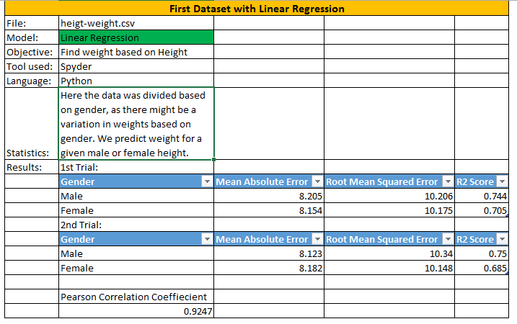
Linear Regression (Contd…)
Results:

Slide 12
Logistic Regression
Dataset used: BlueGills.csv
Here based on BlueGills data, we consider BlueGills fish length as a class, maximum age of a BlueGills fish is 6-8 years, use length as an independent variable and find out Age of the fish (class).
Class: Age
Independent variable: Length of the fish.
Python is used to apply Logistic regression model.
Packages used: sklearn, matplotlib, pandas, seaborn

Slide 13
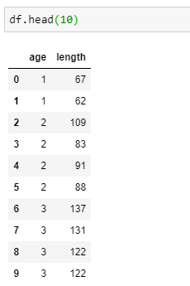
Logistic Regression (contd…)
Importing dataset using pandas from csv.
\
Data: First 10 rows.

Slide 14
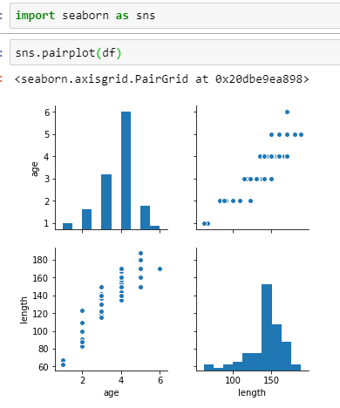
Logistic Regression (contd…)
Plotting between all columns using pairplot(matrix plot)

Slide 15
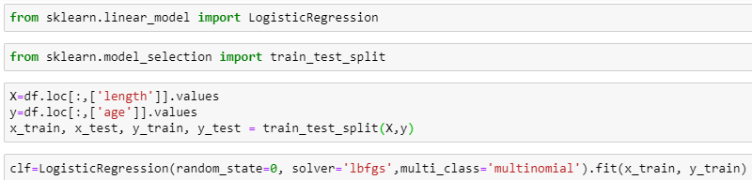

Logistic Regression(Contd…)
Using Logistic Regression from sklearn, training the dataset with train test split method from sklearn.
Predicting using test data

Slide 16

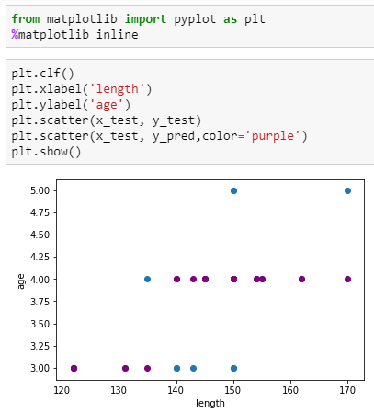
Logistic Regression (Contd…)
Classifier Score:
Plotting test and predicted data:

Slide 17
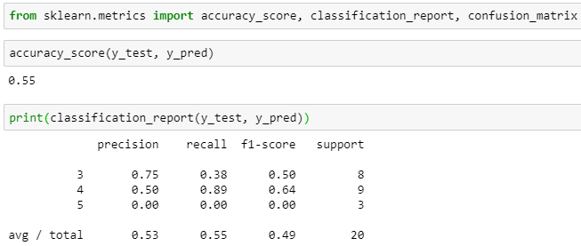

Logistic Regression (Contd…)
Results (metrics):
We used metrics like accuracy_score which we got as 0.55, classification report and confusion matrix.

Slide 18
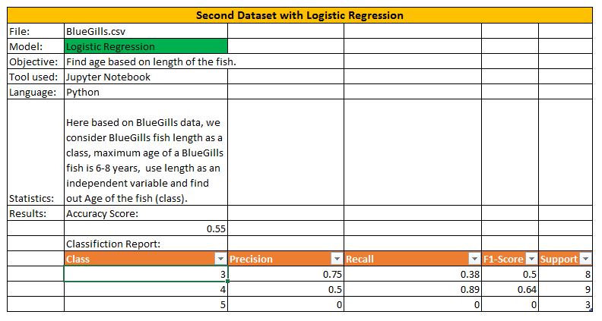
Logistics Regression(Contd…)
Results:

