Slide 1
MEU- Mobile KSD
Semester Project Part 1
Group 16
Varshitha Pendyala -2244279
Deekshitha Teegala - 2247690
Shiva Sai Ram Prasad Yelipeddi - 2250576
Venkata Satya Reddy Kallam - 2249009

Slide 2
What is the dataset we have selected?
Name of the Data Set: MEU- Mobile KSD
Category: Classification Number of Instances: 2856 Number of Attributes: 71
Name of the Attributes : Hold (H), Up-Down (UD), Down-Down (DD), Pressure (P), Finger-Area (A), Averages of Hold (AH), Pressure (AP) and Finger Area (AFA). There are 71 features because each feature has a set of feature elements corresponding to the typed characters.
What is the problem to be solved?
It was aimed to solve the lack of understanding about the mobile device usage patterns and service preferences of Iranian mobile users. The study sought to collect data from this population in order to design knowledge services that better meet their needs and preferences.

Slide 3
Why did we find this dataset interesting?
The MEU-Mobile KSD data set is interesting because it provides valuable insights into mobile device usage patterns and service preferences of Iranian mobile users, includes a wide range of attributes for detailed analysis, and provides a valuable resource for researchers and developers in the field of mobile services and technologies.
Is it structured or unstructured? Why?
Yes, the MEU-Mobile KSD dataset is a structured dataset. It consists of a table with rows and columns, where each row represents a single survey respondent, and each column represents a variable or attribute related to the respondent's mobile device and service usage.
The variables are all quantitative or categorical in nature and are well-defined, with clear and consistent data types and formats. This makes the dataset easy to work with and analyze using various data analysis and statistical software tools.

Slide 4
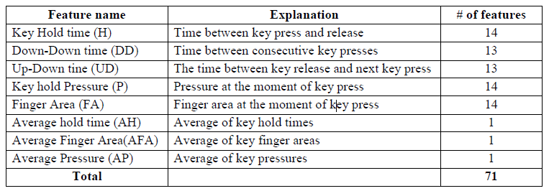
What are the variables? Is it a multimodal dataset?
Variables: The measured features (attributes) are Hold (H), Up-Down (UD), Down-Down (DD), Pressure (P), Finger-Area (A), Averages of Hold (AH), Pressure (AP) and Finger Area (AFA)
Multimodal - The thesis appears to be using a multimodal approach by collecting data on multiple features of the user's typing behavior, including timing features, key-press pressure, and finger area, to improve the accuracy of the keystroke dynamics model.

Slide 5
Data Cleaning
There are a few missing values/empty rows in our dataset. So, we dropped those records.
We smoothened the noisy data. For the outliers, we can't discard them without conclusive evidence. Then, we looked for inconsistencies in the data.
As there are 56 subjects in total and for each subject, we have only 51 records, we cannot afford to lose their significance by dropping the true outliers(which represent natural variation). So, we calculated the IQR, Upper & Lower whiskers for each class in order to detect and smoothen the outliers.

Slide 6
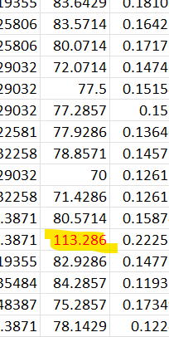
Data Cleaning
For example, in the adjacent picture, when observed manually, we could find few outliers(specific to Subject – 9). So, we applied the Quantile based flooring and capping method here and replaced this value with upper whisker (Upper whisker = Q3 + 1.5*IQR).
Finally, we have saved our cleaned data in different file formats (csv, NPZ, pkl, ipynb, sql)

Slide 7
Thank you

