Slide 1
MEU- Mobile KSD
Semester Project Part 2
Group 16
Varshitha Pendyala -2244279
Deekshitha Teegala - 2247690
Shiva Sai Ram Prasad Yelipeddi - 2250576
Venkata Satya Reddy Kallam - 2249009

Slide 2
Problem Statement The problem being addressed in this study is the inadequate knowledge of the usage patterns and service preferences of Iranian mobile users, which hinders the development of knowledge services that effectively meet their needs and preferences. In this Phase 2, we performed classification using four different models : - Linear Classification - KNN - Random Forest - Decision Tree Baseline - naive model It is a simple model that serves as a benchmark for evaluating more complex models. A naive model is often the simplest possible model that can be used to make predictions or classifications.

Slide 3
Recap of Part 1
There are a few missing values/empty rows in our dataset. So, we dropped those records.
We smoothened the noisy data. For the outliers, we can't discard them without conclusive evidence. Then, we looked for inconsistencies in the data.
Finally, we have saved our cleaned data in different file formats (csv, NPZ, pkl, ipynb, sql)
Remarks from part - 1:
Added the slide numbers for all the slides.
Reduced the text on the slides.

Slide 4
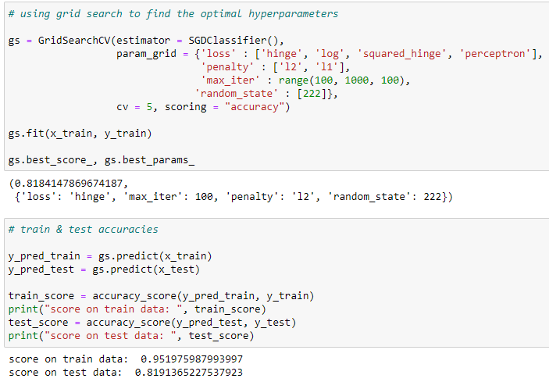
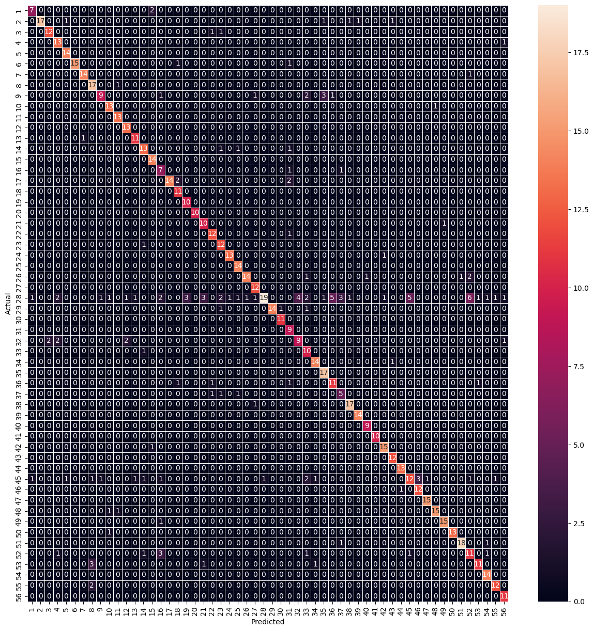
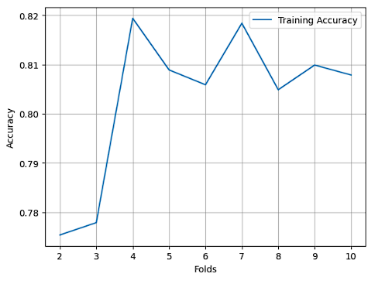
Linear Classification

Slide 5
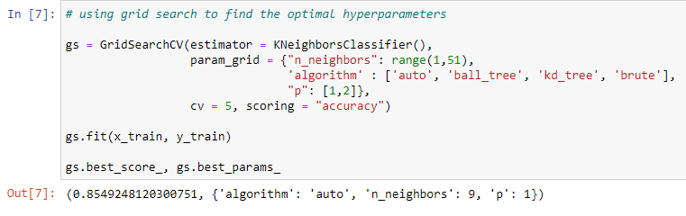
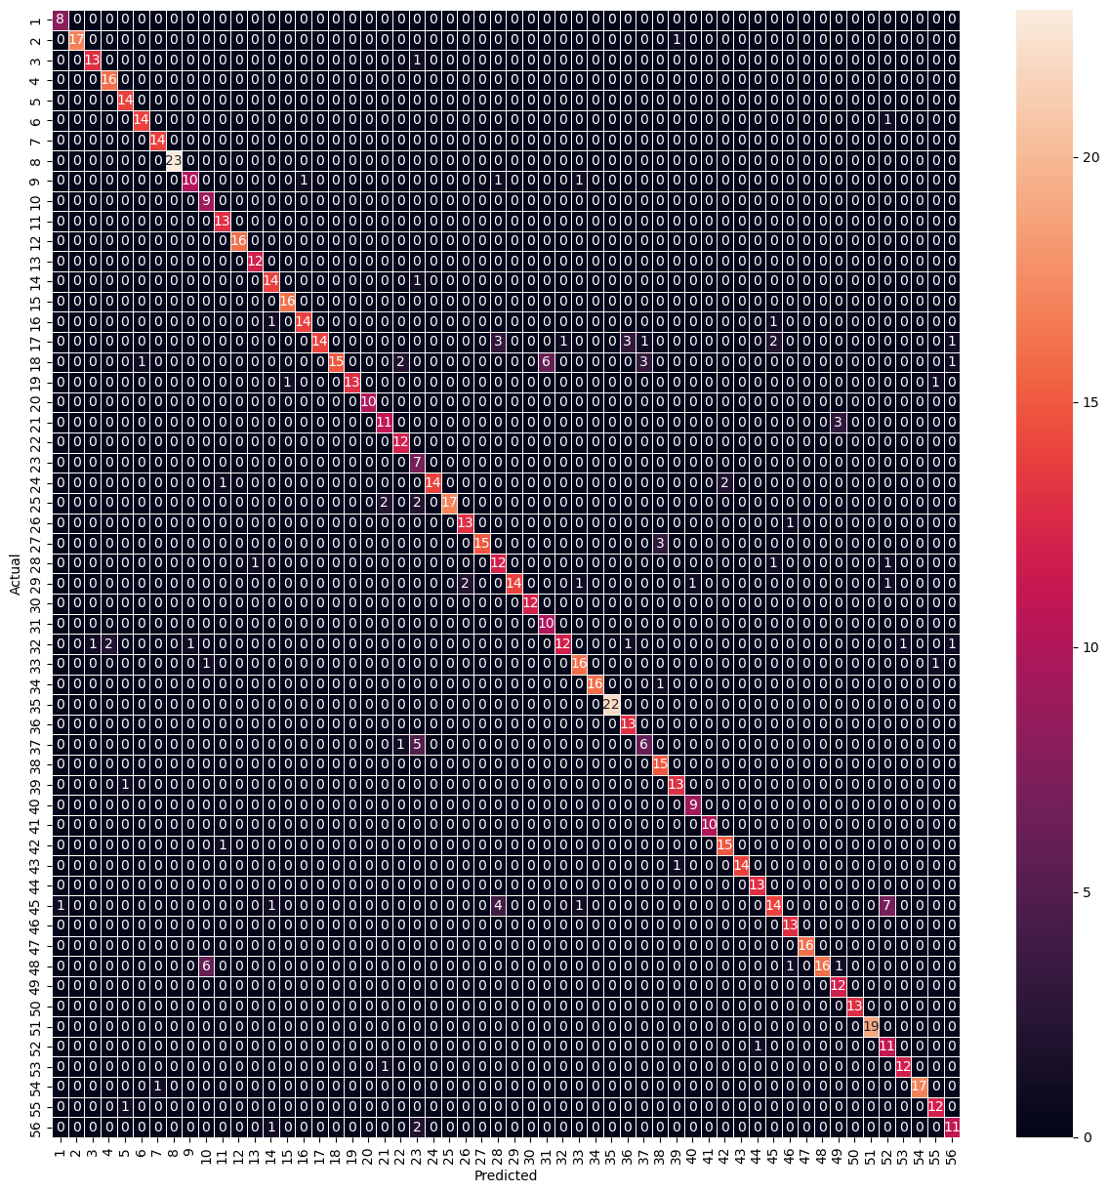
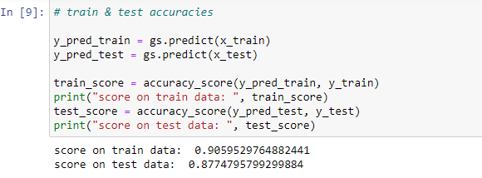
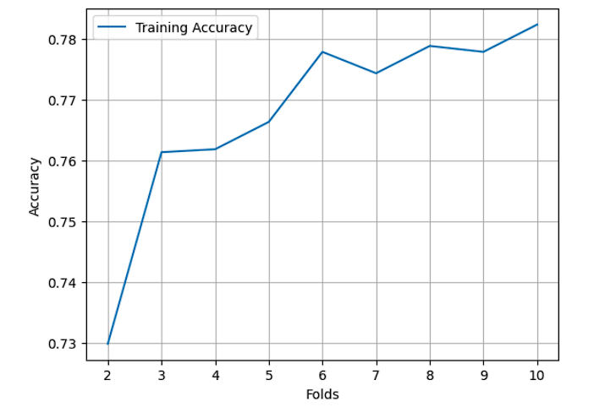
K Nearest Neighbors

Slide 6
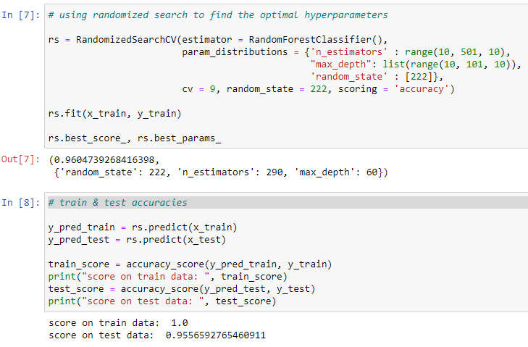

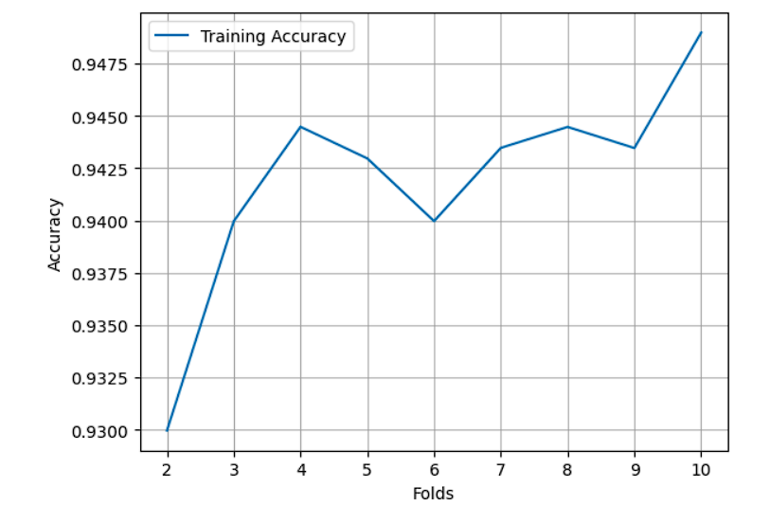
Random Forest

Slide 7
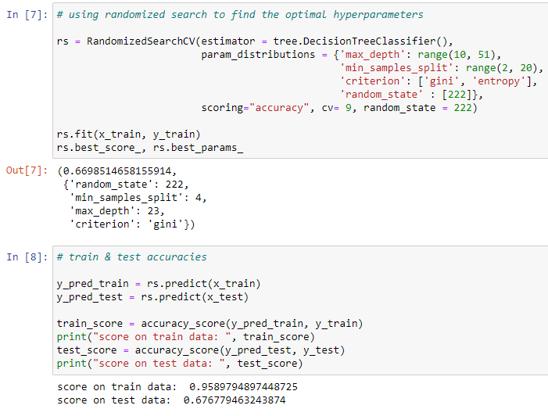
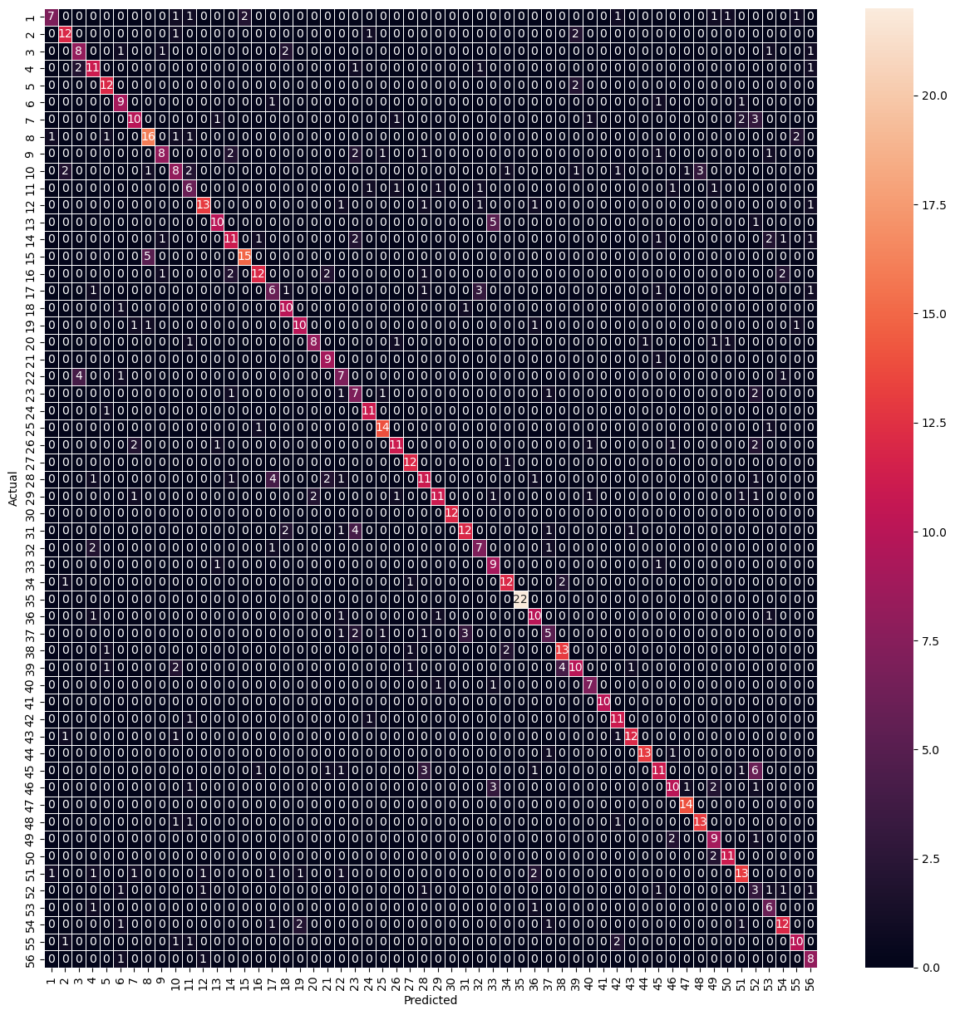
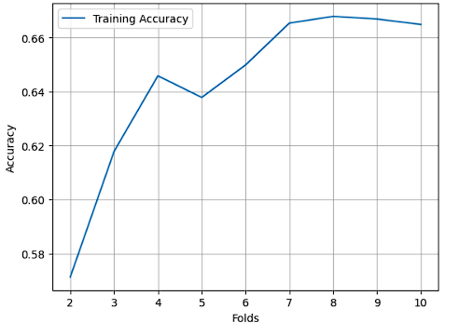
Decision Tree

Slide 8
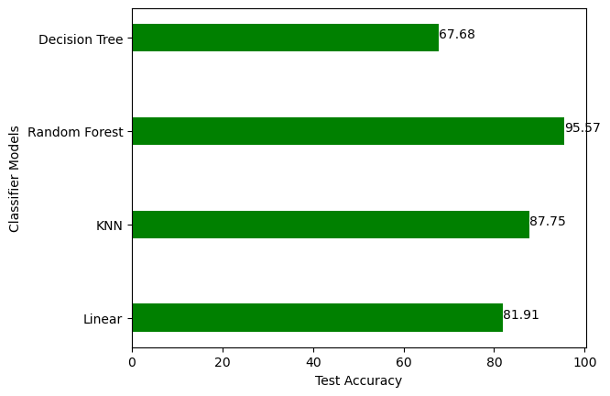
Comparision of accuracy scores of the four models on the test data
For our dataset, we got the best accuracy score of 95.57 for the Random Forest classification model.

