Slide 1
MEU- Mobile KSD
Semester Project Part 3
Group 16
Varshitha Pendyala -2244279
Deekshitha Teegala - 2247690
Shiva Sai Ram Prasad Yelipeddi - 2250576
Venkata Satya Reddy Kallam - 2249009

Slide 2
Part 1(About the Data Set)
The MEU-Mobile KSD data set provides valuable insights into mobile device usage patterns and service preferences of Iranian mobile users, includes a wide range of attributes for detailed analysis, and provides a valuable resource for researchers and developers in the field of mobile services and technologies.
MEU-Mobile KSD dataset is a structured dataset. The variables are all quantitative or categorical in nature and are well-defined, with clear and consistent data types and formats. This makes the dataset easy to work with and analyze using various data analysis and statistical software tools
Feature name | Explanation | # of features
Key Hold time (H) | Time between key press and release | 14
Down-Down time (DD) | Time between consecutive key presses | 13
Up-Down tine (UI)) | The tin* between key release and next key press | 13
Key hold Pressure (P) | Pressure at the moment of key press | 14
Finger Area (FA) | Finger area at the moment of key press | 14
Average hold time (AH) | Average of key hold times | 1
Average Finger Area(AFA) | Average of key finger areas | 1
Average Pressure (AP) | Average of key pressures | 1
Total |  | 71

Slide 3
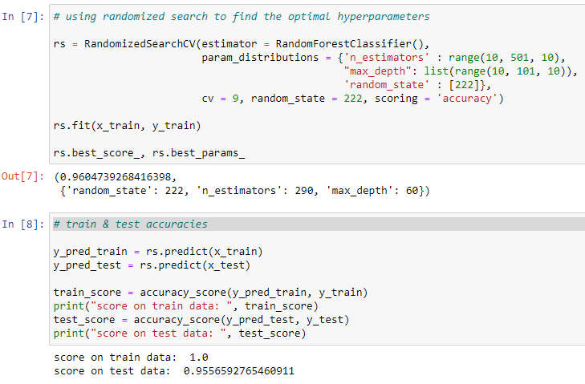
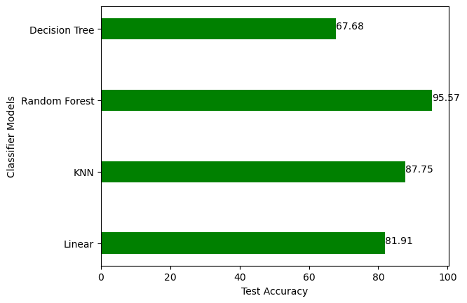
Part-2
We tuned hyper parameters and trained 4 models:
Linear SVM
KNN
Random Forest
Decision Tree
Random Forest model performed best among the 4 with 95.57% accuracy on test data.
?

Slide 4
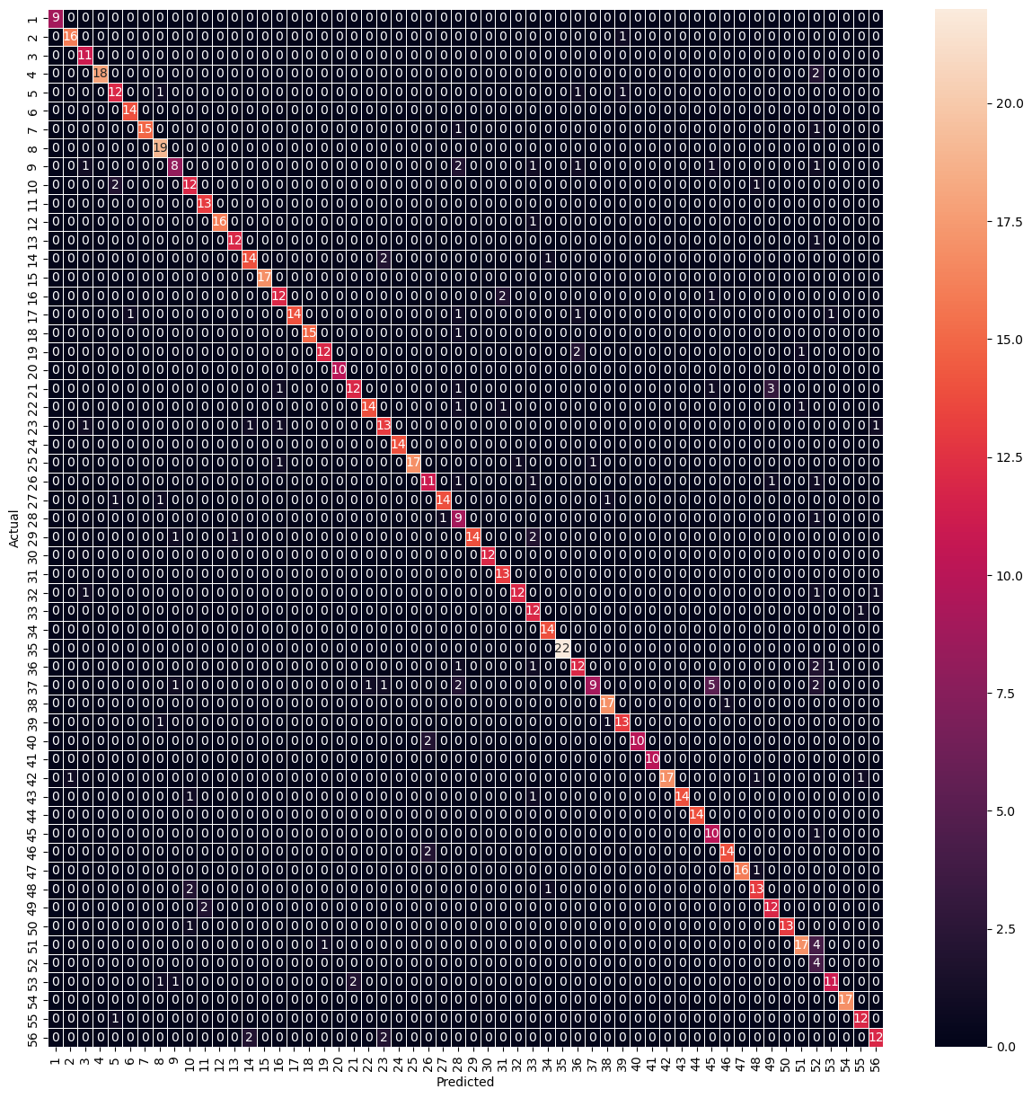
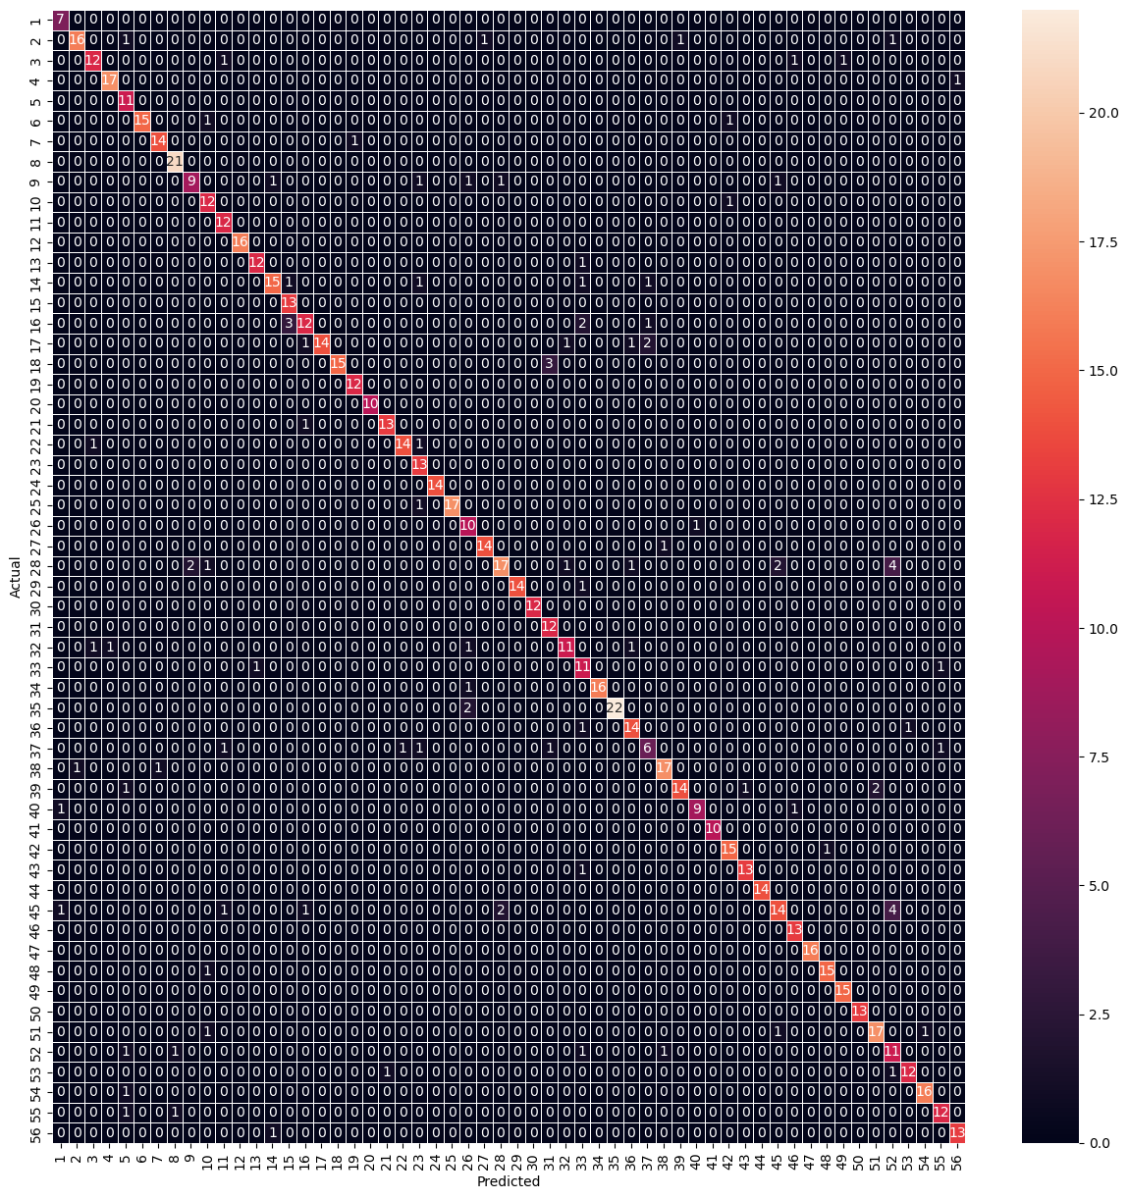
Extreme Learning Machine
model1 = ELMGridSearch(param_grid, cv=5)
Hyperparameter Tuning: param_grid = {'n_neurons' : range(100, 1000, 50), 'ufunc': ['relu', 'tanh’], 'random_state' : [222], 'alpha' : np.arange(0.0001, 0.01, 0.001)}
ELM = ELMClassifier(n_neurons = 500, ufunc = 'relu', random_state = 222, alpha = 0.0001)
score on train data: 0.992496248124062
score on test data: 0.8623103850641773
SVM with Non-Linear kernel (kernel=poly)
Hyperparameter Tuning:
model2 = GridSearchCV(estimator = SVC(), param_grid = {'C' : [0.1, 1, 10, 50, 100], 'degree' : range(2, 5), 'kernel' : ['poly'], 'random_state' : [222]}, cv = 5, scoring = "accuracy")
SVC = SVC(C = 50, degree = 2, kernel = 'poly', random_state = 222)
score on train data: 1.0
score on test data: 0.8798133022170361

Slide 5

Deep Learning (MLP)
Hyperparameter Tuning:
param_grid = {'hidden_layer_sizes': [(100,), (200,), (500,), (1000,)], 'activation': ['relu', 'logistic', 'tanh'], 'solver': ['adam', 'sgd'], 'alpha': [0.0001, 0.001, 0.01], 'learning_rate': ['constant', 'adaptive'], 'random_state' : [222]}
model3 = RandomizedSearchCV(MLPClassifier(), param_grid)SVC = SVC(C = 50, degree = 2, kernel = 'poly', random_state = 222)
MLP = MLPClassifier(solver = 'adam', learning_rate = 'constant', hidden_layer_sizes = (1000,), alpha = 0.0001, activation = 'logistic’)
score on train data: 1.0
score on test data: 0.9393232205367561

Slide 6
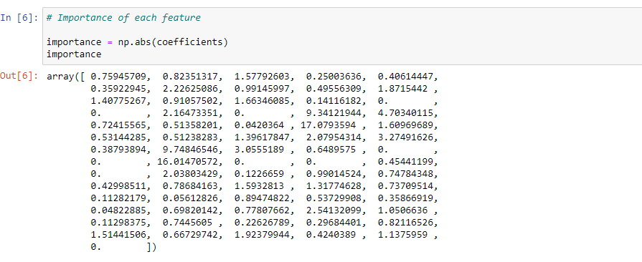
Variable Selection1: LASSO Method
LASSO penalizes the l1 norm of the weights, which induces sparsity in the solution - many weights are forced to zero. We can choose to keep only the non-zero weights and drop the unwanted features.
Random Forest (from part - 2)
rf = RandomForestClassifier(random_state = 222, n_estimators = 290, max_depth = 60)
score on train data: 1.0
score on test data: 0.9498249708284714
Deep Learning/MLP (from part - 3)
mlp = MLPClassifier(solver = 'adam', learning_rate = 'constant', hidden_layer_sizes = (1000,), alpha = 0.0001, activation = 'logistic’)
score on train data: 1.0
score on test data: 0.9334889148191365
Important Features
['Hold .', 'Hold t', 'Hold i', 'Hold e', 'Hold Shift', 'Hold 5', 'Hold Shift.1', 'Hold Caps', 'Hold r', 'Hold o', 'Hold a', 'Hold n', 'Hold l', 'Hold Enter', 'DD t.i', 'DD i.e', 'DD Shift.5', 'DD 5.Shift', 'DD Shift.Caps', 'DD Caps.r', 'DD r.o', 'DD o.a', 'DD a.n', 'DD n.l', 'DD l.Enter', 'UD ..t', 'UD t.i', 'UD i.e', 'UD e.Shift', 'UD Shift.5', 'UD 5.Shift', 'UD Shift.Caps', 'UD o.a', 'UD n.l', 'Pressure t', 'Pressure i', 'Pressure e', 'Pressure Shift', 'Pressure 5', 'Pressure Shift.1', 'Pressure Caps', 'Pressure r', 'Pressure o', 'Pressure a', 'Pressure n', 'Pressure l', 'Pressure Enter', 'Size .', 'Size t', 'Size i', 'Size e', 'Size Shift', 'Size 5', 'Size Shift.1', 'Size Caps', 'Size r', 'Size o', 'Size a', 'Size n', 'Size l', 'Size Enter', 'AvH', 'AvP']

Slide 7
Variable Selection1: Bi-directional Elimination Method
It is a combination of forward selection and backward elimination. While adding a new feature in one direction, it also checks the significance of already added features and if it finds any of the already selected features insignificant, then it simply removes that particular feature through backward elimination.
Random Forest (from part - 2)
rf = RandomForestClassifier(random_state = 222,
n_estimators = 290, max_depth = 60)
score on train data: 1.0
score on test data: 0.9521586931155193
Deep Learning/MLP (from part - 3)
mlp = MLPClassifier(solver = 'adam', learning_rate
= 'constant’, alpha = 0.0001, activation = 'logistic’)
score on train data: 1.0
score on test data: ?
Important Features
['Hold .', 'Hold i', 'Hold e', 'Hold 5', 'Hold Shift.1', 'Hold Caps', 'Hold o', 'Hold a', 'Hold n', 'Hold l', 'Hold Enter', 'DD ..t', 'DD t.i', 'DD i.e', 'DD e.Shift', 'DD Shift.5', 'DD Shift.Caps', 'DD Caps.r', 'DD o.a', 'DD a.n', 'DD n.l', 'DD l.Enter', 'UD ..t', 'UD t.i', 'UD i.e', 'UD e.Shift', 'UD Shift.5', 'UD 5.Shift', 'UD Shift.Caps', 'UD Caps.r', 'UD r.o', 'UD a.n', 'UD n.l', 'UD l.Enter', 'Pressure .', 'Pressure t', 'Pressure i', 'Pressure Shift', 'Pressure 5', 'Pressure Shift.1', 'Pressure Caps', 'Pressure r', 'Pressure o', 'Pressure n', 'Pressure Enter', 'Size t', 'Size i', 'Size e', 'Size Shift', 'Size 5', 'Size Caps', 'Size r', 'Size a', 'Size n', 'Size l', 'Size Enter', 'AvH', 'AvP', 'AvA’]
Important Features
['Hold .','Hold t','Hold i','Hold e','Hold Shift','Hold 5','Hold Shift.1','Hold Caps','Hold r','Hold o','Hold a','Hold n','Hold l','Hold Enter','DD ..t','DD t.i','DD i.e','DD e.Shift','DD 5.Shift','DD Shift.Caps','DD Caps.r','DD r.o','DD o.a','DD a.n','DD n.l','DD l.Enter','UD ..t','UD t.i','UD i.e','UD e.Shift','UD Shift.5','UD 5.Shift','UD Shift.Caps','UD Caps.r','UD r.o','UD o.a','UD a.n','UD n.l','UD l.Enter','Pressure .','Pressure t','Pressure i','Pressure e','Pressure Shift','Pressure 5','Pressure Shift.1','Pressure Caps','Pressure r','Pressure o','Pressure a','Pressure n','Pressure l','Pressure Enter','Size .','Size t','Size i','Size Shift','Size 5','Size Shift.1','Size Caps','Size r','Size o','Size a','Size n','Size l','Size Enter','AvH','AvP','AvA']

Slide 8
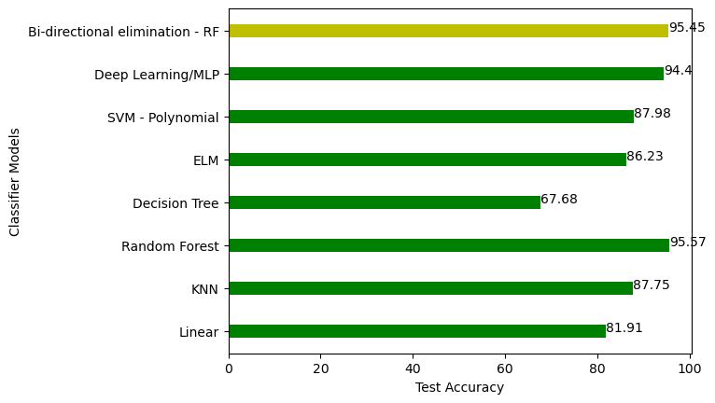
Comparison of accuracy scores of all individual models without variable selection and a Random Forest with feature selection (Bidirectional elimination ) on the test data.
For our dataset, we got the best accuracy score of 95.57 for the Random Forest classification model.

Slide 9
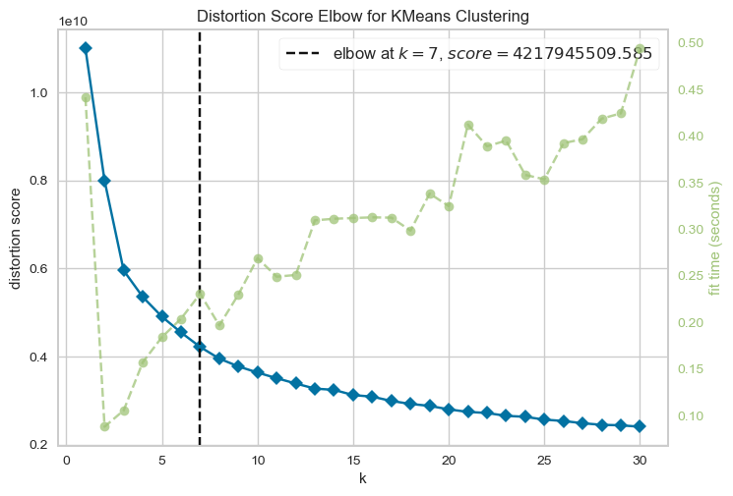
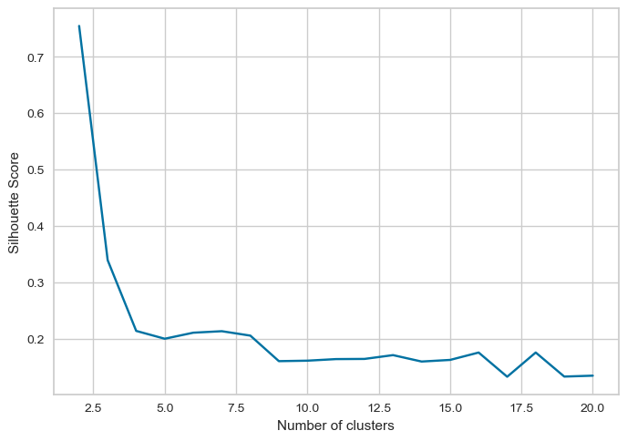
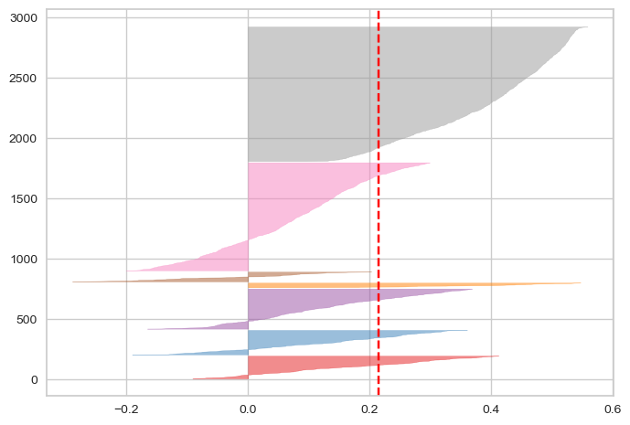
Clustering:
For clusters=7 there is
less inertia and
high silhouette score

Slide 10
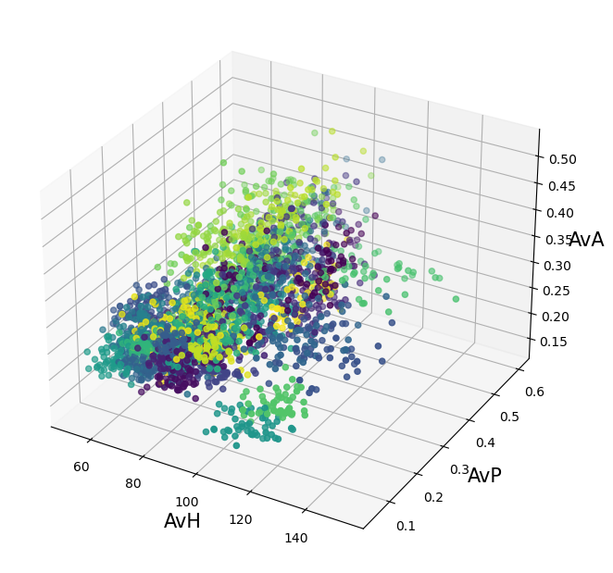
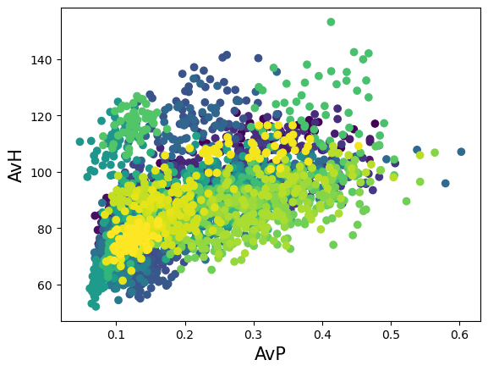
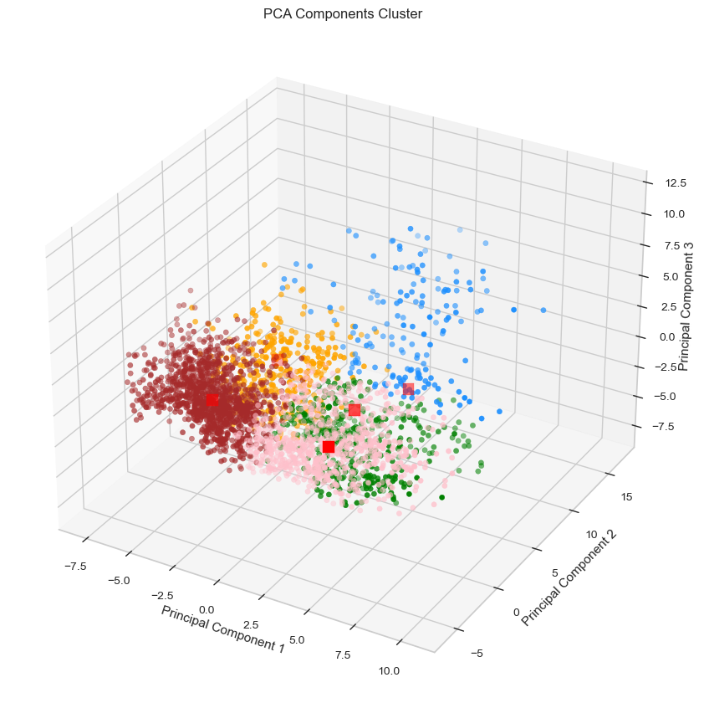
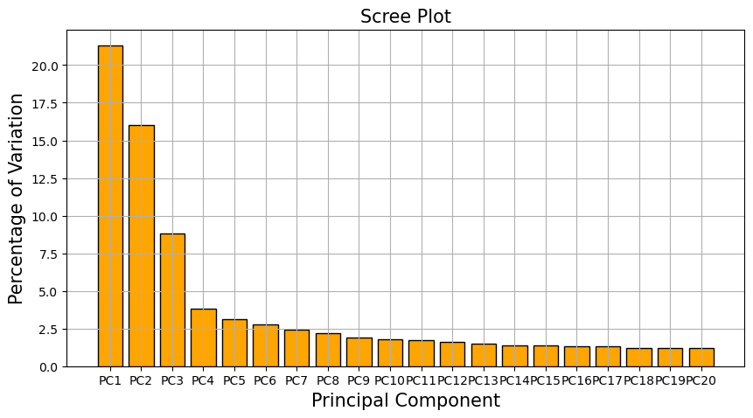
Clustering:

Slide 11
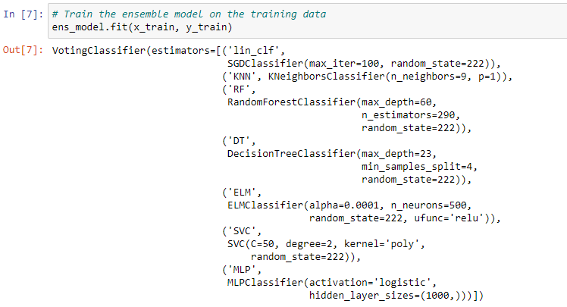
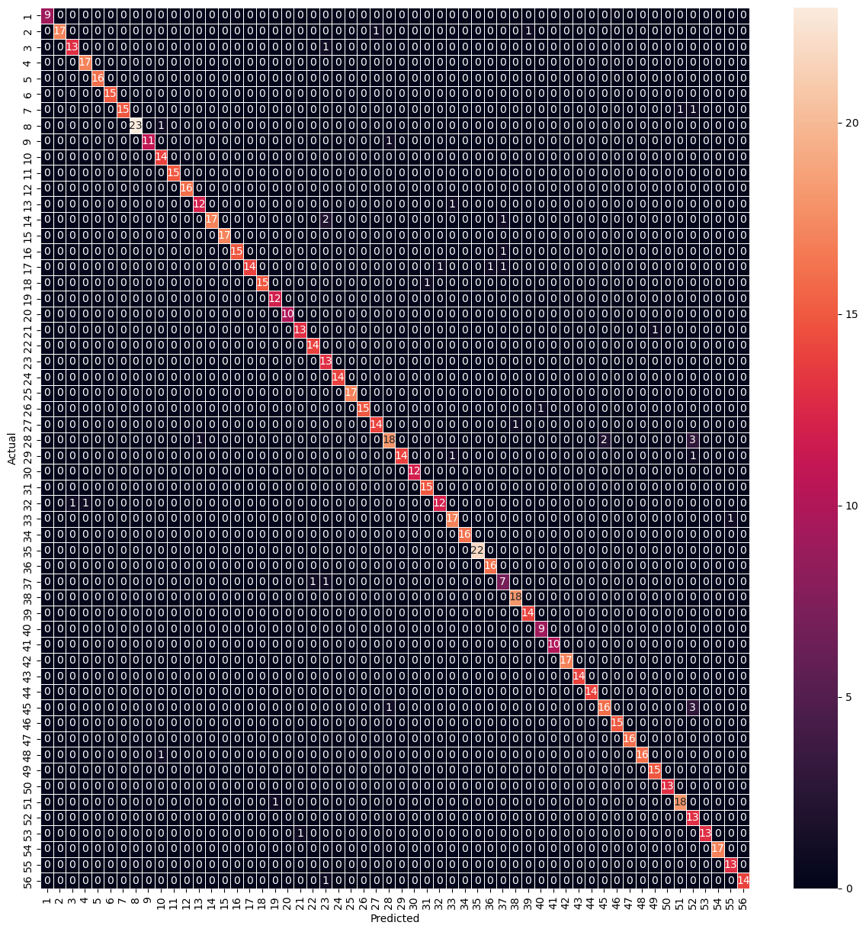
Ensemble Model:
Ensemble –
ens_model = VotingClassifier(estimators=[('lin_clf', lin_clf), ('KNN', KNN), ('RF', RF), ('DT', DT), ('ELM', ELM), ('SVC', SVC), ('MLP', MLP)], voting = 'hard’)
score on train data: 1.0
score on test data: 0.9533255542590432

