Slide 1
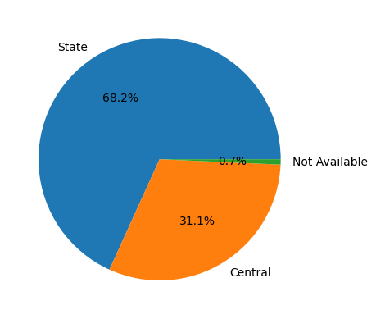
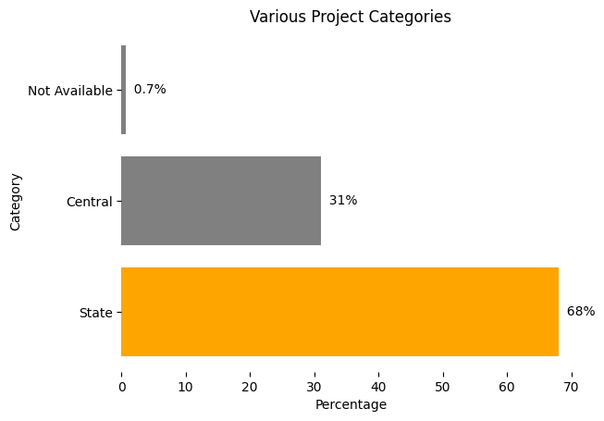
Converted Pie Chart into Horizontal bar graph.
Removed the border from the bar graph
Highlighted the state bar. We can highlight any category based on our audience.
Used grey colour for other categories in order to keep them simple and keep the audience attracted toward the state category.

