Slide 1

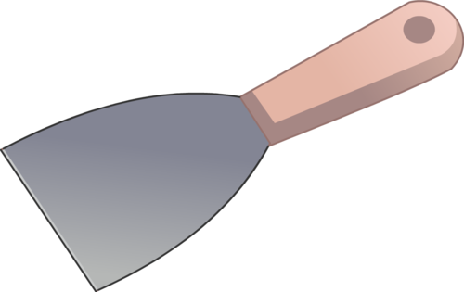
Mongo Scraper

