Slide 1

Flowchart-to-Text AI-Powered Narrative Generation
Mary Evanston, Bruce McGregor and Venkat Viswanathan
Prepared for Professor Sodiq Adewole, Ph.D.
In partial satisfaction of requirements for DS6050 – Deep Learning
April 30, 2025

Slide 2
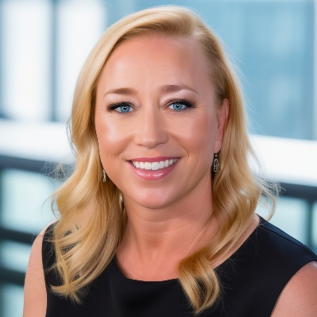


Our Team
Mary Evanston
Bruce McGregor
Venkat Viswanathan
M.S. Data Science
M.S. Data Science
M.S. Data Science
B.S. Mathematics
M.S. Technology Management
B.S. Civil Engineering
BS. Electrical Engineering
2

Slide 3
Project Motivation
Flowcharts as Essential Tools: Widely used across engineering, business automation, and software development for structured workflow representation.
AI’s Current Limitations: Existing AI models struggle to generate meaningful textual explanations from flowcharts, limiting automation in process documentation.
Research Gap: While flowchart parsing and object detection have advanced, AI lacks the ability to infer logical relationships and generate coherent narratives.
Accessibility & Automation: Automating flowchart-to-text conversion can enhance business intelligence, technical documentation, and accessibility for visually impaired users.
Innovation Potential: A robust AI system for flowchart interpretation could improve structured reasoning, making AI-driven process automation more effective.
Goal: Interpret flowcharts by integrating deep learning techniques for structured diagram recognition and natural language generation.

Slide 4
Data
Kaggle Flowchart Dataset (Yaswanth Krishna)
~4,000 vectorized flowcharts from various domains (business, engineering, software)
Primarily used for symbol recognition and structural analysis
Purpose: Helps train models in symbol recognition and structure extraction
Notes:
We also considered using the FlowLearn dataset from Hugging Face. After much pre-processing and running a full pipeline to train the model, we found that the synthetic nature of the data did not lend well to training. Of particular issue were the dashed lines with arrowheads which could not be distinguished from the solid lines with arrowheads. We then abandoned the FlowLearn dataset and used the Kaggle Flowchart Dataset from Yaswanth Krishna.
FlowLearn Dataset (Hugging Face)
3,858 scientific flowcharts from academic papers
10,000 synthetic flowcharts generated with Mermaid.js
Includes bounding box annotations, graph representations, and paired text descriptions
Purpose: Supports supervised training for flowchart-to-text generation

Slide 5




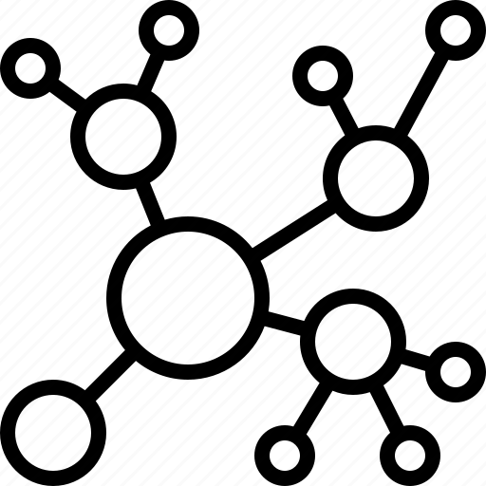
Experiment 1: Kaggle Flowchart Detection & OCR Extraction
Kaggle data: load, restructure and pre-processing (grayscale→ blur → sharpen)
YAML:
Builds yaml configuration file (18 classes)
YOLOv8m:
Training
(50 epochs, mAP ≈ 0.80)
YOLOv8 inference → Tesseract OCR: OCR post processing and JSON graph generation
Notes:
Left at post processing of the extracted ocr content (no json graph) no nodes and edges

Slide 6


Experiment 2: Deploy Flow-to-Text Web App
Upload flowchart to UI: Deployed on Hugging Face
YOLO/OCR:
Run inference on flowchart and return boxes + arrows, reads text runs OCR
Graph Network:
Use Shapely to generate a node/edge graph
Generate text:
Feed JSON to Phi-4 pipeline return narrative, display results

Slide 7

Experiment 3: Benchmarking
End-to-end text quality:
• BLEU ≥ 0.25
• ROUGE‑L ≥ 0.35
• BERTScore ≥ 0.85
Latency & resource use:
Word-error-rate (WER) ≤ 0.25
Arrow→node mapping:
Precision ≥ 0.80, Recall ≥ 0.75
Robustness to noise/rotation: • mAP drop ≤ 10 % • WER rise ≤ 5 %
Avg latency : 4.40 s
90th‑percentile: 4.96 s
Peak VRAM mean : 7.96 GB
Max VRAM peak : 8.92 GB
Avg OCR WER : 0.800
Clean recall : 1.000
Blur recall drop : +58.3%
Rotate recall drop: +90.3%
Clean WER : 1.547
Blur WER rise : +28.9%
Rotate WER rise : -6.5%
BLEU : 0.138
ROUGE_L: 0.499
BERT : 0.858
Precision: 1.0
Recall : 1.0
F1‑score : 1.0

Slide 8
Lessons Learned
What we have been told was true: the preprocessing of the data took the most time
Data Preprocessing for the FlowLearn Dataset was overly cumbersome and the synthetic nature of the images was not producing robust training – we had to abandon the dataset and use the Kaggle data instead
Our proposed workflow was not what we used, in the end – we had to experiment with different tools and libraries and the order in which we called them
Group (parallel) coding wasn’t the most useful – we had serial “hand offs” that worked better and avoided version control issues

Slide 9
Demo
URL: https://huggingface.co/spaces/venkatviswa/flowchart-to-text-v1
Notes:
We also considered using the FlowLearn dataset from Hugging Face. After much pre-processing and running a full pipeline to train the model, we found that the synthetic nature of the data did not lend well to training. Of particular issue were the dashed lines with arrowheads which could not be distinguished from the solid lines with arrowheads. We then abandoned the FlowLearn dataset and used the Kaggle Flowchart Dataset from Yaswanth Krishna.
FlowLearn Dataset (Hugging Face)
3,858 scientific flowcharts from academic papers
10,000 synthetic flowcharts generated with Mermaid.js
Includes bounding box annotations, graph representations, and paired text descriptions
Purpose: Supports supervised training for flowchart-to-text generation

