Slide 1
Insert | To Insert row into a table
Select | Retrieve the data from table
Where | Specifies a condition that has to be satisfied for retrieving data from database.
Update | To update data of an existing table in database.
Delete | Used to delete existing records from a table
Drop | Delete a table from database.
Alter | Used to add, delete or modify columns in an existing table
Like Operator | Like Operator is used to perform queries on strings. This Operator is especially used in where clause to retrieve all the rows that match the given pattern.
Logical Operator | With Logical Operators, we can perform queries based on multiple conditions.
IN AND BETWEEN
IN Operator | To check if a value is present in the list of values.
Between Operator | To check if a particular value exists in the given range. Between Operator is inclusive, i.e., both the lower and upper limit values of the range are included.

Slide 2
Difference between ALTER and UPDATE
ALTER | UPDATE
Modify the structure of database such as adding, modifying or dropping columns, constraints or indexes. Primarily used for making structural changes to database schema | Modifying existing records with in a table. It is used to change the values of specific columns in one or more rows of a table.

Slide 3
Operators
Comparison
String
Logical

Slide 4
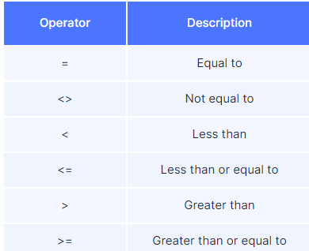
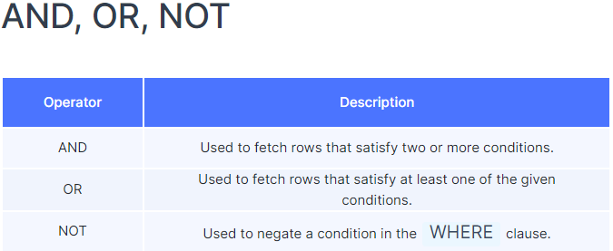

Slide 5
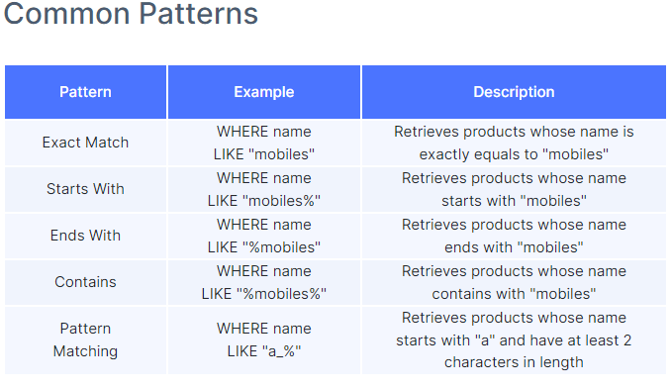
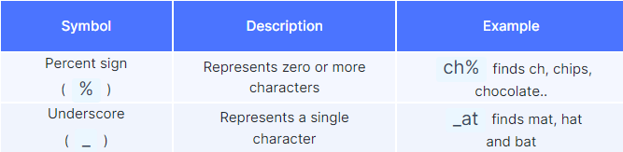

Slide 6
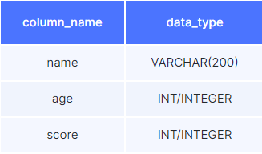
Task: Create a student table to store the following details

Slide 7
Create a student table to store the following details
create table student
(
name VARCHAR(200),
age INT,
score INT
);

Slide 8

Insert data into the table

Slide 9
Insert data into the table
INSERT INTO
player (name, age, score)
VALUES
("Rakesh", 39, 35),
("Sai", 47, 30);

Slide 10
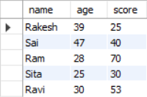
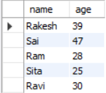

Select only name and age
Select name, age from
Player table whose name is “Sai”

Slide 11
Select only name and age
select * from player;
select
name,
age
from
player;
Select name, age from
Player table whose name is “Sai”
select
name, age
from
player
where
name = “Sai"

Slide 12
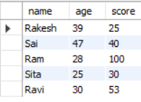
Update score of Ram to 100

Slide 13
Update score of Ram to 100
update
player
set
score = 100
WHERE
name = "Ram";

Slide 14


Delete Sai From Table

Slide 15
Delete Sai From Table
DELETE FROM
student
WHERE
name = "Sai";

Slide 16


Add College Column

Slide 17
Add College Column
ALTER TABLE
student
ADD
college VARCHAR(200);

Slide 18

Change score to pscore

Slide 19
Change score to pscore
ALTER TABLE
student
CHANGE COLUMN
score pscore int;
ALTER TABLE
student
RENAME COLUMN
score to pscore int;

Slide 20

Remove college column

Slide 21
Remove college column
ALTER TABLE
student
DROP COLUMN
college;

Slide 22
Logical Operators:-
SELECT
*
FROM
product
WHERE
category = "Clothing"
AND price <= 1000;
SELECT
*
FROM
product
WHERE
NOT name LIKE "%Cake%";
SELECT
*
FROM
product
WHERE
(brand = "Redmi"
AND rating > 4)
OR brand = "OnePlus";

