Slide 1
Insert | To Insert row into a table
Select | Retrieve the data from table
Where | Specifies a condition that has to be satisfied for retrieving data from database.
Update | To update data of an existing table in database.
Delete | Used to delete existing records from a table
Drop | Delete a table from database.
Alter | Used to add, delete or modify columns in an existing table

Slide 2
Difference between ALTER and UPDATE
ALTER | UPDATE
Modify the structure of database such as adding, modifying or dropping columns, constraints or indexes. Primarily used for making structural changes to database schema | Modifying existing records with in a table. It is used to change the values of specific columns in one or more rows of a table.

Slide 3
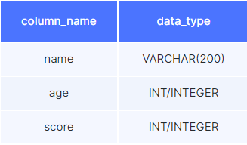
Task: Create a student table to store the following details

Slide 4
Create a student table to store the following details
create table student
(
name VARCHAR(200),
age INT,
score INT
);

Slide 5

Insert data into the table

Slide 6
Insert data into the table
INSERT INTO
player (name, age, score)
VALUES
("Rakesh", 39, 35),
("Sai", 47, 30);

Slide 7
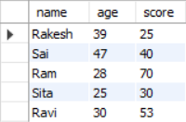
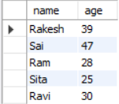

Select only name and age
Select name, age from
Player table whose name is “Sai”

Slide 8
Select only name and age
select * from player;
select
name,
age
from
player;
Select name, age from
Player table whose name is “Sai”
select
name, age
from
player
where
name = “Sai"

Slide 9
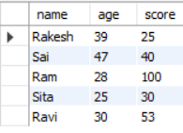
Update score of Ram to 100

Slide 10
Update score of Ram to 100
update
player
set
score = 100
WHERE
name = "Ram";

Slide 11


Delete Sai From Table

Slide 12
Delete Sai From Table
DELETE FROM
student
WHERE
name = "Sai";

Slide 13


Add College Column

Slide 14
Add College Column
ALTER TABLE
student
ADD
college VARCHAR(200);

Slide 15

Change score to pscore

Slide 16
Change score to pscore
ALTER TABLE
student
CHANGE COLUMN
score pscore int;

Slide 17

Remove college column

Slide 18
Remove college column
ALTER TABLE
student
DROP COLUMN
college;

Slide 19
Create Tables:
Personal:
Product:

Slide 20
Create Table and insert data into the table:
Personal:

