Slide 1
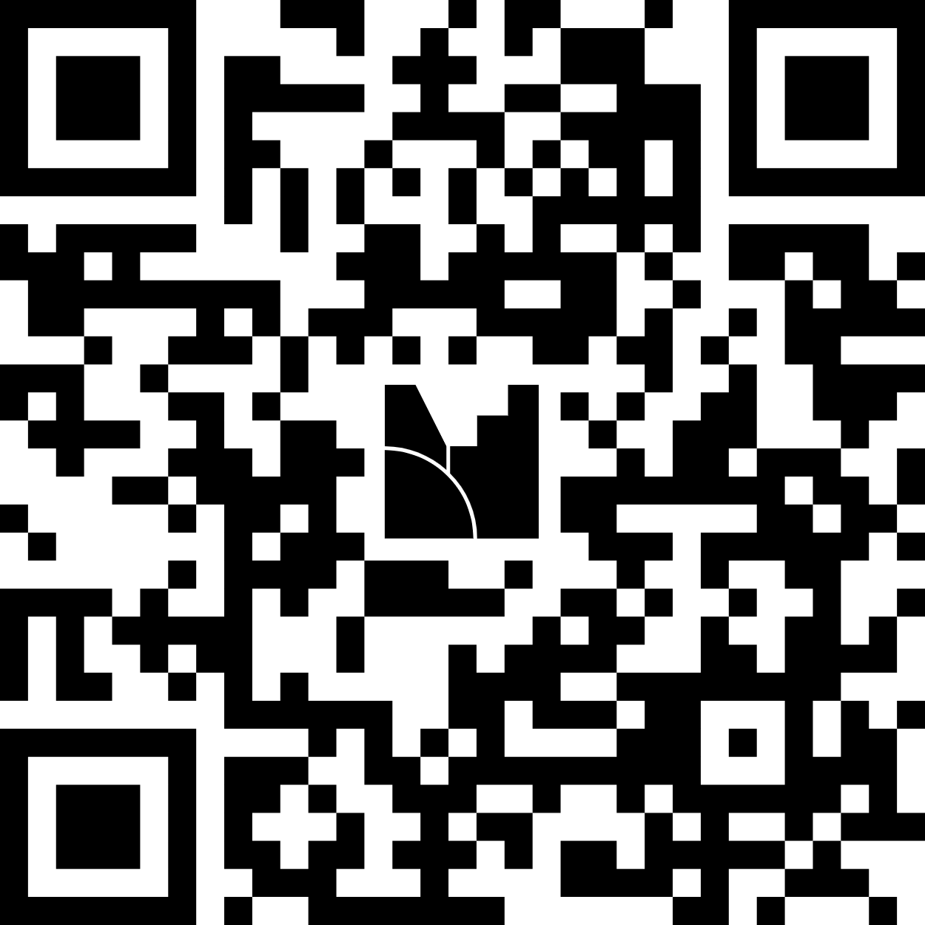


QUICK QUESTION BEFORE WE START
You can keep ONE pet.
Elephant or cat?
Scan the QR and type your pick.
menti.com · Code: 2876 5781
Word cloud: the most-typed words grow biggest
Intro
Problem
SLMs
Run local
Choose
Agents
Edge
Demo
Close
01 / 14
Notes:
[2 min + 1 min on the Menti results]
Say: "Before I bore you with AI on the last session of the day, let's wake up. Phones out, scan this, and type your pet and one word for why. No wrong answers... mostly."
Switch to the Menti window and let everyone watch the words appear. The most-typed words grow bigger, so ELEPHANT and CAT fight it out in the middle with the funny reasons around them. Read a few out loud.
Then: "Hold that thought, you'll see why in a minute."
Menti setup: Word Cloud slide, 2 entries per person (pet + reason), profanity filter ON. Ask people to type just "elephant" or "cat" so answers group together.
TO EDIT: right-click the QR placeholder > Change Picture, and type your Menti code in the line below it.

Slide 2

SESSION
Pocket-Sized Brains
Building Local AI Agents with Small Language Models
LLM
SLM
Large Language Model
Small Language Model
Venket Raj S · Senior Software Engineer, HCLTech
Madurai Sangamam · Dev Carnival 2027 pre-conference
Intro
Problem
SLMs
Run local
Choose
Agents
Edge
Demo
Close
02 / 14
Notes:
[1 min] Click 1 reveals the LLM label, click 2 reveals the SLM label.
Say: "Congratulations, you just made an AI architecture decision."
Click: "The elephant is the large language model: huge, powerful, needs a giant house (a data center) and eats a lot (money and power)."
Click: "The cat is the small language model: small, smart, lives with you, and doesn't need the internet to be useful. Today is about the cat."

Slide 3
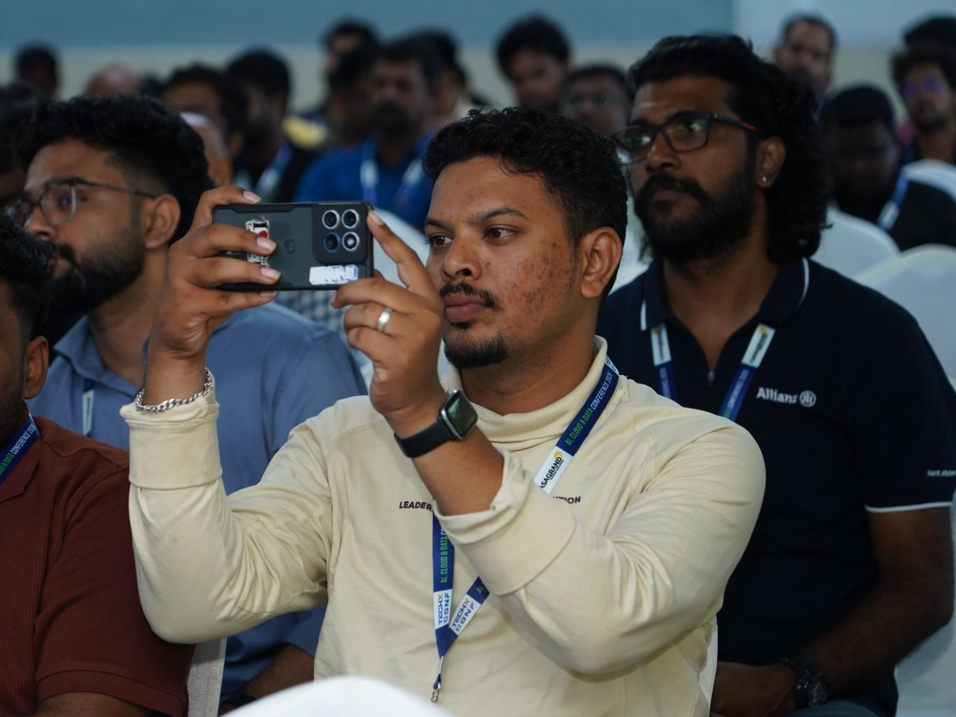
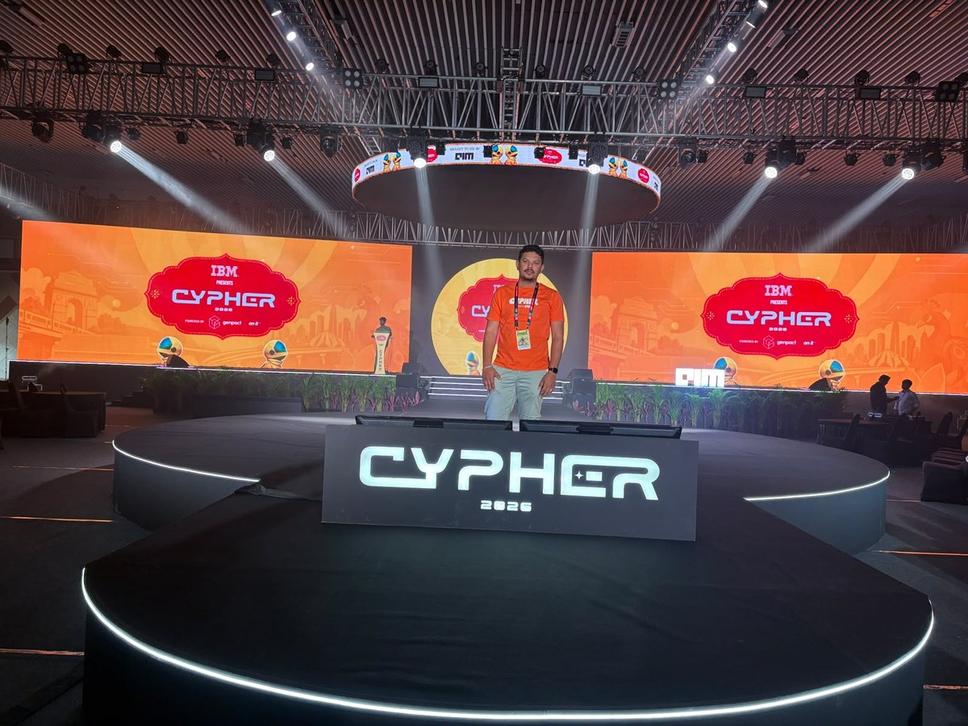



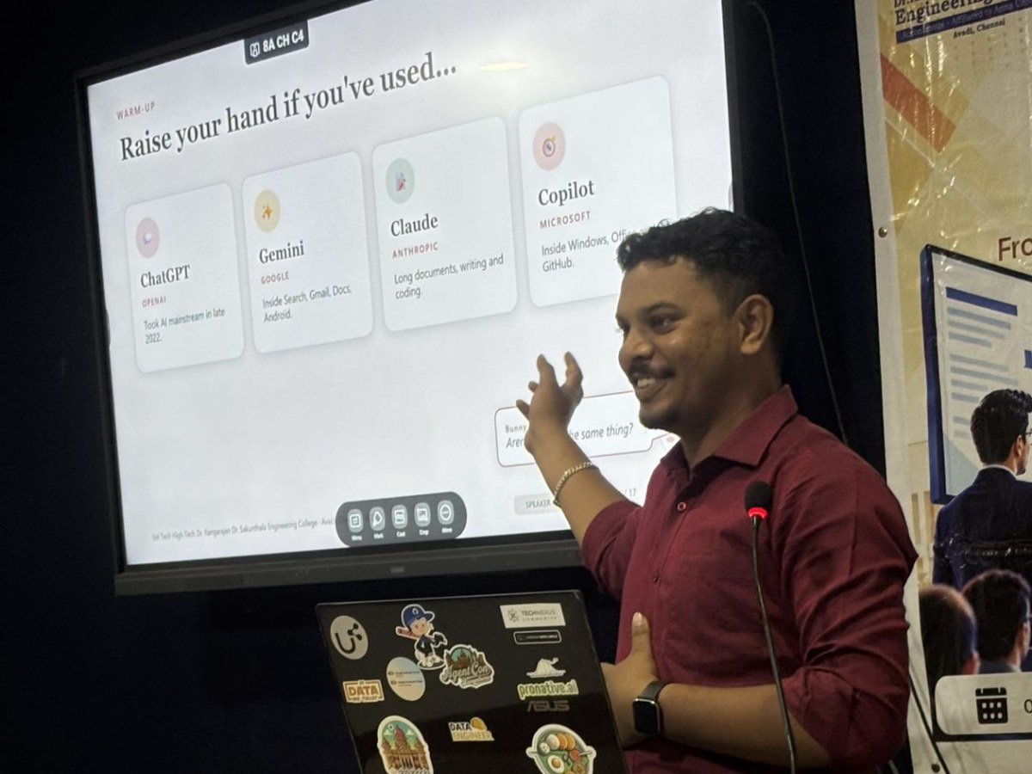
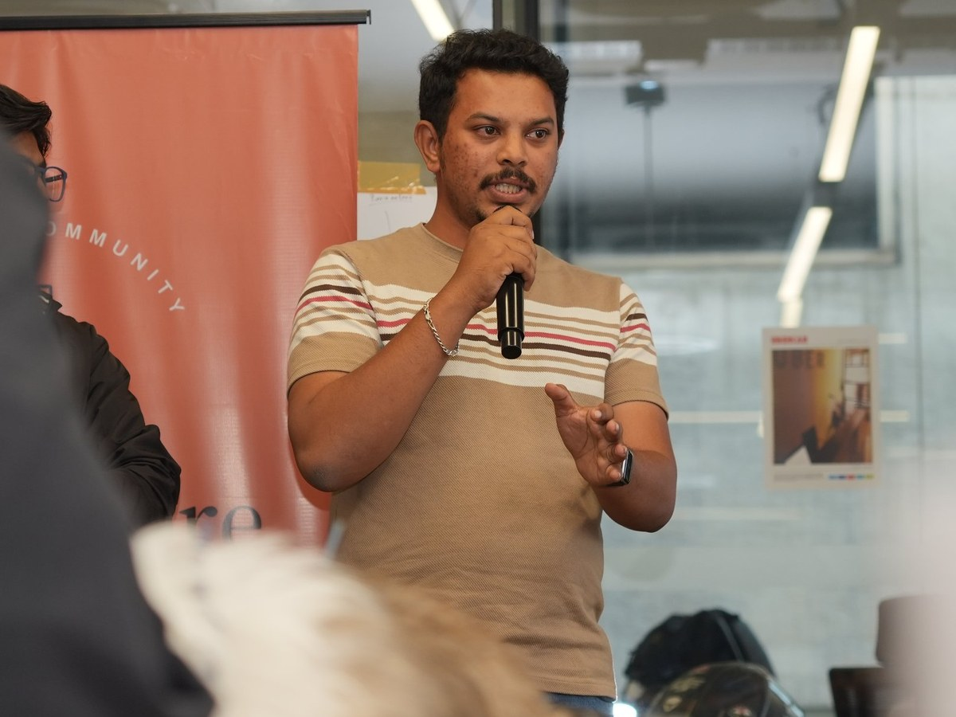
Hi, I'm Venket Raj S
Senior Software Engineer · Data & AI Automation, HCLTech
I build AI agents for enterprises, and I love making AI run on hardware I own.
Embedded electronics → AI agents
Speaker & hackathon judge
TechX Conference 2026
Cypher 2026, Bengaluru · Volunteer
techKoodaram community
“
From blinking LEDs to thinking agents: the best AI isn't the biggest one, it's the one that's there when you need it.
— Venket
Vel Tech · AI agents, LLMs & RAG talk
Claude community meetup
Intro
Problem
SLMs
Run local
Choose
Agents
Edge
Demo
Close
03 / 14
Notes:
[About 30-60 seconds] Keep it short.
Mention that your LinkedIn QR is on the last slide if they want to connect.
Photos, left to right then down: TechX Conference 2026 · Cypher 2026 in Bengaluru (3 days as a volunteer) · Vel Tech talk on AI agents, LLMs and RAG · Claude community meetup. To swap a photo: right-click > Change Picture.

Slide 4




Every elephant call comes with four bills
LLMs are amazing. But at scale, these add up.
What does it cost?
How fast does it answer?
Where does my data go?
What if the internet goes down?
10–30×
~15×
27%
65
cheaper to serve a 7B SLM than a 70–175B LLM
faster: Phi-2 (2.7B) matches 30B models on code
of organisations banned GenAI over privacy, at least for a while
internet shutdowns in India in 2025 (920 since 2016)
NVIDIA Research, 2025
NVIDIA Research, 2025
Cisco Data Privacy Benchmark, 2024
Access Now #KeepItOn
Intro
Problem
SLMs
Run local
Choose
Agents
Edge
Demo
Close
04 / 14
Notes:
[4 min] Each click reveals one stop on the timeline.
Open: "Elephants are amazing. But every time you call one, you pay four bills."
1 COST: every API call is billed per token. Fine for a demo, painful when an agent calls the model 50 times for one task.
2 SPEED: a round trip to a data center plus queueing. A small local model can answer before the cloud request comes back.
3 PRIVACY: tell the Samsung story. In 2023, within three weeks of being allowed to use ChatGPT, Samsung engineers pasted confidential source code and meeting notes into it, and Samsung then restricted generative AI tools at work. The same Cisco study: 48% admitted entering non-public company info into GenAI tools.
4 OFFLINE: in India this isn't hypothetical. Add patchy rural networks, flights and basements.
Close: "So should we stop using LLMs? No. But we should stop using them for everything."

Slide 5



So what is an SLM?
A language model small enough to run on your own device.
Ollama is not the model
It's the app that runs models (slide 8)
Rough rule: under ~10 billion parameters
Quantization isn't what makes it small
Same job as an LLM: predict the next word. Just a smaller brain.
It's a separate trick to shrink any model (slide 7)
Where they live
1–3B
4–9B
100B – 1T+
runs on a phone
runs on a laptop
needs a data center
Intro
Problem
SLMs
Run local
Choose
Agents
Edge
Demo
Close
05 / 14
Notes:
[2 min]
Say: "Parameters are the knobs the model learned during training. More knobs means more general knowledge, but also more memory, more power and more money. NVIDIA's researchers use 'under about 10B' as a working line for SLMs, but the real test is simple: does it run on the device you already own?"
Clear up the two mix-ups out loud:
- Ollama is not the model. It's the app that runs models (slide 8).
- Quantization is not what makes a model 'small'. It's a separate trick that makes any model smaller (slide 7).

Slide 6

Meet the cats: popular open SLMs
Gemma 4
Qwen3
Phi-4-mini
Llama 3.2
by Google
by Alibaba
by Microsoft
by Meta
Sizes
Sizes
Sizes
Sizes
E2B · E4B edge models
0.6B · 1.7B · 4B · 8B
3.8B
1B · 3B
On-device
Tool calling
Reasoning
Ecosystem
All open-weight: download once. No API key, no bill.
Intro
Problem
SLMs
Run local
Choose
Agents
Edge
Demo
Close
06 / 14
Notes:
[1.5 min]
Say: "All of these are open-weight. You download them and they're yours. No API key, no bill."
Mention that today's demo runs on Gemma 4.

Slide 7


Shrinking the brain: quantization
Show of hands: how much space does an 8B model need on a laptop?
500 MB
~5 GB
~5 GB ✓
50 GB
500 GB
16-bit
4-bit
~16 GB
~5 GB
8B × 2 bytes each
8B × ~0.5 bytes, plus overhead
Same brain, compressed.
Like turning a RAW photo into a good JPEG.
Intro
Problem
SLMs
Run local
Choose
Agents
Edge
Demo
Close
07 / 14
Notes:
[3 min] Read out each option and ask for a show of hands. Click 1 highlights the answer (~5 GB). Click 2 shows the explanation.
Say: "Quantization stores each number with fewer bits, like turning a RAW photo into a good JPEG. You lose a little detail, but it looks almost the same and is a fraction of the size. That's how an 8B model like Qwen3 8B fits in about 5 GB and runs on a normal laptop."

Slide 8




How you run one
The model is the song. Ollama is the music player.
Ollama
LM Studio
llama.cpp
Lemonade
One command to download and run a model
Point-and-click desktop app
The engine under many local tools
AMD's local server for Ryzen AI PCs
$ ollama run gemma4
It also gives you a local API on localhost:11434 that speaks the OpenAI format, so most agent frameworks only need a new URL.
Intro
Problem
SLMs
Run local
Choose
Agents
Edge
Demo
Close
08 / 14
Notes:
[1.5 min]
Say: "That one line downloads the model and gives you a chat in your terminal. It also gives you a local API on localhost that works like the OpenAI API, so most agent frameworks only need a different URL."

Slide 9

Elephant or cat? You decide
A hospital app summarising patient records
Autocomplete in your code editor
A farmer's crop-advice app with patchy network
CAT: Data can't leave the building
CAT: Milliseconds, thousands of times a day
CAT: Has to work offline
Researching a 40-page market analysis from scratch
Sorting 10,000 support emails into 5 categories
Planning a complex strategy from vague, messy inputs
ELEPHANT: Open-ended, needs deep reasoning
CAT: Narrow, repetitive, high-volume
ELEPHANT: Rare, hard, worth paying for
Cat: frequent, narrow, private, fast Elephant: rare, open-ended, hard The best systems keep both pets.
Intro
Problem
SLMs
Run local
Choose
Agents
Edge
Demo
Close
09 / 14
Notes:
[3 min] Audience activity. For each card, read the scenario and get the room to shout "Elephant!" or "Cat!", then click to reveal the answer with one reason. The last click shows the rule of thumb.
Answers: 1 Cat (privacy) · 2 Cat (speed) · 3 Cat (offline) · 4 Elephant · 5 Cat (a fine-tuned SLM shines) · 6 Elephant.
Then: "The best systems keep both pets." That leads straight into the next slide.

Slide 10



Keep both pets: the hybrid approach
Cat first. Elephant only when needed.
Router
LLM in the cloud
A light check sends easy requests to the SLM and hard ones to the LLM.
Fallback
not sure? escalate
no internet? stay local
The SLM tries first. Not confident, or a check fails? Escalate.
Privacy split
Request
Answer
Sensitive data stays local. Only masked info goes to the cloud.
95%
of GPT-4's quality while sending only 14% of requests to GPT-4 (over 85% cheaper)
SLM on your device
RouteLLM, LMSYS 2024 (MT Bench)
Intro
Problem
SLMs
Run local
Choose
Agents
Edge
Demo
Close
10 / 14
Notes:
[2.5 min] Clicks reveal the three patterns one at a time, then the stat.
- "You already carry this in your pocket. Apple Intelligence runs a model of about 3B parameters on the iPhone itself, and sends only the harder requests to a bigger model on Apple's servers."
- "Fallback works both ways. For quality, cat to elephant when the task is hard. For availability, elephant to cat when the internet drops. Your app never goes completely dumb."
- "For agents this fits naturally. The SLM handles routine steps like picking a tool or filling in arguments, and the LLM is called for the rare hard planning step. That's the setup NVIDIA's paper argues for."
- Honest catch: routing adds moving parts, because you need a way to decide what counts as "not confident". Start simple: escalate when the output fails a validation rule, such as invalid JSON or no matching tool.
Source: RouteLLM, LMSYS (2024): lmsys.org/blog/2024-07-01-routellm

Slide 11


From model to agent
Agent = Brain + Tools + Loop
Brain
Tools
Loop
The SLM decides what to do next
Functions it can call: read a file, check the time, query a database
Think → act → observe → repeat until done
How much of a real agent's work could a cat do?
~60%
of MetaGPT's model calls could be handled by SLMs
~40%
of Open Operator's model calls could be handled by SLMs
NVIDIA Research, Small Language Models are the Future of Agentic AI (2025)
Intro
Problem
SLMs
Run local
Choose
Agents
Edge
Demo
Close
11 / 14
Notes:
[2 min]
Say: "A chatbot talks. An agent does things. Most of what an agent does is small, repetitive steps: pick a tool, fill in the arguments, read the result. That's cat work."
Be honest about the catch: pick a model trained for tool calling, keep tool descriptions short, and remember small models sometimes skip the tool and guess. That's why the demo keeps its tools simple.

Slide 12








Cats everywhere: SLMs on the edge
Phone
AI laptop
Raspberry Pi 5
Machines
Apple's on-device model
Microsoft Phi Silica
Llama 3.2 via Ollama
Sensors, gateways, robots
~3B parameters, squeezed to about 2 bits per weight
Runs on the laptop's NPU, a 40+ TOPS AI chip
1B at ~8 tokens/sec, 3B at ~5, on the CPU alone
Decide where the data is created, even offline
Edge = the AI goes to the data, not the data to the AI.
Hospitals
Farms
Factories
Enterprises
Intro
Problem
SLMs
Run local
Choose
Agents
Edge
Demo
Close
12 / 14
Notes:
[2.5 min]
Personal hook (optional): "I started my career as an embedded electronics intern. Back then, the boards I programmed could blink LEDs. Today the same kind of board can run a language model."
NPU in one line: "A chip built only for AI maths, so it runs models using far less power than the CPU."
Keep the Pi numbers honest: "Is it as fast as ChatGPT? No. Does it need to be? For a home assistant, a voice command or a smart sensor, no. It doesn't need to be fast, it needs to be there."
Close: "The cat doesn't replace the elephant. It takes AI to places the elephant can't go. Including this laptop. Let me show you." Then switch to the demo.
Prop idea: if you have a Raspberry Pi, hold it up here.
Sources: Apple Intelligence Foundation Language Models Tech Report 2025 · Microsoft Phi Silica transparency note · raspberry.tips Ollama on Raspberry Pi 5.

Slide 13
LIVE DEMO
Pocket Agent
Local brain: Gemma 4 via Ollama Big brain: Claude, only when needed
1
ACT 1
2
ACT 2
3
ACT 3
4
ACT 4
Wi-Fi OFF
Real files
Drives a browser
Wi-Fi back ON
Reads the agenda: how many minutes are left today?
Tidies the folder and saves a 3-line meeting summary
Opens a form and fills in the feedback by itself
Too hard for the cat? Hands a Madurai trip plan to the elephant
read_agenda · get_time · calculate
list_files · move_file · read_file · write_file
open_page · fill_and_submit
ask_big_brain
Watch the dashboard: tool calls, tokens, speed, GPU, network, and what the same work would cost in the cloud.
Intro
Problem
SLMs
Run local
Choose
Agents
Edge
Demo
Close
13 / 14
Notes:
[6-7 min] Switch to the terminal and run: python pocket_agent.py --script demo_script.yaml --reset
The script plays all four acts and toggles Wi-Fi by itself.
ACT 1 (Wi-Fi OFF): "When does the last session end today, and how many minutes do we have left?" The agent reads agenda.txt, checks the clock and does the maths. Say: "No internet. This is all running on this laptop."
ACT 2 (real files): it moves invoices and images into folders and writes summary.md from the meeting notes. The workspace folder opens on the right so people see files move.
ACT 3 (browser): it opens the local feedback form and fills it in by itself.
ACT 4 (Wi-Fi back ON): "Plan a 3-day trip to Madurai." Too open-ended for the cat, so it hands off to Claude. Say: "Cat first, elephant only when needed. That's slide 10, live."
Point at the dashboard: tokens, tokens per second, GPU, and the estimated cloud cost of the same local work.
BEFORE THE TALK: update demo_files/agenda.txt with the real schedule (it has placeholder times) · set DEMO_NOW in .env to freeze the clock · ollama pull gemma4:latest and run once to warm up · ANTHROPIC_API_KEY in .env for act 4 (without it, the agent says the cloud is unavailable and gives a short local answer) · run python rehearse.py -n 1 · keep a screen recording as backup.
Code: github.com/venketraj/pocket-agent (QR on the last slide).

Slide 14
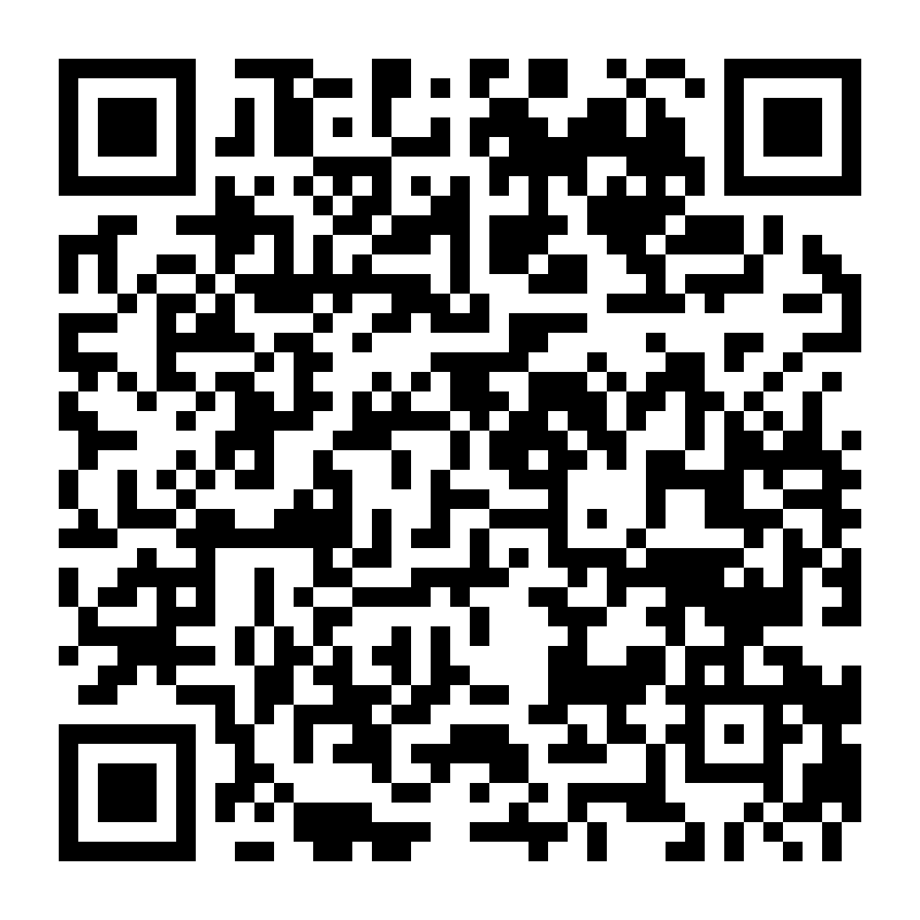
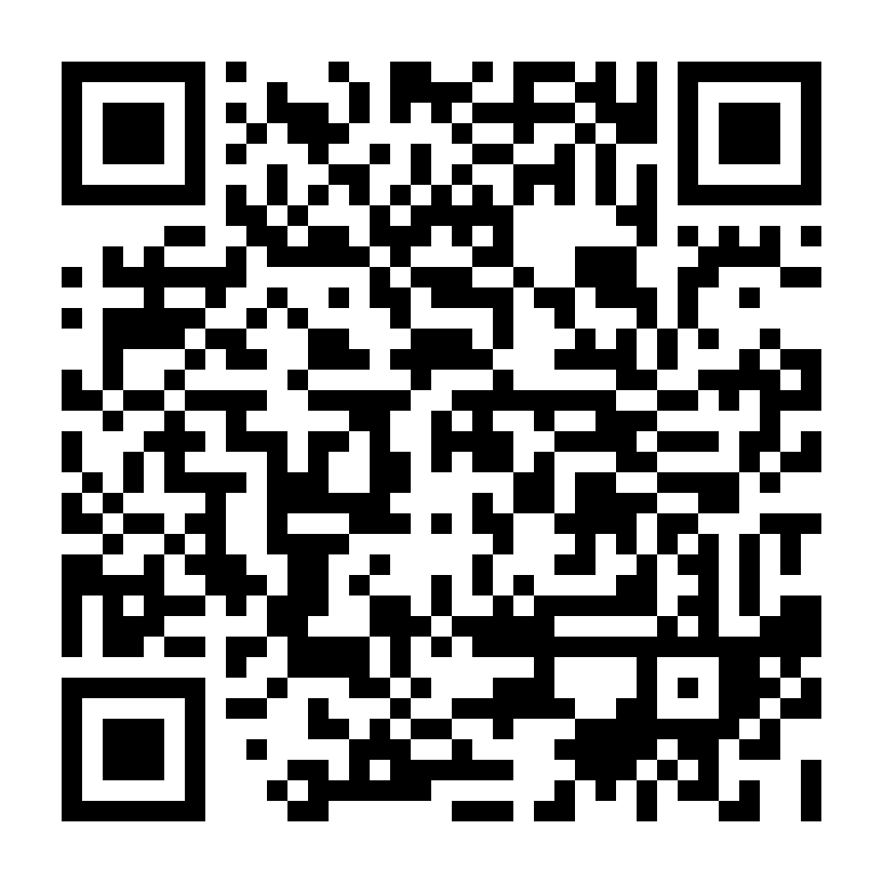
Snap a photo now, scan later
Thank you!
Questions?
Venket Raj S
Senior Software Engineer · Data & AI Automation, HCLTech
Connect on LinkedIn
Demo code on GitHub
github.com/venketraj/pocket-agent
FOOD FOR THOUGHT
Which of your everyday AI tasks is a cat's job that you're still paying an elephant for?
Intro
Problem
SLMs
Run local
Choose
Agents
Edge
Demo
Close
14 / 14
Notes:
[2 min + Q&A]
Call back to the opening: "At the start you picked a pet. Now you know which pet to pick for your next AI project."
Point to the QRs: "Snap a photo of this slide and scan later. LinkedIn to connect, GitHub for today's demo code."
Leave the food-for-thought question on screen during Q&A: "Which of your everyday AI tasks is a cat's job that you're still paying an elephant for?" It's a good prompt if nobody asks the first question.
Make sure the GitHub repo is public before the talk, or the QR will open a 404 page.

