Slide 1
Infrastructure Automation & Configuration Management with Chef
Training material

Slide 2


TOC
Introducing Chef
How It Works
Chef components
Chef Setup & getting started
Chef Real World Use Case- Convert bash script to Chef resource
Breakdown the steps
Write the recipe
Exercises

Slide 3
Introducing Chef
Chef is a Configuration management tool which is used to streamline the task of configuring & maintaining a company's servers. With Chef-
You can create a code-based model for your infrastructure.
Consistently deploy servers and scale applications.
Align resources with specific policies and business goals.
Save time by automating manual tasks.
It’s a systems infrastructure automation framework that makes it easy to deploy servers and applications to any physical, virtual, or cloud location. It has different components like- Server, workstation, node, cookbooks etc. to manage the configuration and automate an infrastructure.

Slide 4
How It Works
Each organization is comprised of one (or more) workstations, a single server, and every node that will be configured and maintained by the chef-client. Cookbooks (and recipes) are used to tell the chef-client how each node in your organization should be configured.
The chef-client (which is installed on every node) does the actual configuration.
The Chef server acts as a hub for configuration data. The Chef server stores cookbooks, the policies that are applied to nodes, and metadata that describes each registered node that is being managed by the chef-client.
Nodes use the chef-client to ask the Chef server for configuration details, such as recipes, templates, and file distributions.
The chef-client then does as much of the configuration work as possible on the nodes themselves (and not on the Chef server).
As it runs, Chef client queries Chef server for the latest set of recipes (configuration instructions) that apply to the current node. The Chef server determines the applicable recipes based on the node's role, (e.g. “web server” or “load balancer”). Chef client executes the applicable recipes in the same order every time, which simplifies how recipes are written and provides consistent, repeatable results.

Slide 5
Chef Components continues..
Server-
The Chef server stores cookbooks, the policies that are applied to nodes, and metadata that describes each registered node that is being managed by the chef-client. Nodes use the chef-client to ask the Chef server for configuration details, such as recipes, templates, and file distributions.
Nodes-
The node object consists of the run-list and node attributes, which is a JSON file that is stored on the Chef server. An attribute is a specific piece of data about the node, such as a network interface, a file system, etc. A run-list is an ordered list of recipes and/or roles that are run in an exact order.
Workstation-
The workstation is the location from which most users will do most of their work. It’s a computer that is configured to run Knife, to synchronize with the chef repository, and interact with a Chef server.
5

Slide 6
Chef Components
Cookbooks-
A cookbook is the fundamental unit of configuration and policy distribution. Each cookbook defines a scenario, such as everything needed to install and configure MySQL, and then it contains all of the components that are required to support that scenario. The chef-client uses Ruby as its reference language for creating cookbooks and defining recipes, with an extended DSL for specific resources.
Policy-
Policy settings can be used to map business and operational requirements, such as process and workflow, to settings and objects stored on the Chef server.

Slide 7
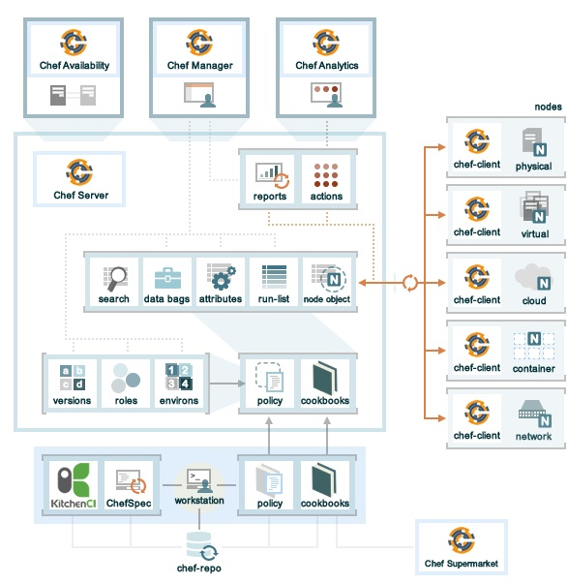
Chef components & their relationship
The diagram shows the relationships between the various elements of Chef, including the nodes, the server, premium features of the server, and the workstation. These elements work together to provide the chef-client the information and instruction that it needs so that it can do its job.
http://docs.getchef.com/_images/chef_overview.png

Slide 8
Chef setup & getting started
Configure the local system with Chef: http://learn.getchef.com/rhel/get-a-virtual-machine/
How Chef manages the configuration- http://www.getchef.com/solutions/configuration-management/
Configure a resource the 15 minute exercise: http://learn.getchef.com/rhel/configure-a-resource/
Watch this Chef fundamental video series: http://learn.getchef.com/fundamentals-series/
http://learn.getchef.com/rhel/ is your complete learning portal for Chef.
See some more contents here: http://learn.getchef.com/legacy/

Slide 9
Chef Real World Use Case

Slide 10
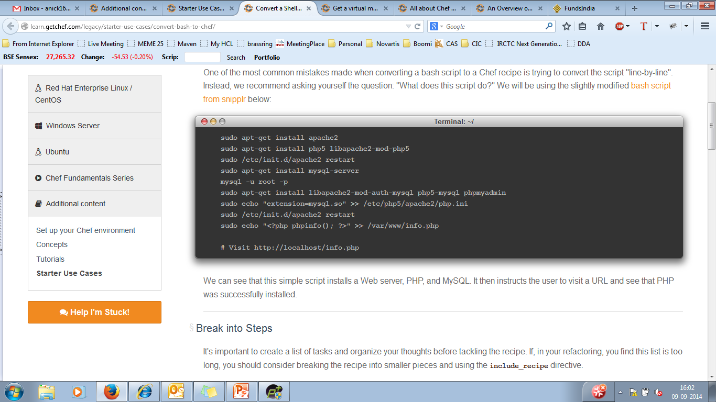
Use Case | Convert a Shell Script to a Chef Recipe-
Generally we have many bash scripts in our existing system to execute certain tasks. However, chef has a number of advantages over bash script. It
Is more understandable and manageable.
Supports easily templating your configuration files.
Is scalable and can grow to easily support your whole stack.
Can be re-executed easily, safely against multiple servers.
So a common real world use case will be to convert our existing bash script into a chef resource to manage the configurations and infrastructure. Below is a simple script which installs a Web server, PHP, and MySQL. Then the user visits a URL and see if PHP was successfully installed or not.

Slide 11
Use case continues..
Break the steps of use case-
Before designing the recipe lets break down the task into steps. In this case, most of our use cases are covered with existing community cookbooks. We should always check the community site for a more feature-complete solution.
Install apache2 - community
Install php - community
Install mysql - community
Install phpmyadmin - package resource
Configure php to use mysql - community
Create an info.php page with content
Write the recipe-
Create a new cookbook-

Slide 12
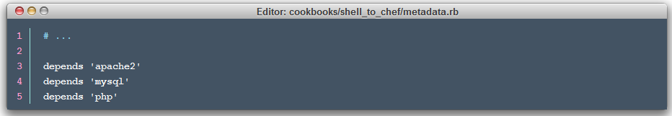
Use case continues..
Open the metadata.rb in an editor and add those community cookbooks as dependencies:
If you're using Enterprise Chef, you'll need to make sure those cookbooks are installed and available on the Chef Server. If you're using Chef Solo, make sure they are in your path.
Open the default recipe (recipes/default.rb) and use the include_recipe directive and the package provider to include the necessary components from the other cookbooks:

Slide 13
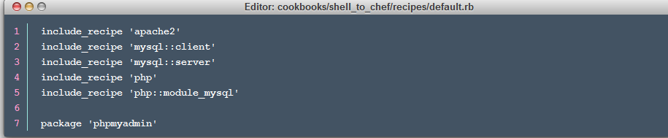
Use case continues..
Open the default recipe (recipes/default.rb) and use the include_recipe directive and the package provider to include the necessary components from the other cookbooks:
Create and use the info.php template:

Slide 14
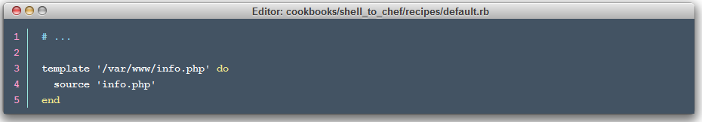
Use case continues..
That's it! You've successfully converted a bash script into a simple Chef recipe.

Slide 15
Exercises

