Slide 1

An Introduction to Chef along with a brief Introduction to CI/CD and Demo
1

Slide 2
Agenda
Overview of DevOps and Continuous Delivery Model
Introduction to Chef
Key Components of Chef
Terminology
Cookbooks
Roles
Environments
Chef Analytics
Demo
Best Practices/When to use Chef
Comparison of popular CM tools (CAPS)
2

Slide 3
DevOps Defined
“A cultural and professional movement, focused on how we build
and operate high velocity organizations, born from the experience of
its practitioners.” – Adam Jacob – Creator of Chef software.
“Reduced time required to release from 7 days to 8 Hours” – MS
“Wait time reduced to hours from days/months.” - IAAC
“Environment builds (DEV & QA) SLA reduction from more than
2 weeks to 1 day” – AT&T
“High-performing IT organizations experience 60X fewer failures and
recover from failure 168X faster than their lower-performing peers.
They also deploy 30X more frequently with 200X shorter lead times.”
- Puppet Labs 2015 State of DevOps Report
Technical benefits:
Continuous software delivery
Less complex problems to fix
Faster resolution of problems
Business benefits:
Faster delivery of features
More stable operating environments
More time available to add value (rather than fix/maintain)
Development (Software Engineering)
Technology Operations
Quality Assurance (QA)
DevOps

Slide 4
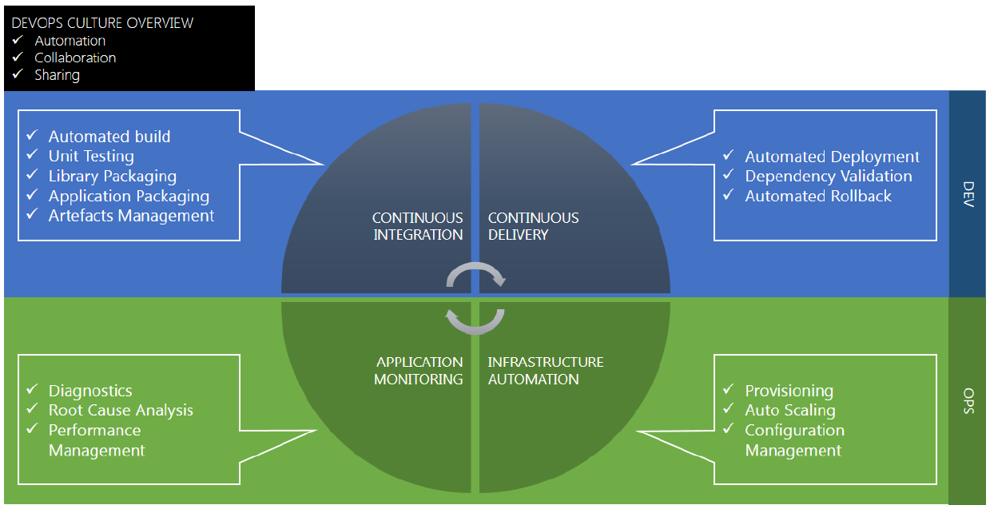
Continuous Integration, Delivery etc.

Slide 5
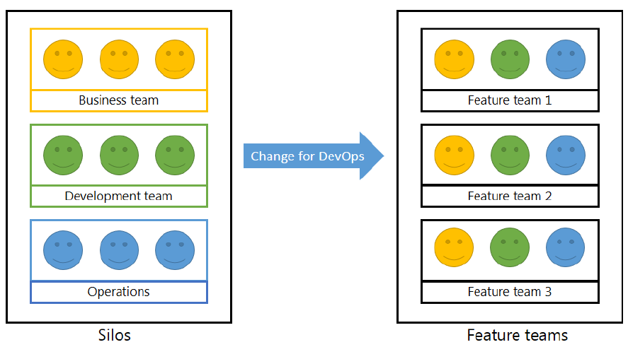
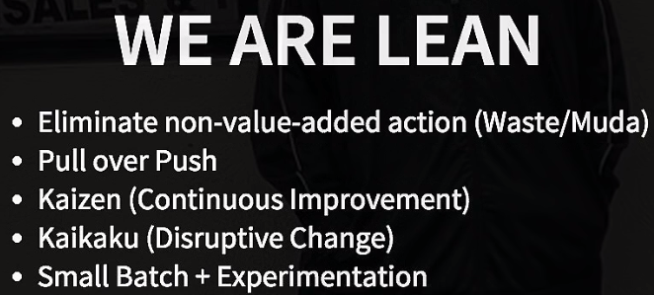
Cultural Change Required for DevOps
5

Slide 6
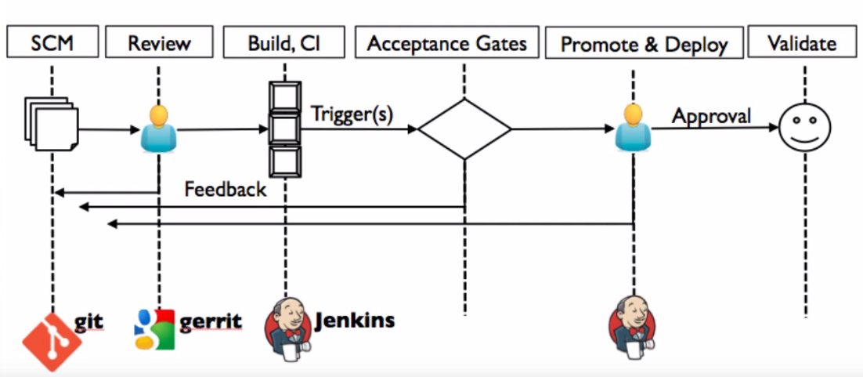
Typical Continuous Delivery Model
6

Slide 7
Continuous Delivery Model – Popular Tools
SCM
Code Review
Build, CI
Deploy to Int. * Env
Testing Tools
Deploy to Func.
Prod. Env & Monitor
GIT*
SVN
TFS
Github/pull req
Gerrit
Other tools
Static Analysis
Sonar
FindBugs
Policheck
Fortify
Jenkins*
Hudson
Bamboo
Release Mgr.
-----using-----
Ant/Ivy*
Maven
Gradle
Makefiles
Chef*
Puppet
Ansible
Autopilot
Octopus
Docker**
Selenium
Ranorex
SmartBear
LoadRunner
Appium
Chef
Puppet
Ansible
Other
Monitoring:
AppDynamics
Wiley
Nagios
Zabbix
HP OpenView
IBM Tivoli
MS System Center
Legend: * - component part of demo today;
** - Container technology, becoming popular due to efficiencies.
7

Slide 8
Chef – Infrastructure as Code
8

Slide 9
ABOUT CHEF
Chef software helps manage infrastructure as code. It is used as chef framework and chef programming language (Ruby) to define the component of your infrastructure.
This allows you to capture and document the shape and configuration of your infrastructure in a consistent way.
Programmatically provision and configure component
Treat like any code base
Reconstruct the business from code repository, data backup, and compute resources
9

Slide 10
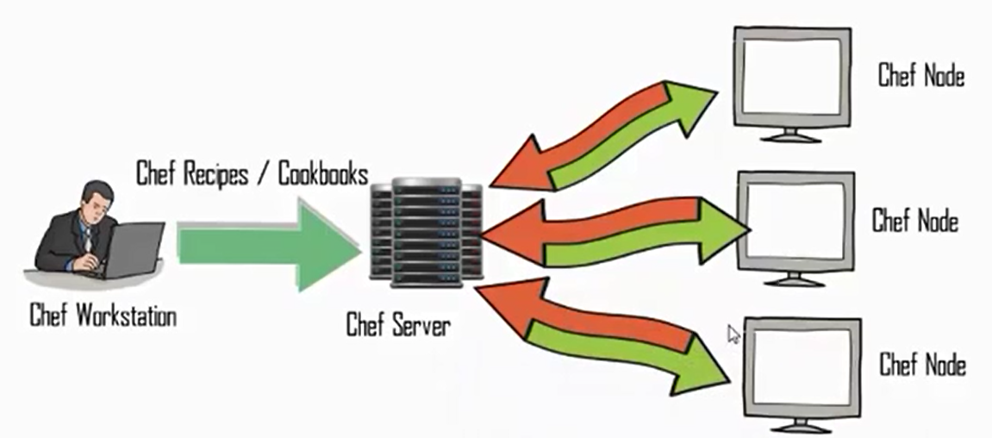
HOW CHEF WORKS ?
Chef Infrastructure
Chef Workstation - The chef workstation is the machine where we do our development. From the workstation we create cookbooks and upload them to chef server. Runs knife tool.
Chef Server- The Chef server is the brain of the system/Application. It stores the information about your infrastructure as well as our policy and reusable component called cookbooks. You can run chef server on premise or host somewhere else.
Chef Nodes- A node is a server (e.g, web server, database server etc.) in your infrastructure. Node is the computer you manage using chef, at your premise. Node can be on local machine or VM or an instance on public or private cloud. Runs chef-client s/w.
10
Notes:
Chef Workstation - The chef workstation is the machine where we do our development. From the workstation we create cookbooks and upload them to chef server.
Chef Server- The Chef server is the brain of the system/Application. It stores the information about your infrastructure as well as our policy and reusable component called cookbooks. You can run chef server on premise or host somewhere else.
Chef Nodes- A node is a server/node in your infrastructure. Node is the computer you manage using chef, at you premise. Node can be on local machine or VM an instance as public or private cloud

Slide 11
OVERVIEW OF WORKSTATION, SERVER AND NODE
Chef Component Overview
Recipe - Recipes that specify the resources to use and the order in which they are to be applied(Attribute values, File distributions, Templates
Extensions to Chef, such as libraries, definitions, and custom resources)
Node objects-
Cookbooks- It defines scenario and contains everything that is required to support that scenario. NOTE: Large library of cookbooks exist that can be downloaded from community portal at supermarket.chef.io.
Knife- knife is a key tool for authoring cookbooks and managing all
Ohai - Ohai is a tool that is used to detect attributes on a node, and then provide these attributes to the chef-client at the start of every chef-client run. Ohai is required by the chef-client and must be present on a node.
Data bags – JSON (can be encrypted) files that provide data needed for applications/systems to run e.g., Users/roles/passwords/keys etc.
Chef Analytics – keeps our finger on the pulse of our infrastructure.
Notes:
In Chef there are mainly 3 components.
1. Workstation, Chef Server and Chef Nodes
Cookbooks – It is a basic unit of configuration and policy distribution. It defines scenario and contains everything that is required to support that scenario:
Recipe - Recipes that specify the resources to use and the order in which they are to be applied
Attribute values
File distributions
Templates
Extensions to Chef, such as libraries, definitions, and custom resources
Knife take cookbooks & publish on Chef server, So Chef server now have a copy of apache cookbooks that we wrote on local workstation
Knife established the connection to my chef server and its said it store the chef server to store this run list on node object within the chef server. So run list recipe the apache which add to my node on chef server

Slide 12
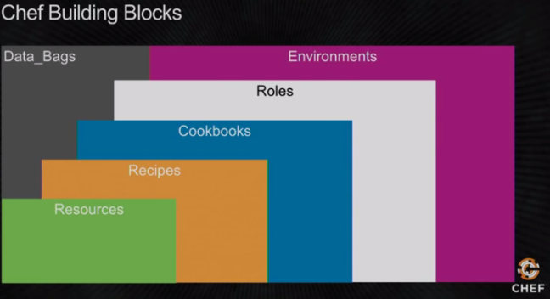
Pictorial Representation of Chef Building Blocks
12

Slide 13
COMPONENT UNDER COMPONENTS
Dev Env.
Node.
(Physical)
Chef Client
Node
(Cloud)
Chef Client
Ohai
Ohai
Chef Server
{
Environment, Roles,
Data Bag
} - Policy
Variations
{
Recipes, Attributes
} - Cookbooks
{
Run-list, Attributes
} – Node Object
Test Env…
Node.
(Cloud)
Chef Client
Node
(Cloud)
Chef Client
Ohai
Ohai

Slide 14
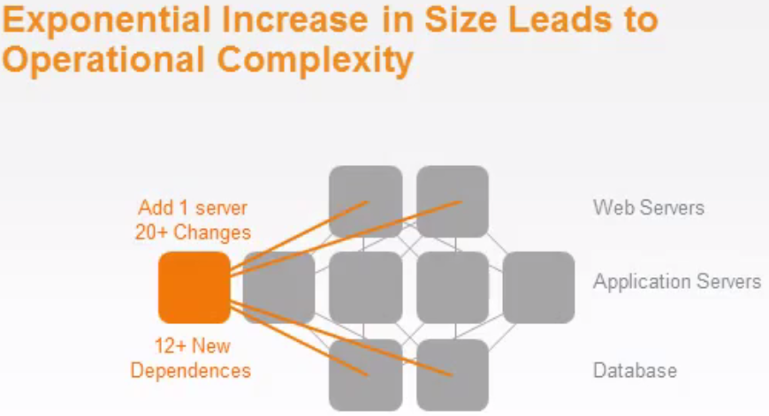
Chef/CM Tools – When to use
Pros
Helps faster recreate of infrastructure from bare metal/VMs plus software and ops as code, helping with DR etc.
Helps manage large # of servers & deployments efficiently, consistently.
Using Ruby or has some ruby skills (while Puppet is Ruby based DSL), Chef uses pure Ruby.
Decreased risk and greater levels of security as all servers will follow specified role/config.
Plus all other benefits of using CM Tool
Cons
Cost of these systems can be significant
Ongoing maintenance is required
Server is only on Linux
14

Slide 15
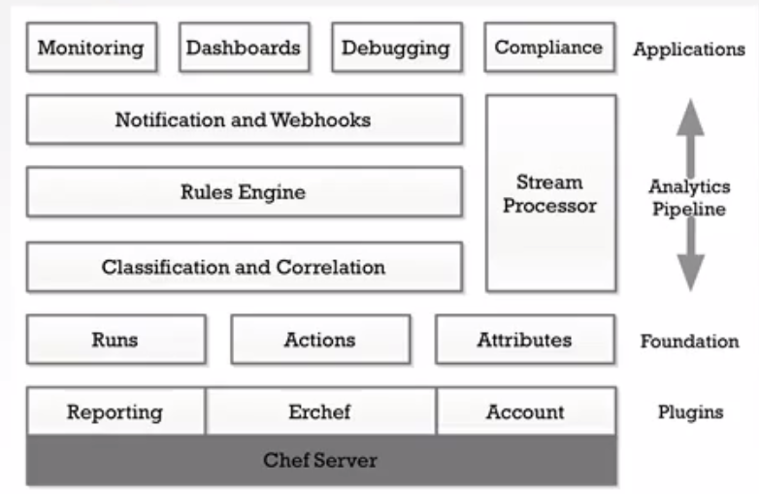
Chef Analytics Architecture
15

Slide 16
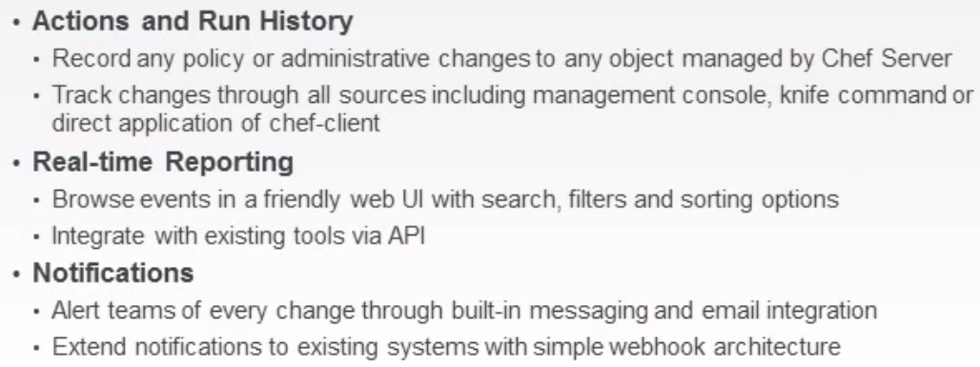
Chef Analytics Provides Three Core Components
16

Slide 17
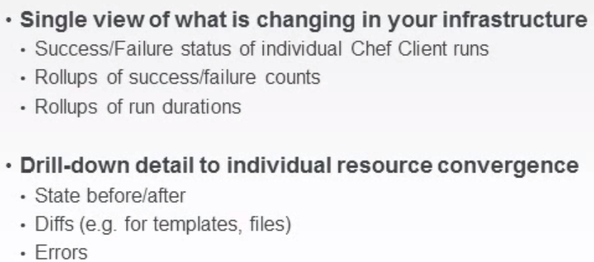
Chef Reporting – Who did what on your Chef Server?
17

Slide 18
Demo
Overview of Demo Environment
Walk through of various components developed
Few Operations:
Modifying an existing java file and get it deployed using CI/CD
Review Environment settings
Review Role settings
Review Cookbooks contents
Walk through various commands available briefly
Chef Analytics/Reports (brief)
Questions and Answers etc.
18

Slide 19
Best Practices to Implementing Chef
Create a brief sketch/layout of your environments for Development, Test, Stage, Production etc.
Identify the OS(s) for your servers in each environment
List all the software that is to be installed over and above the operating system
Identify how this software is to be acquired – ftp download, custom source/repository
Identify desired state configuration
Create CI/CD pipeline – list all tools, servers etc.
Install Chef Server, Workstation and nodes for development, test & prod environment
Make sure the chef repository is checked into a source code control system
Develop Cookbooks/Recipes, Roles, Environments and data bags (before developing any elaborate cookbooks, check out Community for already available open source ones)
Test and rollout to all other environments
Repeat the steps 8-9 whenever new version is required to be released.
Use Food Critic to review cookbooks etc.
19

Slide 20
Comparison of Popular tools
Feature | Ansible (2013) | Chef (2008) | Puppet (2005) | SaltStack (2012)
Summary | Combines multi-node deployment, ad-hoc task execution, and configuration management in one package. Manages nodes over SSH and requires python (2.4 or later) to be installed on them. Modules work over JSON and standard output and can be written in any language. Uses YAML to express reusable descriptions of systems. | Chef is a configuration management tool written in Ruby, and uses a pure Ruby DSL for writing configuration "recipes". These recipes contain resources that should be put into the declared state. Chef can be used as a client–server tool, or used in "solo" mode | Puppet consists of a custom declarative language to describe system configuration, distributed using the client–server paradigm (using XML-RPC protocol in older versions, with a recent switch to REST), and a library to realize the configuration. | Salt started out as a tool for remote server management. As its usage has grown, it has gained a number of extended features, including a more comprehensive mechanism for host configuration. This is a relatively new feature facilitated through the Salt States component. With the traction that Salt has gotten in the last bit, the support for more features and platforms might continue to grow
Pull vs. Push | Both | Pull | Pull | Push
Programming skills | Yaml based scripts | Ruby Programs/config | Ruby based DSL Programs/config | Yaml based scripts
Agent-less | Yes | No | Yes | Yes & No
Encryption | Yes | Yes | Yes | Yes
License | GPL | Apache | Apache, 2.7.0+, GPL before. | Apache
Language | Python | Ruby & Erlang | Ruby | Python
Windows Support | Beta | Only Client, WS | Supported. | Server on Linux only
OpenStack | Best support | Good | Good | Least mature
Key Customers | Blue Box, Red Hat | Facebook, Bloomberg, GE Capital, Nordstrom, Ancestry.com …. | Paypal, NYSE, ADP, Symantec, Sony | Paypal, Verizon, HP, Rackspace
20

Slide 21
Chef – Hosted versus On-prem
 | Pros | Cons
Hosted Chef | No worries about installation, upgrades, backups and maintenance No worries about hardware upgrades and maintenance Best for newbies because of extensive Chef, Inc. support and handholding | Very expensive: from $120 to $700 per month Hosted in the cloud, therefore vulnerable to host provider service outages and security breaches
On Premise (Private) Chef | Allows higher level of fine-grained customization Full control over your own environment; better security Can seat your Chef server on your network, allowing faster communication and deployments | Still expensive: $6/node/month without support Requires real expertise to configure and use If you don’t know what you’re doing you can mess things up very badly Not suitable for newbies or the inexperienced
Open Source Chef | Completely Free Access to user community Ability to tweak source code as you desire | Even more difficult to configure than Private chef – requires expertise in Chef No upgrades or support from Chef, Inc. Doubts about Chef, Inc’s continued commitment to the open-source model
21

Slide 22
References
Training videos by Opscode and Chef documentation on web.
MS Whitepaper on Zend & Azure.
Orchestrating Your Delivery Pipelines with Jenkins
Comparison of CM tools
Other online resources (youtube, etc.)
22

Slide 23
Thank You
Questions and Answers, etc.
23

Slide 24
Backup – Detailed Slides.
24

Slide 25
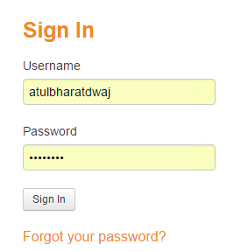
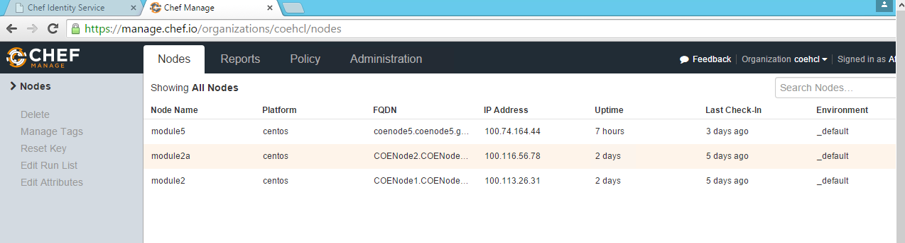
Server View
https://manage.chef.io/login
25

Slide 26
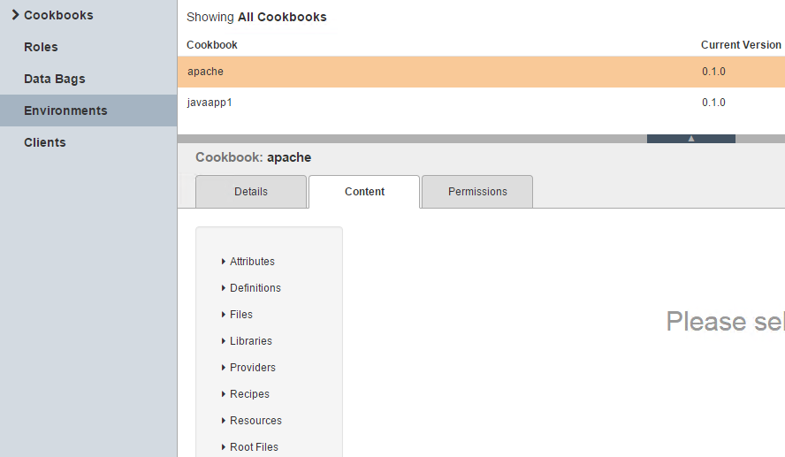
Environment View
26

Slide 27
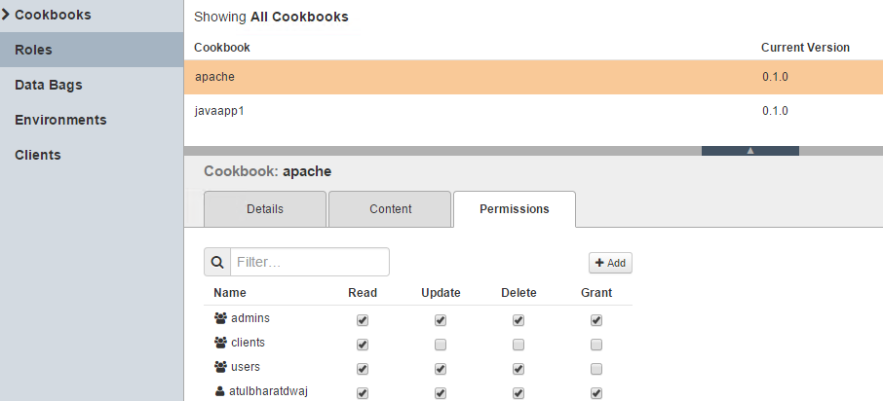
Roles View
27

Slide 28
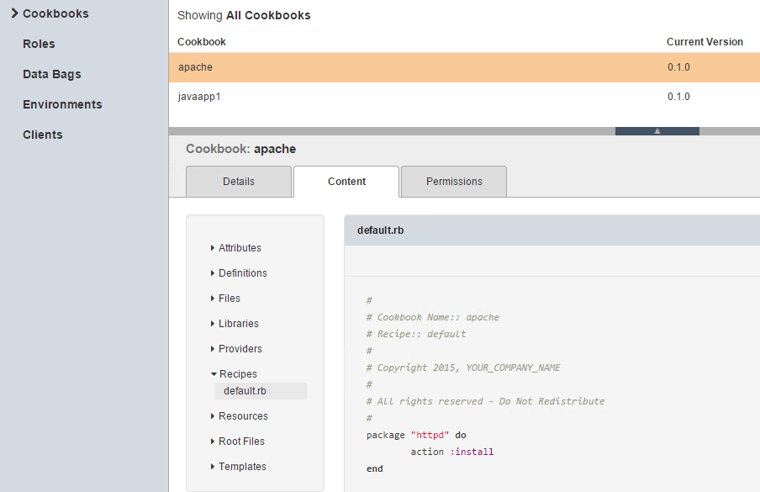
Recipe on server View
28

Slide 29
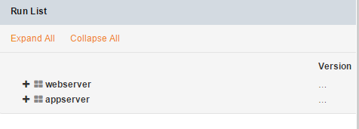
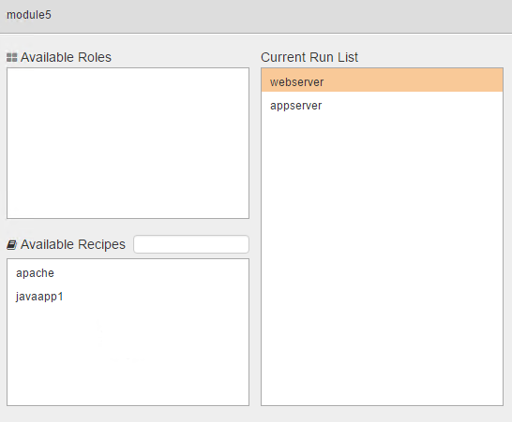
Run List View
29

Slide 30
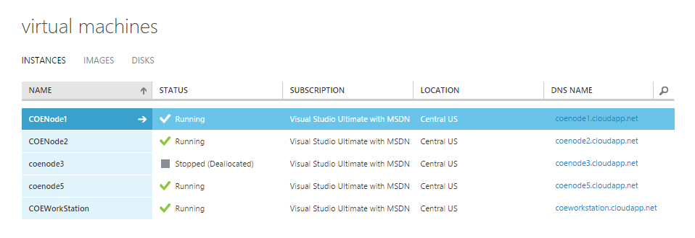
Node View
30

Slide 31
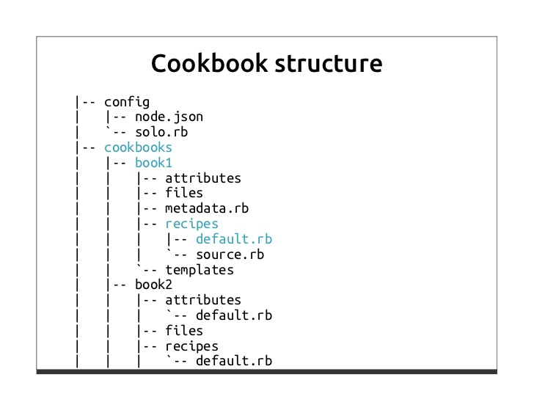
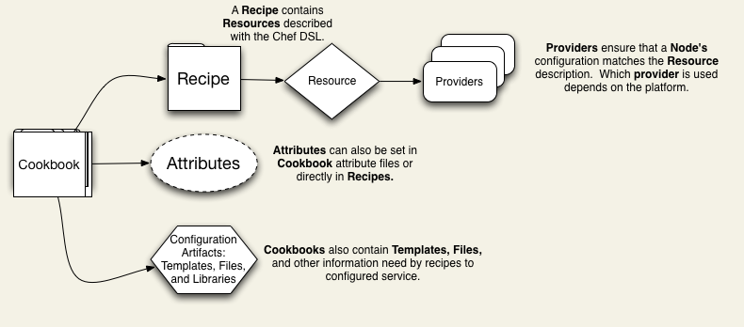
Cookbooks Structure
31

