Slide 1

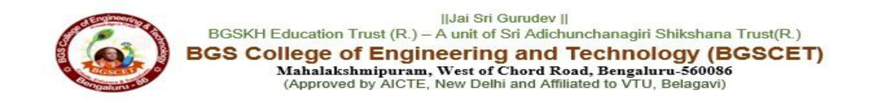
LIGHTWEIGHT MULTIMODAL
DEEPFAKE IMAGE AND
FAKE-NEWS DETECTION
Presented by:
1. VENUPRASAD - 1MP23AD056
2. J THANMAY GOWDA - 1MP23AD019
3. RUSHIKESHAN - 1MP23AD043
4. VINOD. E
- 1MP23AD059
Under the Guidance of:
Dr. Chandhini A G
professor -Dept of AI&DS
BGSCET
AI&DS

Slide 2

ABSTRACT
This project screens manipulated faces and misleading news text.
It combines two lightweight models in one practical application.
EfficientNet-B0 classifies images; TF-IDF with logistic regression
classifies news patterns through Flask, web and Android clients.
The image model achieved 80.41% held-out balanced accuracy.
Cross-source news testing revealed substantial dataset shift.
Uncertain outputs are sent for review, not treated as proof.
2
Notes:
[Sources]
Local project report: Deepfake_Misinformation_Detection_IEEE_Paper.docx
[/Sources]

Slide 3
INTRODUCTION
Deepfakes and misinformation reduce trust in digital content.
Images require spatial evidence; news requires language patterns.
Existing tools often treat these related problems separately.
They may also become overconfident on unfamiliar data sources.
This project unifies both detection paths behind Flask APIs,
uses calibrated thresholds with an uncertainty state, and returns
screening results through browser and Android interfaces.
3
Notes:
[Sources]
Local project report: Deepfake_Misinformation_Detection_IEEE_Paper.docx
[/Sources]

Slide 4
LITERATURE SURVEY
S.No | AUTHOR & YEAR | TITLE / DATASET | CONCEPT USED | KEY FINDINGS
1 | Rössler et al., 2019 | FaceForensics++ | CNN face analysis | Compression affects detection.
2 | Shu et al., 2018 | FakeNewsNet | Content + social context | Text alone misses context.
3 | Nakamura et al., 2020 | Fakeddit | Multimodal benchmark | Supports joint text-image study.
4
Notes:
[Sources]
https://doi.org/10.1109/ICCV.2019.00009
https://arxiv.org/abs/1809.01286
[/Sources]

Slide 5
PROBLEM STATEMENT
• Deepfake images and deceptive news are usually checked by separate tools.
Image-only systems may fail on new generators, compression, and weak faces.
Text-only classifiers learn source language but cannot verify factual claims.
Overconfident binary outputs can mislead users when evidence is uncertain.
There is a need for:
• A unified image-and-text screening application.
• Calibrated predictions with an explicit manual-review state.
• Lightweight web and Android access using moderate resources.
5
Notes:
[Sources]
Local project report and implementation files in the Deepfake_Project workspace
[/Sources]

Slide 6

Research Gaps
• From existing research, we identified:
• Few practical systems combine deepfake-image and news-text screening.
• Cross-source evaluation is often weaker than random-split evaluation.
• Binary decisions rarely expose low-confidence or ambiguous samples.
• Content-only news models cannot retrieve evidence or establish truth.
• Lightweight deployment across web and mobile receives limited attention.
09-08-2026
Notes:
[Sources]
Local project report: Deepfake_Misinformation_Detection_IEEE_Paper.docx
[/Sources]

Slide 7
Objectives
• Detect manipulated facial images using transfer learning.
• Classify suspicious news text using interpretable sparse features.
• Evaluate images with balanced metrics and news by held-out source.
• Calibrate thresholds and reject uncertain predictions.
• Integrate both models through Flask REST APIs.
• Provide accessible web and Android user interfaces.
09-08-2026
Notes:
[Sources]
Local project report: Deepfake_Misinformation_Detection_IEEE_Paper.docx
[/Sources]

Slide 8
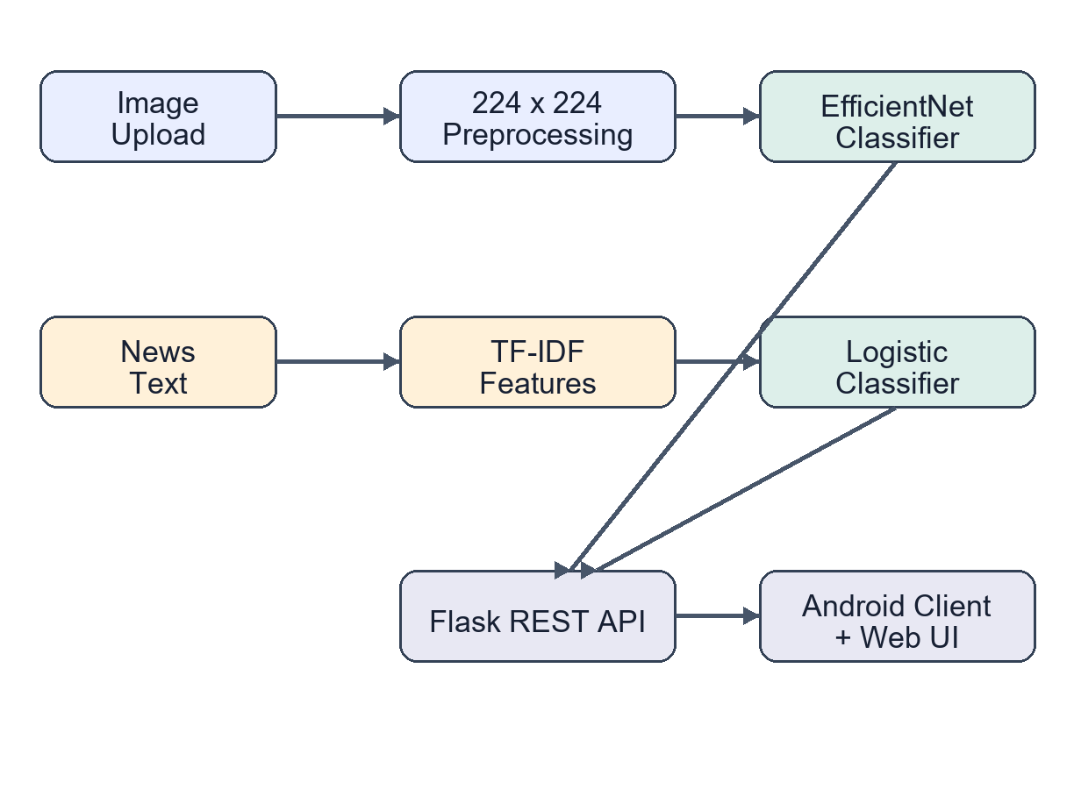
Methodology
09-08-2026
Notes:
[Sources]
Local project figure: paper_architecture.png
[/Sources]

Slide 9
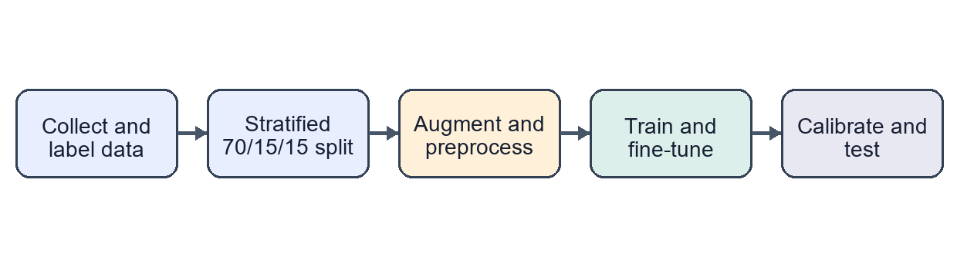
Technology Used
• Python, TensorFlow/Keras, scikit-learn.
• 22,044 balanced real and fake face images.
• EfficientNet-B0 with 160 × 160 inputs.
• 186,032 news records from three sources.
• TF-IDF uni/bigrams with logistic regression.
• REST APIs for image and news prediction.
• Web interface and native Android client.
• Metadata-driven thresholds and loading.
09-08-2026
Notes:
[Sources]
Local implementation: app.py, training scripts, model metadata
Local project figure: paper_training_flow.png
[/Sources]

Slide 10

Experimental Results
• Completed image V2: 80.41% test balanced accuracy.
• Fake recall: 76.09%; real recall: 84.73%.
• Cross-source news accuracy: 65.4%; macro-F1: 0.481.
• Fake-news recall on the unseen source was only 0.155.
• Result: uncertainty handling is essential for responsible use.
09-08-2026
Notes:
[Sources]
Local stored experiment metadata summarized in Deepfake_Misinformation_Detection_IEEE_Paper.docx
[/Sources]

Slide 11
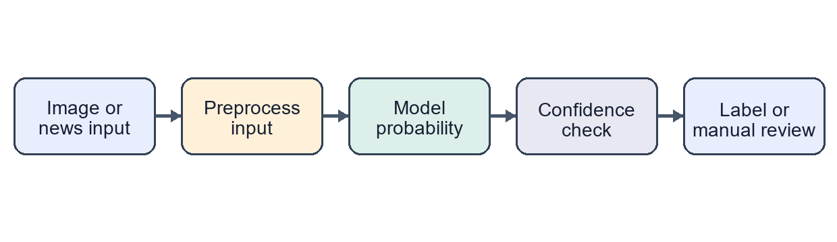
Conclusion
• One service screens facial images and news text.
• EfficientNet-B0 offers practical image accuracy.
• Source-held-out testing exposes text-model limits.
• Weak predictions are returned for manual review.
• Results support decisions; they are not forensic proof.
• Next: V3, external tests, evidence retrieval and HTTPS.
09-08-2026
Notes:
[Sources]
Local project report: Deepfake_Misinformation_Detection_IEEE_Paper.docx
Local project figure: paper_decision_flow.png
[/Sources]

Slide 12
References
• [1] A. Rössler et al., “FaceForensics++: Learning to Detect
Manipulated Facial Images,” ICCV, 2019, pp. 1–11.
• [2] K. Shu et al., “FakeNewsNet: A Data Repository for
Studying Fake News on Social Media,” arXiv:1809.01286, 2018.
• [3] M. Sandler et al., “MobileNetV2: Inverted Residuals and
Linear Bottlenecks,” CVPR, 2018, pp. 4510–4520.
• [4] M. Tan and Q. Le, “EfficientNet: Rethinking Model Scaling,”
ICML, 2019, pp. 6105–6114.
• [5] M. Tan and Q. Le, “EfficientNetV2: Smaller Models and
Faster Training,” ICML, 2021, pp. 10096–10106.
• [6] J. Thorne et al., “FEVER: Fact Extraction and Verification,”
NAACL-HLT, 2018, pp. 809–819.
• [7] K. Nakamura et al., “r/Fakeddit: A Multimodal Benchmark,”
LREC, 2020, pp. 6149–6157.
• [8] T.-Y. Lin et al., “Focal Loss for Dense Object Detection,” ICCV, 2017.
09-08-2026
Notes:
[Sources]
https://doi.org/10.1109/ICCV.2019.00009
https://arxiv.org/abs/1809.01286
https://proceedings.mlr.press/v97/tan19a.html
https://aclanthology.org/N18-1074/
https://aclanthology.org/2020.lrec-1.755/
[/Sources]

Slide 13
THANK YOU

