Slide 1
MAJOR PROJECT
Deepfake Image &
Fake-News Detection
IMAGE
+
TEXT
A lightweight multimodal screening framework with uncertainty-aware decisions
Presented by
Venuprasad • J Thanmay Gowda • Rushikeshan • Vinod E
Guided by Dr. Chandhini A G | BGSCET
Notes:
[Sources]
Local project source: Deepfake_Misinformation_Detection_IEEE_Paper.docx
[/Sources]

Slide 2
02
Abstract
One application, two detection paths
The system screens manipulated facial images and suspicious news text through independent models served by a common Flask backend.
Core outcome
80.41%
EfficientNet-B0 for binary image classification
image test balanced accuracy
TF-IDF + logistic regression for news patterns
Web and Android clients share the same REST APIs
Honest evaluation matters as much as model choice.
Low-confidence predictions are routed to manual review
BGSCET • Department of AI & Data Science
2
Notes:
[Sources]
Local project source: Deepfake_Misinformation_Detection_IEEE_Paper.docx
[/Sources]

Slide 3
03
Introduction
Digital trust requires evidence from both pixels and language
WHY IT MATTERS
Synthetic faces and fast-moving misinformation can appear credible while carrying weak or manipulated evidence.
IMAGE PATH
Learns spatial artifacts, texture inconsistencies and facial manipulation cues.
TEXT PATH
Learns vocabulary and language patterns—but cannot independently prove a claim true.
The project combines both paths without pretending they are the same problem.
BGSCET • Department of AI & Data Science
3
Notes:
[Sources]
Local project source: Deepfake_Misinformation_Detection_IEEE_Paper.docx
https://doi.org/10.1109/ICCV.2019.00009
https://arxiv.org/abs/1809.01286
[/Sources]

Slide 4
04
Literature Survey
Prior work motivates a lightweight multimodal design
Study | Focus | Method | Project insight
Rössler et al., 2019 | Deepfake faces | FaceForensics++ benchmark | Compression and manipulation type affect accuracy.
Shu et al., 2018 | Fake news | Content + social context | Article text alone misses propagation evidence.
Nakamura et al., 2020 | Multimodal news | Fakeddit benchmark | Text and images benefit from joint investigation.
BGSCET • Department of AI & Data Science
4
Notes:
[Sources]
https://doi.org/10.1109/ICCV.2019.00009
https://arxiv.org/abs/1809.01286
https://aclanthology.org/2020.lrec-1.755/
[/Sources]

Slide 5
05
Problem Statement
Current screening tools create three practical risks
01
02
03
FRAGMENTED
BRITTLE
OVERCONFIDENT
Image and news checks are usually performed in separate systems.
Models can weaken on unseen generators, compression and new sources.
Forced binary labels can hide ambiguity and mislead users.
Need: one deployable, uncertainty-aware screening service.
BGSCET • Department of AI & Data Science
5
Notes:
[Sources]
Local project source: Deepfake_Misinformation_Detection_IEEE_Paper.docx
[/Sources]

Slide 6
06
Research Gap
The missing piece is responsible integration
What existing work often does
What this project adds
Optimizes a single modality
Unified image and text screening
Uses random splits that hide source shift
Source-held-out evaluation for news
Returns confident labels for borderline cases
Explicit “manual review” outcomes
Stops at model evaluation
Web and Android deployment
BGSCET • Department of AI & Data Science
6
Notes:
[Sources]
Local project source: Deepfake_Misinformation_Detection_IEEE_Paper.docx
[/Sources]

Slide 7
07
Objectives
Build, evaluate and deploy without overstating certainty
01
Detect
Manipulated facial images with transfer learning.
02
Screen
Suspicious news using sparse language features.
03
Evaluate
Balanced image metrics and held-out news sources.
04
Calibrate
Thresholds and uncertainty rejection.
05
Deploy
Shared Flask APIs for web and Android.
BGSCET • Department of AI & Data Science
7
Notes:
[Sources]
Local project source: Deepfake_Misinformation_Detection_IEEE_Paper.docx
[/Sources]

Slide 8
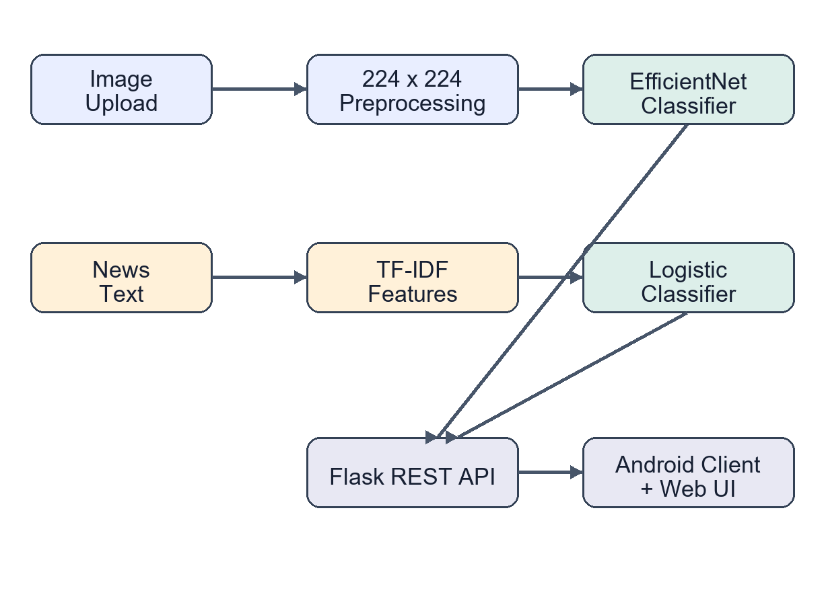
08
Methodology
Two independent inference paths converge at one service
IMAGE
22,044 faces
70 / 15 / 15 split
EfficientNet-B0
Threshold calibration
TEXT
186,032 records
TF-IDF uni/bigrams
Logistic regression
Held-out source test
BGSCET • Department of AI & Data Science
8
Notes:
[Sources]
Local project source: Deepfake_Misinformation_Detection_IEEE_Paper.docx
Local project figure: paper_architecture.png
[/Sources]

Slide 9
09
Technology Used
A lightweight stack supports training, serving and mobile access
MODEL
TEXT
BACKEND
CLIENTS
VISION
TensorFlow / Keras
EfficientNet-B0
scikit-learn
TF-IDF + Logistic Regression
Python / Flask
REST + JSON
HTML/CSS/JS
Native Android
OpenCV / Pillow
Artifact maps
Deployment principle: model artifacts remain separate from interface code, enabling controlled upgrades.
BGSCET • Department of AI & Data Science
9
Notes:
[Sources]
Local implementation: app.py, requirements files, Android application source
[/Sources]

Slide 10
10
Experimental Results
Image detection is promising; cross-source news transfer remains weak
84.73%
real-image recall
Key limitation
Fake-news recall on the unseen source was only 15.5%.
BGSCET • Department of AI & Data Science
10
Notes:
[Sources]
Local stored experiment metadata summarized in Deepfake_Misinformation_Detection_IEEE_Paper.docx
[/Sources]

Slide 11
11
Conclusion
The framework is useful when uncertainty remains visible
What was achieved
What comes next
One service for image and news screening
Complete EfficientNetV2 V3 training
80.41% image balanced accuracy
Test on external deepfake datasets
Web and Android access
Add evidence retrieval for textual claims
Manual-review state for weak predictions
Move to authenticated HTTPS deployment
Decision support—not forensic proof.
BGSCET • Department of AI & Data Science
11
Notes:
[Sources]
Local project source: Deepfake_Misinformation_Detection_IEEE_Paper.docx
[/Sources]

Slide 12
12
References
Selected foundations for the project
[1] A. Rössler et al., “FaceForensics++,” ICCV, 2019.
[5] M. Tan and Q. Le, “EfficientNetV2,” ICML, 2021.
[2] K. Shu et al., “FakeNewsNet,” arXiv:1809.01286, 2018.
[6] J. Thorne et al., “FEVER,” NAACL-HLT, 2018.
[3] M. Sandler et al., “MobileNetV2,” CVPR, 2018.
[7] K. Nakamura et al., “r/Fakeddit,” LREC, 2020.
[4] M. Tan and Q. Le, “EfficientNet,” ICML, 2019.
[8] T.-Y. Lin et al., “Focal Loss,” ICCV, 2017.
Thank you
BGSCET • Department of AI & Data Science
12
Notes:
[Sources]
https://doi.org/10.1109/ICCV.2019.00009
https://arxiv.org/abs/1809.01286
https://proceedings.mlr.press/v97/tan19a.html
https://aclanthology.org/N18-1074/
https://aclanthology.org/2020.lrec-1.755/
[/Sources]

