Slide 1
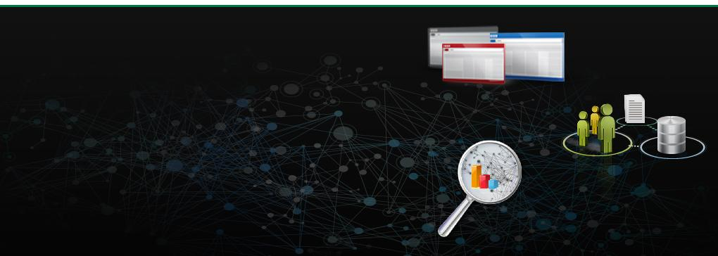
MULE ESB – Day1

Slide 2
Agenda
      Introduction To SOA architecture
Integration Need
Approaches & Solutions for Integration
Introduction ESB Frameworks
Introduction to MULE ESB
Mule ESB Runtime and Anypoint Studio Installation
Practical : Running “Hello World” Using HTTP
Deploy on Standalone.

Slide 3
Introduction To SOA
evolution of distributed computing based on the request/reply design paradigm
business logic or individual functions are modularized and presented as services for consumer/client applications
loosely coupled nature; i.e., the service interface is independent of the implementation
build applications by composing one or more services without knowing the services' underlying implementations
For example, a service can be implemented either in .Net or J2EE, and the application consuming the service can be on a different platform or language.

Slide 4

Integration Need
Integration is Must

Slide 5
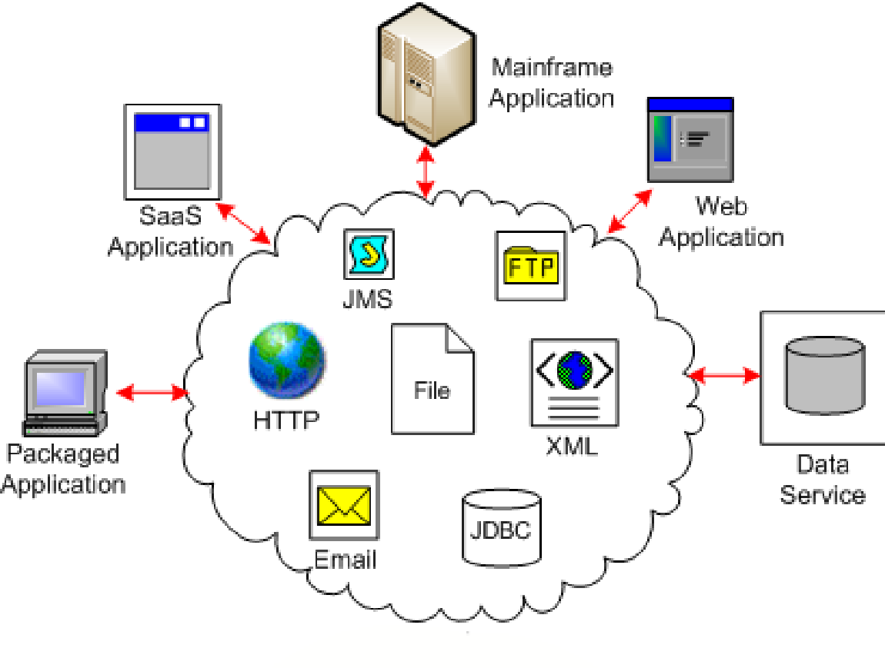
Integration Need

Slide 6
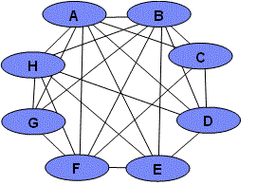
Approaches & Solutions for Integration
Application Integration
Point to Point
Tight Coupling

Slide 7
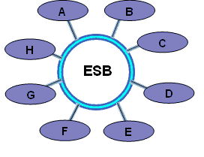
Approaches & Solutions for Integration
Enterprise Service Bus
Loose Coupling

Slide 8
Introduction To ESB Frameworks
Service Mix
Fuse ESB
Mule ESB
Spring Integration
Some of the real-world integration benefits of Mule ESB include:
  Does not restrict developers to single arbitrary standard
Simplified POJO-based programming model leveraging existing developer skill-sets for fast deployment
Support for multiple access points such as JMS, JDBC, and SOAP
Ease of use – services can be configured easily in one configuration file.
Extensive data transformations out of the box
Small footprint: memory and disk, no application server required
Integration platform model: highly modular, easily extensible codebase - implement proven patterns and build streamlined solutions to unique challenges
The open source advantage: large community of real-world integration experts and developers using Mule and contributing to codebase

Slide 9

MULE ESB

Slide 10
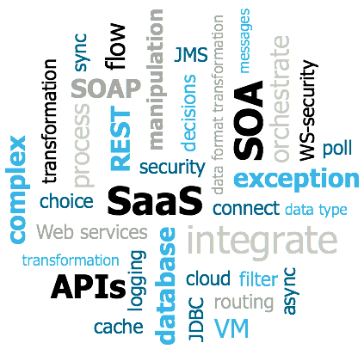
Mule Fundamentals
Lightweight integration platform that enables you to connect anything, anywhere
Open source projects under the CPAL license
Mule ESB Community and Enterprise
Intelligently manage message routing, data mapping, orchestration, reliability, security, and scalability between nodes
Plug other systems and applications into Mule
Mule named 'carries the heavy development load' of connecting systems.

Slide 11
Mule can do
Integrate applications or systems on premise or in the cloud
Use out-of-the-box connectors to create SaaS integration applications
Build and expose APIs
Consume APIs
Create Web services which calls to other services
Create interfaces to expose applications for mobile consumption
Integrate B2B with solutions that are secure, efficient, and quick to build and deploy
Shift applications onto the cloud
Connect B2B e-commerce activities

Slide 12
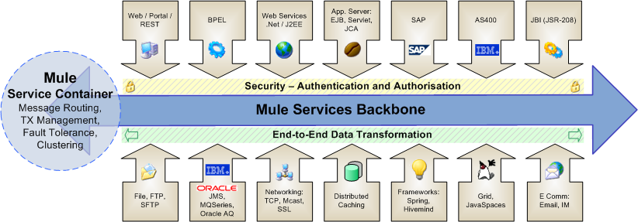
MULE ESB

Slide 13
Mule Tools
Design and Develop
  AnyPoint Studio
    An eclipse based graphical development environment (Visual editor and XML editor) for designing, testing and running Mule flows.
    powerful “drag and drop” application builder
  Mule Healthcare Toolkit -
    The Mule Healthcare Toolkit is a collection of features that facilitates integration with healthcare systems by providing the tools needed to easily create, read and transform HL7 version v2.x messages within Mule.
Deploy
  Standalone server
  Embedded
  CloudHub
  Api Gateway
Management
  Mule Management Console
    A user interface which provides run time management facility of deployment to the Mule Repository and clusters.
    Facilitates deployment to the Mule Repository and subsequent deployment to Mule high-availability clusters.
    Provides robust runtime management capabilities for on-premises deployments.
  CloudHub
    Insight tracks everything your data does in an application deployed to CloudHub
  Anypoint Platform for APIs
    An API and service registry and governance platform

Slide 14
Compatible technologies
Application servers
Standalone
Tcat
Tomcat
Weblogic
WebSphere
Geronimo
JBoss
Jetty
Resin
Containers
EJB 3
jBPM
Spring
Databases
Oracle
MySQL
DB2
Postgres
MS SQL Server
Any other JDBC-compatible
Deployment topologies
ESB
Client/Server
Peer-to-Peer
Enterprise Service Network
Hub and Spoke
Pipeline
Event Handling
Asynchronous
Routing Patterns
SEDA
Streaming
Synchronous
Transactions

Slide 15
Compatible technologies (Cont.)
Data formats
Atom
Base 64 encoded
Byte arrays
CSV
XML
Encrypted
GZIP
Jython (Python)
Hex strings
XML entity encoded
JAXB
JSON
Streaming
Strings
Java objects
HTML
XHTML
Developer Tools
Ant
Eclipse
Japex
Maven
Mule Studio
Profiler
JMS servers
ActiveMQ
FioranoMQ
JBossMQ
OpenJMS
OpenMQ
Oracle AQ
SeeBeyond
SonicMQ
Sun JMS Grid
SwiftMQ
TIBCO EMS
WebLogic JMS

Slide 16
Compatible technologies (Cont.)
Languages
Groovy
Java
JavaScript
Jaxen
JRuby
JXPath
MVEL
Jython (Python)
OGNL
RegEx
SXC
XPath
XQuery
MEL
Operating Systems
Linux
Windows
Solaris
AIX
HP-UX
Mac OS X
Security
WS-Security
Acegi
Jaas
PGP
Spring Security
SAML
SSL/TLS
Web Service Technologies
Axis
Atom
CXF
.NET Web Servces
REST
SOAP
WS-Addressing
WS-Policy
WS-Security
WS-I BasicProfile
WS-I SecurityProfile
WSDL

Slide 17
Mule Cloud Connectors
SalesForce
Amazon Services S3,SQS
CMIS (Alfresco)
Facebook
LinkedIn
Twitter
MongoDb
Magento
Box
DropBox
GutHub
Microsoft Dynamics CRM, SharePoint
Jira
Netsuite
Google Spreadsheets,Calendar, Task,Contact
Hadoop
Oracle
Neo4j
Apple Push Notification
LDAP
SSH
SAP R/3
Drupal
Documentum
Twillo
JBOSS
GitHub
EXCEL/CSV
FTP,SFTP
Weblogic JMS
WebSpehere MQ
Paypal
Google Spreadsheets,Calendar, Task,Contact
Hadoop
Oracle
Neo4j
Apple Push Notification
LDAP
SSH
SAP R/3
Drupal
Documentum
Twillo
JBOSS
EXCEL/CSV
FTP,SFTP
Weblogic JMS
WebSpehere MQ
Paypal
......and Many More.........

Slide 18
Mule Runtime and Anypoint Studio Installation
Mule Runtime Installation Link
  https://developer.mulesoft.com/download-mule-esb-runtime
Anypoint Studio Installation Link
  https://www.mulesoft.com/lp/dl/studio

Slide 19
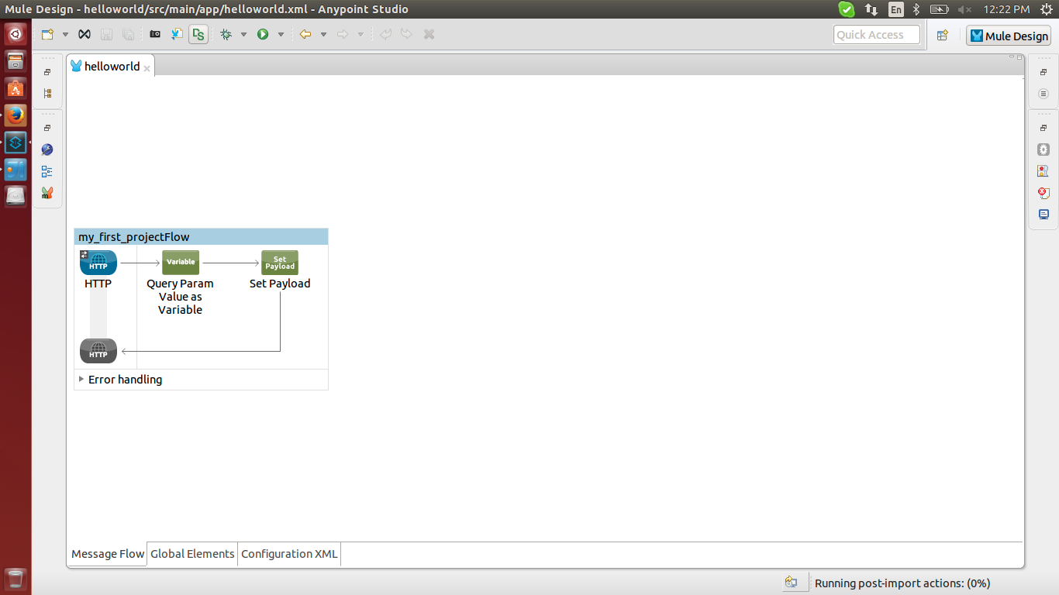
Practical : Running “Hello World” Using HTTP -
Flow

Slide 20
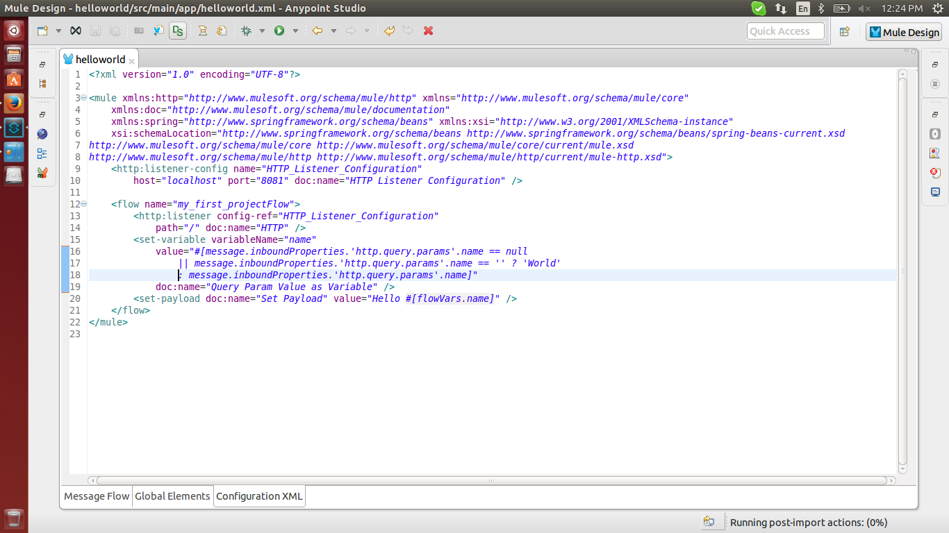
Practical : Running “Hello World” Using HTTP -
Code Snippet

Slide 21
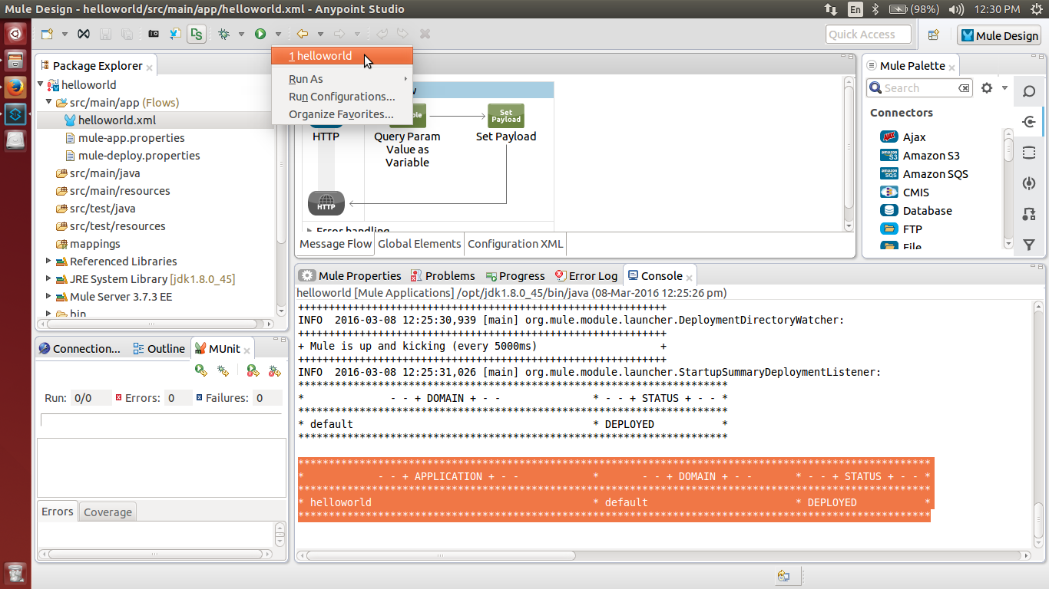
Practical : Running “Hello World” Using HTTP -
Running using Anypoint Studio

Slide 22
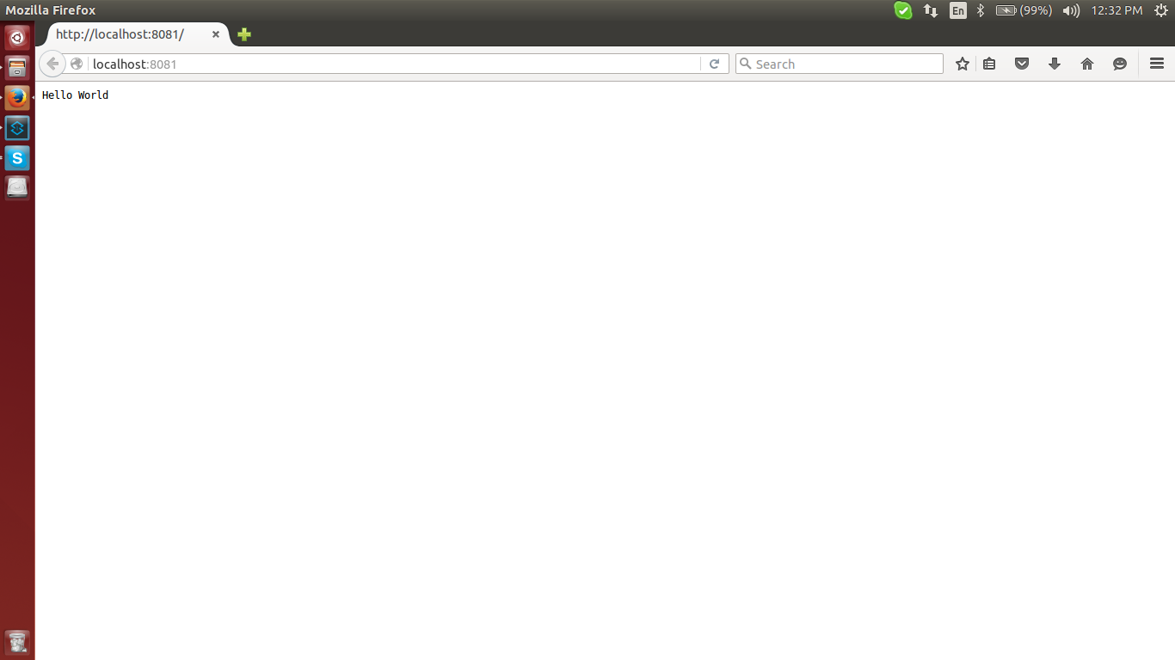
Practical : Running “Hello World” Using HTTP -
Output Without Parameter

Slide 23
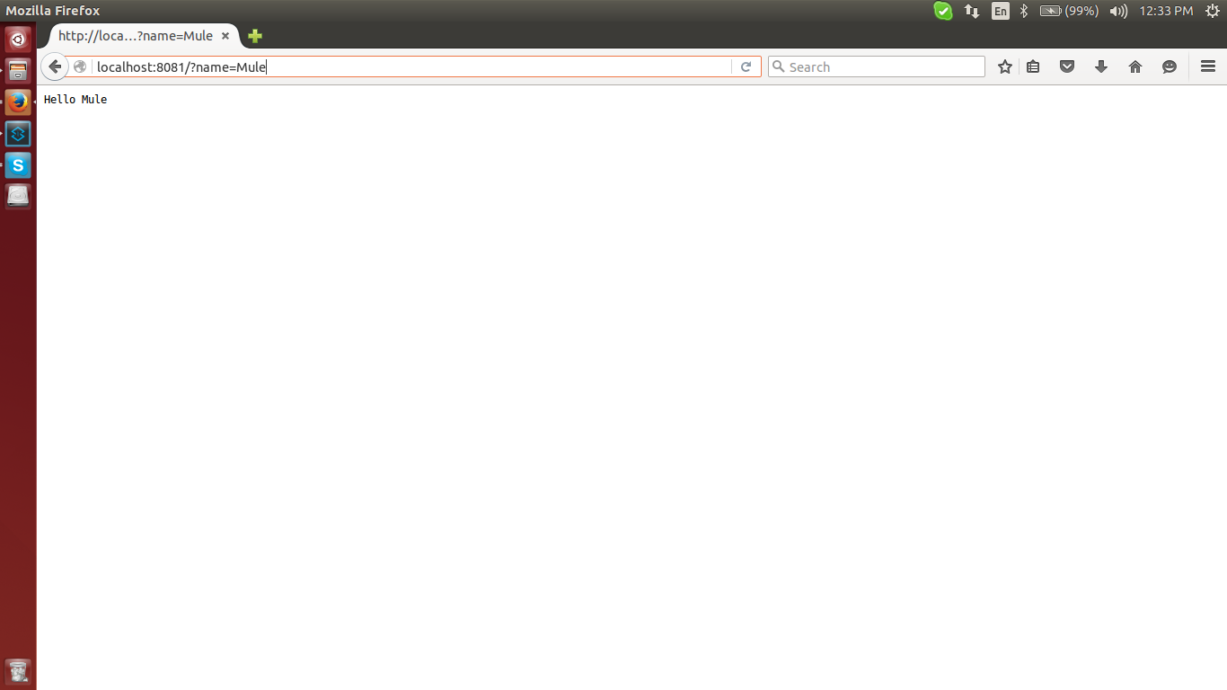
Practical : Running “Hello World” Using HTTP -
Output With Parameter

Slide 24
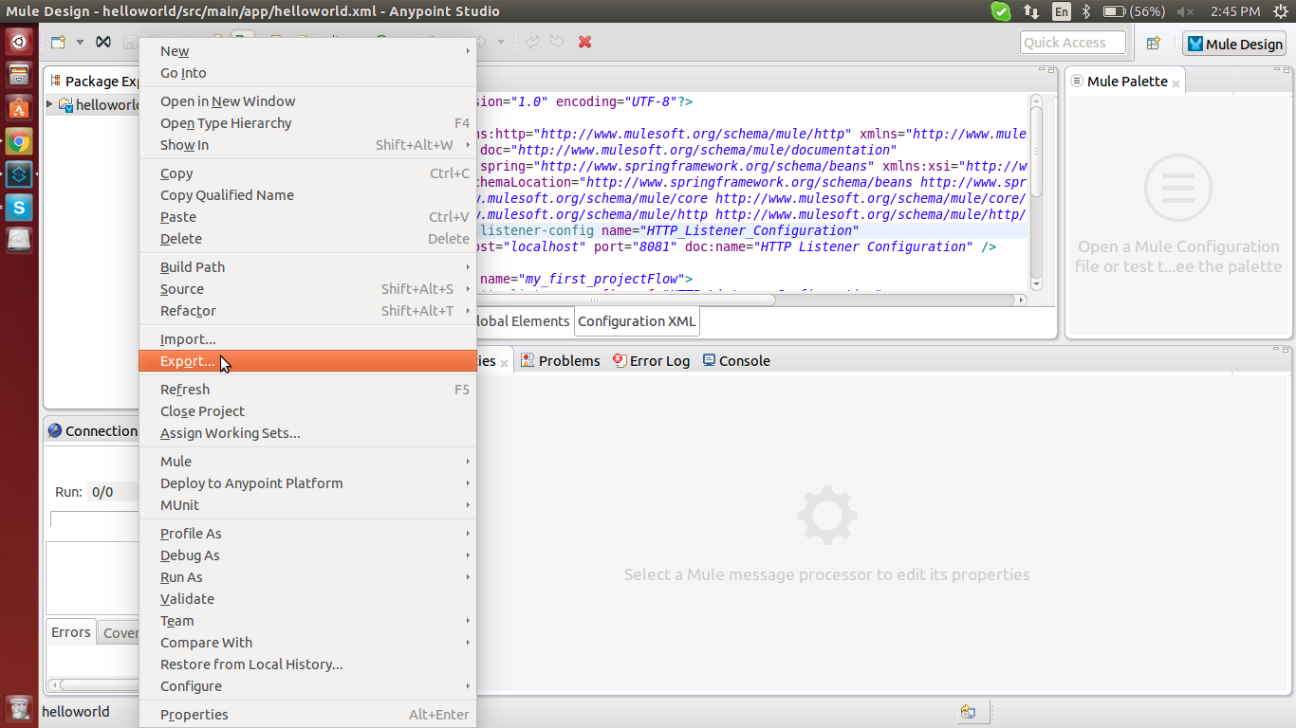
Deploy Application in Mule Standalone -
Export Application using Anypoint Studio - Step 1

Slide 25
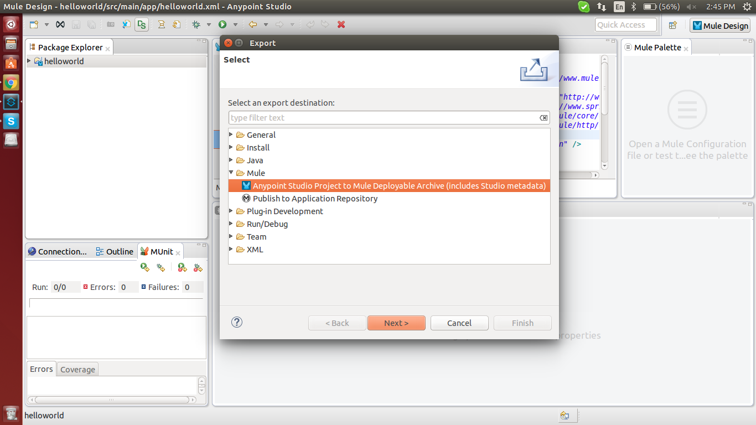
Deploy Application in Mule Standalone -
Export Application using Anypoint Studio - Step 2

Slide 26
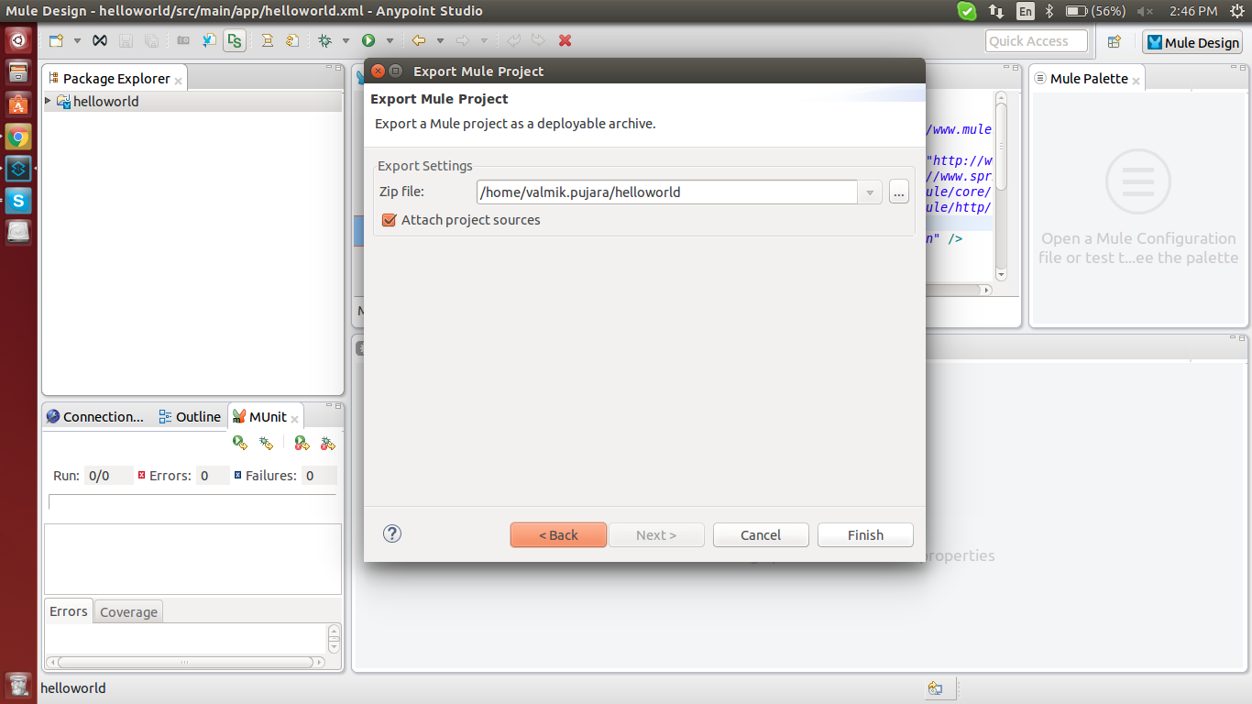
Deploy Application in Mule Standalone -
Export Application using Anypoint Studio - Step 3

Slide 27
Deploy Application in Mule Standalone
get the exported zip file
copy it and put it into MULE_HOME/apps directory
go to MULE_HOME/bin directory
run mule.bat file or mule.sh file based on the platform

Slide 28
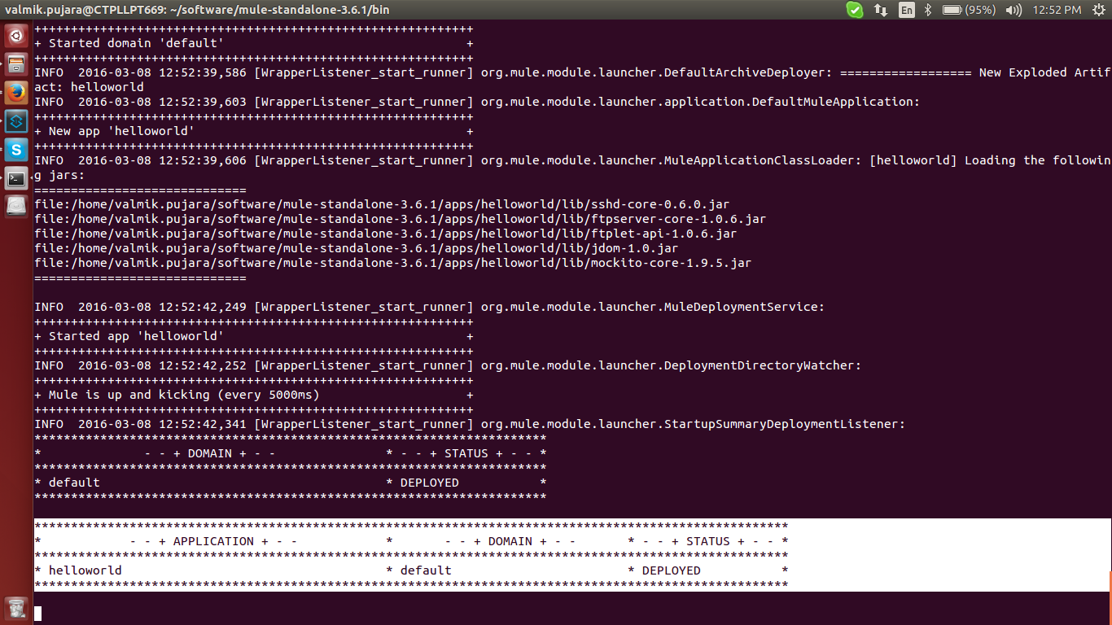
Deploy Application in Mule Standalone

Slide 29
Deploy Application in Mule Standalone -
Output Without Parameter

Slide 30
Deploy Application in Mule Standalone -
Output With Parameter

Slide 31

Web Resources
MULE - http://www.mulesoft.org
Guide - http://www.mulesoft.org/documentation/display/current/Home
Mule Cloud Connectors - http://www.mulesoft.org/connectors
Mule vs. ServiceMix/Fuse ESB
- http://www.mulesoft.com/resources/esb/understanding-integration-needs-based-perspective-mule-vs-servicemix-fuse-esb
Pratical Source :

Slide 32
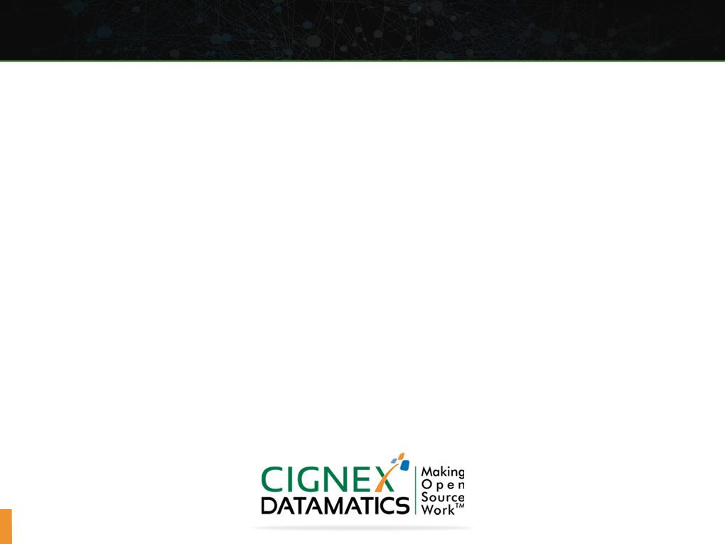
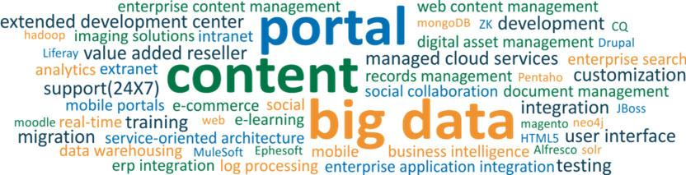
Thank You. Any Questions ?
Making Open Source Work
Name: Rajesh Maheshwari , Nitin Patel
Email: rajesh.maheshwari@cignex.com , nitin.patel@cignex.com
Title: MULE ESB

