Slide 1


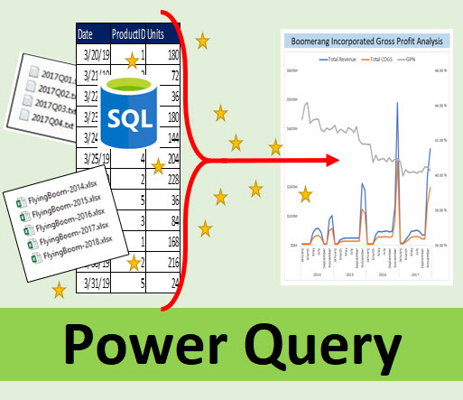


Data Analysis & Business Intelligence Made Easy with Excel Power Tools
Excel Data Analysis Basics = E-DAB

Slide 2
E-DAB-01: Introduction to Class. What is Data Analysis?
Instructor
Scope of Class
Version of Excel
Define Data Analysis & Business Intelligence
Goals of Class
Videos Topics Presented In Class
Files for you to Download
What You Will Gain After Taking This Class

Slide 3



Instructor: Mike Girvin
Highline College Instructor
Microsoft Excel MVP 2013-present
excelisfun YouTube Channel 2008 – present
+3000 Video, +100 classes/playlists

Slide 4
Scope of Class
Introduction to Data Analysis
For People With No Experiences With Data Analysis
Learn how to turn data into useful information and insight
Pre-Requisite for the Advanced Data Analysis class here at the excelisfun YouTube Channel: MSPTDA

Slide 5
Version of Excel
What Version of Excel:
Excel Office 365
What Version of Power BI Desktop:
Free Download

Slide 6
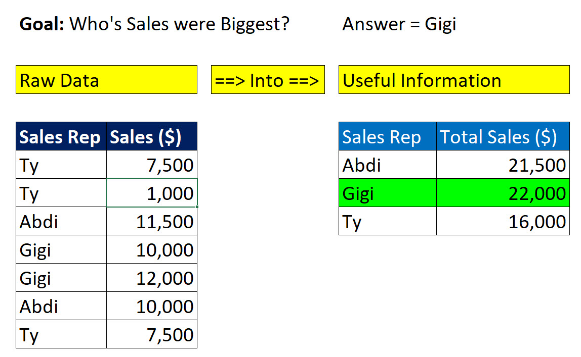
Define Data Analysis & Business Intelligence
Data Analysis:
Convert Data into Useful Information for Decision Makers
Business Intelligence:
Convert Data into Useful/Actionable/Refreshable Information for Decision Makers in a Business Situation
The Business is Intelligent because it is making decisions based on Data!
Both Help To:
See Trends & Patterns
Answer Questions & Gain Insight
Short Definition for both:
Data ➔ Information

Slide 7
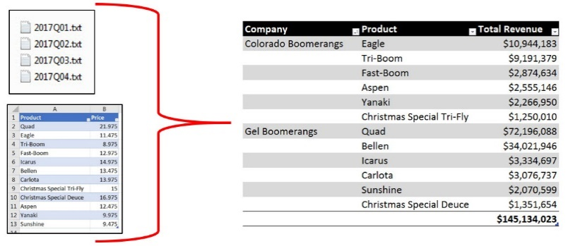
Goal of Data Analysis and Business Intelligence
Create useful, updateable, actionable information for decision makers in the form of reports, visualizations and dashboards.

Slide 8
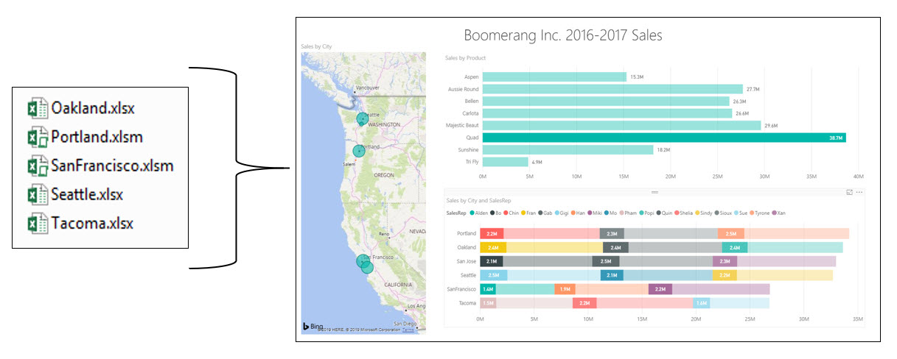
Goal of Data Analysis and Business Intelligence
Create useful, updateable, actionable information for decision makers in the form of reports, visualizations and dashboards.

Slide 9
Goals of Class
Introduction to these Excel Power Categories:
Excel Spreadsheet Formulas & Features
Standard PivotTables
Power Query (in both Excel and Power BI Desktop)
Data Model PivotTables using Excel Power Pivot
Data Model Visualizations using Power BI Desktop

Slide 10
Goals of Class
Introduction to these Specific Data Analysis Power Tools in Excel Office 365:
Sort
Filter
Excel Table Feature
Spreadsheet Functions like: SUMIFS, COUNTIFS and AVERAGEIFS
Office 365 Dynamic Arrays
Standard PivotTables & Slicers
Charts & Visualizations
Power Query
VLOOKUP Spreadsheet Function
Relationship Feature
Power Pivot Data Model
DAX Functions like: SUMX, AVERAGEX, RELATED and COUNTROWS
Power BI Desktop

Slide 11
Goals of Class
Introduction to Data Analysis Terms and Processes, such as:
Data
Proper Data Set
Delimiter
Relationships
ETL
Data Model
Columnar Database
Dashboard
More…

Slide 12
Goals of Class
Perform these Data Analysis Steps:
Import Data
Clean & Transform Data
Build Data Model
Build Reports, Visualizations and Dashboards that Deliver Useful Information
When New Data Arrives, Refresh Information
Assess Usefulness of Information
Repeat Earlier Steps

Slide 13
Videos Topics Presented In Class
E-DAB-01: Introduction to Class. What is Data Analysis?
E-DAB-02: Data, Proper Data Sets, Excel Tables, Sorting, Filtering & Logical Tests
E-DAB-03: Summary Reports with Excel Spreadsheet Formulas
E-DAB-04: Summary Reports with Standard PivotTables & Slicers
E-DAB-05: Visualizations: Tables, Charts, Conditional Formatting & Dashboards
E-DAB-06: Clean, Transform & Import Data with Power Query
E-DAB-07: VLOOKUP Spreadsheet Function to create a Worksheet Data Model
E-DAB-08: Relationship Feature to Create Power Pivot Data Model
E-DAB-09: Power Query & Power Pivot for Big Data
E-DAB-10: Power BI Desktop
E-DAB-11: Excel & Power BI Together

Slide 14
Final Video Titles:
E-DAB 1: What is Data Analysis & Business Intelligence?
E-DAB 2: Data, Proper Data Sets, Excel Tables, Logical Tests, More
E-DAB 3: Excel Spreadsheet Formulas Old School? Or Dynamic Arrays?
E-DAB 4: PivotTables & Slicers to Create Dashboards & Summary Reports
E-DAB 5: Visualizing Data w Tables, Charts, Formatting & Dashboards
E-DAB 6: The Magic of Power Query to Import, Transform & Load Data
E-DAB 7: Data Modeling: Excel Formulas, Power Query, Power Pivot?
E-DAB 8: Power Pivot: Big Data, Data Modeling, DAX & Dashboard
E-DAB 9: Power BI: Interactive Visualizations
E-DAB 10: Excel & Power BI Together to create Combined, Sharable Dashboards

Slide 15
Downloadable Files and Practice Problems
Excel Files
Power BI Files
Source Data Files
Practice Problems
Pdf Notes from Class Video

Slide 16
What You Will Gain After Taking This Class
Have experience with all the Power Tools in Excel used for Data Analysis.
Be able to take data and convert it into refreshable reports, visualizations and dashboards that can be used for decision making.
Have the introductory level skills to move on to the more advanced Data Analysis and Business Intelligences classes taught for free at YouTube my Mike “excelisfun” Girvin:
Excel Basics (Calculations & Data Analysis)
Highline College Advanced Excel
Highline College BI 348 Microsoft Power Tools for Data Analysis
Dynamic Array Playlist

Slide 17
Links to other classes
Full excelisfun Channel at YouTube:
https://www.youtube.com/user/excelisfun
Excel Basics (Calculations & Data Analysis)
https://www.youtube.com/playlist?list=PLrRPvpgDmw0n34OMHeS94epMaX_Y8Tu1k
Highline College Advanced Excel
https://www.youtube.com/playlist?list=PLrRPvpgDmw0lcTfXZV1AYEkeslJJcWNKw
Highline College BI 348 Microsoft Power Tools for Data Analysis
https://www.youtube.com/playlist?list=PLrRPvpgDmw0ks5W7U5NmDCU2ydSnNZA_1
Dynamic Array Playlist
https://www.youtube.com/playlist?list=PLrRPvpgDmw0nwgWhZjKjqnAwfZBxLcsxx

