Slide 1
Project 3:
Supercharge Cowrie
Presented by: Thomas, Selby, Lucy, Shruti, Sridhar, Deepika

Slide 2
Scope
Introduce members
What will be discussed
Minimal viable product

Slide 3

Interaction
Selby Dasent

Slide 4

Honeypots
Detect attacks
Capture malware for study
Help understand an attacker
Selby Dasent

Slide 5
Successful Honeypots
Enticing to attackers
Predictable behaviour
Cowrie
Selby Dasent

Slide 6
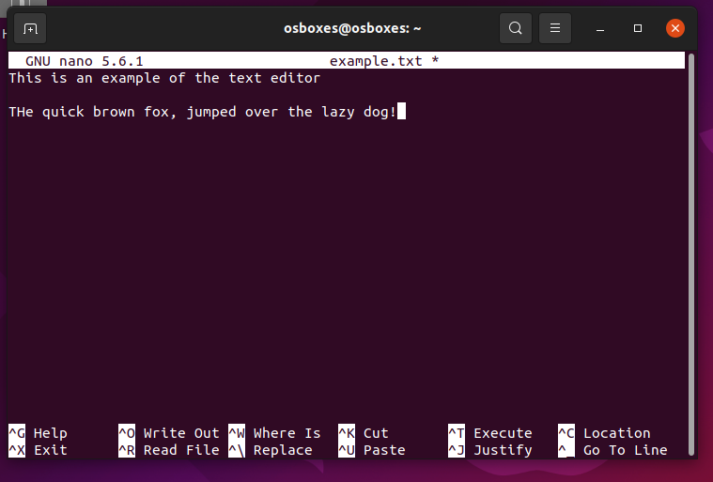
Nano text editor
Common on Linux machines
Attackers love to use it
Selby Dasent

Slide 7
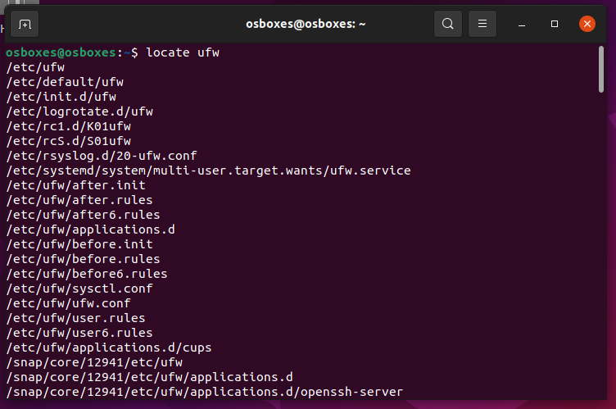
Locate
Faster then find
Find a known file
Selby Dasent

Slide 8
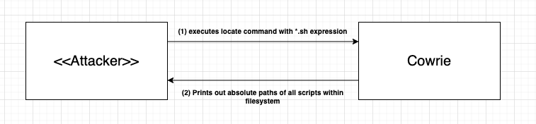
How
Shruti Raja

Slide 9
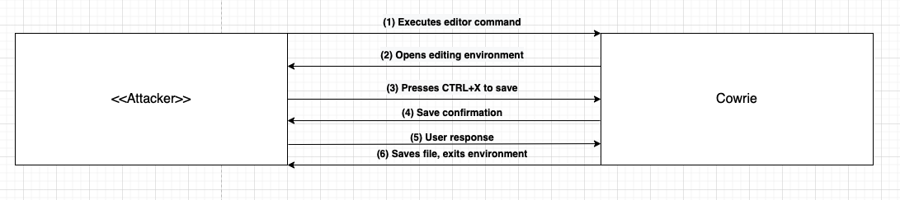
How
Shruti Raja

Slide 10
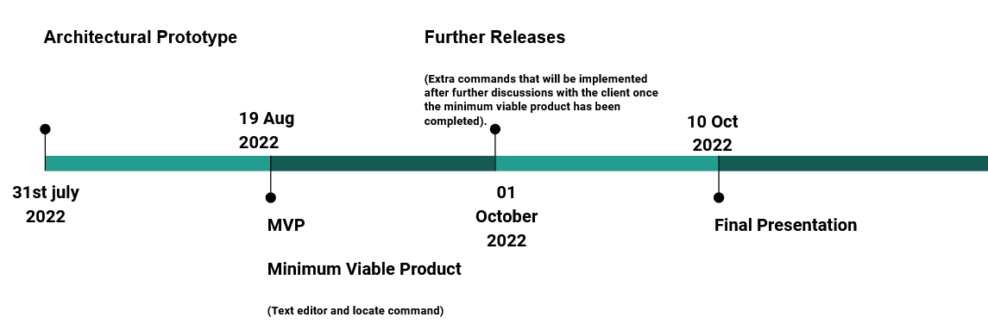
Timeline

Slide 12
Proof of concept
Video of basic implementation

Slide 13
Conclusion
Minimum Viable Product
Importance of Cowrie Changes
Implementation of Changes
Timeline of Project
Proof of Concept
Lucy Carver

