Slide 1
Project 3:
Supercharge Cowrie
Presented by: Thomas, Selby, Lucy, Shruti, Sridhar, Deepika

Slide 2
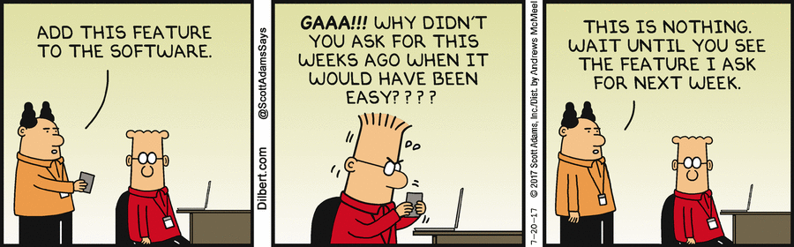
Scope
Group members: Thomas, Selby, Shruti, Deepika, Sridhar, and Lucy
Why is Scope important
Minimal viable product
  Nano text editor
  Locate command
Thomas Yang

Slide 3

Interaction
Selby Dasent

Slide 4

Honeypots
Detect attacks
Capture malware for study
Help understand an attacker
Selby Dasent

Slide 5
Successful Honeypots
Enticing to attackers
Predictable behaviour
Cowrie
Selby Dasent

Slide 6
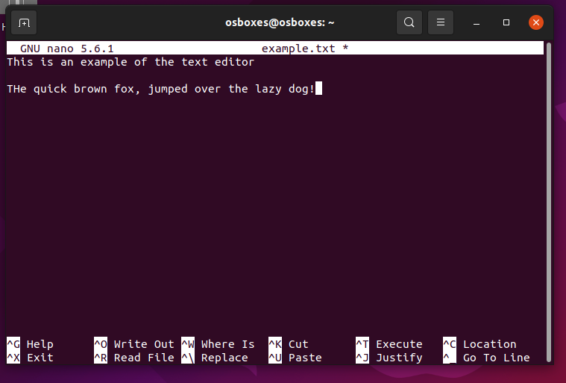
Nano text editor
Common on Linux machines
Attackers love to use it
Selby Dasent

Slide 7
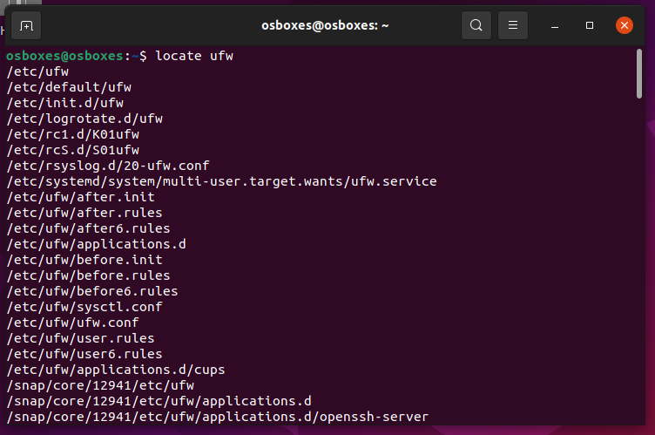
Locate
Faster then find
Find a known file
Selby Dasent

Slide 8
Implementation - NANO
Attacker executes editor command
Cowrie opens editing environment
Attacker can use editor
Attacker saves file and exits environment
Shruti Raja

Slide 9
Implementation - Locate
Attacker executes Locate command
Cowrie prints out absolute path to the file
Shruti Raja

Slide 10
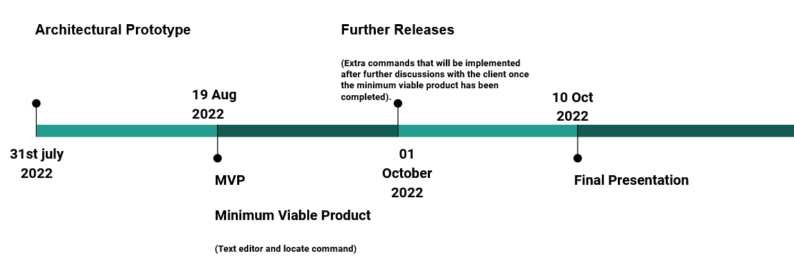
Timeline
Deepika Raheja

Slide 11
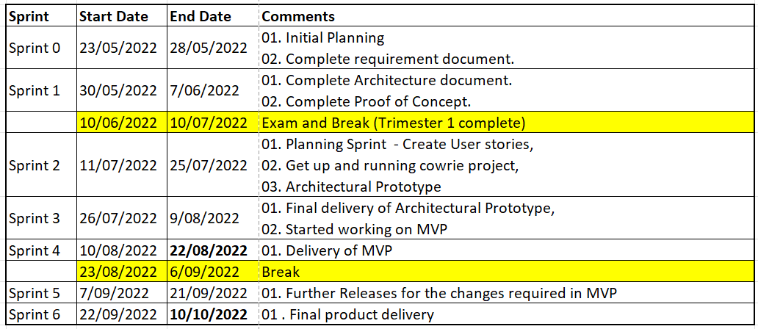
Sprint Planning
Deepika Raheja

Slide 12
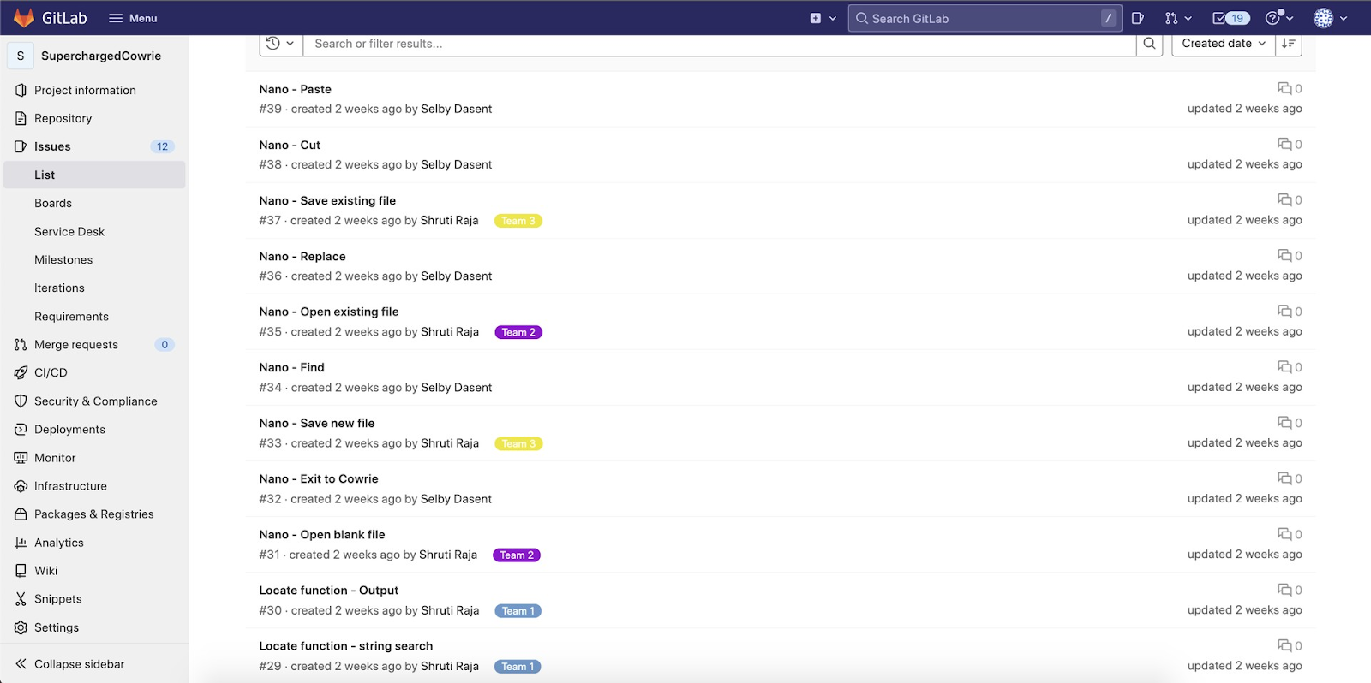
Gitlab Issues
Deepika Raheja

Slide 13
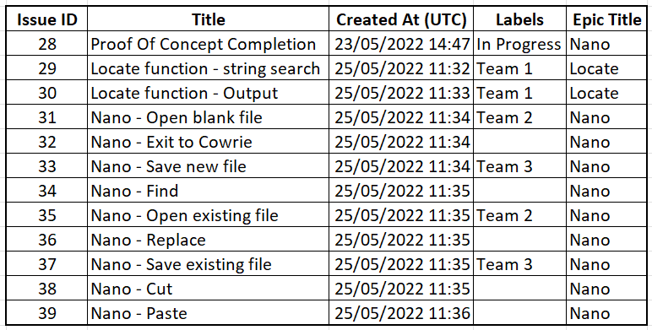
Gitlab Issues
Deepika Raheja

Slide 14
Proof of concept
Shridhar Venkatesh

Slide 15
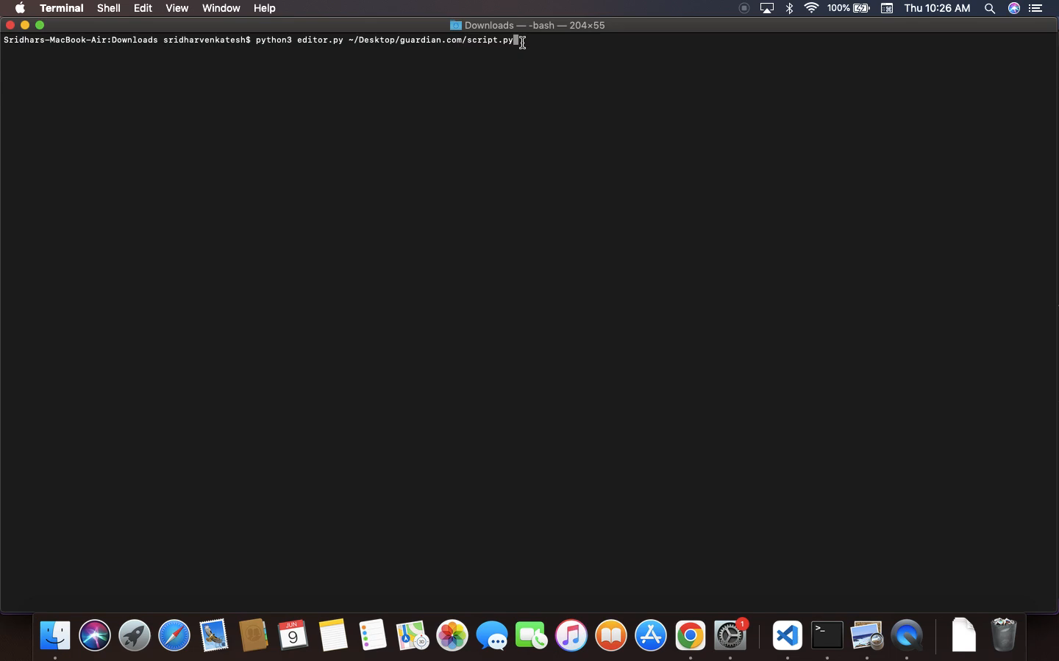
Shridhar Venkatesh

Slide 16
Conclusion
Minimum Viable Product
Importance of Cowrie Changes
Implementation of Changes
Timeline of Project
Proof of Concept
Lucy Carver

