Slide 1

Sentimental Analysis For Code-Mixed Language Using DL
Dikshya Aryal Anitha K J B S Swaraj B Venkatesh 1BM21CS058 1BM22CS401 1B22CS403 1BM22CS404
Prof. Sandhya A Kulkarni
Assistant Professor
Department of Computer Science and Engineering
B.M.S. College of Engineering
1

Slide 2
Table of Contents
Introduction
Problem Statement
Objectives
Sustainable Development Goals
Collaboration
Literature Survey
Research Gap Identification
High Level Design
Technology
Datasets
Gantt chart for Major Project Phase 1
References
Multimodal Sentimental Analysis For Code-Mixed Language Using DL

Slide 3
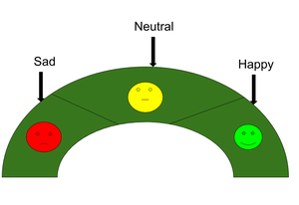
Introduction
Purpose: This project performs Multi-modal Sentiment Analysis using Deep Learning techniques to analyze code-mixed Kannada , Hindi in English texts and audios with improved sentiment classification.
Motivation: The rapid increase in the usage of code-mixing languages in digital communication has urged a massive need for the development of proper sentiment analysis solutions that can accurately interpret emotional content within mixed-language data.
Sentimental Analysis: Sentiment analysis is the process of analyzing large volumes of text to determine whether it expresses a positive sentiment, a negative sentiment or a neutral sentiment. It focuses not only on polarity (positive, negative & neutral) but also on emotions (happy, sad, angry, etc.).
Department of CSE, BMSCE

Slide 4
Key approaches to Sentiment Analysis:
1.Rule-based Approach: Over here, the lexicon method, tokenization and parsing come in the rule-based. This involves using predefined dictionaries of words and phrases with associated sentiment values (positive, negative, neutral). It relies on sentiment lexicons to determine the sentiment polarity of the text.
2. Machine Learning-based Approach: In this approach, classifiers are trained on labeled data to predict the sentiment of the text. Advanced models, such as those based on deep learning and LLMs, can automatically learn complex patterns from data to improve sentiment classification performance, especially for code-mixed and multilingual contexts.
3. Neural Network: It involves using artificial neural networks, which are inspired by the structure of the human brain, to classify text into positive, negative, or neutral sentiments. it has Recurrent neural networks, Long short-term memory, Gated recurrent unit etc to process sequential data like text.
4. Hybrid Approach: It is the combination of two or more approaches i.e. rule-based and Machine Learning approaches. The surplus is that the accuracy is high compared to the other two approaches

Slide 5
Code-mixed Language refers to a communication style where speakers or writers blend words, phrases, and syntactic structures from two or more languages in the same conversation or sentence. This phenomenon is common in bilingual and multilingual communities, especially in social media, where informal communication often leads to mixing languages like Hindi, Kannada, and English.
Example:
Hindi-English:
Bhai ho gaye yaar 7 million sai jada views
Kannada-English:
Sir e dog bagge ondu movie kuda ede tommy antha movie name
In this sentences, the structure and syntax follow Hindi and kannada respectively, but key words are in English.
Multimodal sentiment analysis (MSA) is a technology that uses multiple types of data, such as text, audio, and visual, to determine the sentiment or emotional content of a speaker. MSA can be bimodal, using two modalities, or trimodal, using three modalities.
MSA uses fusion techniques to analyze the different types of data. These techniques include feature-level, decision-level, and hybrid fusion. One of the main challenges in MSA is integrating the cross-modal sentiment information.

Slide 6
Scope Overview :
Code-mixed Language: Analysing Kannada, Hindi written in English script.
Multi-modal Analysis: Integrating the text and audio information.
Advanced Models: Applying deep learning for sentiment analysis.
Applications: Sentiment analysis of social media, mental health, customer feedback.

Slide 7
Problem Statement
Traditional approaches to sentiment analysis often meet their difficulties with code-mixed languages, especially those written in Kannada , Hindi script in the English language. The end result is thus a poor grasp of emotions in informal communication, like in messages from social media or the like. The existing models are unable to capture nuances and the sentiment contained in mixed-language data, thus creating problems in the interpretation of public sentiment and emotional context.
Therefore, this project takes upon these gaps by creating a robust multi-modal sentiment analysis system capable of accurately analyzing code-mixed Kannada- English and Hindi-English and extracting insights that serve to meaningfully act upon them.

Slide 8
Objectives
• To Build /Collect a dataset of code-mixed Kannada-English and Hindi-English texts, annotated for sentiment, sarcasm, and idioms.
To develop a system to identify the language of the text given.
To build a multi-modal system that integrates text, audio, and fine-tune LLMs, and deep learning models to analyze mixed languages and detect hidden emotions.
To test and validate the model's effectiveness, measuring improvements over traditional sentiment analysis systems.

Slide 9
Sustainable Development Goals (SDGs) Addressed
Goal 3: Good Health and Well-being Rationale: Mental health monitoring will be achieved through this project as it increases the capabilities of analyzing emotions. Meaning, relating to emotional cues in communication processes can help in the early notification of mental health problems that can be intervened before time lapses.
Goal 9: Industry, Innovation, and Infrastructure Reason: Advanced technologies like AI and deep learning help promote innovation in the field of sentiment analysis, thereby increasing smart city initiatives. Improved understanding of sentiment can enhance public services and safety measures.

Slide 10
Collaboration
This project may fall under Both Community Oriented Project and Multidisciplinary Project because it will be working on public safety and emotional well-being by utilizing the most advanced technology.
Potential Collaborations:
Local Police Department Field Work: Partner with the local police department for the field implementation of the sentiment analysis system in public places to give insight into probable threats and to enhance safety protocols. Objective: Allow real-time alerts and intervention strategies by analyzing sentiment data.

Slide 11
Collaboration
NGOs that Specialize on Women Safety Collaboration: Organizations working on women's rights or safety are collaborated to determine specific needs and tailor the analysis toward gender-specific issues. Purpose: The insights drawn from this sentiment analysis will be used in campaigns and in regard to the safety concerns.

Slide 12
Literature Survey
Sl No | Paper Title | Year of Publication | Problem Statement Addressed | Methodology Followed | Quantitative Results | Future Work Proposed | Complete Reference
1. | Machine Learning Techniques for Sentiment Analysis of Code-Mixed and Switched Indian Social Media Text Corpus: A Comprehensive Review | 2022 | Challenges in analyzing code-mixed Indian social media data due to linguistic complexities and lack of resources. | Reviewed ML and DL models like SVM, Naïve Bayes, LSTM, and CNN. Evaluated preprocessing, language identification, and sentiment classification. | SVM (accuracy: 83.54%), CNN-BiLSTM (accuracy: 83.21%), BiLSTM (F1: 0.827). | Develop annotated datasets, better tools for Indian languages, and manage noise in preprocessing. | https://thesai.org/Publications/ViewPaper?Volume=13&Issue=2&Code=IJACSA&SerialNo=54
2. | Sentiment Analysis of Code-Mixed Text: A Comprehensive Review | 2024 | Challenges in analyzing sentiment in code-mixed texts due to language switching and mixing. | Reviewed existing methods, datasets, and models for code-mixed sentiment analysis. | Identified gaps in datasets, low F1-scores in current models for code-mixed text tasks. | Develop robust datasets, multimodal approaches, and improved context handling techniques. | Perera, A. and Caldera, A., 2024. Sentiment Analysis of Code-Mixed Text: A Comprehensive Review. Journal of Universal Computer Science (JUCS), 30(2).

Slide 13
Sl No | Paper Title | Year of Publication | Problem Statement Addressed | Methodology Followed | Quantitative Results | Future Work Proposed | Complete Reference
3. | Code-Mixed Sentiment Analysis using Transformer for Twitter Social Media Data | 2023 | Limited datasets and challenges in analyzing Indonesian-English code-mixed text for sentiment analysis in NLP. | Developed a new dataset and tested five scenarios using pre-trained BERT models (IndoBERTweet, Multilingual BERT) with preprocessing techniques. | Best results: Precision = 76.07%, Recall = 75.52%, F1-Score = 75.51%, Accuracy = 76.56% (IndoBERTweet with preprocessing). | Improve lexicon for out-of-vcabulary words, enhance preprocessing methods, and train new models for code-mixed data without existing scenarios. | Astuti, L.W. and Sari, Y., 2023. Code-Mixed Sentiment Analysis using Transformer for Twitter Social Media Data. International Journal of Advanced Computer Science and Applications, 14(10).
4. | Enhancing Multilingual Hate Speech Detection: From Language-Specific Insights to Cross-Linguistic Integration | 2024 | Detecting hate speech in multilingual settings is challenging, especially for resource-limited languages like Roman Urdu, Korean, and Italian. | Used ML, DL, and transformer-based models (e.g., AraBERT, GermanBERT, mBERT) with hyperparameter tuning and explainable AI for 13 languages. | Achieved up to 10% higher precision and recall over baselines. E.g., F1 = 0.93 for Roman Urdu, F1 = 0.90 for German datasets. | Extend hate speech detection with richer datasets, better cross-lingual models, and advanced preprocessing for complex languages. | Hashmi, E., Yayilgan, S.Y., Hameed, I.A., Yamin, M.M., Ullah, M. and Abomhara, M., 2024. Enhancing multilingual hate speech detection: From language-specific insights to cross-linguistic integration. IEEE Access.

Slide 14
Sl No | Paper Title | Year of Publication | Problem Statement Addressed | Methodology Followed | Quantitative Results | Future Work Proposed | Complete Reference
5. | Sailor: Open Language Models for South-East Asia | 2024 | Current language models struggle with SEA languages due to limited datasets and English-centric pretraining, resulting in poor multilingual performance. | Developed multilingual models (0.5B to 7B parameters) using aggressive data cleaning, deduplication, BPE dropout, and proxy models for optimization. | Improved performance in SEA languages: F1 scores increased across tasks (e.g., TydiQA: 40.88 for 1.8B, XQuAD: 57.88 for 7B Thai subset). | Enhance code-switching capabilities, add more SEA languages, explore cross-lingual instructions, and refine data deduplication processes. | Dou, L., Liu, Q., Zeng, G., Guo, J., Zhou, J., Lu, W. and Lin, M., 2024. Sailor: Open Language Models for South-East Asia. arXiv preprint arXiv:2404.03608.
6. | SemEval 2024 – Task 10: Emotion Discovery and Reasoning its Flip in Conversation (EDiReF) | 2024 | Identifying emotions and reasoning their flips in English and Hindi-English code-mixed dialogues remains a challenge in NLP. | Developed annotated datasets for emotion recognition and flip reasoning; utilized transformer models like BERT, RoBERTa, and ensemble approaches. | Best F1-scores: 0.70 (emotion recognition in code-mixed), 0.79 (emotion flip reasoning in code-mixed), 0.76 (emotion flip reasoning in English). | Address implicit triggers, enhance multilingual models, explore cross-lingual datasets, and refine reasoning accuracy for practical deployment. | Kumar, S., Akhtar, M.S., Cambria, E. and Chakraborty, T., 2024. SemEval 2024--Task 10: Emotion Discovery and Reasoning its Flip in Conversation (EDiReF). arXiv preprint arXiv:2402.18944.

Slide 15
Sl No | Paper Title | Year of Publication | Problem Statement Addressed | Methodology Followed | Quantitative Results | Future Work Proposed | Complete Reference
7. | ChatGPT vs Gemini vs LLaMA on Multilingual Sentiment Analysis | 2024 | Performance of large language models (LLMs) like ChatGPT, Gemini, and LLaMA is inconsistent in handling ambiguous and multilingual sentiment analysis. | Tested ChatGPT 3.5, ChatGPT 4, Gemini Pro, and LLaMA2 7b on 20 ambiguous scenarios across 10 languages, compared outputs with human benchmark ratings. | ChatGPT 4 performed closest to human sentiment; Gemini showed stronger negativity, and LLaMA exhibited consistent positivity bias across languages. | Investigate biases in LLM training, improve handling of irony, sarcasm, and multilingual inconsistencies, and address censorship transparency issues. | Buscemi, A. and Proverbio, D., 2024. Chatgpt vs gemini vs llama on multilingual sentiment analysis. arXiv preprint arXiv:2402.01715.
8. | Sentiment Analysis of Mixed Code for The Transliterated Hindi and Marathi Texts | 2018 | Sentiment analysis of transliterated, code-mixed Hindi-Marathi texts is challenging due to spelling variations, mixed languages, and lack of structured tools. | Used supervised learning (KNN, Naïve Bayes, SVM) with steps including language identification, transliteration, feature extraction, and sentiment tagging. | Achieved ~80% accuracy for Hindi and ~90% for Marathi datasets; Linear SVM and Random Forest performed best. | Improve language identification, develop Marathi-specific SentiWordNet, and better handle mixed-language POS tagging. | Ansari, M.A. and Govilkar, S., 2018. Sentiment analysis of mixed code for the transliterated Hindi and Marathi texts. International Journal on Natural Language Computing (IJNLC) Vol, 7.

Slide 16
Sl No | Paper Title | Year of Publication | Problem Statement Addressed | Methodology Followed | Quantitative Results | Future Work Proposed | Complete Reference
9. | Sentiment Analysis of Twitter Data: A Survey of Techniques | 2016 | Challenges in analyzing unstructured, heterogeneous Twitter data | Comparative analysis of Naive Bayes, SVM, Max Entropy, and lexicon-based techniques. | SVM with unigrams outperformed other models | Improve corpus quality and adapt to dynamic Twitter contexts. | Vishal A. Kharde, S.S. Sonawane, IJCA, Vol. 139, No. 11, 2016​
10. | Sentiment Analysis of Customer Reviews of Food Delivery Services Using Deep Learning and Explainable Artificial Intelligence: Systematic Review | 2023 | Existing methods in FDS sentiment analysis face challenges with the black-box nature of DL models and limited interpretability, impacting trust and adoption. | Reviewed ML and DL methods like CNNs and LSTMs, emphasizing the role of XAI tools such as LIME and SHAP to enhance model interpretability. | No specific numerical results; instead, highlights state-of-the-art techniques and gaps in DL-XAI integration for FDS sentiment analysis. | Develop hybrid DL-XAI approaches for better sentiment classification and use topic modeling to analyze specific complaint categories | (2023). Sentiment Analysis of Customer Reviews of Food Delivery Services Using Deep Learning and Explainable Artificial Intelligence: Systematic Review.

Slide 17
Sl No | Paper Title | Year of Publication | Problem Statement Addressed | Methodology Followed | Quantitative Results | Future Work Proposed | Complete Reference
11. | ArSa-Tweets: A Novel Arabic Sarcasm Detection System | 2024 | Challenges in detecting sarcasm in Arabic text due to idioms and lack of datasets. | Developed ArSa-Tweets model using LSTM, CNN-LSTM-GRU, and AraBERT variants with robust preprocessing. | AraBERT-V02 achieved the highest accuracy among tested methods. | Enhance dataset coverage and refine multilingual sarcasm detection. | Qusai Abuein et al., Heliyon, Vol. 10, e36892, 2024​ ​
12. | BiERU: Bidirectional Emotional Recurrent Unit for Conversational Sentiment Analysis | 2021 | Existing models for conversational sentiment analysis struggle with contextual encoding and require high parameters, limiting efficiency. | Proposed a party-ignorant BiERU framework using Emotional Recurrent Unit (ERU) with GNTB for context integration and TFE for emotional features. | BiERU outperformed state-of-the-art models on IEMOCAP, AVEC, and MELD datasets with higher accuracy, faster training, and fewer parameters. | Extend BiERU to more diverse datasets and explore its applicability in real-world conversational AI systems. | (2021). BiERU: Bidirectional Emotional Recurrent Unit for Conversational Sentiment Analysis.

Slide 18
Sl No | Paper Title | Year of Publication | Problem Statement Addressed | Methodology Followed | Quantitative Results | Future Work Proposed | Complete Reference
13. | A multimodal approach to cross-lingual sentiment analysis with ensemble of transformer and LLM​ | 2024 | Sentiment analysis in non-English languages without labeled data. | Ensemble model combining transformers and LLMs with translation tools for cross-lingual analysis. | Accuracy >86% on sentiment analysis. | Expanding to more languages and enhancing models. | Md Saef Ullah Miah et al., 2024, Scientific Reports.
14. | Code-mixed Sentiment and Hate-speech Prediction​ | 2024 | Sentiment and hate speech detection in multilingual, code-mixed text. | Creation and fine-tuning of bilingual masked LLMs and evaluations across five languages. | Fine-tuned bilingual models outperform others. | Testing more languages and further specialization of models. | Anjali Yadav et al., 2024, arXiv preprint.

Slide 19
Sl No | Paper Title | Year of Publication | Problem Statement Addressed | Methodology Followed | Quantitative Results | Future Work Proposed | Complete Reference
15. | A Review of Sentiment Analysis: Tasks, Applications, and Deep Learning Techniques​ | 2024 | Overview of challenges and advancements in sentiment analysis with a focus on deep learning. | Literature review covering techniques, datasets, and applications of sentiment analysis. | Emphasis on BERT and deep learning efficacy. | Addressing sarcasm, multimodal data, and ethical concerns. | Neeraj Anand Sharma et al., 2024, International Journal of Data Science and Analytics.
16. | Advancing Sentiment Analysis Through Emotionally-Agnostic Text Mining​ | 2024 | Emotionally-neutral sentiment analysis to avoid biases from human emotional cues. | Proposal of an emotion-agnostic framework integrated with LLMs. | Improved interaction accuracy in user contexts. | Exploring deeper contextual relevance and memory systems in AI. | Jeremiah Ratican and James Hutson, 2024, Journal of Biosensors and Bioelectronics Research.

Slide 20
Sl No | Paper Title | Year of Publication | Problem Statement Addressed | Methodology Followed | Quantitative Results | Future Work Proposed | Complete Reference
17. | Sentiment Analysis using Large Language Models: Methodologies, Applications, and Challenges | 2024 | Challenges in sentiment analysis using LLMs. | Reviewed traditional methods (rule-based, ML) and advancements (BERT, GPT, XLNet); discussed fine-tuning, transfer learning, domain adaptation. | Discussed model performance with pre-trained LLMs like BERT, achieving state-of-the-art results in NLP tasks. | Proposed focus on model interpretability, robustness, scalability, multimodal analysis, and ethical implications. | Akshata Upadhye, International Journal of Computer Applications, Vol. 186, May 2024.
18. | Word Level Language Identification in Code-Mixed Kannada-English Texts using Deep Learning Approach | 2020 | Difficulty in identifying languages at the word level in code-mixed Kannada-English texts. | Developed a Bi-LSTM-based model with attention mechanism for word-level language tagging | Achieved 94.8% accuracy and 0.91 F1-score on a curated Kannada-English dataset. | Extend the approach to handle transliterated and highly code-switched text across languages. | G. Kumar et al., "Word Level Language Identification in Code-Mixed Kannada-English Texts using Deep Learning Approach," 2020.

Slide 21
Sl No | Paper Title | Year of Publication | Problem Statement Addressed | Methodology Followed | Quantitative Results | Future Work Proposed | Complete Reference
19. | Sentiment Analysis Dataset for Code-Mixed Malayalam-English | 2020 | Lack of sentiment analysis datasets for Malayalam-English code-mixed text, hindering effective NLP tasks. | Created a gold-standard dataset from YouTube comments; annotated with sentiment labels; evaluated using machine learning (SVM, LR) and deep learning (BERT). | Dataset: 6,739 posts, 70,075 tokens, Krippendorff’s alpha > 0.8. BERT achieved best weighted F1 (0.75). | Enhance annotation coverage, explore advanced models for better accuracy, and expand dataset. | Chakravarthi, B. R., et al. A Sentiment Analysis Dataset for Code-Mixed Malayalam-English. arXiv:2006.00210v1, 2020. arXiv link
20. | Sentimental analysis from imbalanced code-mixed data using machine learning approaches | 2023 | Addressing class imbalance in sentiment analysis for Tamil-English code-mixed data, incorporating spelling variations and leveraging machine learning. | Combines preprocessing techniques (Levenshtein distance, recurrent character/word normalization), resampling (SMOTE, ADASYN), and machine learning classifiers | Macro F1-Score improved significantly using preprocessing and resampling; in handling class imbalance with a 2% improvement after removing non-code-mixed data. | Investigate hybrid feature extraction methods and other techniques to resolve the residual class imbalance issue. | Srinivasan, R. and Subalalitha, C.N., 2023. Sentimental analysis from imbalanced code-mixed data using machine learning approaches. Distributed and Parallel Databases, 41(1), pp.37-52.

Slide 22
Sl No | Paper Title | Year of Publication | Problem Statement Addressed | Methodology Followed | Quantitative Results | Future Work Proposed | Complete Reference
21 | Multi-class Sentiment Classification on Bengali Social Media Comments Using Machine Learning | 2023 | Existing studies on Bengali sentiment analysis focus on binary or ternary classification, achieving low accuracy due to dataset limitations and resource challenges. | Proposed a CNN-LSTM-based classifier (CLSTM) for multi-class sentiment analysis; compared against ML and DL models using TF-IDF, Count Vectorizer, and word embeddings. | CLSTM achieved 85.8% accuracy and 0.86 F1-score on a dataset of 42,036 Bengali social media comments across four classes: acceptable, religious, political, and sexual | Expand the dataset to include more sentiment classes and explore additional DL architectures for better accuracy and scalability. | Haque, R., Islam, N., Tasneem, M., & Das, A. K. (2023). Multi-class sentiment classification on Bengali social media comments using machine learning.
22 | A systematic review of hate speech automatic detection using natural language processing | 2023 | Automatic detection of hate speech online | Systematic review of NLP-based hate speech detection; PRISMA guidelines; focus on deep learning and datasets | Highlights challenges, provides state-of-art insights | Emphasizes multilingual datasets, hybrid approaches, and BERT enhancements | Md Saroar Jahan, Mourad Oussalah, Neurocomputing 546 (2023)

Slide 23
Sl No | Paper Title | Year of Publication | Problem Statement Addressed | Methodology Followed | Quantitative Results | Future Work Proposed | Complete Reference
23 | Emotion Prediction and Parts-of-Speech Tagging Resources and Experiments for Kannada-English Code-Mixing | 2022 | Lack of annotated datasets for Kannada-English code-mixed text | Creation of annotated corpus; Machine learning models like SVM, LSTM for emotion prediction; CRF, Bi-LSTM, Bi-LSTM-CRF for POS tagging | Achieved significant accuracy for tasks using annotated corpus | Develop models for multilingual contexts, extend analysis to other code-mixed languages | Appidi Abhinav Reddy, IIIT Hyderabad Thesis, 2022.
24 | Enhancing Named Entity Recognition in Low-Resource Dravidian Languages | 2024 | Addressing data scarcity in NER for Dravidian languages like Kannada, Tamil, Telugu, and Malayalam. | Used multilingual and cross-lingual transfer learning with models like mBERT, RoBERTa, and XLM-RoBERTa | Cross-lingual learning improved accuracy for Kannada-Tamil and Telugu datasets. | Explore domain-specific models, include more languages, and refine transfer learning | Journal of Artificial Intelligence and Machine Learning, 2024

Slide 24
Sl No | Paper Title | Year of Publication | Problem Statement Addressed | Methodology Followed | Quantitative Results | Future Work Proposed | Complete Reference
25 | Deep Learning Based Sentiment Analysis and Offensive Language Identification on Multilingual Code-Mixed Data | 2022 | Addressing sentiment analysis and offensive language identification in multilingual code-mixed datasets, with challenges like noise, language mixing, and semantic extraction. | Utilizes preprocessing steps (removal of stop words, emojis, and normalization), GloVe and BERT embeddings, and deep learning models like Bi-LSTM, CNN, BERT, RoBERTa, and Adapter-BERT for classification tasks. | Adapter-BERT achieved 65% accuracy for sentiment analysis and 79% accuracy for offensive language identification, outperforming other models like CNN and Bi-LSTM. | Explore multitask learning and advanced techniques to improve system performance for both sentiment analysis and offensive language identification. | Shanmugavadivel, K., Sathishkumar, V.E., Raja, S., Lingaiah, T.B., Neelakandan, S. and Subramanian, M., 2022. Deep learning based sentiment analysis and offensive language identification on multilingual code-mixed data. Scientific Reports, 12(1), p.21557.
26 | Machine Learning Approaches for Code-Mixed Language Identification at the Word Level in Kannada-English Texts | 2022 | Addresses the challenge of identifying languages in code-mixed Kannada-English texts at the word level, which is crucial for NLP tasks involving multilingual social media content. | Developed CoLI-Kenglish dataset; created word embeddings combining word, sub-word, and character vectors; used Machine Learning (CoLI-ngrams, CoLI-vectors), Deep Learning (CoLI-BiLSTM), and Transfer Learning (CoLI-ULMFiT) models. | CoLI-ngrams (ML) achieved the highest macro F1-score of 0.64, outperforming other models. CoLI-ULMFiT also showed competitive performance, except for specific categories like "Location." | Enhance datasets with better label distribution; explore additional features and learning models; integrate morphological features into vector spaces for better performance. | Shashirekha, H.L., Balouchzahi, F., Anusha, M.D. and Sidorov, G., 2022. CoLI-machine learning approaches for code-mixed language identification at the word level in Kannada-English texts. arXiv preprint arXiv:2211.09847.

Slide 25
Sl No | Paper Title | Year of Publication | Problem Statement Addressed | Methodology Followed | Quantitative Results | Future Work Proposed | Complete Reference
27 | A Transformer-Based Approach for Abuse Detection in Code-Mixed Indic Languages | 2022 | Detection of abusive content in 13 Indic code-mixed languages. | Compared classical ML models and transformer-based architectures (XLM-RoBERTa, indic-BERT, MurilBERT, mBERT). Enhanced performance by combining emoji embeddings and training a multilingual model. | Best model (XLM-RoBERTa + emoji embeddings): F1 score 0.88, AUC 0.94. Improved performance for combined datasets. | Scale dataset with multi-sourced data; Develop better models for low-resource languages; Enhance language-specific preprocessing tools. | ACM Trans. Asian Low-Resour. Lang. Inf. Process.
28 | Machine Learning Techniques for Sentiment Analysis of Code-Mixed and Switched Indian Social Media Text Corpus: A Comprehensive Review | 2022 | Sentiment analysis of code-mixed text from Indian social media. | Comprehensive review of ML and DL approaches for code-mixed sentiment analysis (e.g., SVM, BiLSTM). | Neural network approaches (e.g., BiLSTM) outperform traditional ML models in accuracy and F1-score. | Explore statistical reviews of ML approaches for sentiment analysis on code-mixed data. | Shashirekha, H.L., Balouchzahi, F., Anusha, M.D. and Sidorov, G., 2022.

Slide 26
Sl No | Paper Title | Year of Publication | Problem Statement Addressed | Methodology Followed | Quantitative Results | Future Work Proposed | Complete Reference
29 | Sentiment Analysis on Multilingual Code-Mixed Kannada Language | 2021 | Sentiment analysis for code-mixed Kannada text, addressing challenges in multilingual and mixed-language datasets. | Various ML models, hybrid CNN-BiLSTM, and transformer-based BERT (using TensorFlow and ktrain implementations). | Best weighted F1-score: 0.66 (validation), 0.619 (test) with BERT using ktrain. | Increase dataset size and quality; further optimize model for improved F1-score. | Dutta, S., Agrawal, H. and Roy, P.K., 2021, December. Sentiment Analysis on Multilingual Code-Mixed Kannada Language. In FIRE (Working Notes) (pp. 908-918).
30 | KanCMD: Kannada CodeMixed Dataset for Sentiment Analysis and Offensive Language Detection | 2020 | Lack of dataset for sentiment analysis and offensive language detection in Kannada code-mixed text. | Developed KanCMD dataset with 7,671 YouTube comments; applied ML models like Logistic Regression and SVM. | Baseline F1-scores: 0.66 (sentiment analysis), 0.66 (offensive language detection) with Logistic Regression. | Encourage research in Kannada code-mixed data; explore multi-task learning and improve model performance. | Hande, A., Priyadharshini, R. and Chakravarthi, B.R., 2020, December. KanCMD: Kannada CodeMixed dataset for sentiment analysis and offensive language detection. In Proceedings of the Third Workshop on Computational Modeling of People's Opinions, Personality, and Emotion's in Social Media (pp. 54-63).

Slide 27
Research Gap Identification
Lack of Contextual Understanding
Models struggle with context in code-mixed text, especially sarcasm and phrases like “great mera phone gir gaya”
2. Challenges with Language Identification
Difficulty handling phonetically transliterated words (e.g., "uta aayta") and hybrid constructs (e.g., “Movie Super Agide“, “Man ka pasand”).
3. Dataset Limitations
Datasets are small, unbalanced, and lack diverse code-mixed examples, especially for Kannada-English.
4. Absence of Multimodal Sentiment Analysis
Existing approaches rely solely on textual data, ignoring rich multimodal cues.
5. Limited Performance in Sarcasm
Sarcasm detection remains a significant challenge, particularly in code-mixed text where the sentiment conveyed is often opposite to the literal meaning.

Slide 28
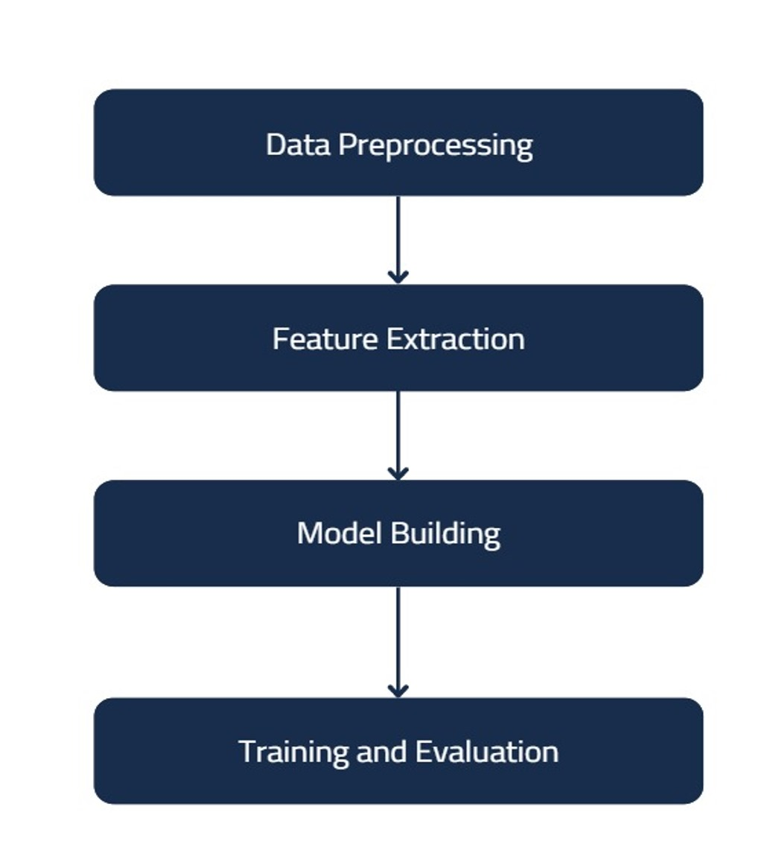
High Level Design

Slide 29
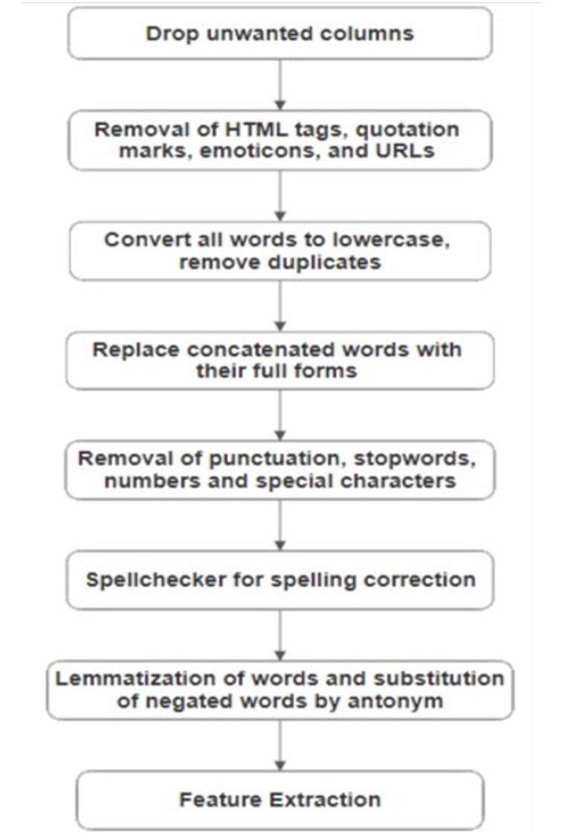
Detailed Design

Slide 30
Technology to be Used
Large Language Models (LLMs):
Transformers for code-mixed Kannada-English and Hindi-English.
Pre-trained models like mBERT and BERT for fine-tuning sentiment and sarcasm detection.
Deep Learning:
TensorFlow or PyTorch for neural network training with multimodal inputs.
Multi-modal Integration:
Combining text, audio, for sentiment analysis using SpeechRecognition (audio).

Slide 31
Technology to be Used
Traditional Machine Learning:
Scikit-learn for baseline models and evaluation metrics like precision, recall, F1-score.
Data Processing & Annotation:
NLTK for NLP tasks.
COVAREP for acoustic features (e.g., pitch, Mel-frequency coefficients)
Scrapy and Youtube Comments Downloader for data scraping from YouTube, Twitter, etc.

Slide 32
Hardware And Software Requiements
Hardware Requirements:
GPU-enabled systems (such as NVIDIA GPUs) for accelerated model training, especially for deep learning models.
High-performance server with multi-core CPUs to support large datasets and intensive computational tasks.
16 GB+ RAM to handle memory-heavy tasks like training deep neural networks and processing large datasets.
1 TB+ storage for holding datasets, model checkpoints, and output results.
Software Requirements:
Python as the core programming language for all model implementations and data preprocessing.
TensorFlow or PyTorch for deep learning model development.
Transformers for working with pre-trained LLMs.

Slide 33
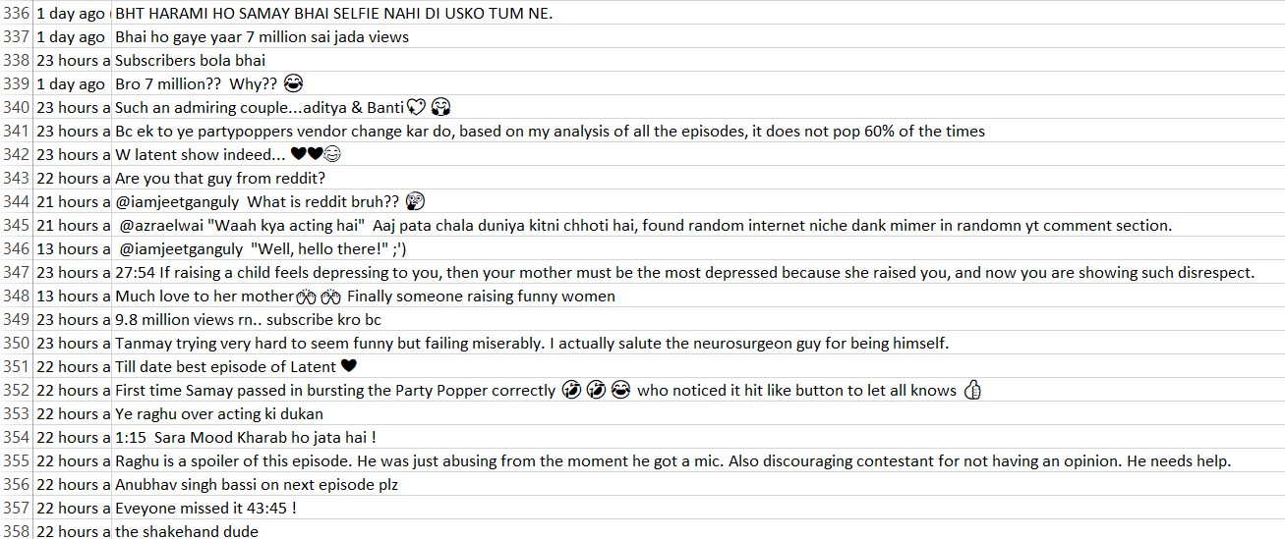
Datasets Used

Slide 34
Datasets Used
https://github.com/bharathichezhiyan/DravidianCodeMix-Dataset/blob/main/DravidianCodeMix-2020.zip
The above dataset is used in this paper: https://pmc.ncbi.nlm.nih.gov/articles/PMC9388449/pdf/10579_2022_Article_9583.pdf
And the file contains the datasets which can be used for the model training.(includes Kannada, Tamil and Malayalam datasets)
For identification of emotion and sarcasm we made a dataset from collecting comments from the social media like Instagram, YouTube etc.
https://github.com/AnithaKJ/Major-Project/blob/main/Dataset/cleaned_dataset.csv
The above file contains the both cleaned and uncleaned dataset.

Slide 35
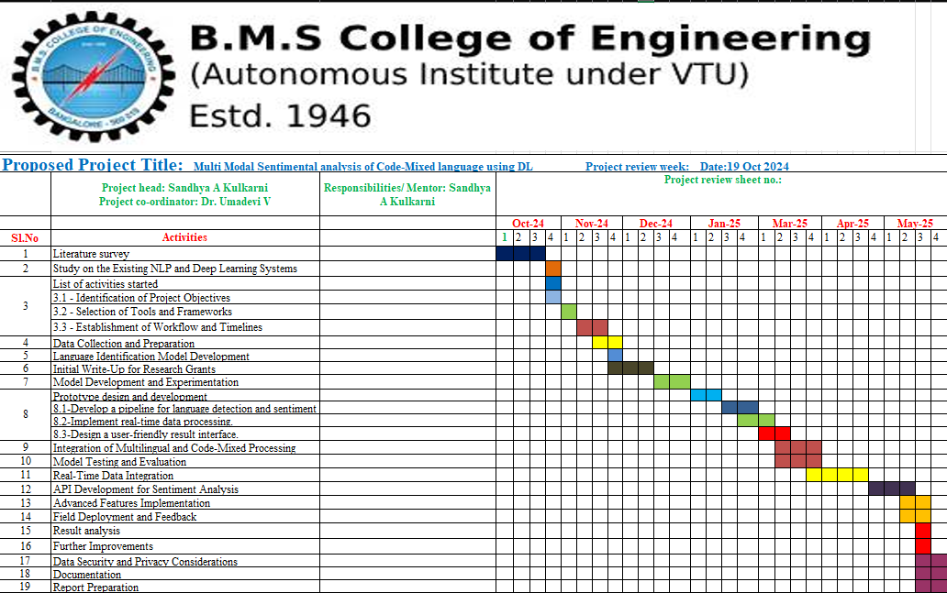
Gantt chart for Major Project Phase 1

Slide 36
Work plan
1.⁠ ⁠Research and Data Collection (Weeks 1-4): Weeks 1-2:Gather code-mixed Kannada and Hindi data from social media platforms (e.g., YouTube, Twitter).Collect multimodal data (text, audio, video). Weeks 3-4:Organize collected data and pre-process (e.g., removing noise, translations, etc.). | 2.⁠ ⁠Data Annotation (Weeks 5-8): Weeks 5-6:Annotate the dataset for sentiment, sarcasm expressions. Use both manual and automated annotation tools. Weeks 7-8:Validate and finalize the annotation for accuracy.
3.⁠ ⁠Model Design and Development (Weeks 9-12): Weeks 9-10:Design the multimodal sentiment analysis architecture. Fine-tune LLMs (e.g., mBERT, GPT) and integrate text and audio data. Weeks 11-12: Begin training models with both text and audio data. | 4.⁠ ⁠Model Training and Evaluation (Weeks 13-16): Train the model on the annotated dataset. Evaluate performance on sentiment, sarcasm, and idiom detection using precision, recall, and F1-score.

Slide 37
Work plan
5.⁠ ⁠Testing and Validation (Weeks 17-20): Test the model on unseen data. Compare results against existing sentiment analysis models. Perform result analysis and identify areas for improvement. | 6.⁠ ⁠Result Analysis and Further Improvements (Weeks 21-24): Analyze model performance in detail, including across different modalities (text, audio, video). Implement improvements (e.g., enhance sarcasm detection). Fine-tune based on insights from testing.
7.⁠ ⁠Final Implementation (Weeks 25-26): Finalize the system with all improvements incorporated. Ensure the model is ready for real-world application. | 8.⁠ ⁠Documentation and Report Submission (Weeks 27-28): Prepare detailed project documentation (data, models, evaluation). Submit the final report and present findings and insights to stakeholders or research bodies.

Slide 38
References
Ahmad, G.I., Singla, J., Anis, A., Reshi, A.A. and Salameh, A.A., 2022. Machine learning techniques for sentiment analysis of code-mixed and switched indian social media text corpus: A comprehensive review. International Journal of Advanced Computer Science and Applications, 13(2).
Perera, A. and Caldera, A., 2024. Sentiment Analysis of Code-Mixed Text: A Comprehensive Review. Journal of Universal Computer Science (JUCS), 30(2).
Astuti, L.W. and Sari, Y., 2023. Code-Mixed Sentiment Analysis using Transformer for Twitter Social Media Data. International Journal of Advanced Computer Science and Applications, 14(10).
Hashmi, E., Yayilgan, S.Y., Hameed, I.A., Yamin, M.M., Ullah, M. and Abomhara, M., 2024. Enhancing multilingual hate speech detection: From language-specific insights to cross-linguistic integration. IEEE Access.
Dou, L., Liu, Q., Zeng, G., Guo, J., Zhou, J., Lu, W. and Lin, M., 2024. Sailor: Open Language Models for South-East Asia. arXiv preprint arXiv:2404.03608.
Kumar, S., Akhtar, M.S., Cambria, E. and Chakraborty, T., 2024. SemEval 2024--Task 10: Emotion Discovery and Reasoning its Flip in Conversation (EDiReF). arXiv preprint arXiv:2402.18944.
Buscemi, A. and Proverbio, D., 2024. Chatgpt vs gemini vs llama on multilingual sentiment analysis. arXiv preprint arXiv:2402.01715.
Ansari, M.A. and Govilkar, S., 2018. Sentiment analysis of mixed code for the transliterated Hindi and Marathi texts. International Journal on Natural Language Computing (IJNLC) Vol, 7.
Shanmugavadivel, K., Sampath, S.H., Nandhakumar, P., Mahalingam, P., Subramanian, M., Kumaresan, P.K. and Priyadharshini, R., 2022. An analysis of machine learning models for sentiment analysis of Tamil code-mixed data. Computer Speech & Language, 76, p.101407.

