Slide 1
🌱 BeanAI — Intelligent Dry Bean Classification
Multiclass Crop Cultivar Prediction Using Machine Learning & Interactive Web Dashboard
Course: B.Tech in Artificial Intelligence & Data Science
Team Members & IDs:
• 24EU01007 — Data Engineering, EDA & Data Preprocessing
• 24EU01046 — ML Modeling, Hyperparameter Tuning & Evaluation
• 24EU01055 — FastAPI Backend, React Dashboard & Integration

Slide 2
B.TECH AI & DATA SCIENCE
Problem Statement & Agricultural Motivation
• Industrial Context: Turkey is among the world's leading producers and exporters of dry edible beans (Phaseolus vulgaris L.).
• Market Challenge: 7 distinct commercial varieties command significantly different market values, cooking properties, and culinary applications.
• The Problem: Varieties often look identical to the naked eye. Manual seed grading is subjective, labor-intensive, error-prone, and inconsistent.
• System Objective: Develop an automated, objective Machine Learning system to classify bean varieties from 16 physical geometric measurements.
• Outcome: High-accuracy multiclass classifier (>92%) deployed via a real-time FastAPI service and interactive React frontend.

Slide 3
B.TECH AI & DATA SCIENCE
Dataset Source & Class Characteristics
Dataset Origin: UCI Machine Learning Repository (Koklu & Ozkan, 2020).
Sample Dimensions: 13,611 high-resolution images segmented into 16 numerical geometric features.
Zero Missing Values: Complete, verified dataset with 0 missing entries.
Target: 7 Cultivar Classes:
1. DERMASON: 3,546 samples (26.05%) — Most popular commercial flat-oval white bean.
2. SIRA: 2,636 samples (19.37%) — Small-medium compact white bean.
3. SEKER: 2,027 samples (14.89%) — Spherical bean with highest roundness (0.958).
4. HOROZ: 1,928 samples (14.16%) — Rooster bean, elongated cylindrical profile.
5. CALI: 1,630 samples (11.98%) — Large kidney-shaped variety.
6. BARBUNYA: 1,322 samples (9.71%) — Mottled borlotti pinto-type bean.
7. BOMBAY: 522 samples (3.84%) — Massive white runner bean (>150,000 px² area).

Slide 4
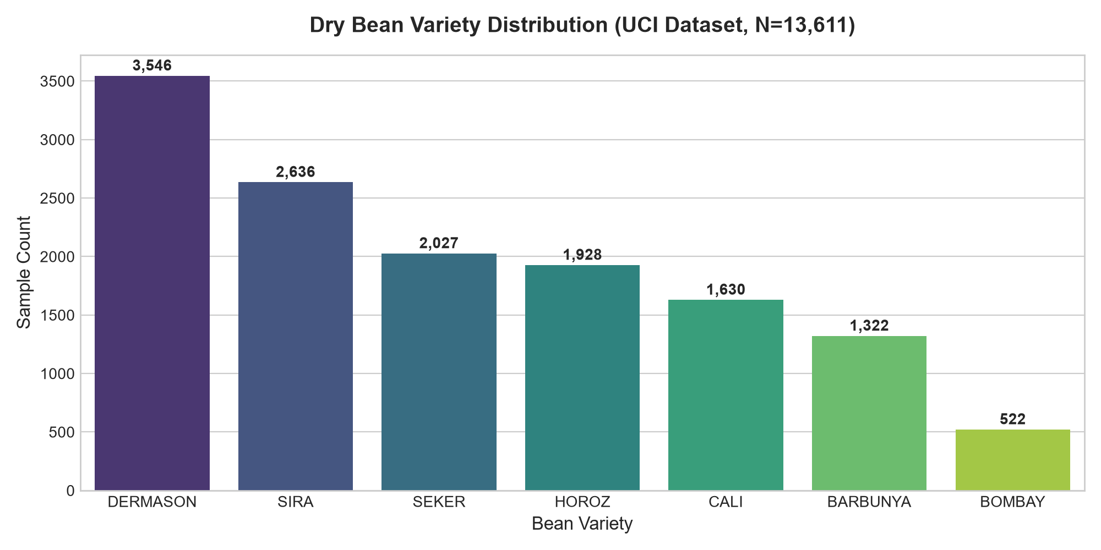
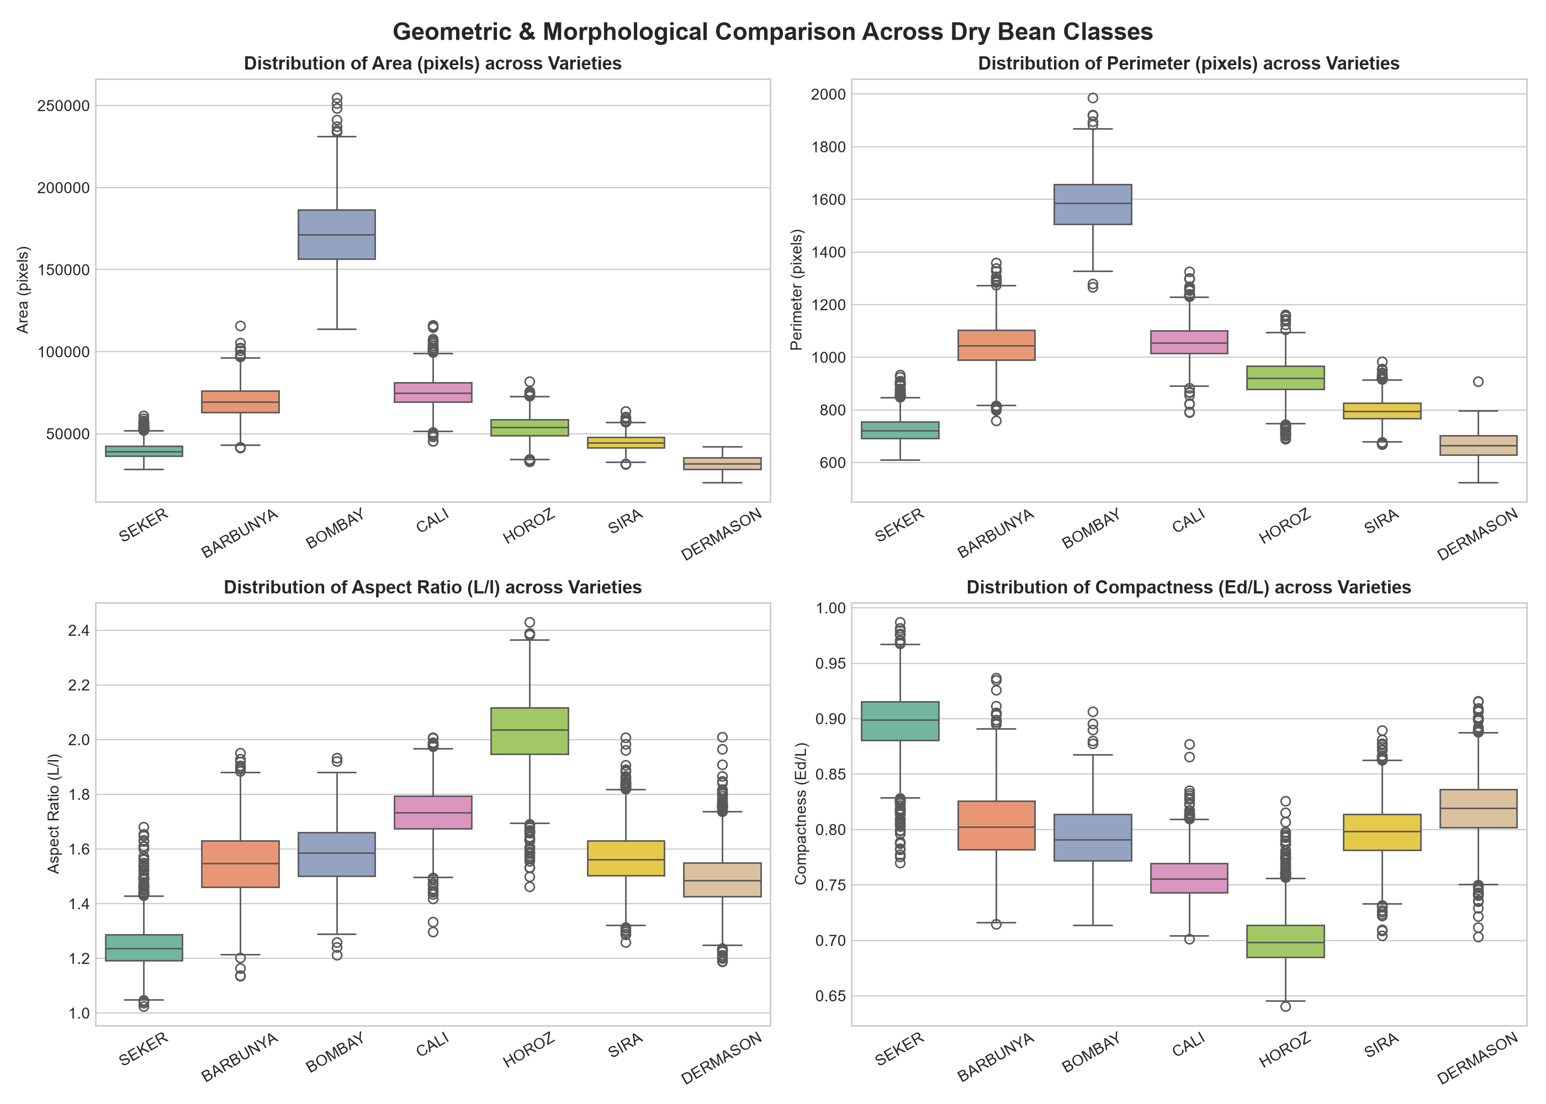
B.TECH AI & DATA SCIENCE
Exploratory Data Analysis & Feature Distributions

Slide 5
B.TECH AI & DATA SCIENCE
Data Preprocessing & Leakage Prevention
• Stratified 80/20 Train/Test Split: 10,888 training samples, 2,723 test samples.
• Strict Leakage Prevention: All feature scaling (StandardScaler) was encapsulated within an sklearn Pipeline. Scaler parameters (mean, std) were fitted strictly on training folds.
• Feature Integrity: Validated exact 16 predictor columns in precise order required by the mathematical model.
• Collinearity Analysis: Correlation matrix revealed r > 0.99 between Area and ConvexArea; dimensionless Shape Factors (1-4) were retained for non-scale morphology separation.

Slide 6
B.TECH AI & DATA SCIENCE
Three ML Architectures Evaluated
1. Logistic Regression (Linear Reference Baseline):
- Softmax multiclass classification with L2 regularization and StandardScaler.
- Fast, interpretable benchmark across 7 classes.
2. Random Forest Classifier (Non-linear Ensemble):
- 100-200 bagging decision trees with randomized feature splits.
- Scale-invariant, captures non-linear feature interactions, calculates Gini feature importance.
3. Support Vector Machine (SVM - Margin Based):
- Radial Basis Function (RBF) kernel mapping continuous measurements into infinite-dimensional space.
- Standardized features with calibrated probability estimates enabled.

Slide 7
B.TECH AI & DATA SCIENCE
Hyperparameter Tuning (Stratified 5-Fold Cross Validation)
Search Strategy: Exhaustive GridSearchCV with 5-fold Stratified K-Fold cross-validation on 10,888 training rows.
Optimization Metric: Macro F1-Score (guarantees equal weighting across minority classes like Bombay).
Tuning Results:
• Logistic Regression: C in [0.1, 1.0, 10.0], solver in ['lbfgs', 'saga'] -> Best: C=10.0, solver='saga' (CV F1: 0.9368)
• Random Forest: n_estimators in [100, 200], max_depth in [15, 25, None] -> Best: max_depth=15, n=100 (CV F1: 0.9358)
• Support Vector Machine: C in [1.0, 10.0], gamma in ['scale', 'auto'] -> Best: C=10.0, kernel='rbf', gamma='scale' (CV F1: 0.9443)

Slide 8
B.TECH AI & DATA SCIENCE
Model Comparison & Final Test Set Evaluation
Evaluated on Held-out Test Set (2,723 samples, 20%):
Model Accuracy Macro Precision Macro Recall Macro F1 Train Time
------------------------------------------------------------------------------------------------------
Support Vector Machine (SVM) 🏆 92.43% 93.85% 93.42% 0.9361 20.8s
Logistic Regression 92.14% 93.60% 93.10% 0.9332 47.1s
Random Forest 91.88% 93.48% 92.83% 0.9313 56.4s
Key Findings:
• Support Vector Machine achieved highest test accuracy (92.43%) and Macro F1 (0.9361).
• Average inference time per bean measurement: 0.16 milliseconds.

Slide 9
B.TECH AI & DATA SCIENCE
Model Persistence & Production Architecture
Pipeline Serialization: Saved the entire fitted pipeline (StandardScaler + SVC) using Joblib into models/dry_bean_pipeline.joblib.
Reload Verification: Loaded pipeline into backend memory on startup; verified predictions match original training output exactly.
FastAPI Backend: REST API with Pydantic type validation enforcing exact 16-feature schema.
• GET /health — Health check & model status
• GET /model-info — Model parameters and metrics
• POST /predict — Real-time inference with probability distribution across all 7 classes
• GET /samples — Curated real bean presets

Slide 10
B.TECH AI & DATA SCIENCE
Interactive Web Application (BeanAI)
Frontend Stack: React 19 + Vite + Recharts + Lucide Icons.
Core Features:
1. Dashboard: Dataset metrics (13,611 rows, 16 features), class distributions bar/pie charts, and cultivar catalogue.
2. Bean Prediction Form: 16 organized input fields with 1-click real sample presets for all 7 bean varieties.
3. Interactive Probability Chart: Recharts horizontal bar chart showing class probability confidence.
4. Model Performance Page: Side-by-side comparison bar chart, interactive confusion matrix, and feature importances.
5. About & Team Page: Complete documentation, team roles, and scientific citations.

Slide 11
B.TECH AI & DATA SCIENCE
Real-World Applications & Technical Limitations
Industrial Applications:
• High-speed optical sorters in agricultural grain packaging plants.
• Quality control inspection and cultivar certification for seed export agencies.
• Pricing and purity verification for automated grain elevators.
Limitations & Scope:
• Feature dependency on optical segmentation quality (camera lighting and calibration).
• Misclassification bottleneck between Sira and Dermason (~7% overlap) due to biological morphology proximity.
• Future Work: Integrating convolutional neural networks (CNNs) for direct image inference alongside tabular physical traits.

Slide 12
B.TECH AI & DATA SCIENCE
Conclusion & Project Defense
Summary of Achievements:
✓ Complete ML lifecycle: Acquisition -> EDA -> Preprocessing -> Modeling -> Tuning -> Persistence -> Deployment.
✓ Evaluated 3 candidate models; optimized champion SVM achieving 92.43% test accuracy and 0.9361 Macro F1.
✓ Production-grade FastAPI backend with zero-retraining inference.
✓ Modern, responsive React dashboard with 1-click real bean presets and probability visualizations.
✓ Comprehensive automated test suite (9/9 unit tests passing).
Thank you! We welcome questions from the faculty panel.

