Slide 1
ONLINE FEEDBACK SYSTEM_RUCE
TSP - PROJECT DEMONSTRATION
Presented By:
ARIMUTTU VENKATA KRISHNA – RUCE KURNOOL(B.TECH CSE)
J P HANUMANTHEGOWD GARI KAMAKSHI
ANUKALI SHIVANI
GOLLA RAMYA KRISHNA
Guided By: Mr. HRISHIKESH MAHURE

Slide 2

Problem Statement
When we made a research on Existed Feedback Systems , we found some issues are –
Complicated User Interface
Inefficient processing
Limited Customization Options
Sparse and unreliable data
Timely and accurate feedback processing challenges
Lack of Application Security from Unexpected Crashes or data Thefts.

Slide 3

Proposed Solution
This product not only enhances user engagement but also ensures superior data quality and streamlines the feedback processing workflow
In addition to addressing the challenges of current Online Feedback Systems, our solution boasts the reliability of being hosted on Azure Windows VM. Furthermore, we prioritize data security by implementing regular backups, ensuring a robust system that can track and recover from crashes or potential data theft incidents.

Slide 4
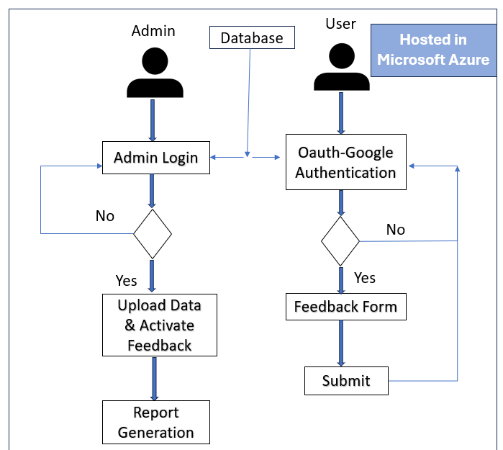
Algorithm & Deployment
Services and Tools used:
MySQL Database
Apache web Server
oAuth Google Authentication Services
Azure Virtual Machine (Windows)
Microsoft Azure Recovery Service (Reg Backups)

Slide 5

Conclusion & Future Scope
Ensures heightened user engagement, improved data quality, and streamlined processing, supported by secure hosting on Azure Windows VM and regular backups for optimal reliability and data security.
Future scope:
Recommendation System
Chatbot - Faculty/Staff Queries
Customizable – Able to fit for all other organizations

Slide 6

THANK YOU

