Slide 1
ONLINE FEEDBACK SYSTEM
Track1_Applied_CC_for_Software_Development
Presented By:
1. ARIMUTTU VENKATA KRISHNA – 20RU1A0505 (CSE)
2. J P HANUMANTHEGOWD GARI KAMAKSHI – 20RU1A0563 (CSE)
3.ANUKALI SHIVANI – 20RU1A0504 (CSE)
4.GOLLA RAMYAKRISHNA – 21RU5A0503 (CSE)
Guided By:
HRISHIKESH MAHURE
ANKIT

Slide 2
OUTLINE
Abstract
Problem Statement
Aims , Objective & Proposed System/Solution
System Design
Sample Screenshots
System Development Approach(Technology Used)
Algorithm & Deployment
Conclusion
References
Future Scope

Slide 3
Abstract
This paper introduces an innovative Online Feedback System designed specifically for engineering colleges. In the ever-evolving educational landscape, this system aims to streamline the feedback process, fostering improved communication between students and faculty. The platform provides students with a convenient avenue to offer constructive feedback on courses, instructors, and overall college experience. Simultaneously, it empowers educators to collect valuable insights, facilitating continuous improvement in teaching methodologies. Through user-friendly interfaces and data-driven analytics, this system promises to enhance the educational quality and overall satisfaction of all stakeholders, promoting excellence in engineering education.

Slide 4
Problem Statement
Colleges often lack an efficient and systematic feedback mechanism, hindering the valuable exchange of insights between students and faculty. This absence of an Online Feedback System results in missed opportunities for improvement in teaching methodologies and course offerings. Additionally, students' voices remain unheard, leading to potential dissatisfaction and disengagement. Therefore, there is an urgent need for an effective Online Feedback System tailored to engineering colleges, enabling students to provide constructive feedback on various aspects of their educational experience while empowering faculty and administrators to harness this input for continuous enhancement and better alignment with students' needs and expectations.

Slide 5
Proposed Solution
We propose the development and implementation of a comprehensive Online Feedback System for all colleges. This system will include user-friendly interfaces for students to submit feedback on courses, instructors, and overall college experience. Additionally, it will provide faculty and administrators with robust analytics tools to process and interpret this feedback effectively. The system will support real-time data collection and analysis, allowing colleges to identify areas for improvement promptly. By fostering transparent communication and facilitating data-driven decision-making, the proposed solution aims to bridge the feedback gap, enhance teaching quality, and ensure a more satisfactory educational experience for engineering college students.

Slide 6
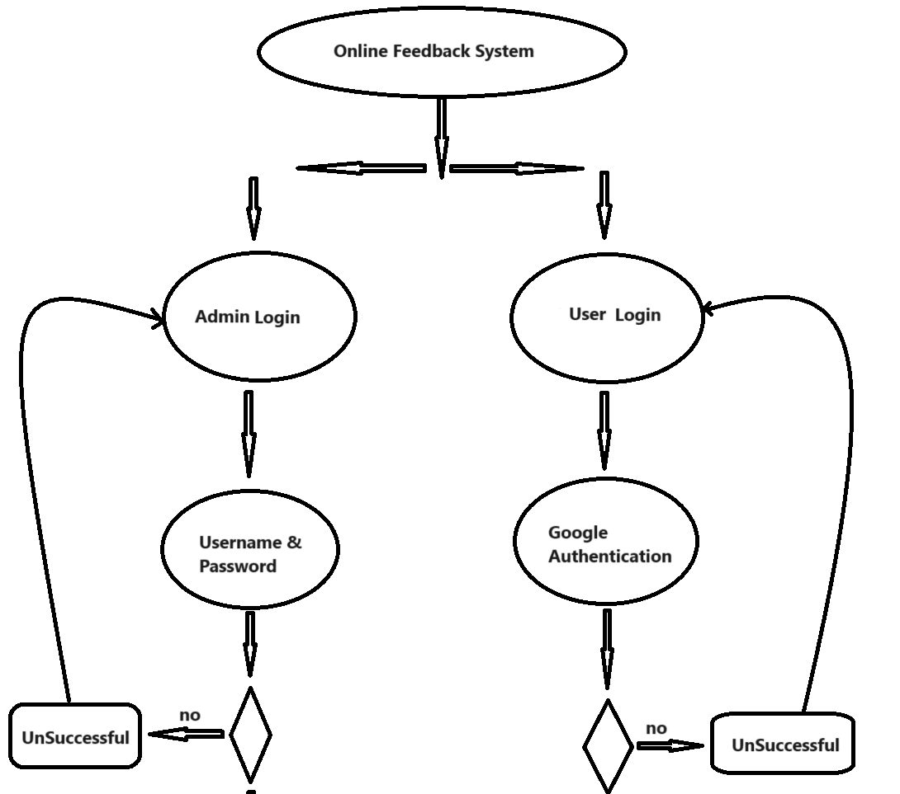
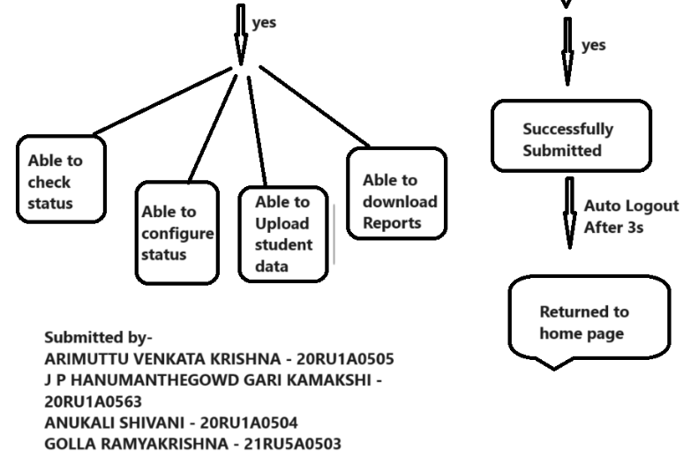
System Architecture

Slide 7
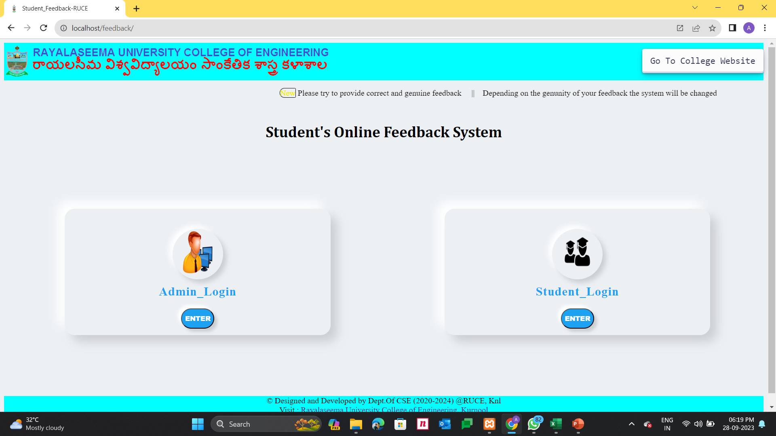
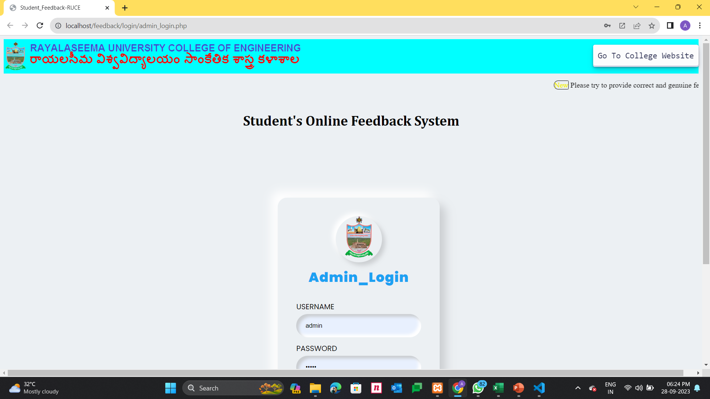
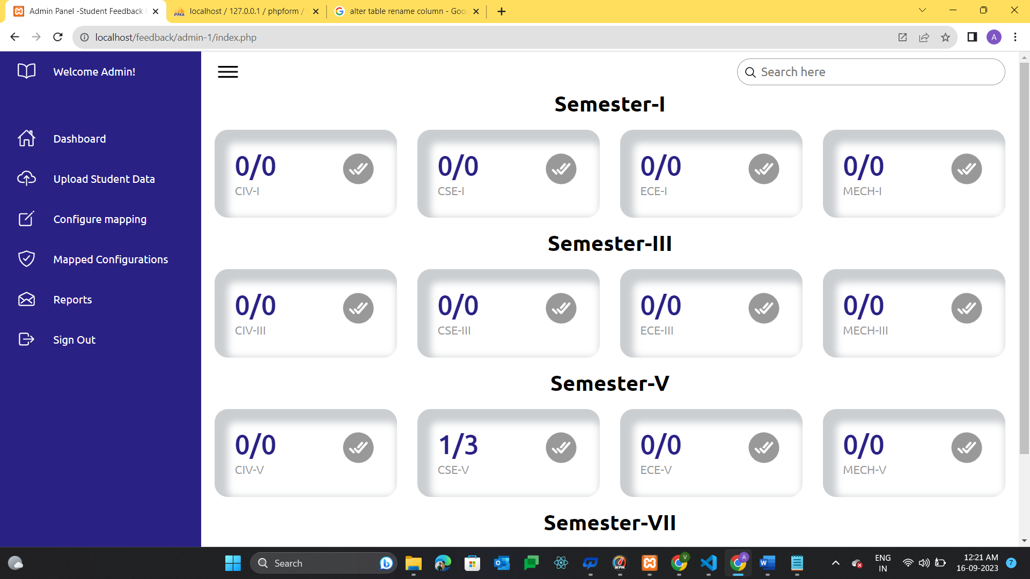
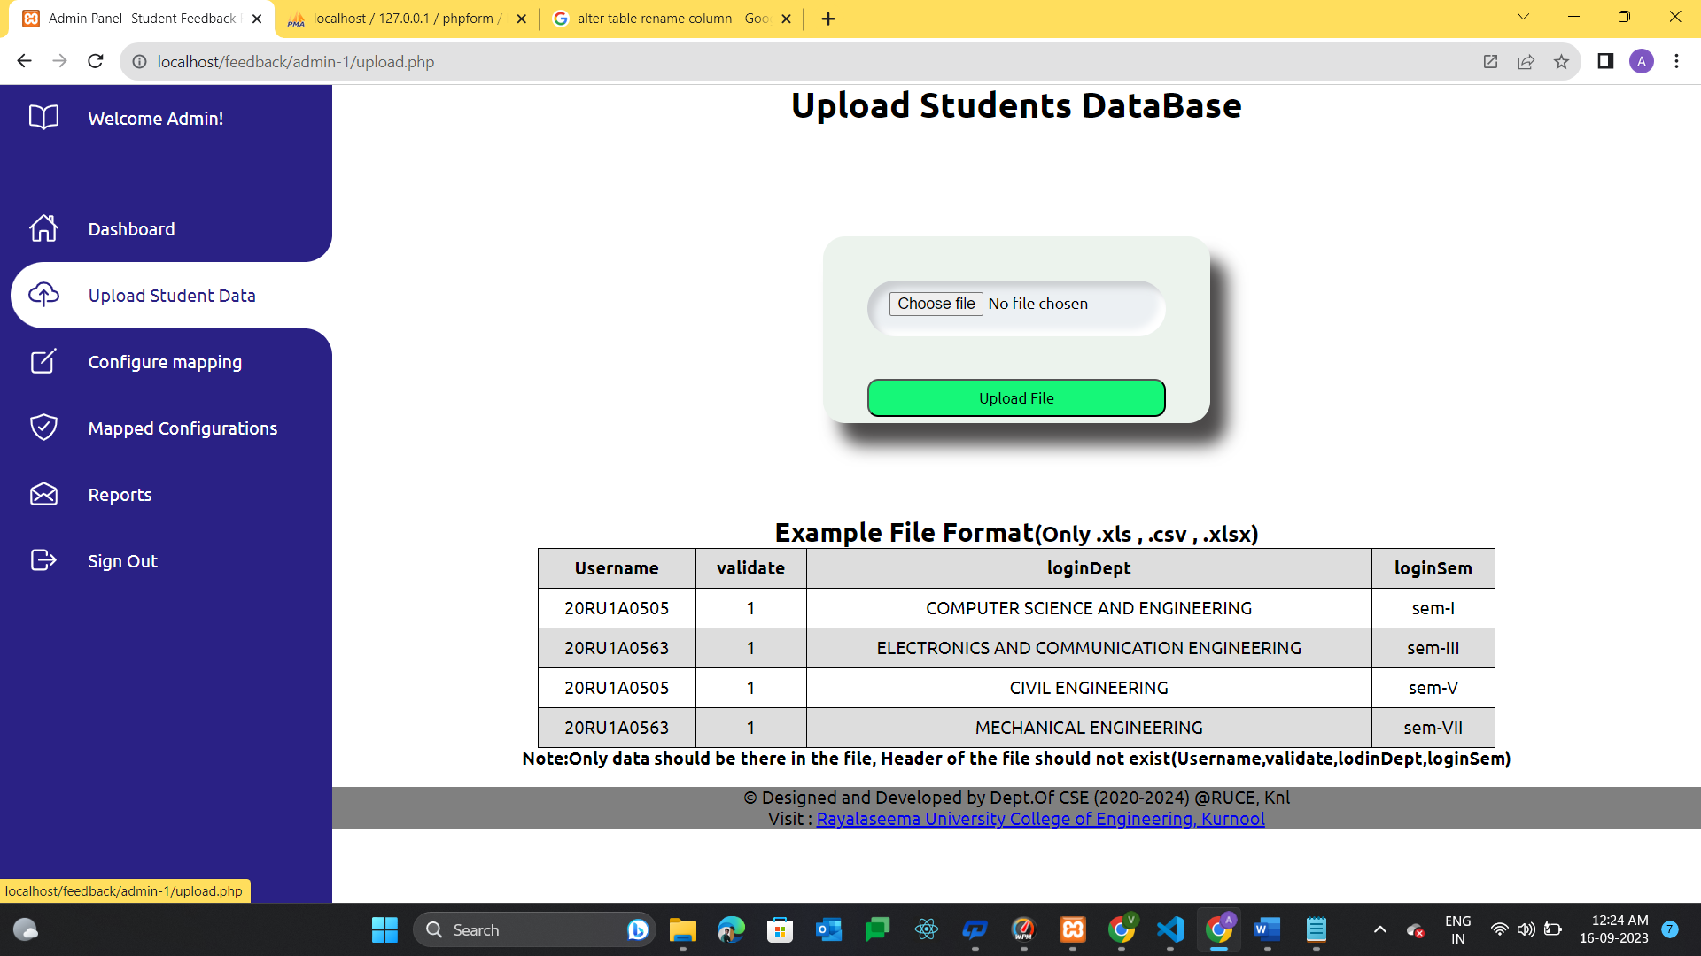
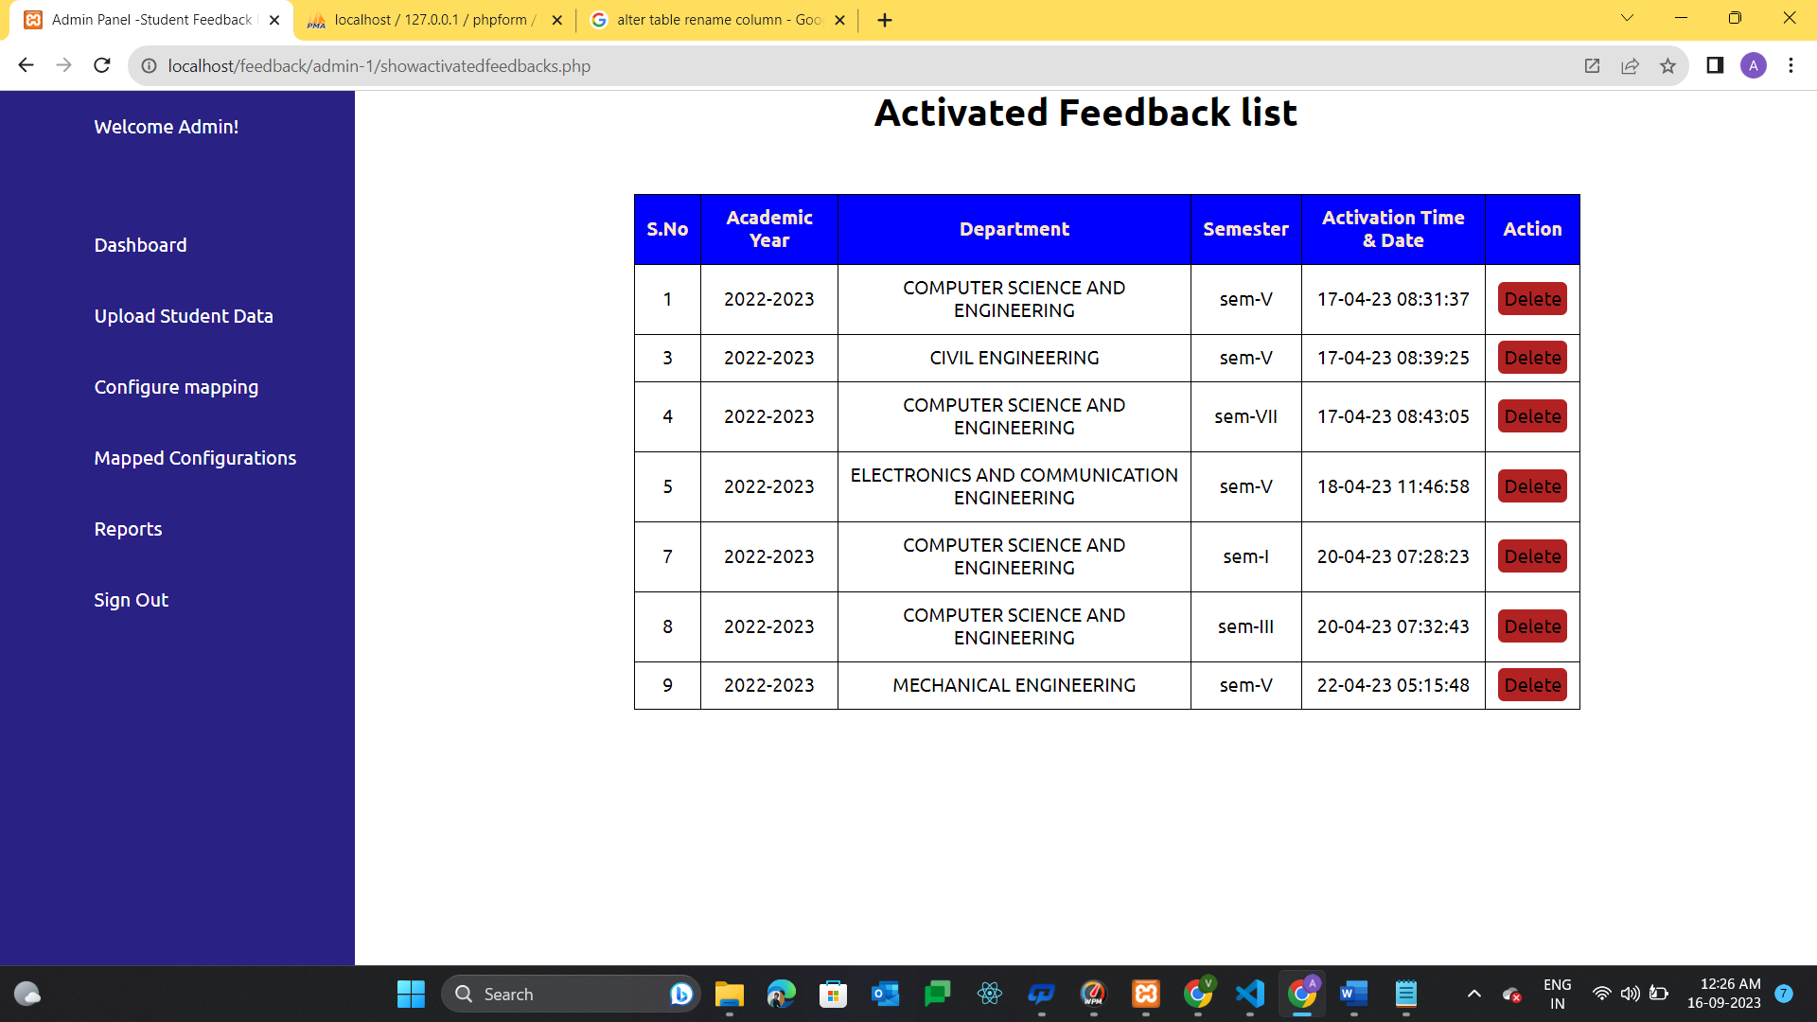
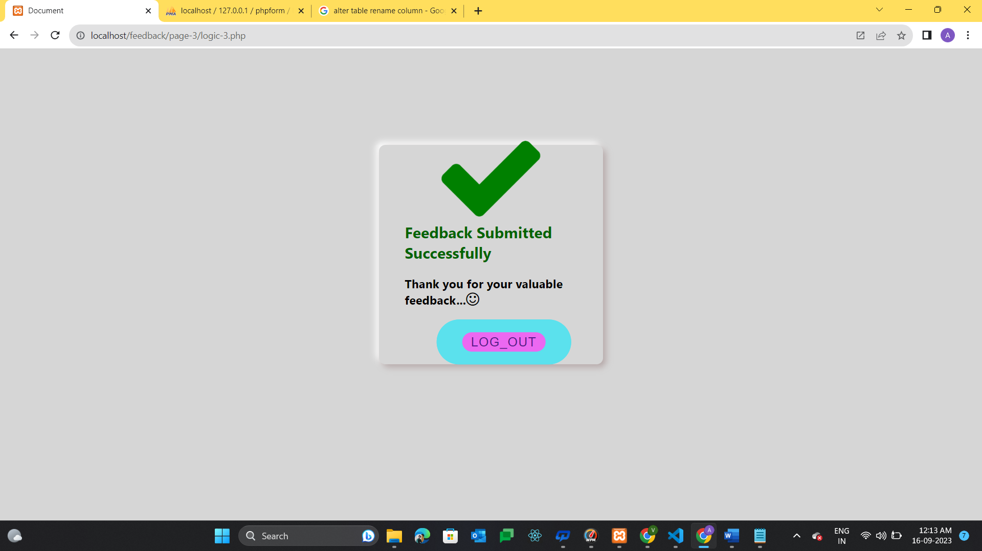
Sample Screenshots

Slide 8
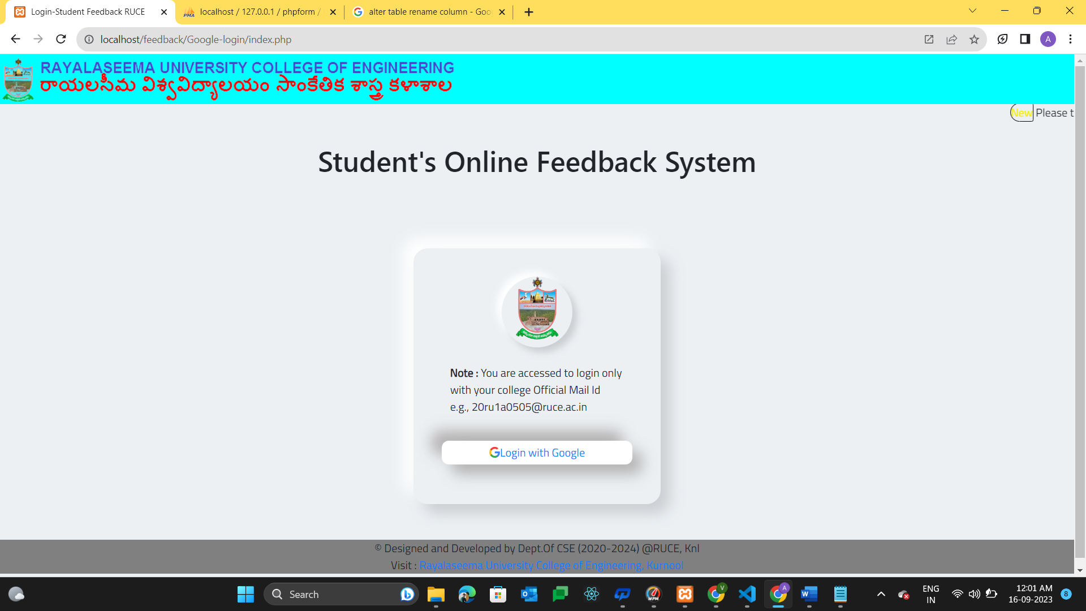
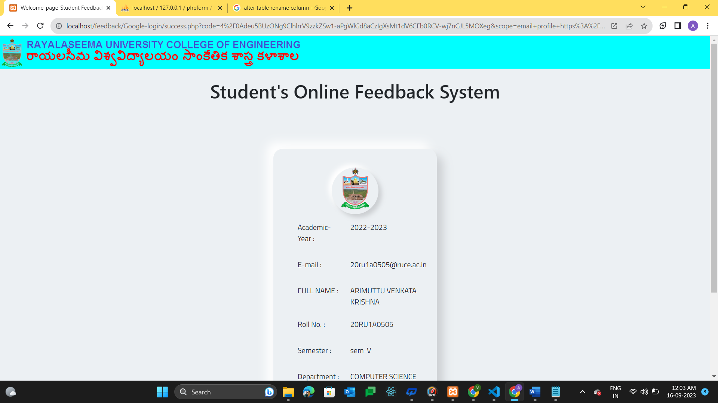
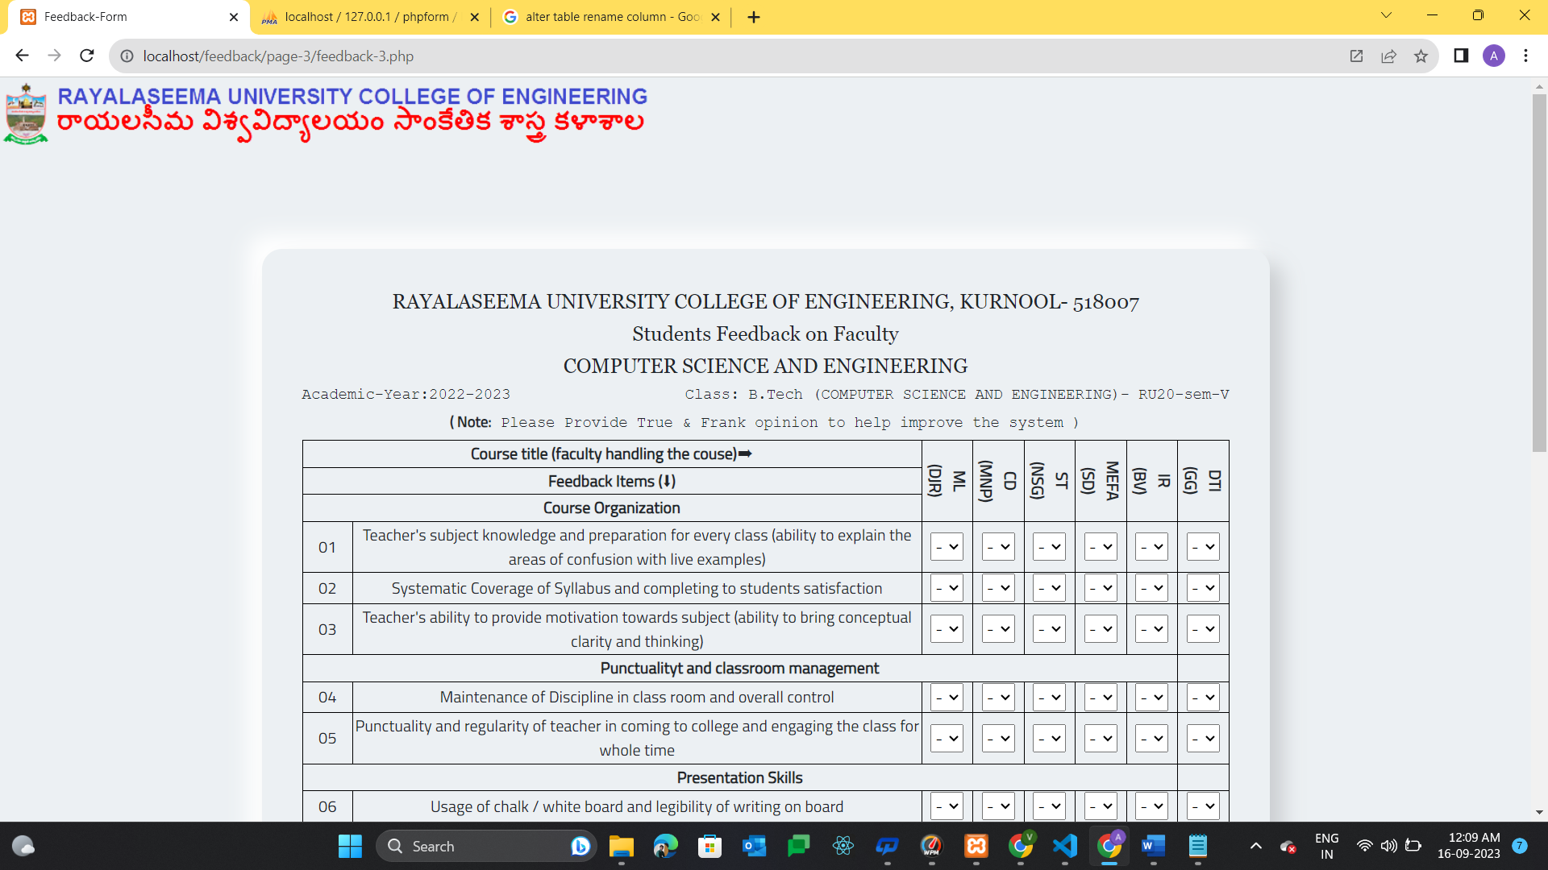
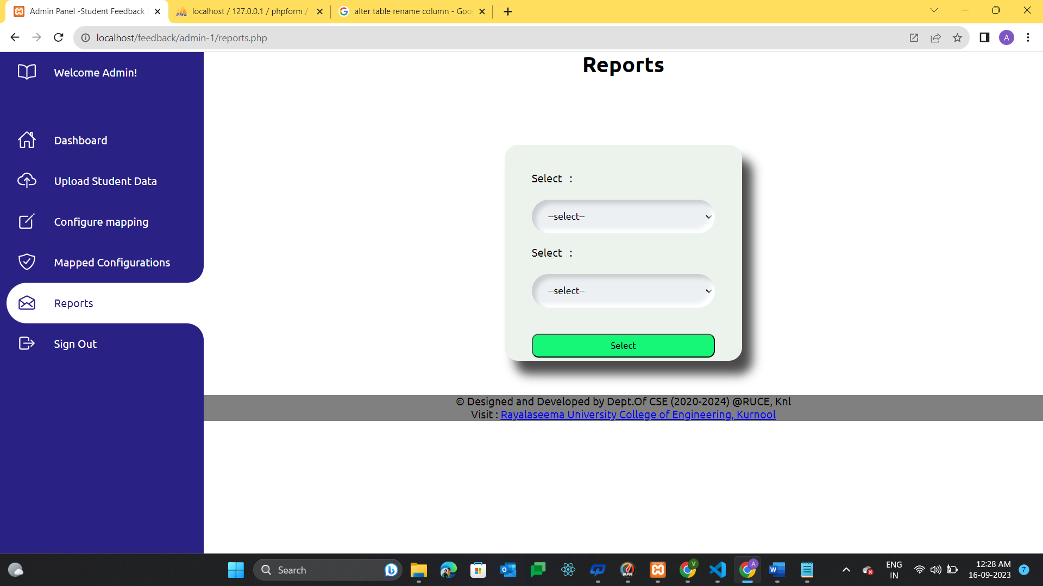
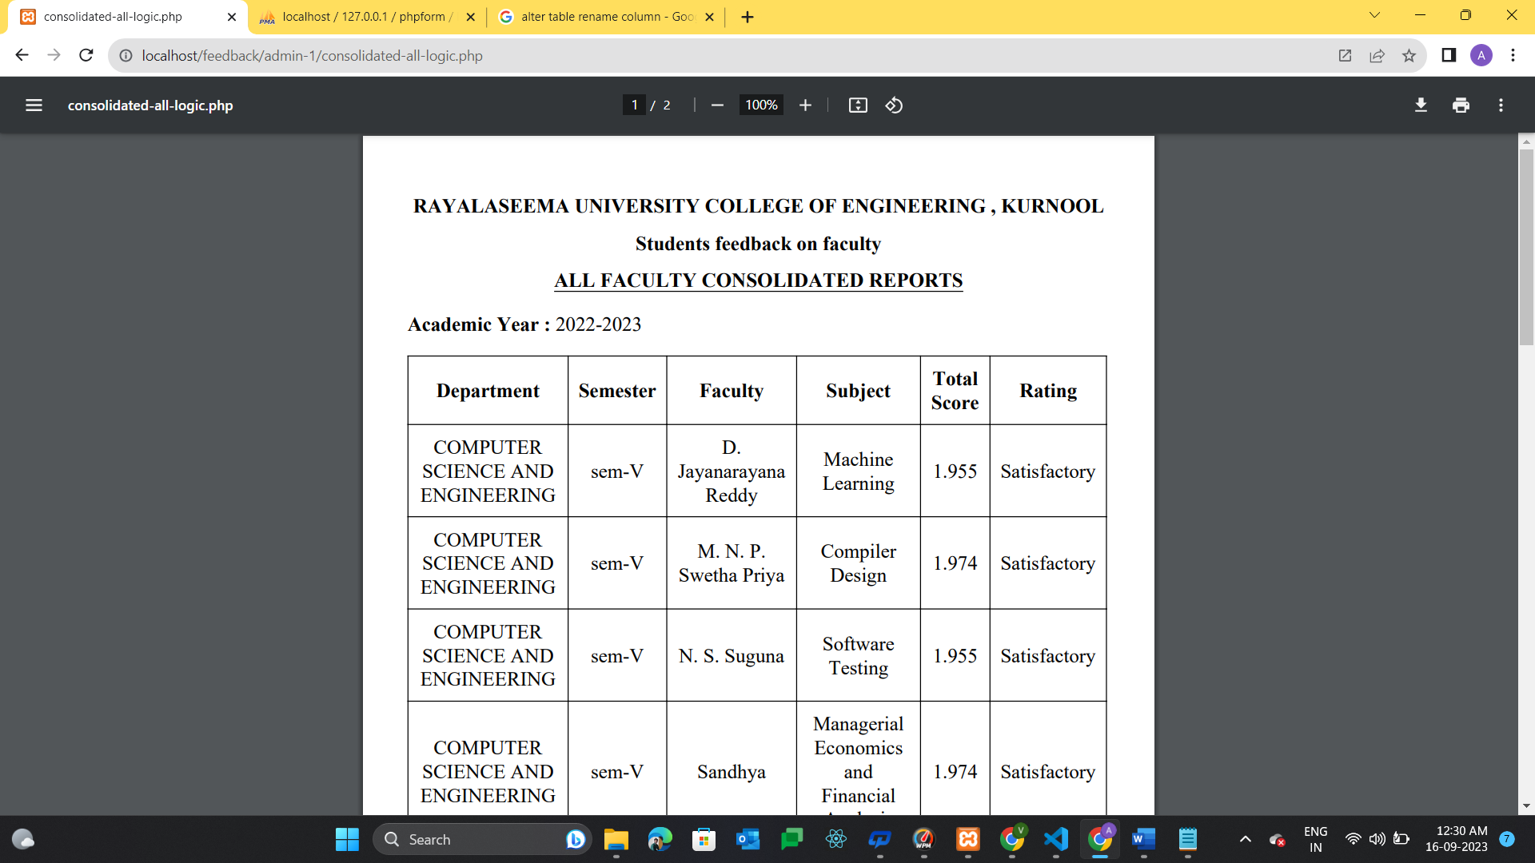
Sample Screenshots

Slide 9
System Deployment Approach
The deployment of an Online Feedback System for an engineering college involves careful selection of technologies to ensure the system's efficiency, scalability, and security. Here's an overview of the technology stack that can be employed:
1. Server & Database: Set up a web server compatible with PHP and MySQL. Configure the database with necessary tables.
2. Version Control: Use Git for code management and host the repository online.
3. Continuous Integration: Implement CI/CD pipelines for automated testing and deployment.
4. Web Hosting: Choose a PHP and MySQL-compatible hosting service. Upload your HTML, CSS, JavaScript, and PHP files.

Slide 10
5. Security: Apply security measures, including input validation, encryption, and SSL/TLS for HTTPS.
6. Domain & DNS: Register a domain and configure DNS settings to point to your server.
7. Testing & Documentation: Thoroughly test the system, create user documentation, and provide training.
8. Backup & Monitoring: Set up regular backups, monitoring tools, and resource scaling.
9. Launch & Promotion: Announce the system launch, promote it, and gather user feedback.

Slide 11
10. Iterate & Comply: Continuously improve the system based on user feedback and ensure compliance with data protection regulations.
11. Support & Maintenance: Provide user support and keep documentation updated for ongoing maintenance.
This streamlined approach will help you efficiently deploy and manage your online feedback system.

Slide 12
Algorithm & Deployment
Deployment: Implementing the Online Feedback System requires a phased approach. Start with a limited user group for initial testing and issue identification. Gradually expand to the entire user base while closely monitoring performance and gathering feedback. Leverage web-based hosting for scalability and resource efficiency. Employ automated testing and continuous integration to streamline updates and ensure system stability. Regularly review and improve the system, keeping it aligned with evolving user requirements and technological advancements.

Slide 13
Conclusion
In conclusion, the deployment of an Online Feedback System for our engineering & all other colleges represents a significant step towards enhancing education quality and user satisfaction. By carefully selecting the right technologies, following a systematic deployment strategy, and maintaining a user-centric approach, we can ensure the successful implementation of this vital system. Continuous improvement, scalability, and security measures will be essential for its long-term effectiveness. As we foster a culture of feedback and adapt to the evolving needs of our educational institution, this system will serve as a cornerstone for facilitating communication, data-driven decision-making, and ultimately, the advancement of our engineering college.

Slide 14
References
My GitHub Reference -
https://github.com/venky123-lang/oNlineFeedbackSystem.git
Journals Reference -
International Journal of creative research Thoughts (IJCRT)
Ref link : https://ijcrt.org/papers/IJCRT_192903.pdf
Iconic Research and Engineering journals
Ref link : https://www.irejournals.com/formatedpaper/1700576.pdf
International Journal of Innovations and in Engineering and Science
Ref link : http://www.ijies.net/finial-docs/finial-pdf/3103198.pdf

Slide 15
Future Scope
The future scope of the Online Feedback System for our engineering college is promising. It offers opportunities for further integration with artificial intelligence and machine learning to provide more in-depth insights from feedback data. Enhanced mobile accessibility and personalized recommendation systems can be explored. Additionally, the system can evolve to support real-time feedback during lectures and virtual reality-based interactions. Moreover, expanding its application beyond academia into the corporate world for employee feedback can be considered. Continuous adaptation to emerging technologies and pedagogical trends will ensure that the system remains a valuable tool for fostering communication and driving improvements in education and beyond.

Slide 16
THANK YOU
Submitted by –
ARIMUTTU VENKATA KRISHNA
J P HANUMANTHEGOWD GARI KAMAKSHI
ANUKALI SHIVANI
GOLLA RAMYAKRISHNA

