Slide 1
Seminar On : Artificial Intelligence –Autonomous Car Speed Control By :Venkatesh Lokare Roll No :3438 Seminar Guide :Prof. R.s.Paswan

Slide 2
Name of the Topic: Intelligent Speed Adaptation Using a Self-Organizing Neuro-Fuzzy Controller with Speed Sign Detection Capability
Contents:
Introduction.
Presentation Of The GenSoFNN-Yager.
Adaption Of The GenSoFNN-Yager .
Speed Sign Detection.
Mathematics.
Advantages and Disadvantages.

Slide 3
1. Introduction: The basics ..
What is Artificial Intelligence ?
Artificial intelligence (AI) is the intelligence exhibited by machines or software. It is an academic field of study which studies the goal of creating intelligence.
"the science and engineering of making intelligent machines".

Slide 4
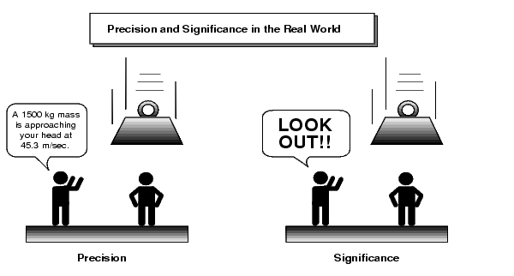
1. Introduction: The basics ..
What is intelligence ?
Intelligence has been defined in many different ways such as in terms of one's capacity for logic, abstract thought, understanding, self-awareness, communication, learning, emotional knowledge, memory, planning, creativity and problem solving. It can also be more generally described as the ability to perceive and/or retain knowledge or information and apply it to itself or other instances of knowledge or information creating referable understanding models of any size, density, or complexity, due to any conscious or subconscious imposed will or instruction to do so.
Intelligence is most widely studied in humans, but has also been observed in non-human animals and in plants. Artificial intelligence is the simulation of intelligence in machines.

Slide 5
1. Introduction: The basics ..
What is artificial intelligence ?
Machine Learning .
Curated Knowledge .
Reverse Engineering the Brain .

Slide 6
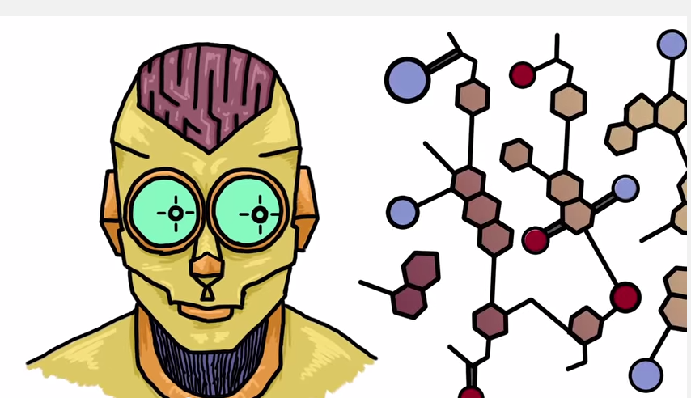
Machine Learning

Slide 7
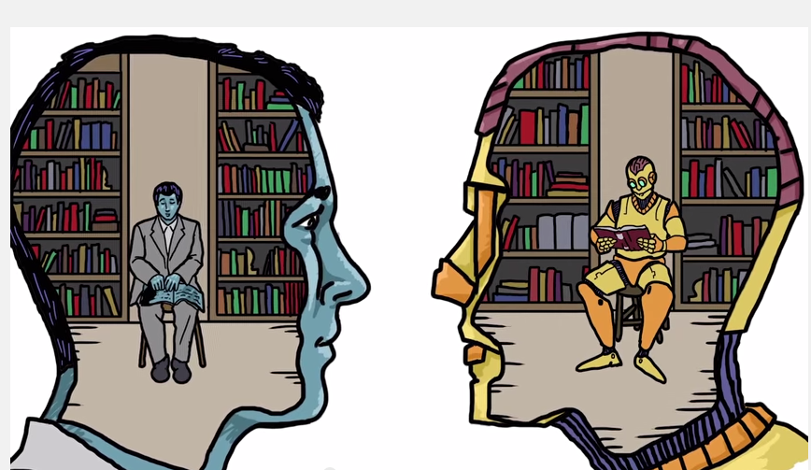
Curated Knowledge

Slide 8
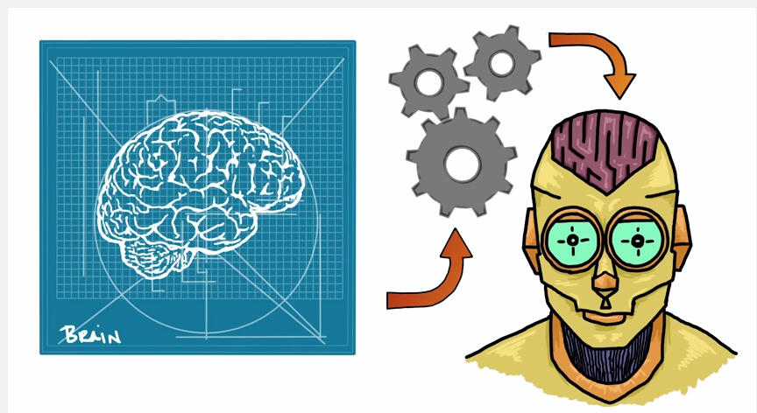
Reverse Engineering the Brain

Slide 9
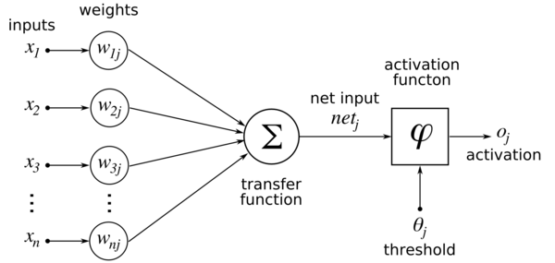
1. Introduction: The basics ..
What is neural network ?
In machine learning and cognitive science, artificial neural networks (ANNs) are a family of statistical learning algorithms inspired by biological neural networks (the central nervous systems of animals, in particular the brain) and are used to estimate or approximate functions that can depend on a large number of inputs and are generally unknown. Artificial neural networks are generally presented as systems of interconnected "neurons" which can compute values from inputs, and are capable of machine learning as well as pattern recognition thanks to their adaptive nature.

Slide 10
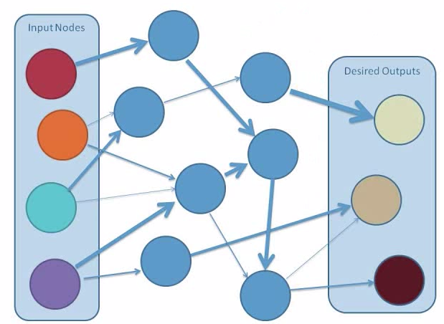
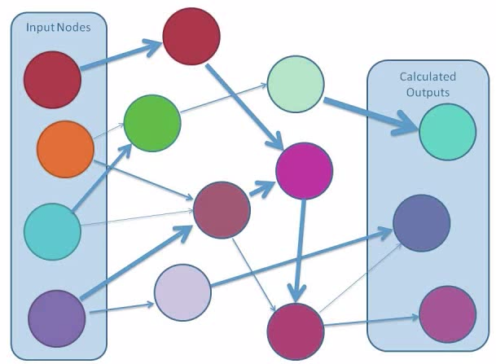
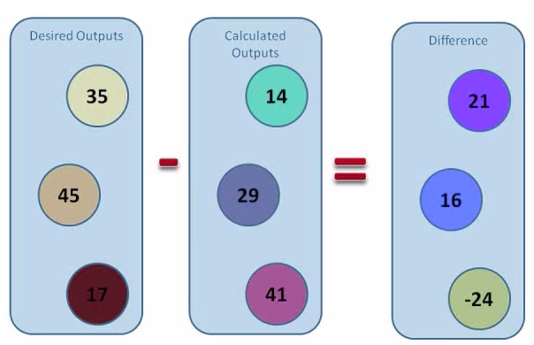
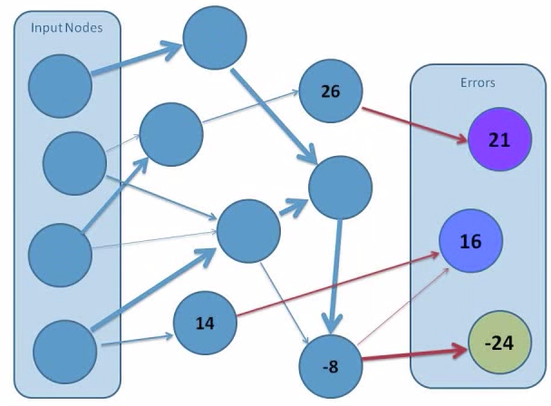
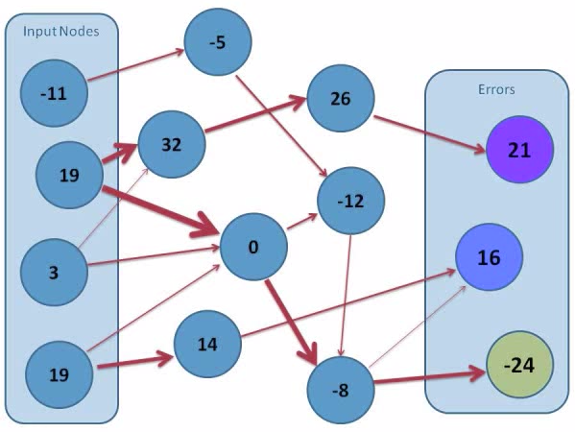

Slide 11
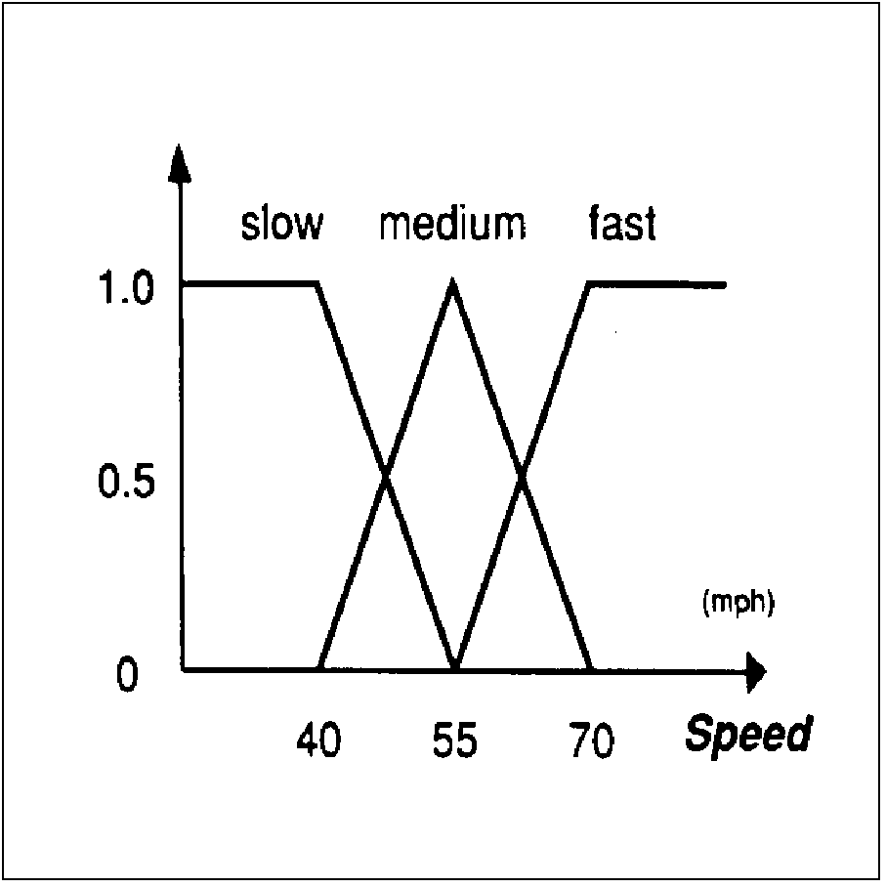
1. Introduction: The basics ..
What is Fuzzy Logic?
Fuzzy logic is a form of many-valued logic that deals with approximate, rather than fixed and exact reasoning. Compared to traditional binary logic (where variables may take on true or false values), fuzzy logic variables may have a truth value that ranges in degree between 0 and 1. Fuzzy logic has been extended to handle the concept of partial truth, where the truth value may range between completely true and completely false. Furthermore, when linguistic variables are used, these degrees may be managed by specific functions.

Slide 12
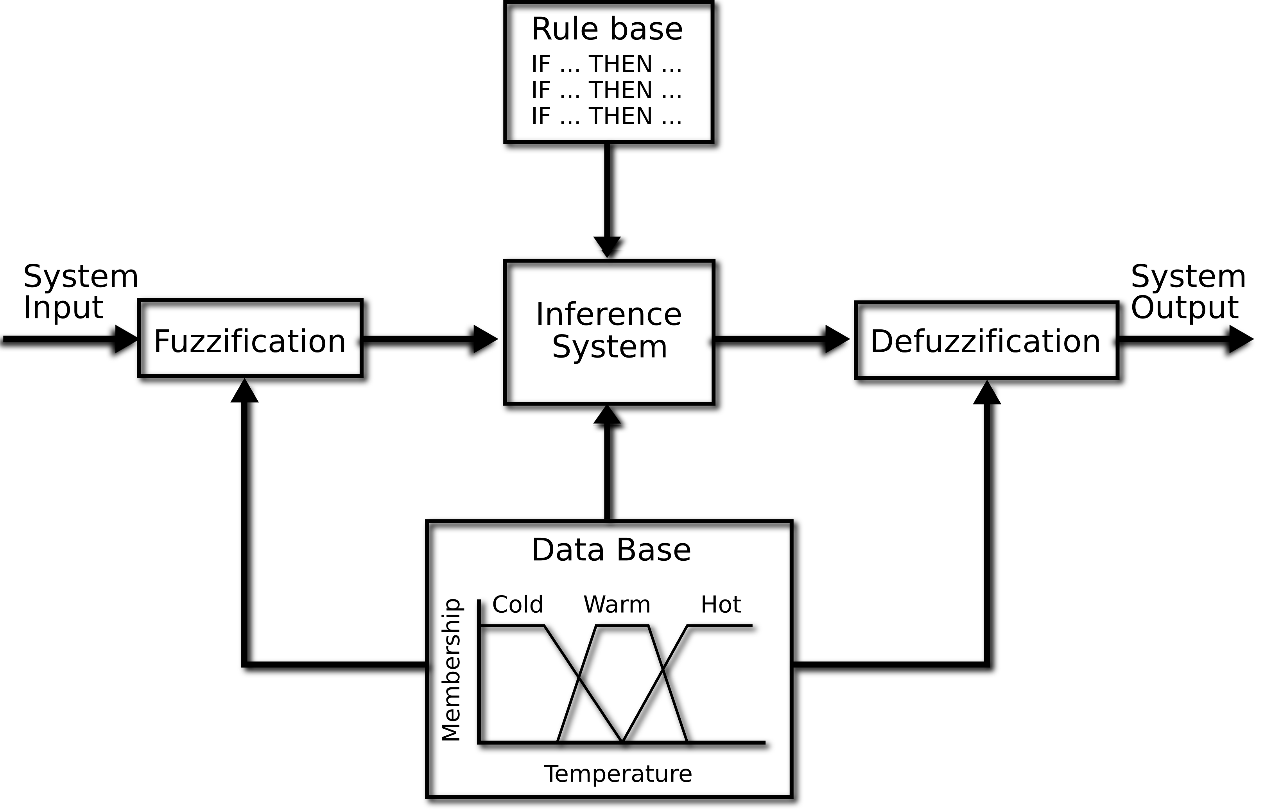

Slide 13
2. Presentation Of The GenSoFNN-Yager
Generic Self Organizing Fuzzy Neural Network using the Yager inference scheme (GenSoFNN(Yager))
Output linguistic nodes
Layer 5
Output term node
Layer 4
Layer 3
Rule nodes
Input term nodes
Layer 2
Input linguistic nodes
Layer 1

Slide 14
2. Presentation Of The GenSoFNN-Yager
Yager’s Inference Scheme: It is an extension of modus pones rule which is nothing but similar to implication & is also called as affirmative mode
It can be stated as
P1:If X is A is Then Y is B f(x,y)=max(1-f(x),f(y))
P2: X is A (x -> y) = (~x V y)
Thus Y is B . (A -> B)

Slide 15
2. Presentation Of The GenSoFNN-Yager
Mapping of Yager Interence Scheme
Layer 1 (Fuzzyfication)
Layer 2 (Antecedent Matching)
Layer 3 (Rule Fulfillment)
Layer 4 (Consequent Derivation)
Layer 5 (Output defuzzification)

Slide 16
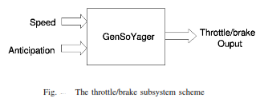
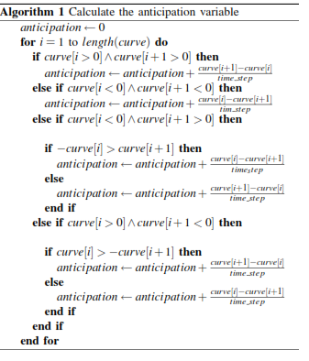
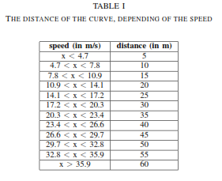
3. Adaption Of The GenSoFNN-Yager For control of the vehicle
Implementation of Longitudinal Control: Anticipation variable used to memorize the shape of the upcoming curve (t=1.6s)

Slide 17
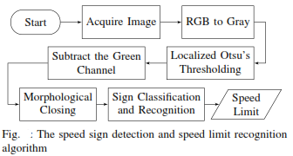
4. Speed Sign Detection

Slide 18

4. Speed Sign Detection
Image Thresholding
The simplest thresholding methods replace each pixel in an image with a black pixel if the image intensity is less than some fixed constant T (that is, ), or a white pixel if the image intensity is greater than that constant. In the example image on the right, this results in the dark tree becoming completely black, and the white snow becoming complete white.

Slide 19
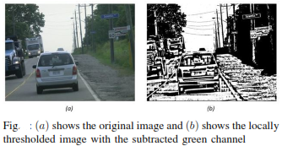
4. Speed Sign Detection
Image Thresholding :Otsu Method

Slide 20
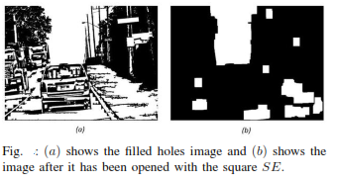
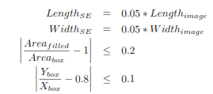
4. Speed Sign Detection
Morphing Operation
Filling: fills holes within object boundaries
Opening: morphs all objects in image with rectangular object SE(structural element)
Constrains : Length(sign)>0.8*Width(sign)

Slide 21
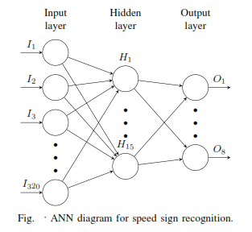
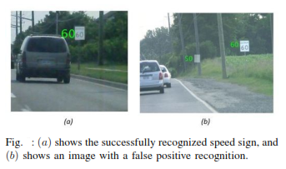
4. Speed Sign Detection
Speed Limit Recognition: Artificial Neural Network

Slide 22
5.Mathematics:-Inputs and outputs
Input
Speed € {Slow , Fast}
Angle € { straight, soft left, right, soft right, left, hard right, hard left, extreme right, extreme left }
Output
Throttle € {normal acceleration, slow acceleration, hand acceleration, no acceleration }

Slide 23
5.Mathematcis :-Fuzzy rules
1) IF S is slow AND C is straight THEN T is slow acceleration
2) IF S is slow AND C is soft left THEN T is slow acceleration
3) IF S is slow AND C is right THEN T is normal acceleration
4) IF S is fast AND C is hard right THEN T is no acceleration
5) IF S is fast AND C is soft right THEN T is normal acceleration
6) IF S is slow AND C is soft right THEN T is normal acceleration
7) IF S is fast AND C is soft left THEN T is fast acceleration
8) IF S is fast AND C is left THEN T is fast acceleration
9) IF S is fast AND C is extreme right THEN T is no acceleration
10) IF S is slow AND C is hard right THEN T is no acceleration
11) IF S is fast AND C is straight THEN T is fast acceleration
12) IF S is fast AND C is right THEN T is no acceleration

Slide 24
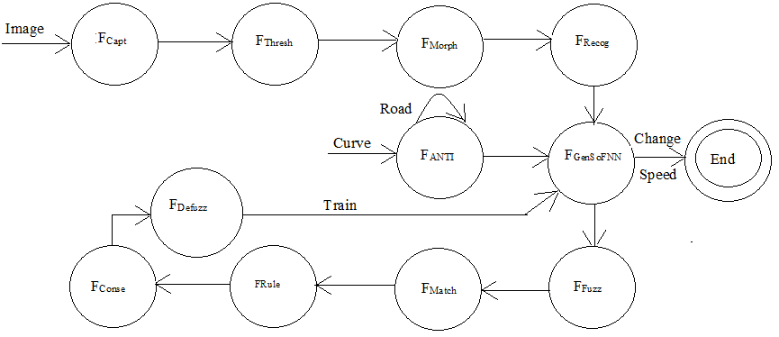
5. Mathematics: State Diagram

Slide 25
6. Advantages and disadvantages
Advantages
Comparatively better control.
Anticipation Factor doesn’t vary .
Chances of Road mishaps reduces.
Disadvantages
It doesn’t take into account the action of centripetal force during the car Slipping over a turning.
For this we have to depend upon the reliability of the system to control the vehicle

Slide 26
7. References
1. Rizvi, R., Kalra, S., Gosalia, C., Rahnamayan, S. "Fuzzy Adaptive Cruise Control system with speed sign detection capability.” Fuzzy Systems (FUZZ-IEEE), 2014 IEEE International Conference.
2. Partouche, D, Pasquier, M. and Spalanzani, A." Intelligent Speed Adaptation Using a Self-Organizing Neuro-Fuzzy Controller” Intelligent Vehicles Symposium, 2007 IEEE.
3. https://www.youtube.com/watch?v=DG5-UyRBQD4
4. https://www.wikipedia.com

