Slide 1
BUILDING SITES POWER CONSUMPTION
PRESENTED BY
VENKATESH INTURI
DURGAPRASAD NELAKURTHI

Slide 2
Overview - Building Sites Power Consumption
Assessing the value of energy efficiency improvements can be challenging as there's no way to truly know how much energy a building would have used without the improvements
We will build a model on historic usage rates and observed weather.
The dataset includes one years of hourly meter readings from over one thousand buildings at several different sites around the world.
Main data
building_id - Foreign key for the building metadata.
meter - The meter id code
timestamp - When the measurement was taken
meter_reading - The target variable. Energy consumption in kWh (or equivalent).
Weather Data
air_temperature - Degrees Celsius
cloud_coverage - Portion of the sky covered in clouds
dew_temperature - Degrees Celsius
precip_depth_1_hr - Millimeters
sea_level_pressure - Millibar/hectopascals
wind_direction - Compass direction (0-360)
wind_speed - Meters per second
Building Metadata
site_id - Foreign key for the weather files.
primary_use - Indicator of the primary category of activities for the building
square_feet - Gross floor area of the building
year_built - Year building was opened
floor_count - Number of floors of the building

Slide 3
Solution Design
ML Type – Supervised ML (Regression)
Metrics – r2score
Data(Train) – 80% of 3.7 Million
Data(Test) - 20% of 3.7 Million
Data download → Data Analysis → Pre-processing → Model training → Validation
Download data using Kaggle API
Calculate r2score on test data
Check Nulls
Check feature correlation
Build Keras model
Train on the model
Loss - mse
Handle Nulls
Feature engineering**
Train/Test splits
Create TF dataset

Slide 4
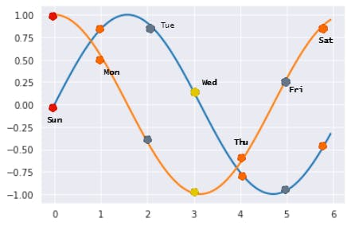
Feature engineering
Winddirection
– Wind is given in degrees 0 – 360. For a ML model it will be better if we add a sense of direction to it i.e., 200 = - 20 etc.
Time features
- We will extract Hour, Day, Month, Weekdays from the time feature
- Hour, Day, Month are cyclic features i.e., Day 7 (Sunday) is equally closer to day 7(Saturday) and Day 0 (Monday)
- We will convert such features to Sine and Cosine split. It will add a sense of cyclic direction
Feature to cyclic encoding →

Slide 5
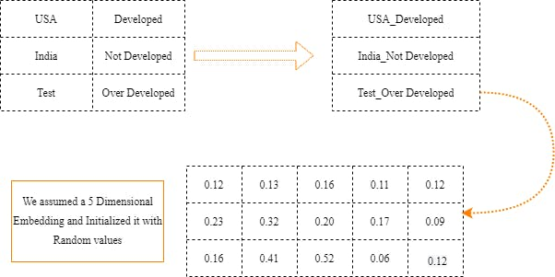
Feature engineering
Categorical features
- 'building_id','site_id','meter','primary_use’
- Neural network is nit very good with categorical feature
- We will use word-embedding technique to encode above features

Slide 6
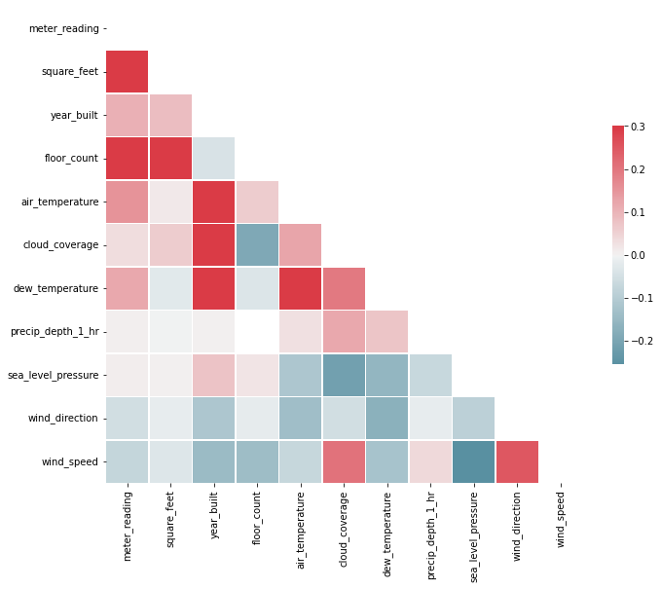
Pre-processing
Null values
Correlation
building_id – 0%
meter – 0%
timestamp – 0%
meter_reading – 0%
site_id – 0%
primary_use – 0%
square_feet – 0%
wind_direction - 2.6%
wind_speed - 0.19%
dew_temperature - 0.015%
air_temperature – 0.15%
year_built – 46.8%
floor_count - 65.7%
cloud_coverage - 51.4% precip_depth_1_hr – 37.4% sea_level_pressure - 21.9%
Fill these features
Drop these features

Slide 7
Model
CAT Data
Embedding
C
O
N
C
A
T
Multiple block of Dense, BN and Dropouts
Output
NUM Data
Training Parms.
learning_rate=0.001
epochs=50
optimizer=‘Adam’
loss='mse'

Slide 8
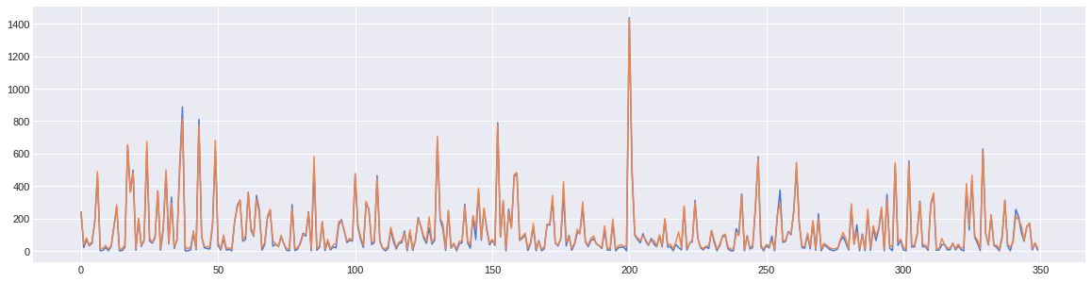
Performance
Test r2score - 0.989

