Slide 1
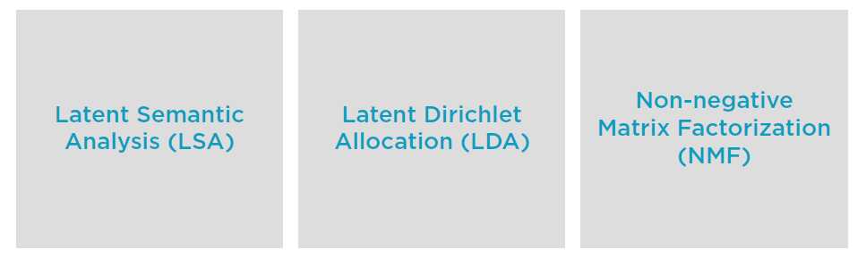
Topic Modeling Algorithms
Notes:
LSA & NMF - * Build low-rank approximations of the Document-Word Matrix using linear algebra
* Rank refers to the number of topics
LSA uses Singular Value Decomposition - a form of factor analysis - to find the topics
SVD Factor Analysis - Apply Singular Value Decomposition (SVD) to re express highly correlated X-variables in terms of new, unrelated components.
NMF is similar but imposes an inherent clustering in output
LDA does not use linear algebra to find a low-rank approximation

Slide 2
Latent Semantic Analysis
LSA is a form of Factor Analysis
Factors ~ Topics
SVD is a robust, well-known technique
Unfortunately, factors have no intuitive explanation
Hard to inspect a factor and see what topic it corresponds to
When used in the context of information retrieval applications, is often referred to as LSI
“Latent Semantic Indexing”
Using topics to index and lookup documents

Slide 3
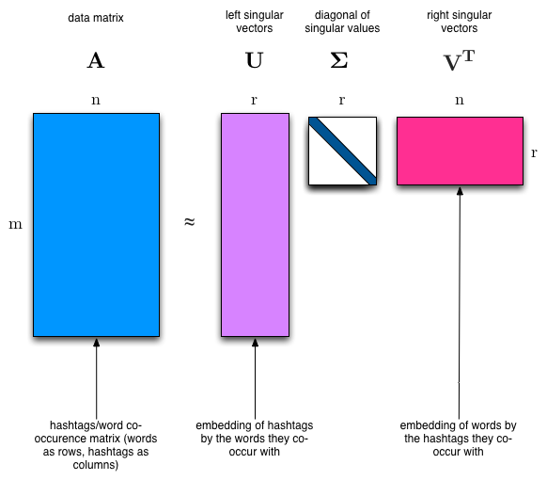
Singular Value Decomposition (SVD)
Notes:
"SVD is not nearly as famous as it should be." - Gilbert Strang
We would clearly expect that the words that appear most frequently in one topic would appear less frequently in the other - otherwise that word wouldn't make a good choice to separate out the two topics. Therefore, we expect the topics to be orthogonal.
The SVD algorithm factorizes a matrix into one matrix with orthogonal columns and one with orthogonal rows (along with a diagonal matrix, which contains the relative importance of each factor).
SVD is an exact decomposition, since the matrices it creates are big enough to fully cover the original matrix. SVD is extremely widely used in linear algebra, and specifically in data science, including:
semantic analysis
collaborative filtering/recommendations
data compression
principal component analysis

Slide 4
Non-negative Matrix Factorization
NMF is also based on linear algebra
Also yields a low-rank approximation of the document-word matrix
However now topics contain inherent clustering
NMF involves setting up an optimization
problem
Factor original matrix to minimize loss
Impose non-negativity constraint on mapping from topics to words

Slide 5
Latent Dirichlet Allocation
LDA seeks to find topics that answer these related questions
“Given these documents, what topics do they most likely belong to?”
“Given a set of topics, how might these documents have been generated?”
“Given these documents, what topics do they most likely belong to?”
- LDA is probabilistic
“Given a set of topics, how might these documents have been generated?”
- LDA is generative

Slide 6
Latent Dirichlet Allocation
LDA is used to classify text in a document to a particular topic. It builds a topic per document model and words per topic model, modeled as Dirichlet distributions.
Each document is modeled as a multinomial distribution of topics and each topic is modeled as a multinomial distribution of words.
LDA assumes that the every chunk of text we feed into it will contain words that are somehow related. Therefore choosing the right corpus of data is crucial.
It also assumes documents are produced from a mixture of topics. Those topics then generate words based on their probability distribution.

Slide 7
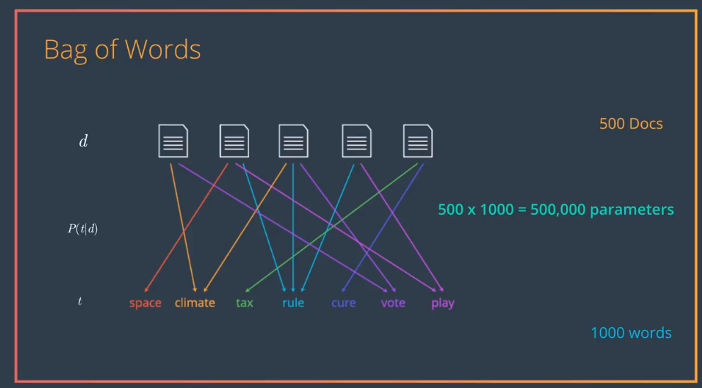
Bag of Words

Slide 8
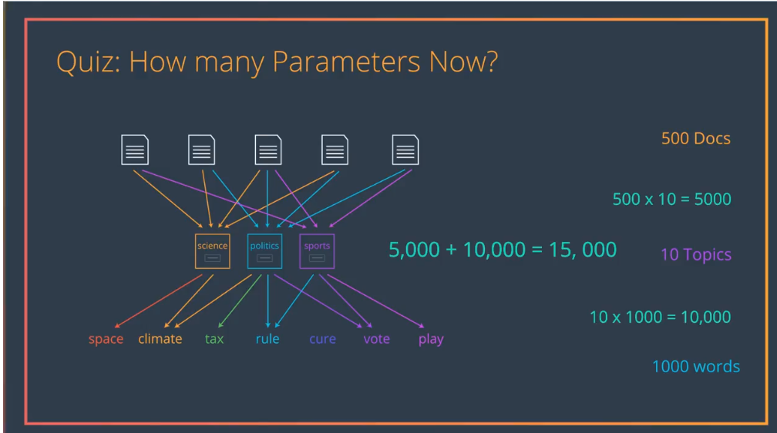
Latent Variables
Notes:
Reduced No of parameters to 15000

Slide 9
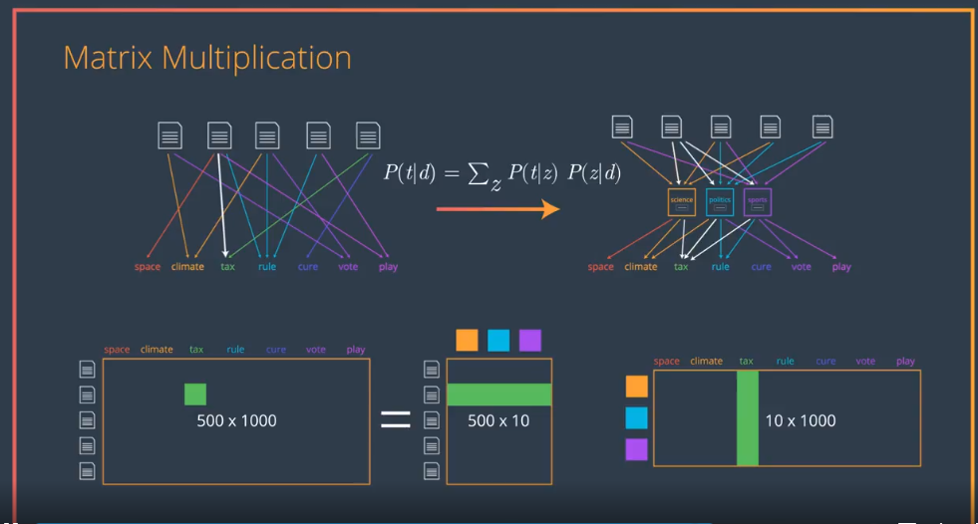
LDA Matrix
Notes:
Document with words = Document term matrix * Term Document matrix

Slide 10
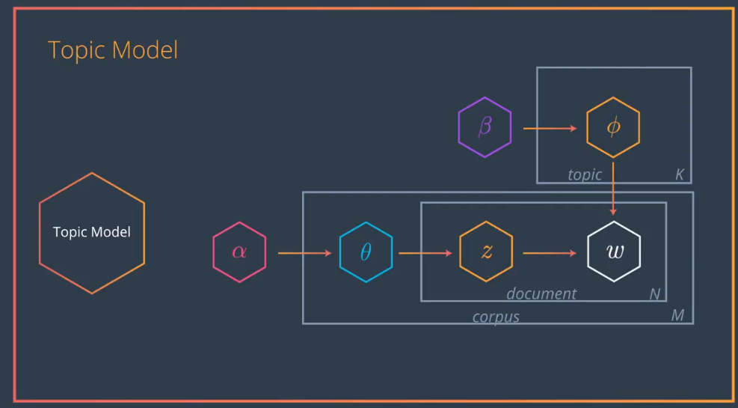
Latent Dirichlet Alocation
Notes:
Probability Distribution of Topic in the Document

Slide 11
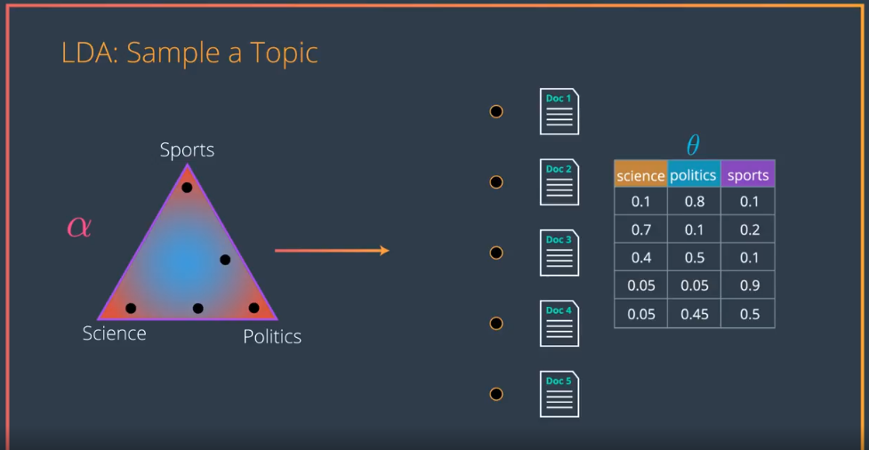
Sample Topic
Notes:
Alpha – pdf Topic
Teta – Probablity of Topic in the Document

Slide 12
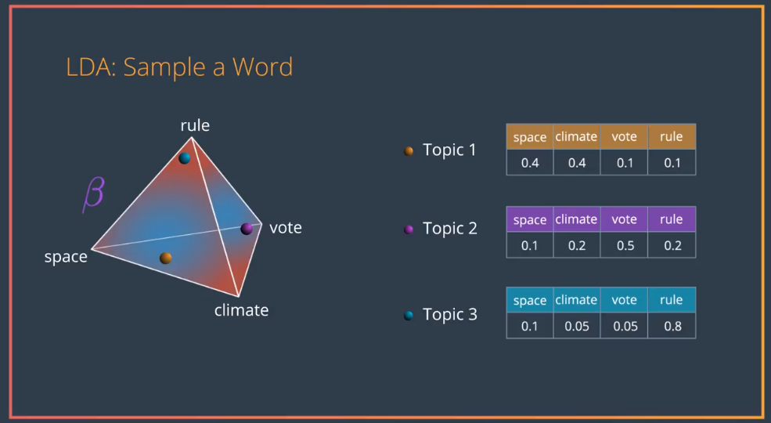
Sample A Word
Notes:
Beat – pdf Words
PI – Probability of words in that topic

Slide 13
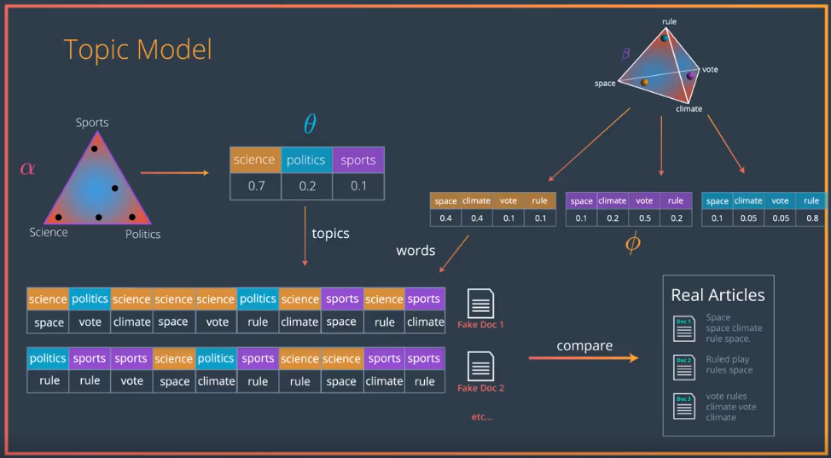
Topic Model

Slide 14
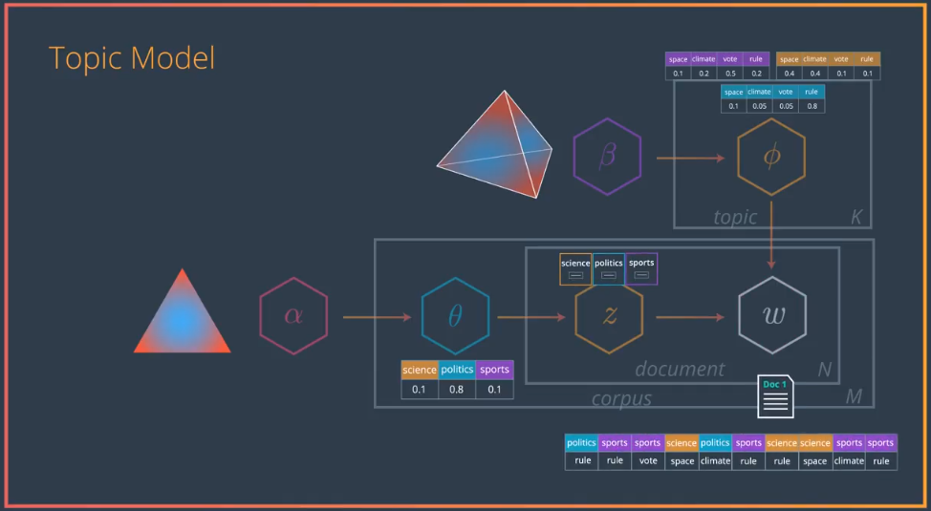
Topic Model - Logic

Slide 15
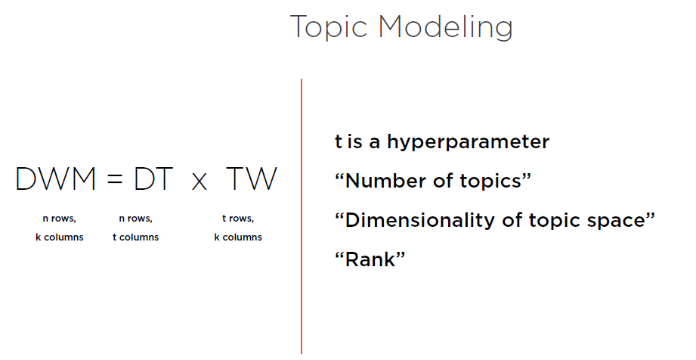

Slide 16
Demo

