Slide 1

Internet of Things and its applications
Pasquale Puzio
Sistemi e Reti Wireless
a.a. 2010/2011
Università di Bologna

Slide 2
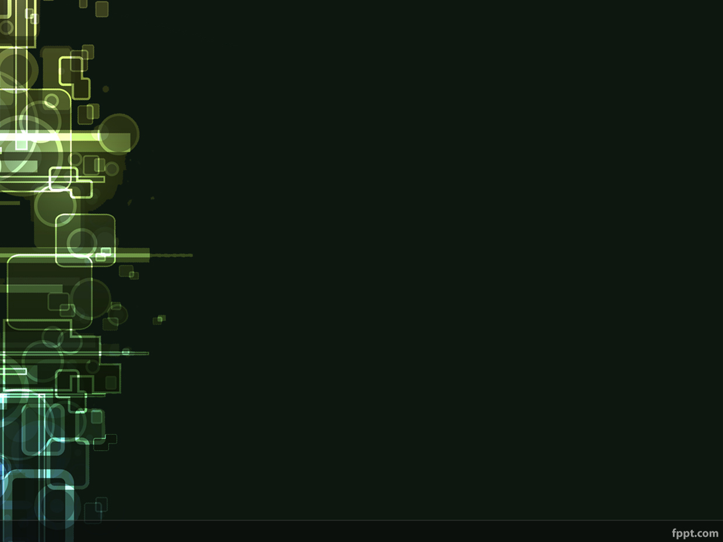
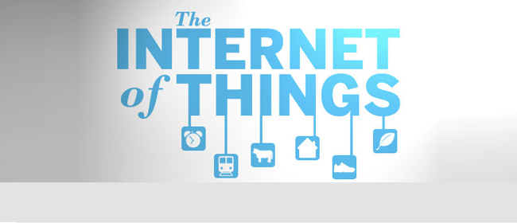
What's Internet of Things

Slide 3
CISCO'S PREVISION
In 2008 the number of things connected to the Internet was greater than the people living on Earth.
Within 2020 the number of things connected to the Internet will be about 50 billion.

Slide 4
Definition
CERP-IOT: Internet of Things (IoT) is an integrated part of Future Internet and could be defined as a dynamic global network infrastructure with self configuring capabilities based on standard and interoperable communication protocols where physical and virtual ‘things’ have identities, physical attributes, and virtual personalities and use intelligent interfaces, and are seamlessly integrated into the information network. In the IoT, ‘things’ are expected to become active participants in business, information and social processes where they are enabled to interact and communicate among themselves and with the environment by exchanging data and information ‘sensed’ about the environment, while reacting autonomously to the ‘real/physical world’ events and influencing it by running processes that trigger actions and create services with or without direct human intervention. Interfaces in the form of services facilitate interactions with these ‘smart things’ over the Internet, query and change their state and any information associated with them, taking into account security and privacy issues.

Slide 5
Features
Univocally identifiable and addressable objects
Artificial Intelligence
Architecture
Geo-Localization
Size Considerations

Slide 6
Tecnologies
RFID
WiFi IEEE 802.11
Barcode e QR Code
ZigBee IEEE 802.15.4
Sensors and smartphones

Slide 7
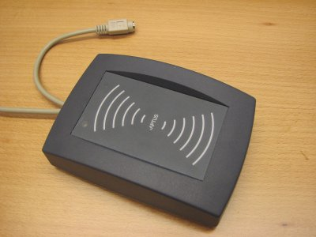
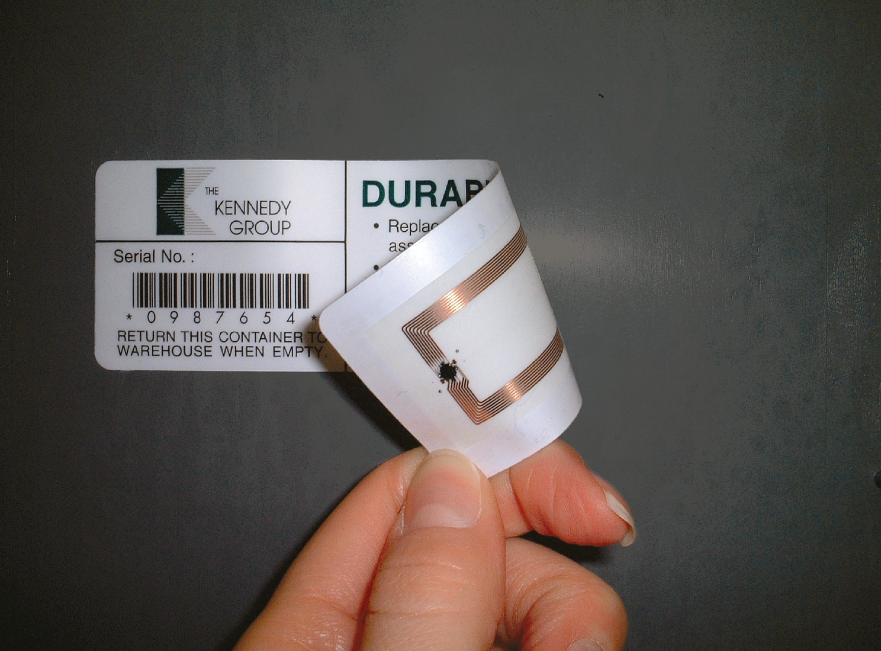
RFID

Slide 8
RFID
Widely used in Transport and Logistics
Easy to deploy: RFID tags and RFID readers
The communication range and the frequency depends on the type of technology

Slide 9
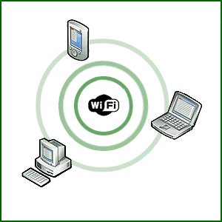
WiFi

Slide 10
WiFi
Very common
Widely used both in indoor and outdoor environments
General purpose
Low cost
Highly interoperable
Maybe not a good solution in some special conditions

Slide 11
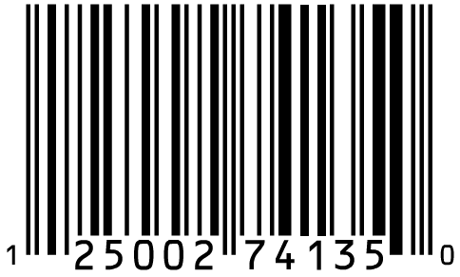
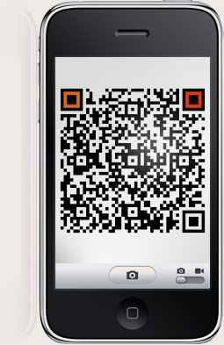
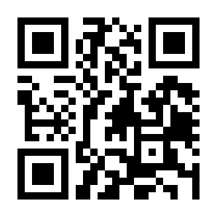
Barcode e QR Code

Slide 12
Barcode e QR Code
Low cost
No technological difficulties
Several devices can read a barcode
Starting point for more complex systems
Example: price comparison

Slide 13
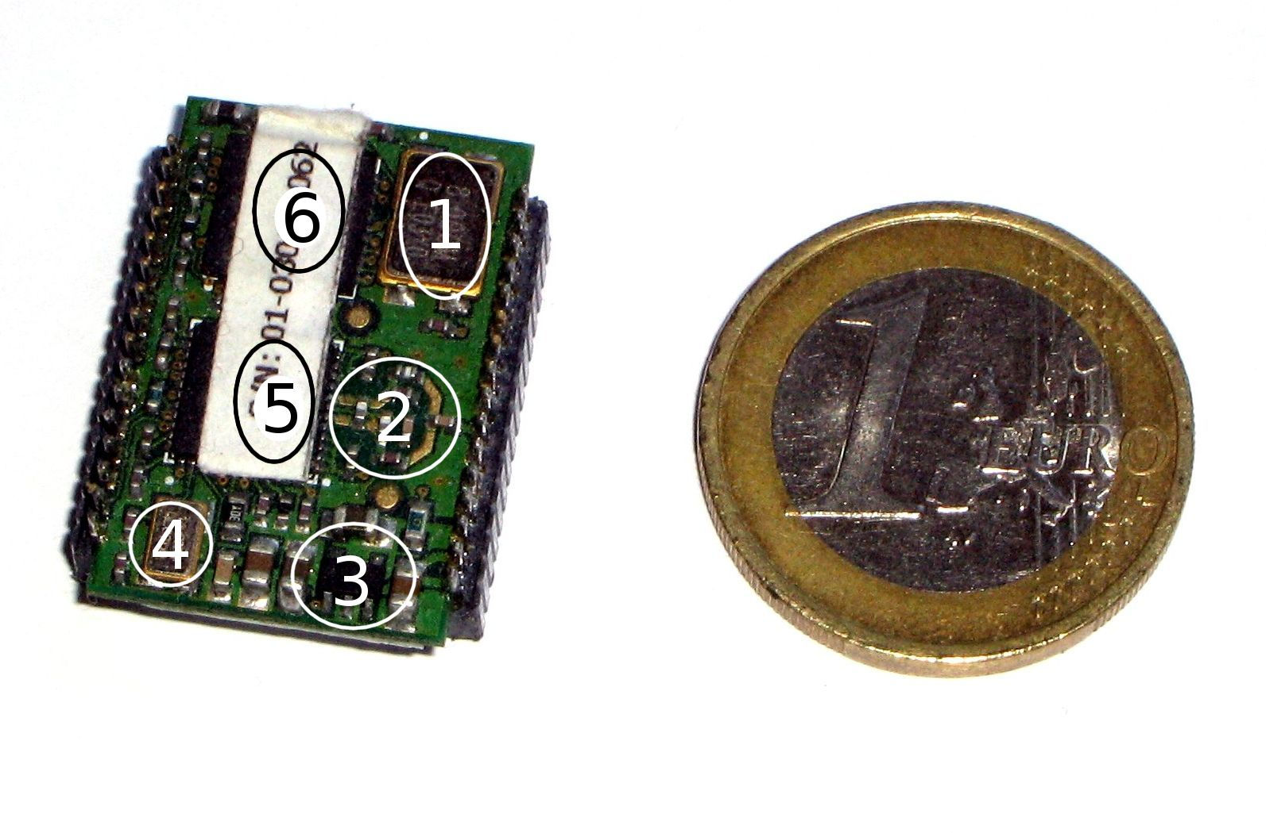
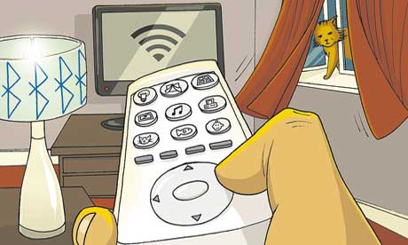
ZigBee

Slide 14
ZigBee
Low cost
Very long battery life
Easy to deploy
Large number of nodes (up to 64770)
Can be used globally
Secure
Ideal for WPAN and mesh networks
Support for multiple network topologies

Slide 15
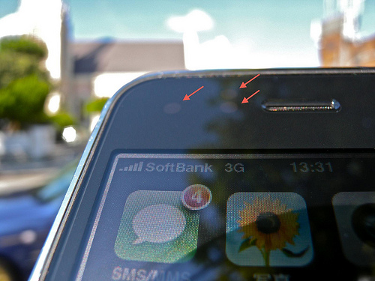
Sensors and smartphones

Slide 16
Sensors and smartphones
In the near future almost everybody will probably have a smartphone
A smartphone isn't just a mobile phone that has access to the Internet
The iPhone has a lot of different types of sensors

Slide 17
Top Applications
Traffic monitoring
Health
Security
Transport and Logistics
Daily life and domotics

Slide 18
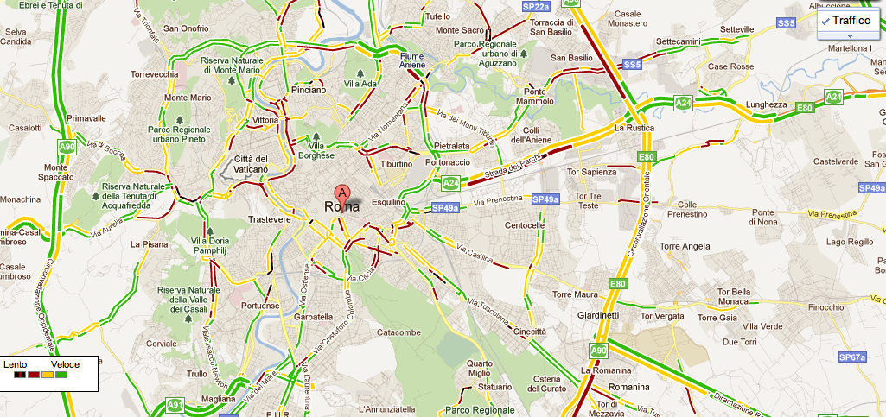
Google Traffic

Slide 19
Google Traffic
Not exactly a IoT application
Example of an application for everyday usage.

Slide 20
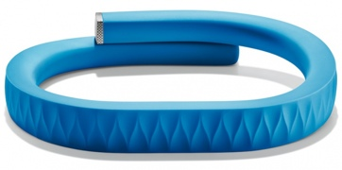
Jawbone UP

Slide 21
Jawbone UP
Linked to an iPhone application
Not just a passive bracelet
The application recommends to change life-style or diet

Slide 22
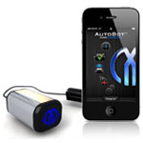
AutoBot

Slide 23
AutoBot
Diagnostics service for cars
Alerts relatives in case of an accident
Discovery service of car position
Integrated with several web services

Slide 24
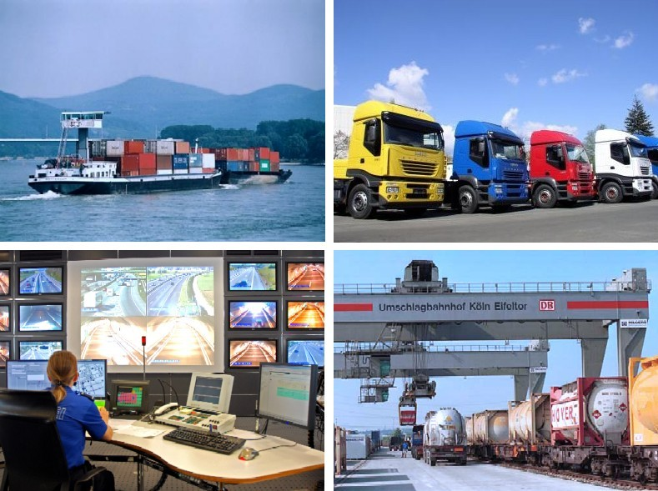
Transport and Logistics

Slide 25
Transport and Logistics
One of the first business sectors interested in IoT technologies
Currently two systems are already available and deployed: ConLock and ContainerSafe
Integration of light sensors, GPS and GSM

Slide 26
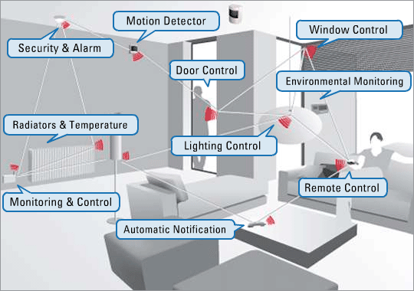
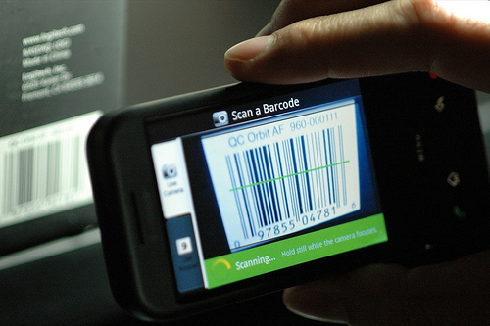
Daily Life and Domotics

Slide 27
Daily Life and Domotics
Many possible developments to Domotics
There are no standard and widely accepted solutions yet for Domotics
A framework has been developed for Home Automation applications: FreeDom

Slide 28
Web of Things
To achieve IoT we need a universal protocol to combine several heterogeneous devices.
This protocol should be: simple, lightweight, loosely-coupled, scalable, flexible and standard.
Sounds like the WEB

Slide 29
Web of Things
Several technologies and protocols already available and widely accepted by the community:
  HTTP, TCP, IPV6, XML, JSON, RSS, ATOM, REST, WS-*, URI, etc.
URI to make the objects easily identifiable and addressable
XML, WS-* and REST to allow the objects to expose their features and to communicate with external or centralized services
Simpler mashup

Slide 30
Semantic Web
Objects (things) are the resources
Ontologies for knowledge representation (information collected by the objects, etc.)

Slide 31
Issues
Privacy
Security

Slide 32
The future of IoT
World sensor networks
Home automation and domotics
Daily life (traffic monitoring, shopping, etc.)
Tracking and shipping of goods
Health
Unpredictable developments...

Slide 33
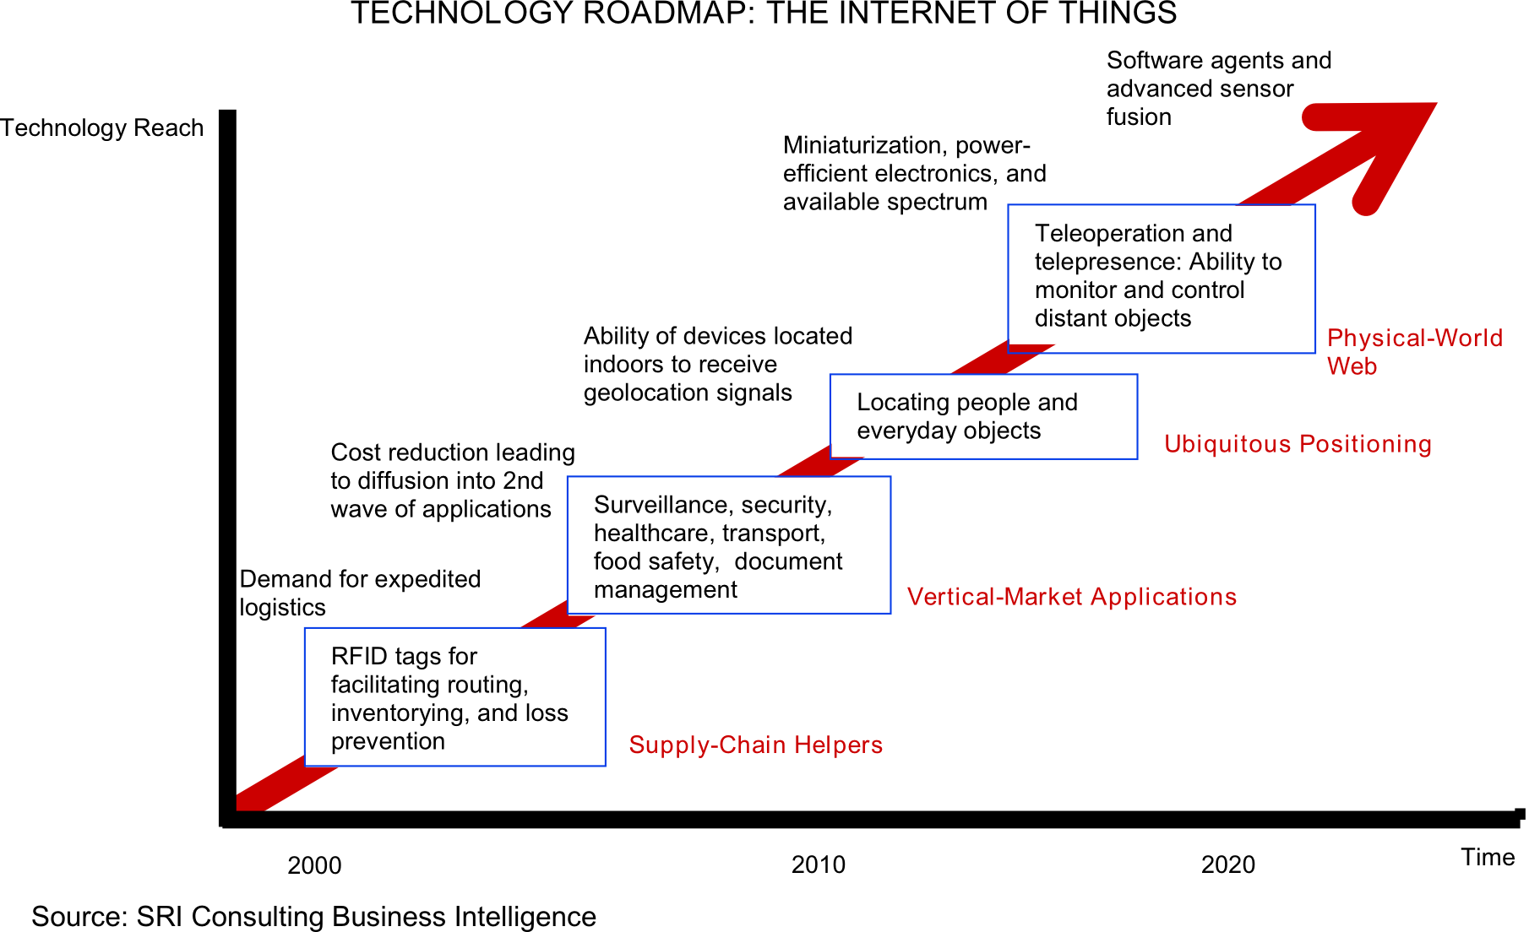
IoT roadmap

Slide 34
References
Kevin Ashton: That 'Internet of Things' Thing. In: RFID Journal, 22. Juli 2009. Abgerufen am 8. April 2011
Cisco: Over 50 billions of devices connected to Internet http://blogs.cisco.com/news/the-internet-of-things-infographic/
Vlad Trifa: HomeWeb and Android at Home – challenges? http://www.webofthings.com/2011/06/10/homeweb-and-android-at-home-challenges/
IoT - Visit the future:
http://www.iot-visitthefuture.eu/index.php?id=108

Slide 35
References
Google Favorite Places: http://www.google.com/help/maps/favoriteplaces/business/barcode.html
Jawbone UP: http://jawbone.com/up/preview
AutoBot: http://mavizontech.com/MeetMavia.htm
IoT for Shipping: http://www.iot-visitthefuture.eu/?id=113
Social Web of Things: http://www.ericsson.com/thinkingahead/idea/110217_social_network_for_you_1968920151_c

Slide 36
References
FreeDom - Open Source Home Automation: http://freedom.disi.unitn.it/
ZigBee Alliance: http://www.zigbee.org/
Web of Things: http://www.webofthings.com/

Slide 37
Thanks for your attention
Questions?

