Slide 1
SUDOKU
BACKTRACKING

Slide 2
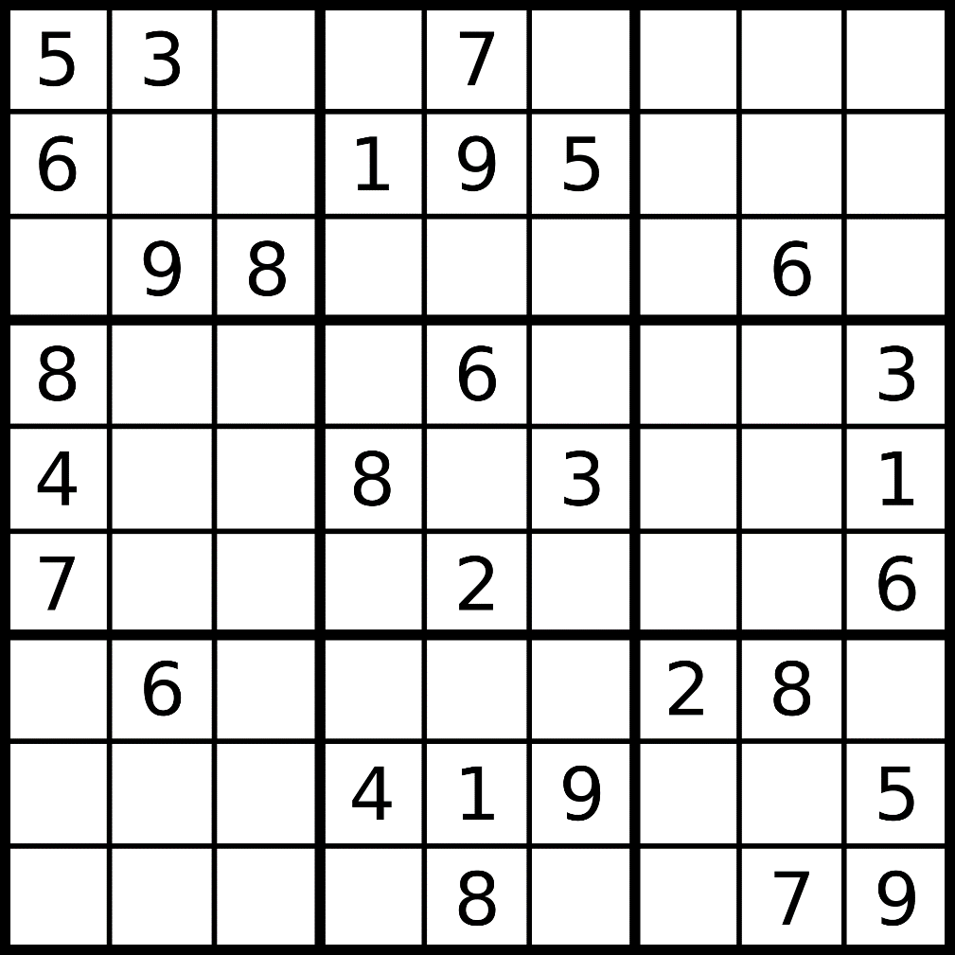

Slide 3
A single box

Slide 4
Sudoku
The aim of sudoku is to fill a 9×9 chessboard-like grid with digits
We have some rules:
Each column + each row, and each of the nine 3×3 sub-grids that compose the grid (boxes) contains all of the digits from 1 to 9
Initially we have → a partially completed grid, which for a well-posed puzzle has a unique solution
The same integer may not appear twice in the same row + column or in any of the nine 3×3 subregions / boxes of the 9x9 grid

Slide 5
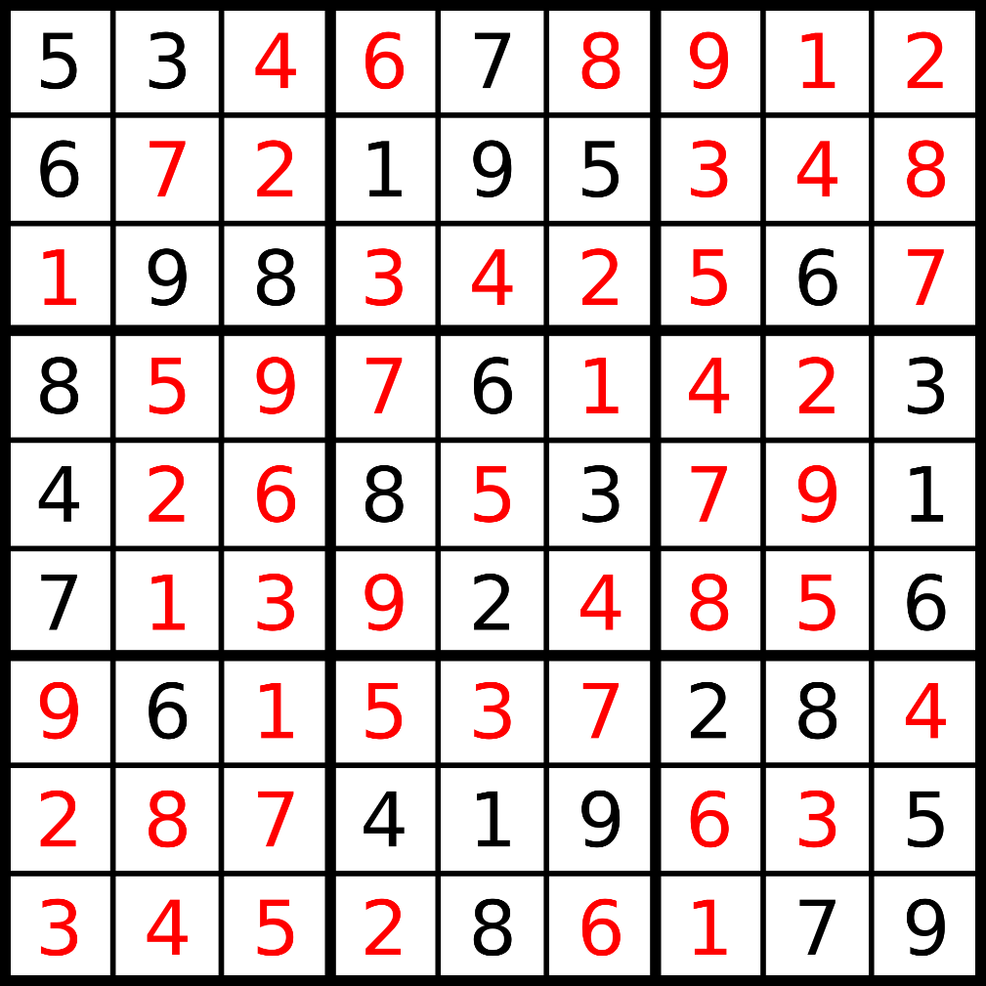

Slide 6
Sudoku
The problem itself is NP-complete
Running time complexity: O(m )
m: number of possibilities for a single cell (9)
n: number of blank fields at the beginning
Backtracking:
Iterates all the possible solutions for the given Sudoku
If the solutions assigned do not lead to the solution of Sudoku, the algorithm discards the solutions and rollbacks to the original solutions and retries again
n

Slide 7
Search tree

Slide 8
Search tree
5
3
6
9
8
5
3
5
3
5
3
5
3
5
3
5
3
5
3
5
3
5
3
6
6
6
6
6
6
6
6
6
1
9
8
2
9
8
3
9
8
4
9
8
5
9
8
6
9
8
7
9
8
8
9
8
9
9
8
BAD
BAD
BAD
BAD
5
3
6
7
1
9
8
5
3
4
6
7
2
1
9
8
GOOD

