Slide 1
NUMERICAL METHODS
INTEGRATION

Slide 2
Trapezoidal formula
Its is a technique for approximating the definite integral
The trapezoidal rule tends to become extremely accurate when periodic functions are integrated over their periods
The error of the formula depends on the second derivative
It follows that if the integrand is concave up (and thus has a positive second derivative), then the error is negative and the trapezoidal rule overestimates the true value.
A concave-down function yields an underestimate because area is unaccounted for under the curve, but none is counted above. If the interval of the integral being approximated includes an inflection point, the error is harder to identify.

Slide 3

$$\int_{a}^{b}{f\left(x\right)dx}$$
So we have an f(x) function and we want to calculate
the integral on in interval [a,b]
Idea: let’s approximate the area under the function with a trapezoid
// calculating the area of a trapezoid is quite simple !!!
f(x)
x
a
b

Slide 4
$$\int_{a}^{b}{f\left(x\right)dx}$$
So we have an f(x) function and we want to calculate
the integral on in interval [a,b]
Idea: let’s approximate the area under the function with a trapezoid
// calculating the area of a trapezoid is quite simple !!!
f(x)
We can approximate with a trpezoid !!!
x
a
b

Slide 5
$$\int_{a}^{b}{f\left(x\right)dx}$$
So we have an f(x) function and we want to calculate
the integral on in interval [a,b]
Idea: let’s approximate the area under the function with a trapezoid
// calculating the area of a trapezoid is quite simple !!!
f(x)
We can approximate with a trpezoid !!!
We approximate the integral with the area of this
yellow area !!!
If the [a,b] interval is small enough -> it is good
x
a
b

Slide 6


$$\int_{a}^{b}{f\left(x\right)dx}$$
So we have an f(x) function and we want to calculate
the integral on in interval [a,b]
Idea: let’s approximate the area under the function with a trapezoid
// calculating the area of a trapezoid is quite simple !!!
f(x)
$$\int_{a}^{b}{f\left(x\right)dx= }$$
~
(b-a)
$$\frac{f\left(a\right)+f(b)}{2}$$
x
a
b

Slide 7
$$\int_{a}^{b}{f\left(x\right)dx}$$
So we have an f(x) function and we want to calculate
the integral on in interval [a,b]
Idea: let’s approximate the area under the function with a trapezoid
// calculating the area of a trapezoid is quite simple !!!
f(x)
Iterative process: we have to make more and more
points on the x axis
x
a
b

Slide 8
$$\int_{a}^{b}{f\left(x\right)dx}$$
So we have an f(x) function and we want to calculate
the integral on in interval [a,b]
Idea: let’s approximate the area under the function with a trapezoid
// calculating the area of a trapezoid is quite simple !!!
f(x)
Iterative process: we have to make more and more
points on the x axis
x
a
b
c

Slide 9
$$\int_{a}^{b}{f\left(x\right)dx}$$
So we have an f(x) function and we want to calculate
the integral on in interval [a,b]
Idea: let’s approximate the area under the function with a trapezoid
// calculating the area of a trapezoid is quite simple !!!
f(x)
Iterative process: we have to make more and more
points on the x axis
x
a
b
c
d
e

Slide 10



Procedure
1.) make N equally spaced domains – for this we need N+1 points
on the x axis as we have seen
2.) make the interval: a = x < x < ... < x = b
h = (b-a) / N this is the grid spacing, the distance between two
points on the x axis
1
2
N+1
$$\int_{a}^{b}{f\left(x\right)dx= }$$
$$\frac{h}{2}$$
$$\sum_{k=1}^{N}{[ f\left(x \right)+f\left(x \right)]}$$
~
k
k+1

Slide 11


Procedure
1.) make N equally spaced domains – for this we need N+1 points
on the x axis as we have seen
2.) make the interval: a = x < x < ... < x = b
h = (b-a) / N this is the grid spacing, the distance between two
points on the x axis
1
2
N+1
$$\int_{a}^{b}{f\left(x\right)dx= }$$
~
$$\frac{b−a}{2N}$$
[ f(x ) + 2 f(x ) + ... + 2 f(x ) + f(x ) ]
1
2
N
N+1

Slide 12
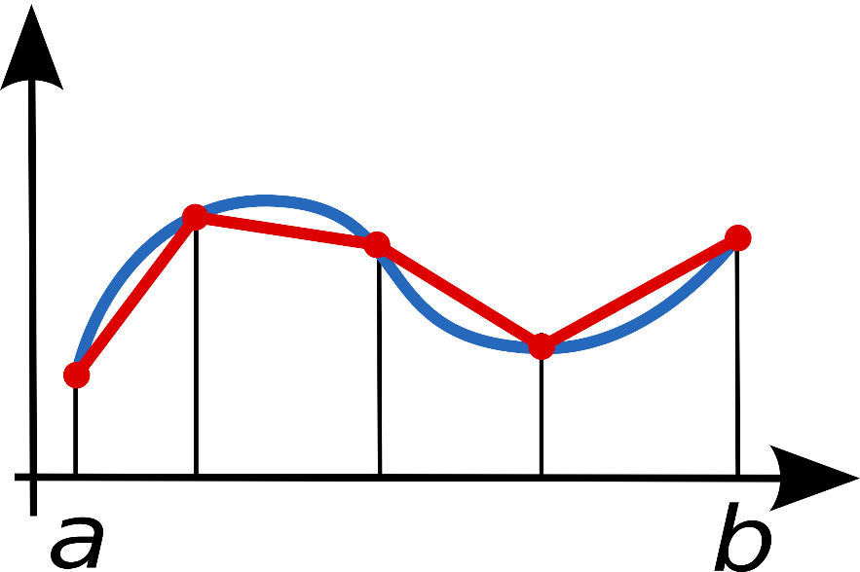
Trapezoidal formula
f(x)
x

Slide 13

Trapezoidal formula
$$\int_{a}^{b}{f\left(x\right)dx=\left(b−a\right)\frac{f\left(a\right)+f(b)}{2}}$$

Slide 14
NUMERICAL METHODS
INTEGRATION

Slide 15
Simpson formula
Simpson's rule is a method for numerical integration, the numerical approximation of definite integrals
Basically it is a quadratic interpolation !!!
The error of the algorithm is proportional to the fourth derivative
Yields better results than trapezoidal rule
Here we have a start point a, and end point b and an additional middle point at (a+b)/2

Slide 16
$\int_{a}^{b}{f\left(x\right)dx=}$ $\frac{b−a}{6}(f\left(a\right)+4f\left(\frac{a+b}{2}\right)+f\left(b\right))$
f(x): the function itself
P(x): the quadratic interpolation
m: the middle point // (a+b)/2
f(x)
P(x)
f(x)
x
a
m
b

Slide 17
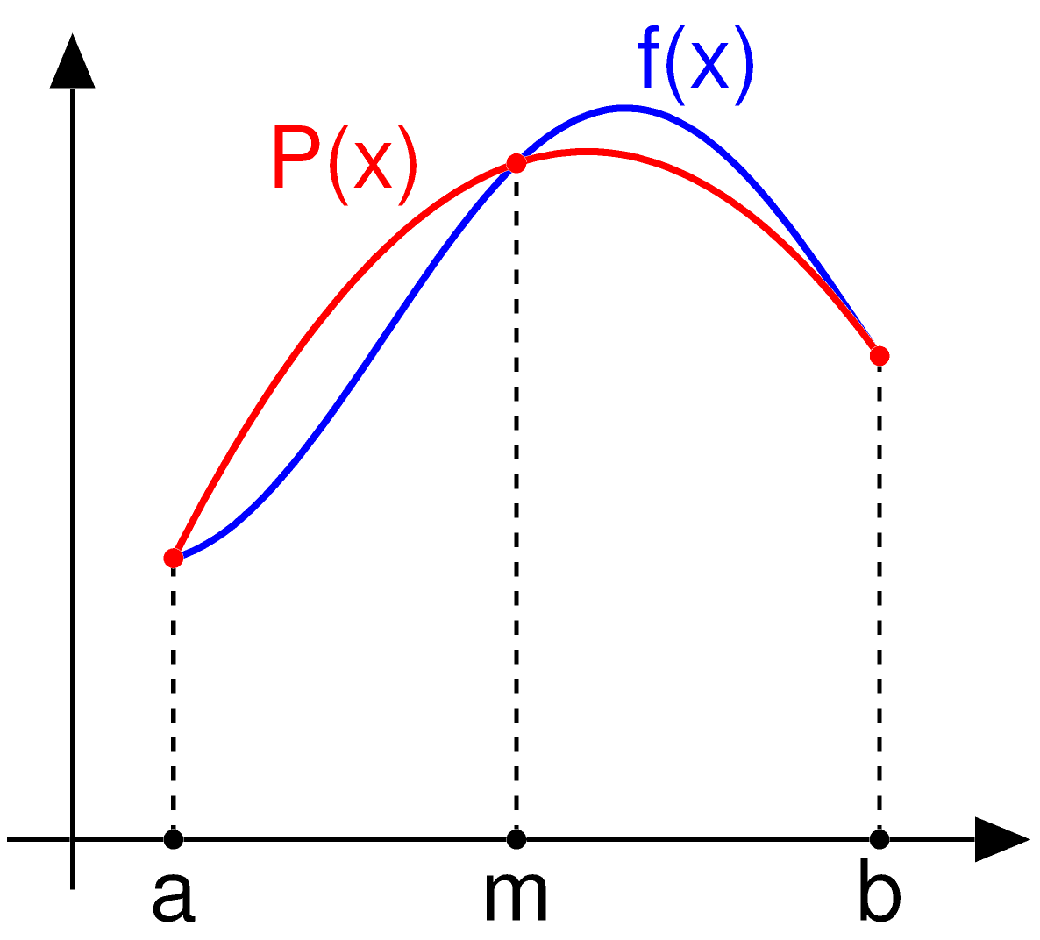
Simpson formula

Slide 18
NUMERICAL METHODS
INTEGRATION

Slide 19
Monte-Carlo integration
Numerically computes a definite integral on a given interval
Monte Carlo approach randomly choose points at which the integrand is evaluated ( non-deterministic approach )
Because of the non-deterministic feature: it may yield different results
Relies on the law of large numbers: uniformly distributed random numbers are needed
This method is particularly useful for higher-dimensional integrals
Very popular technique: in finance, in physics …

Slide 20

$$\frac{1}{\sqrt{N}}$$
the error goes down like this: have to quadruple the number of
simulations to double the accuracy of your approximation
BUT !!! No dependence on dimensions
- in low dimensions: for example integrating f(x) one-dimensional functions
other methods are better
- in high dimensions: it outperforms other methods

Slide 21
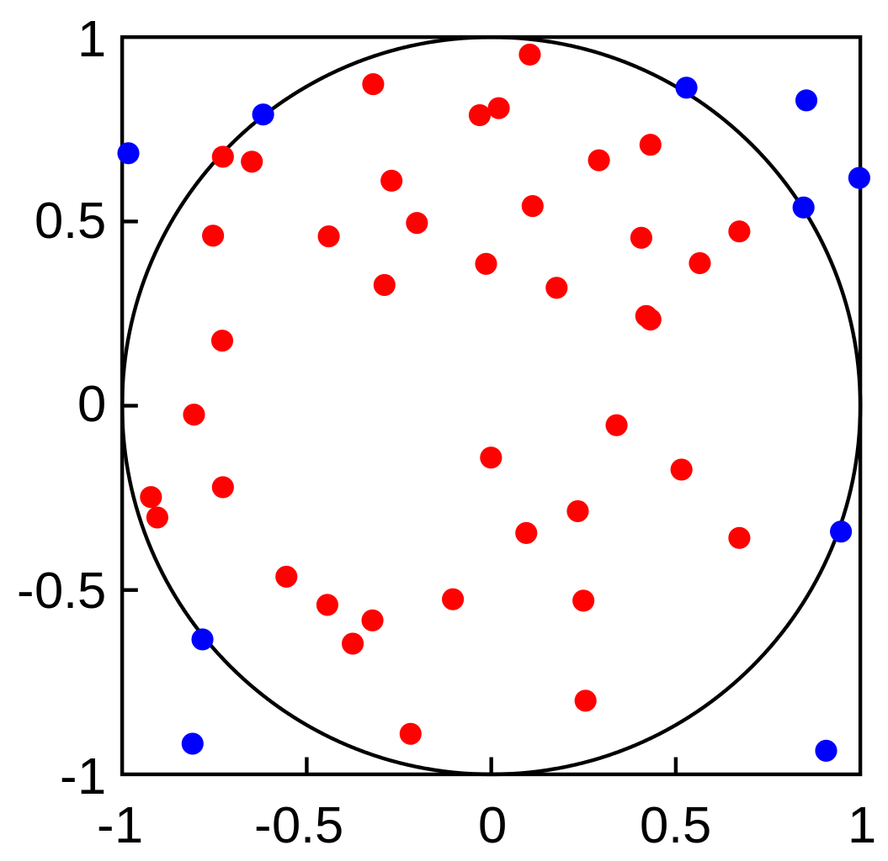




Monte-Carlo integration
2
2
2
x + y = r
equation of a circle
$\frac{T}{T′}$ =
$$\frac{DotsAll}{DotsInside}$$
$T′$ =
$$\frac{DotsAll}{DotsInside}$$
T

