Slide 1
Closest Pair of Points (Algorithmic Problems)

Slide 2
Closest Pair of Points Algorithm
it is a problem of computational geomtery
we are given an array of N points on a two-deimensional plane and the aim is to find the closest pair of points in the array
it has several applications: for example air-traffic control
we may want to monitor planes that are too close - they might collide
brute-force approach has O(N²) quadratic running time complexity and we are after a faster approach
divide-and-conquer approach might help to achieve O(NlogN) time complexity

Slide 3
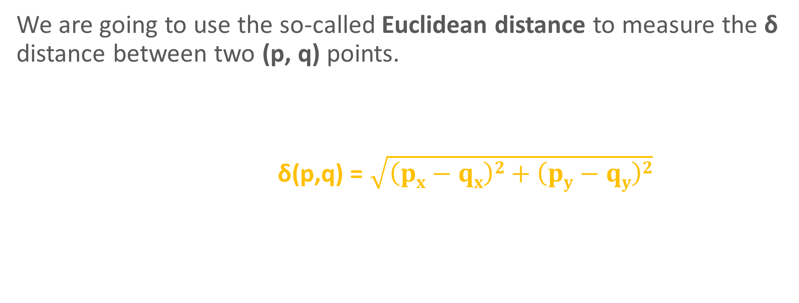
Closest Pair of Points Algorithm
We are going to use the so-called Euclidean distance to measure the δ distance between two (p, q) points.
δ(p,q) = $\sqrt{\left(px−qx\right)2+\left(py−qy\right)2}$
y
_{p(x,y)}
δ
_{q(x,y)}
x

Slide 4
Closest Pair of Points Algorithm
we have to sort all points according to the x coordinates and then according to the y coordinates
divide all points into two subsets with the help of a middle_index
find the minimum distances (δ₁, δ₂) recursively in the two subsets
calculate the minimum distance δ = min(δ₁, δ₂)
check the neighbourhood of the middle line (strip) there may be points that are closer to each other than min(δ₁, δ₂) so find the smallest distance in the strip
finally return min(δ, δ_{strip})

Slide 5
Closest Pair of Points Algorithm
a good question: why to sort the items in advance by the x coordintes and the y coordinates?
after the sorting procedure we just have to walk through the list and compute the δ distance from each point to the one that comes after it in the sorted order
NOW WE HAVE TO CONSIDER ADJACENT ITEMS

Slide 6
Closest Pair of Points Algorithm
this is a typical divide-and-conquer approach
divide into smaller and smaller subproblems recursively
when the subproblem is small (<3) then we can use the brute-force approach
combine solutions of the subproblems to get the final solution for the original problem – this is the conquer phase

Slide 7
Closest Pair of Points Algorithm

Slide 8
Closest Pair of Points Algorithm
divide the points into two
subsets recursively

Slide 9
Closest Pair of Points Algorithm
δ₁

Slide 10
Closest Pair of Points Algorithm
δ₁
δ₂

Slide 11
Closest Pair of Points Algorithm
δ₁
δ₂
δ = min(δ₁, δ₂)
δ
δ

Slide 12
Closest Pair of Points Algorithm
δ₁
δ₂
we have to check in O(N) whether
in this region near the
middle line contains pair
of points that have
less distance than sigma
if we want to guarantee O(NlogN)
overall running time
δ
δ

Slide 13
Closest Pair of Points Algorithm
δ_{min}
δ₁
δ₂
we have to check in O(N) whether
in this region near the
middle line contains pair
of points that have
less distance than sigma
if we want to guarantee O(NlogN)
overall running time
δ
δ

Slide 14
Closest Pair of Points Algorithm
δ₁
δ₂
intuition: finding closest pair of
point in the stip would take
O(N²) time when using
brute-force approach but there
are just a few items this is why
it can be done in O(N)
δ
δ

Slide 15
Closest Pair of Points Algorithm
S is the array with the items
within the strip [x- δ, x+ δ]
As you can see the inner for loop makes
15 iterations at most – constant factor
overall O(N) linear running time
δ₁
for i=1 to |S|-15
for j=1 to 15
brute force distance(i,j)
δ₂
δ
δ

Slide 16
Closest Pair of Points Algorithm
S is the array with the items
within the strip [x- δ, x+ δ]
As you can see the inner for loop makes
7 iterations at most – constant factor
overall O(N) linear running time
δ₁
for i=1 to |S|-7
for j=1 to 7
brute force distance(i,j)
δ₂
δ
δ

Slide 17
Closest Pair of Points Algorithm
Of course we do not have to consider
all the items in the strip: just the ones
within the δ range
this is why there is a constant
(16, 15, 7 or 5) number of items
to be consider
How to find those items? THIS IS
WHY WE HAVE TO SORT THE POINTS
BY THE Y COORDINATES AS WELL !!!
δ₁
δ₂
δ
δ
δ

