Slide 1
Bankruptcy Prevention Project
Exploratory Data Analysis
Presented By: ExcelR Group-2
Garnimitta Venkateswarlu
Baruri Manoj
Tanguturi Sai Pravallika
Bhargavi Rageeru
Varun Ramavtar Pareek
Shital Manik Chavan
Byrebanda Gireesh
Under The Guidance Of
Karthik Muskula

Slide 2
Table of Contents
Introduction
Overview of the Project
Objectives
Exploratory Data Analysis (EDA)
Data Quality Assessment
Visualizations
Feature Relationships
Data Preprocessing
Handling Missing Values
Outlier Treatment
Feature Selection Techniques
Addressing Class Imbalance
Down Sampling
Up Sampling Techniques
SMOTE Method
Conclusion
Summary of Findings
Future Work

Slide 3
Business Objective:
This project aims to classify whether a business is likely to go bankrupt or not based on various risk factors. The target variable is binary, indicating either bankruptcy or non-bankruptcy. The goal is to model the probability of a business going bankrupt using the given features.
Data Description:
The dataset contains 7 features for around 250 companies, each representing different business risks and flexibility.
Below is a description of the variables in the dataset:
Feature | Values
Industrial Risk | 0 = Low, 0.5 = Medium, 1 = High
Management Risk | 0 = Low, 0.5 = Medium, 1 = High
Financial Flexibility | 0 = Low, 0.5 = Medium, 1 = High
Credibility | 0 = Low, 0.5 = Medium, 1 = High
Competitiveness | 0 = Low, 0.5 = Medium, 1 = High
Operating Risk | 0 = Low, 0.5 = Medium, 1 = High
Class (Target Variable) | Bankruptcy, Non-Bankruptcy

Slide 4
Data Preprocessing
1. Data Cleaning
Handling Missing values : Checked for the missing values in the data but there are no null values or missing values in the data set.
Handling Replicated records : There are 147 replicated (duplicated ) rows , those are removed from the dataset to avoid overfitting of the model.
2. Handling Outliers
Here there are only categorical features in the dataset so there are no outliers in the dataset.
3. Encoding Categorical Variables
All the features are categorical and independent features are already in the format of label encoded data, hence the dependent (target) feature is Label Encoded.
4. Feature Scaling
Scale of each features is same ( 0 to 1 ) Hence the scaling is not performed, if necessary the normalization is preferred.

Slide 5
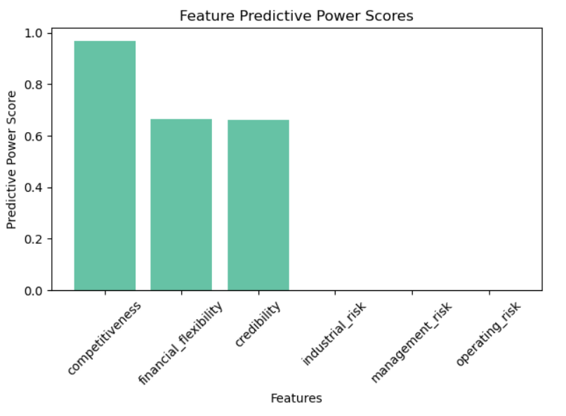
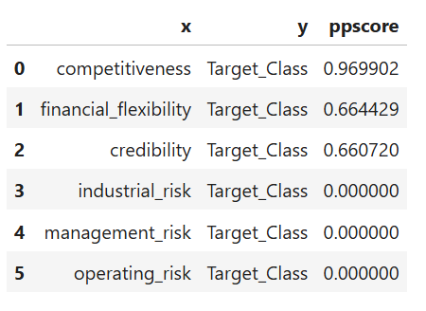
Feature Selection
We applied feature selection to remove redundant and less important features, aiming to improve model accuracy and reduce complexity
Methods Used
PPS Matrix
Hence all the features are categorial in nature so we have performed correlation between Target feature and Independent features using PPS

Slide 6
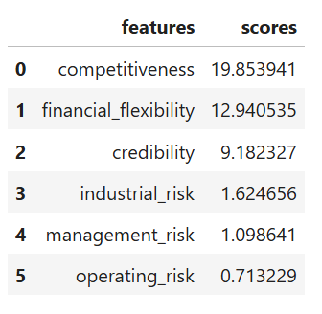
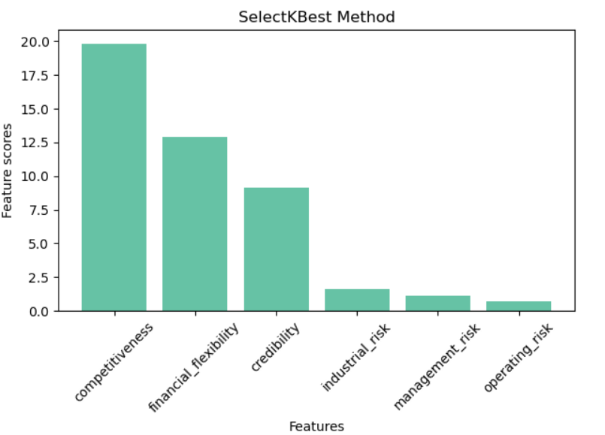
Feature Selection Contd..
2. SelectKBest Method
SelectKBest selects the top K most relevant features based on statistical tests like Chi-Square or ANOVA. It helps improve model performance by focusing on the best features and reducing noise.

Slide 7
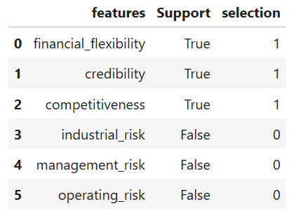
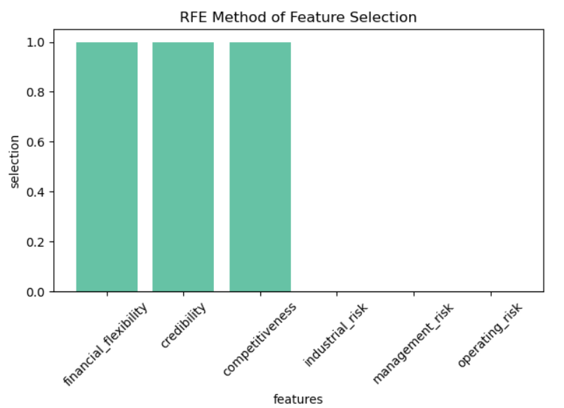
Feature Selection Contd..
3. Recursive Feature Elimination (RFE)
Recursive Feature Elimination (RFE) is a feature selection method that iteratively removes the least important features based on a model's performance. It retains the most significant features to improve model accuracy and reduce complexity.

Slide 8
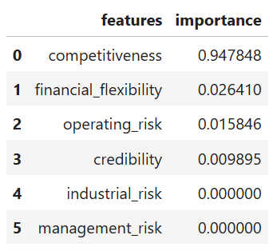
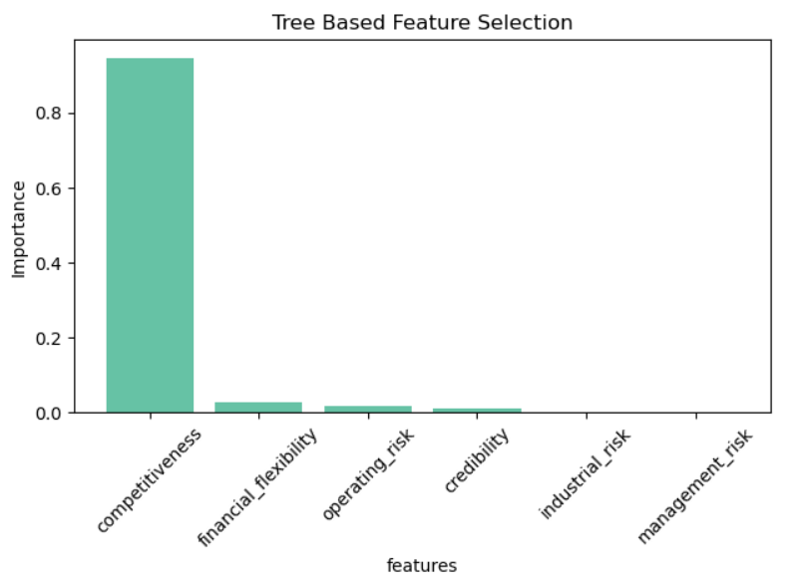
Feature Selection Contd..
4. Tree-Based Feature Selection
Tree-Based Feature Selection uses algorithms like decision tree, random forest etc. to evaluate feature importance based on how well they contribute to model predictions. Features are ranked by their impact on reducing impurity or improving accuracy.

Slide 9
Handling Imbalance Data
After dropping the duplicated rows the dataset has only 103 records , among them 78 records are related to non_bankruptcy and only 25 records are related to bankruptcy so we have to handle this imbalance data to avoid bias in prediction.
Down Sampling
Balancing the dataset by decreasing the class which has highest number of records to number of records in lowest class.
but dataset size is small if we perform down sampling the data set reduced to 50 points thus the model building becomes complicated thus avoid down sampling and go with upsampling.
Up Sampling
Up sampling increases the number of data points in the minority class to match the majority class.
we have used the SMOTE method which generates synthetic data by analyzing the existing data points.
After applying SMOTE, the dataset was balanced, resulting in a total of 156 records—78 for the majority class and 78 for the minority class.

Slide 10
EDA Conclusion
In conclusion, the Exploratory Data Analysis (EDA) provided valuable insights into the dataset, revealing patterns, trends, and relationships among features. Key findings include:
Data Quality: Identified and addressed missing values and outliers to improve data integrity.
Feature Importance: Through various selection methods, we determined the most relevant features for predicting bankruptcy.
Class Imbalance: Recognized the imbalance in class distribution and opted for up sampling to enhance model training.
Overall, the EDA laid a strong foundation for subsequent model building, ensuring that the dataset is both informative and well-prepared for analysis.

Slide 11
Next Steps
Model Building
Train multiple models using the balanced dataset to identify the best-performing algorithms.
Model Testing
Evaluate model performance using metrics such as accuracy, precision, recall, and F1-score on a separate test set.
Comparing Models
Compare the results of different models to select the most effective one for predicting bankruptcy.
Model Deployment
Deploy the chosen model into a production environment for real-time predictions and monitoring.
Continuous Improvement
Regularly update the model with new data and refine it based on performance feedback.

