Slide 1
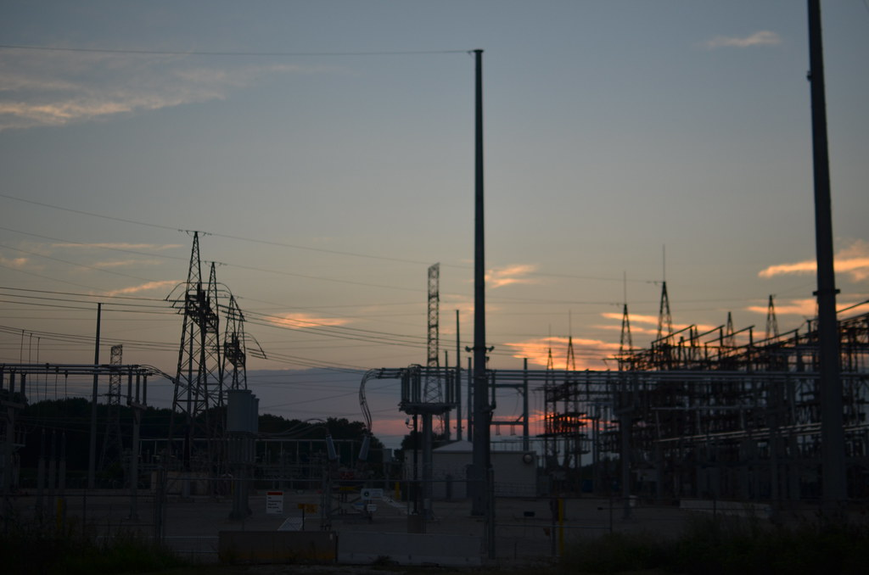
INDUSTRY INTERNSHIP
#SUMMER VACATION
This Photo by Unknown Author is licensed under CC BY-NC

Slide 2

JNTUA COLLEGE OF ENGINEERING, KALIKIRI.
BACHELOR OF TECHNOLOGY
in
ELECTRICAL AND ELECTRONICS ENGINEERING
SHORT TERM INTERNSHIP
in
132KV/33KV SUBSTATION AP TRANSCO, BANAGANAPALLI.
by
PUNNA SUDHA KIRAN 21KA5A0212
Under the external guidance of
Mr. B. LUKE PRAKASH
DEPUTY EXECUTIVE ENGINEER
AP TRANSCO
Under the Internal Guidance of
Mrs. M. MEHETAJ M.Tech
ASSISTANT PROFESSOR
Department of EEE

Slide 3
CONTENTS:
Abstract
Objectives
Introduction
Observations
Conclusion

Slide 4
ABSTRACT
Under the supervision of the Deputy Executive Engineer 132KV/33KV substation AP TRANSCO. Internship went for 8 weeks With the reference of our HOD. The internship gave us essential practical knowledge and real time work experience. We have learnt a lot of things related to transmission substation which includes lightning arrestors, capacitive voltage transformers, wave traps, current transformers, circuit breakers, isolators, potential transformers, bus bars, Power transformer, capacitor banks, control room, Incoming and outgoing feeders, load relief, line clear, maintenance and safety precautions. We also learnt a lot of conceptual things from Assistant Executive Engineer of that substation.

Slide 5
OBJECTIVE:
To gain practical knowledge.
To get real time work experience.
To know the need of the substation.
To get a clear idea of working of every equipment in substation.
To improve communication and interaction with the working staff and higher authorities.

Slide 6
INTRODUCTION:
The rating of the substitution is 132KV/33KV.
It comes under AP TRANSCO.
It is located in Banaganapalli, which is 35 KM away from Nandyal.
There are 2 incoming 132KV feeders, one is coming from Nandyal and the another is coming from Vemulapadu.
There are 4 stepped down 33KV outgoing feeders and 2 out going 33KV outgoing feeders.

Slide 7
OBSERVATIONS:
Single line diagram
Lightning Arrestors
Capacitive Voltage Transformer (CVT)
Wave Trap
Current Transformer (CT)
Circuit Breaker
Isolator
Busbars
Potential Transformer (PT)
Power Transformer
Control Room
Capacitor Bank

Slide 8
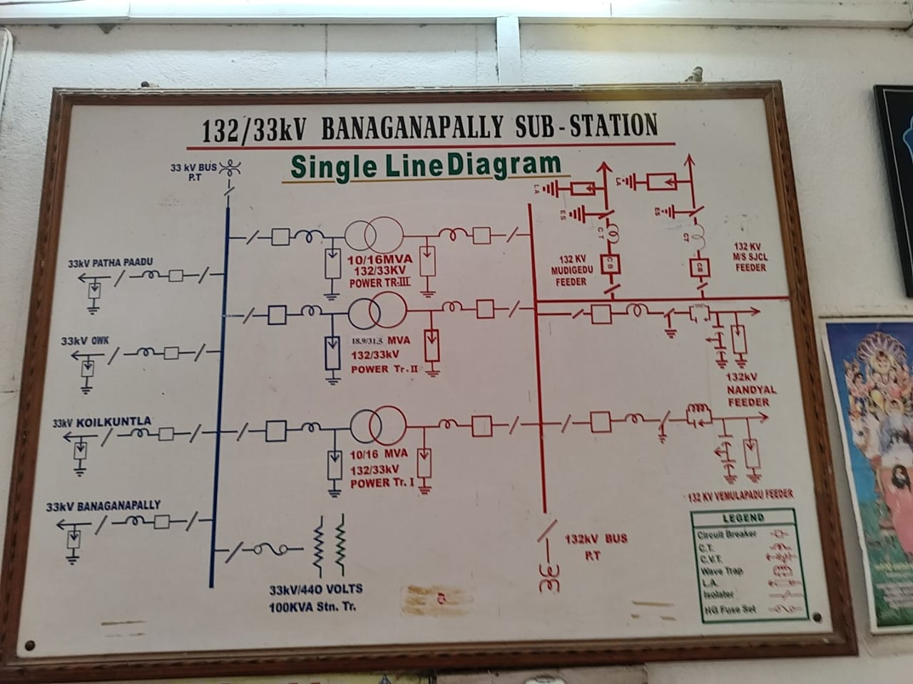
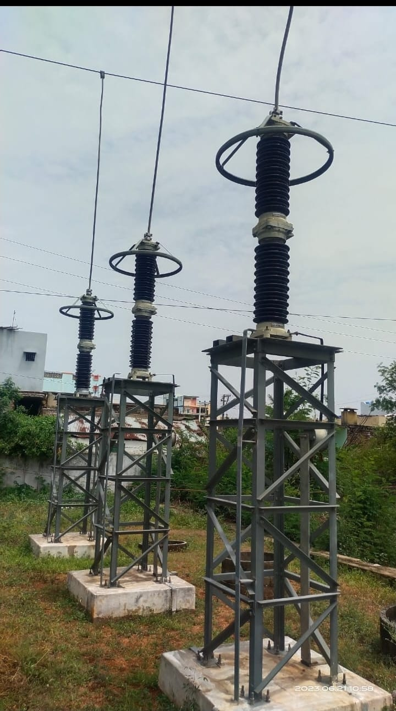
SINGLE LINE DIAGRAM:
It is a symbolic or graphical representation of a three-phase power system.
Simply, it’s the plan of the substation showing the layout and equipment in short.
Fig.1: Single line diagram
LIGHTNING ARRESTORS:
They protect structures and electrical systems from the damaging effects of lightning strikes.
It is made up of non linear resistive material which do not allow high voltage to pass through it and allows the high voltage to pass through the Earth.
Its ratings are 10 KA, 120 KV.
Fig.2: Lightning Arrestors

Slide 9
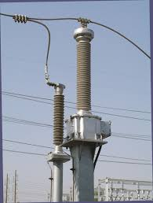
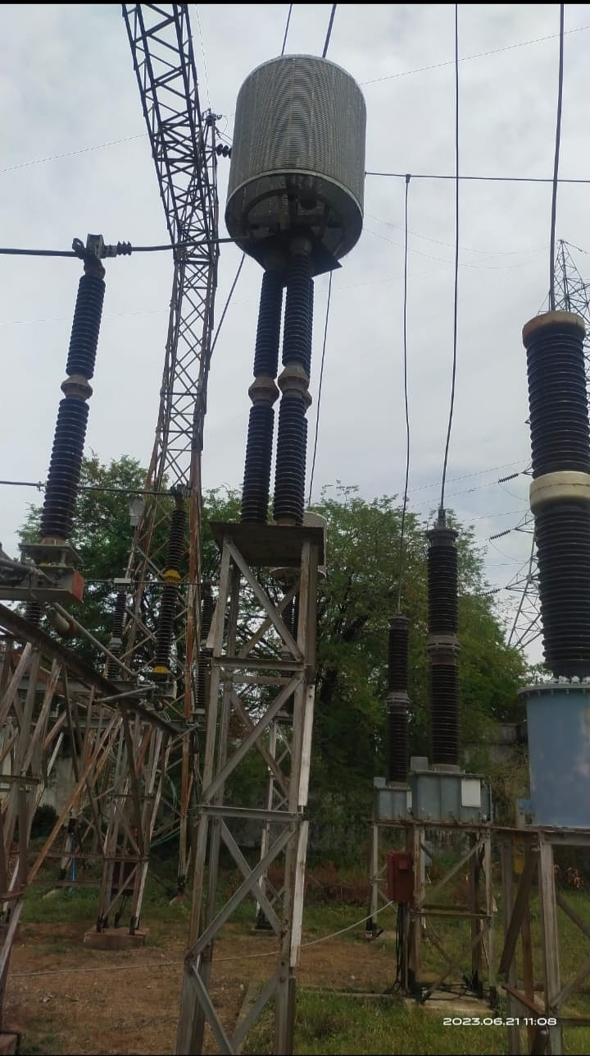
CVT:
Capacitive voltage transformer (CVT) is a type of instrument transformer used to measure high-voltage electrical potentials and provide a reduced voltage output proportional to the input voltage.
It is commonly used in electrical power systems for voltage measurement and protection purposes.
The rating of CVT is 4400pF.
Fig.3: CVT
WAVE TRAP:
It isolates or attenuates certain frequencies which are not power frequencies.
This is achieved by creating a resonant circuit that is tuned to a specific frequency or range of frequencies.
The name plate details are, Type: Suspension, Inductance: 0.2, Capacity: 630A, Blocking band 250-500KHz.
Fig.4: Wave Trap

Slide 10
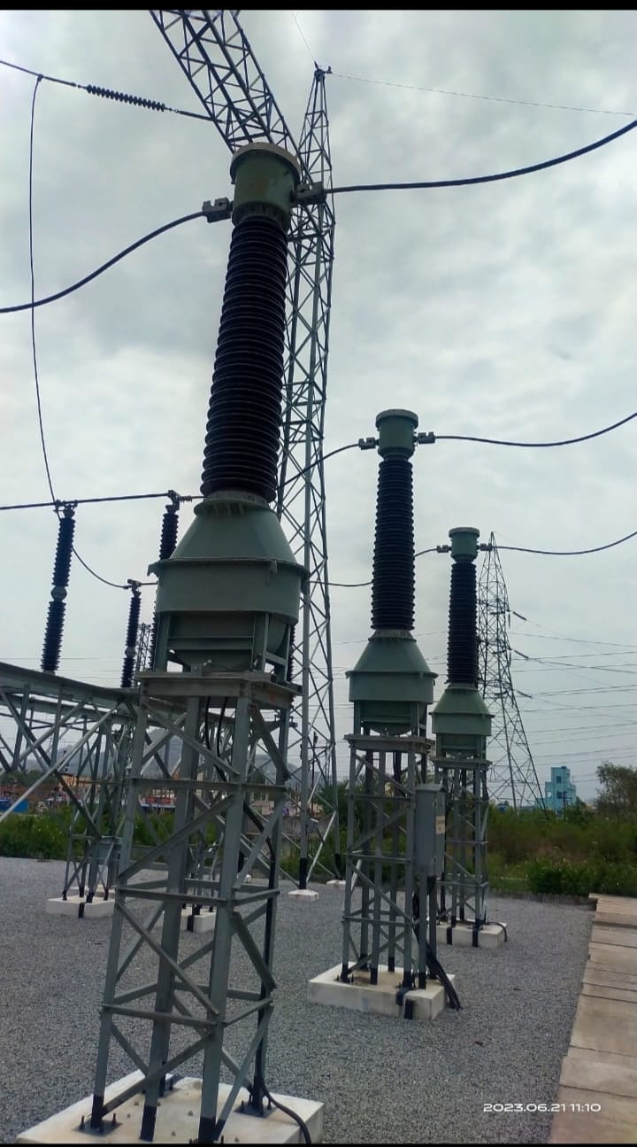
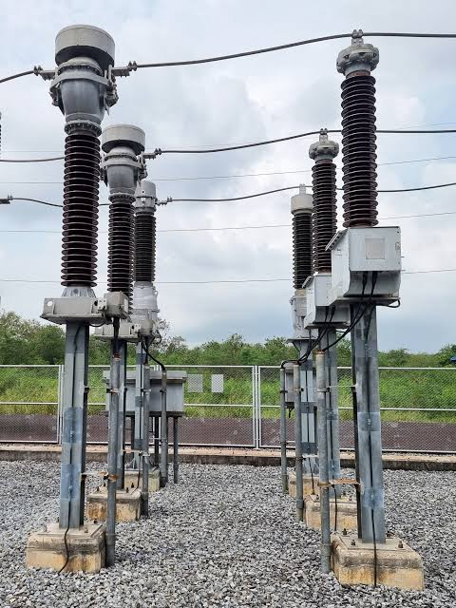
CURRENT TRANSFORMER:
It steps down high currents to a level suitable for measurement or protection devices.
It provides galvanic isolation and accurate current measurements, making it essential for various applications in power systems.
Its ratings are 132 KV, 300/1A.
Fig.5: C.T
POTENTIAL TRANSFORMER:
Its primary function is to step down high voltages to a lower, more manageable level for measurement, control, and protection purposes.
Its ratings are 132 KV/110 V.
Fig.6: P.T

Slide 11
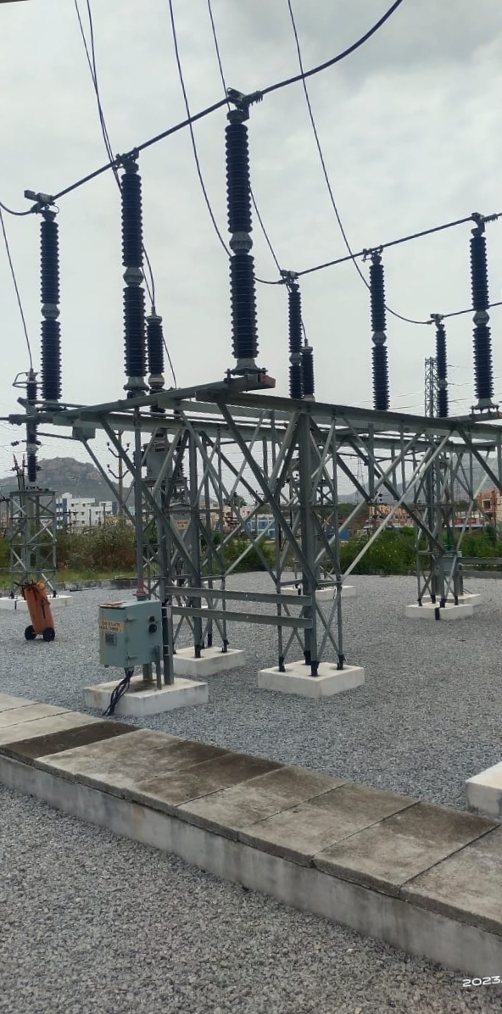
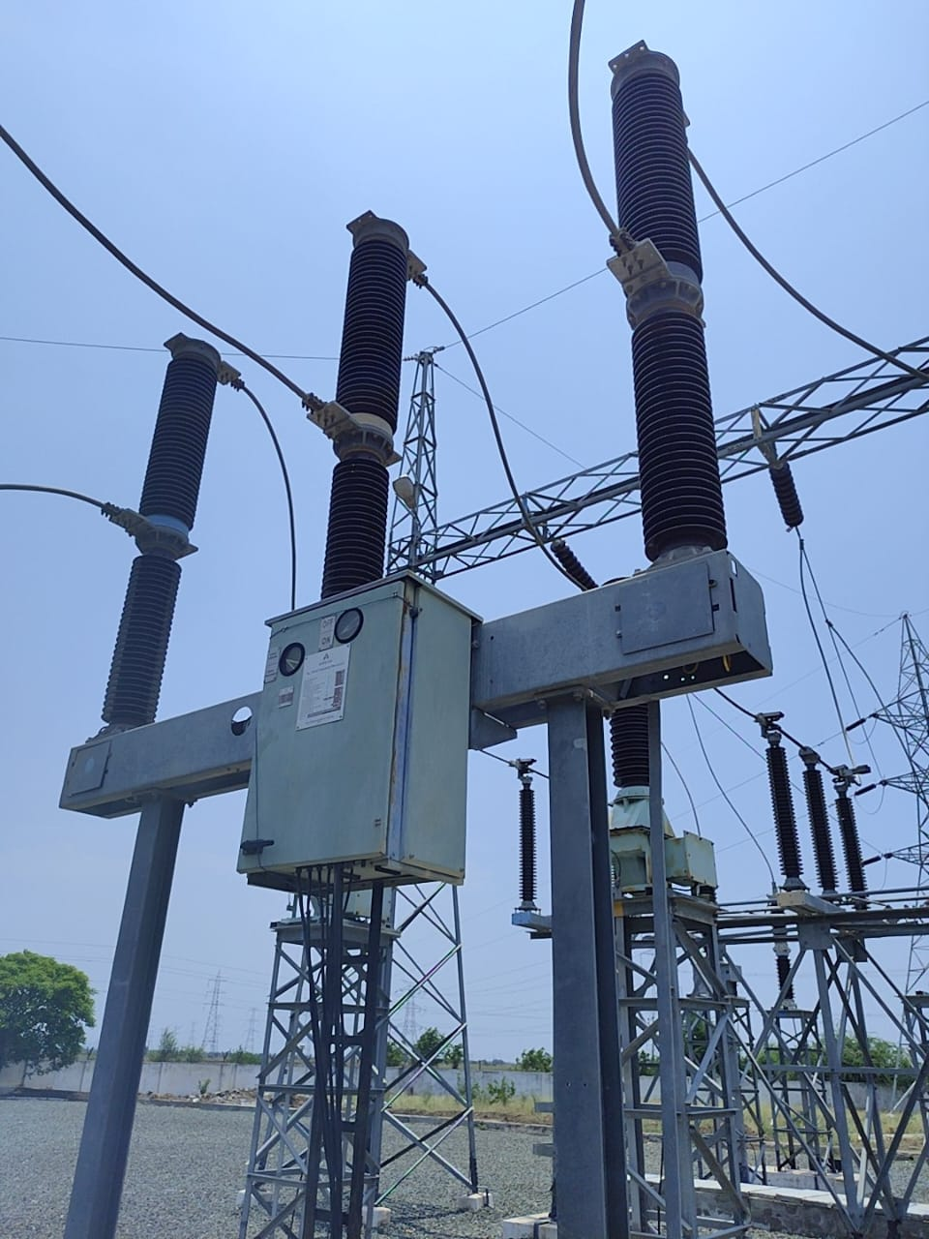
ISOLATOR:
It provides a visible break in the electrical circuit. Unlike a circuit breaker, which is designed to interrupt the current flow under normal or fault conditions, an isolator is primarily used for isolation purposes and is not intended to interrupt currents.
The ratings of isolators are 800A (H.V), 400A (L.V).
Fig.7: Isolator
CIRCUIT BREAKER:
It is an electrical switch that automatically interrupts the flow of electric current when it detects a fault or an overload in a circuit.
It protects electrical circuits and prevent damage to equipment and potential hazards such as electrical fires.
Its ratings are 3150 A, 145 KV for H.V side and 1250 A, 36 KV for L.V side.
Fig.8: Circuit Breaker

Slide 12
The ratings of Circuit Breakers are,
For 132 KV side SF6 circuit breaker is used.
For 33 KV side vaccum circuit breaker is used.
Rated lighting impulse withstand voltage : 650 KV
Rated short circuit breaking current : 31.5 KA
Rated operating pressure : 15 kg/cm^2-g
Rated duration of short circuit current : 31.5 KA for 3 sec
Rated voltage : 145 KV
Rated normal current : 3150 A
Rated gas pressure : 5 kg/cm62-g
Rated normal current : 1250 A
Rated normal voltage : 36 KV
Short circuit braking current : 25 KA
Short time current : 25 KA for 3 sec

Slide 13
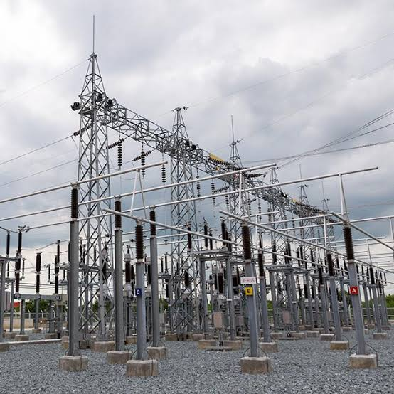
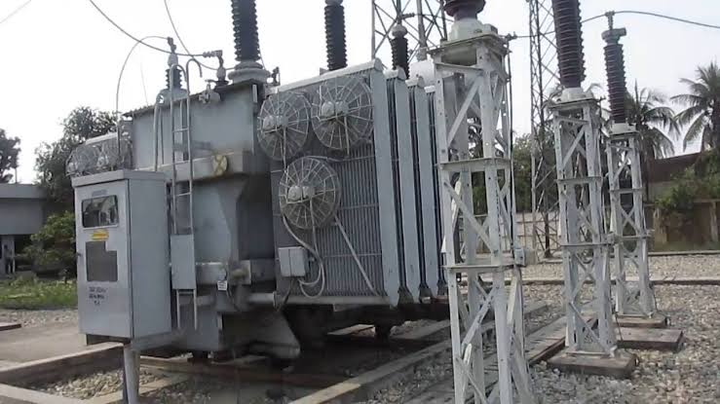
BUSBAR:
It is a conductive bar or a system of bars that is used to distribute electric power within the facility.
It serves as a common electrical junction point where multiple incoming and outgoing electrical circuits or equipment are connected.
Fig.9: Busbar
POWER TRANSFORMER:
It is used to transfer electrical energy between different voltage levels.
It is a static device that does not contain any moving parts and operates based on the principles of electromagnetic induction.
Its ratings are 18.9/31.5 MVA, 132 KV/33 KV.
Fig.10: Power Transformer

Slide 14
The ratings of power transformer are,
Rating: 31.5 MVA
Rated voltage (HV): 132 KV
Rated voltage (LV): 33 KV
Rated current (HV): 137.77 A
Rated current (LV): 551.10 A
Temperature rise oil: 50 C
Temperature rise winding: 55 C
Rating: 16 MVA
Type of cooling: ONAF
Temperature rise oil over: 40 C
Voltage at (HV/LV): 132/33 KV
Line current at HV side: 69.981 VA
Line current at LV side: 279.527 A
Temperature rise winding over: 45 C
Type of cooling: ONAF

Slide 15
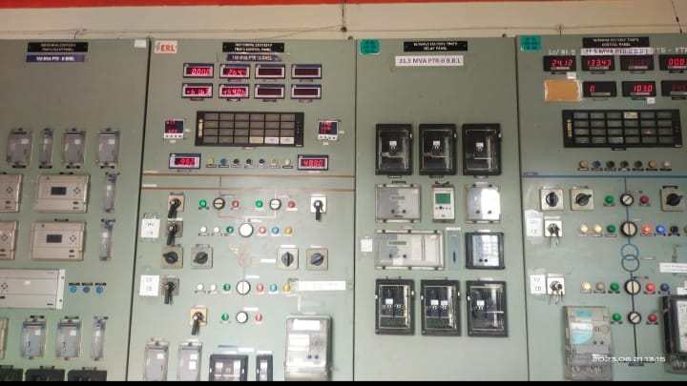
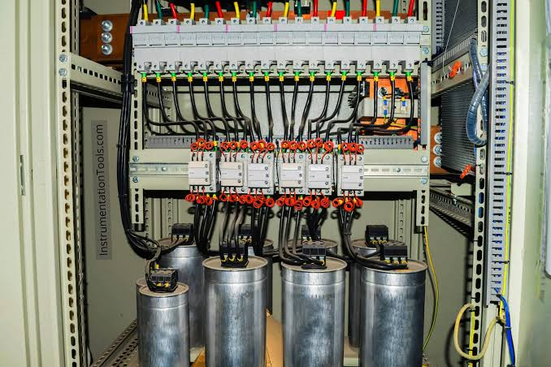
CONTROL ROOM:
It is a centralized location where operators monitor, control, and manage the electrical equipment and processes within the substation.
It serves as the nerve center for the substation's operations, allowing operators to make informed decisions and take necessary actions to ensure the safe and reliable operation of the electrical system.
Fig.11: Control Room
CAPACITOR BANK:
It is a group or collection of individual capacitors that are connected together in parallel or series to achieve a higher capacitance value or to provide specific electrical characteristics.
Fig.12: Capacitor Bank

Slide 16
CONCLUSION:
Finally, with this industrial internship, There is chance of gaining a lot of practical knowledge regarding electrical transmission substation. One can get a real time work experience and have a clear idea of working of every equipment in substation and also can improve communication and interaction with the working staff and higher authorities. Finally, It is a very good learning program for a student.

Slide 17
Thank you

