Slide 1

Jawaharlal Nehru Technological University Anantapur
College of Engineering, Kalikiri
Department of Electrical and Electronics Engineering
SHORT TERM INTERNSHIP
AT
AP TRANSCO 132/33 KV substation, Banaganapally, Nandyal (Dist.), AP
Under the external guidance of Under the internal guidance of
Mr. B. Luke Prakash Mrs. M. Mehetaj, M.Tech
Deputy Executive Engineer Assistant professor (Adhoc)
AP TRANSCO 132/33 KV SS Department of EEE
Banaganapally, Nandyal (Dist.) JNTUA college of Engineering
Andhra Pradesh Kalikiri, Annamayya (Dist.), AP
Presented by
P. Krishna Pradeep Reddy – 21KA5A0201

Slide 2
CONTENTS
ABSTRACT
OBJECTIVES
INTRODUCTION
SINGLE LINE DIAGRAM OF SUBSTATION
EQUIOMENT IN SUBSTATION
CONCLUSION

Slide 3
ABSTRACT :
The short-term internship at the AP TRANSCO 132/33 KV substation in Banaganapalli, Nandyal (District), the main objective is to gain hands-on experience with the operation and maintenance of the equipment at the substation. This substation is equipped with two incoming 132 KV feeders and four outgoing 33 KV feeders. It also functions as a switching station, responsible for controlling two outgoing 132 KV feeders. The substation receives a total power of 66 MW, out of which 24 MW is transmitted through the two 132 KV feeders to respective substations. The remaining 42 MW passes through three transformers, which step down the voltage from 132 KV to 33 KV, and then through four 33 KV feeders to respective substations for distribution purposes. To ensure safety against leakage currents, pipe earthing is employed at this substation.

Slide 4
OBJECTIVES :
To understand the importance of substation and how it works.
To analyze practical knowledge on equipment used in substation.
To know the control of substation equipment at control room.

Slide 5
INTRODUCTION :
The Andhra Pradesh Transmission Corporation (AP TRANSCO) 132/33 KV substation is located in Banaganapally.
It receives power from two sources: the AP TRANSCO 220/132/33 KV substation in Nandyal and a 70 MW solar plant in Vemulapadu. Equipped with two incoming 132 KV feeders, four outgoing 33 KV feeders and two additional outgoing 132 KV feeders to Mudigedu and Sri Jaya Jyothi cements limited Banaganapally. The substation effectively steps down the voltage using three power transformers. The stepped-down voltage of 33 KV is then transmitted through four feeders to four different APSPDCL 33/11 KV substations which are located at Patha paadu, Owk, Koilakuntla, Banaganapally.

Slide 6
INTRODUCTION (continued) :
This substation receives 40 MW from 70 MW solar power plant, Vemulapadu and 26 MW from AP TRANSCO 220/132/33 KV substation, Nandyal. 24 MW is sent through two outgoing 132 KV feeders and remaining 42 MW is sent through four 33 KV feeders to four APSPDCL 33/11 KV substations and power will be distributed based on load demands at the respective substations.

Slide 7
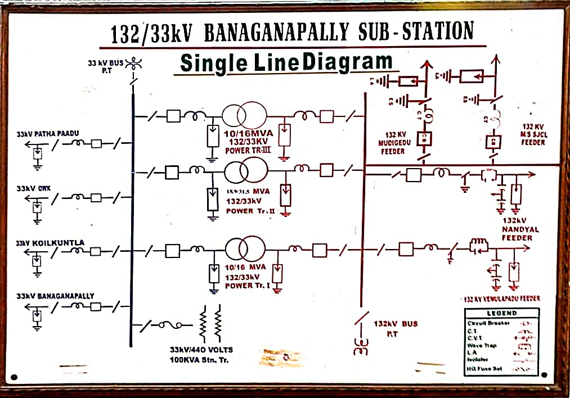
SINGLE LINE DIAGRAM OF SUBSTATION :
Fig - 1 : Single line diagram of AP TRANSCO 132/33 KV substation, Banaganapalli

Slide 8
EQUIPMENT USED IN SUBSTATION :
Lighting arrestor
Capacitance voltage transformer
Wave trap
Isolator
Circuit Breaker
Current transformer
Potential transformer
Power Transformer
Control room
Battery room
Earthing

Slide 9
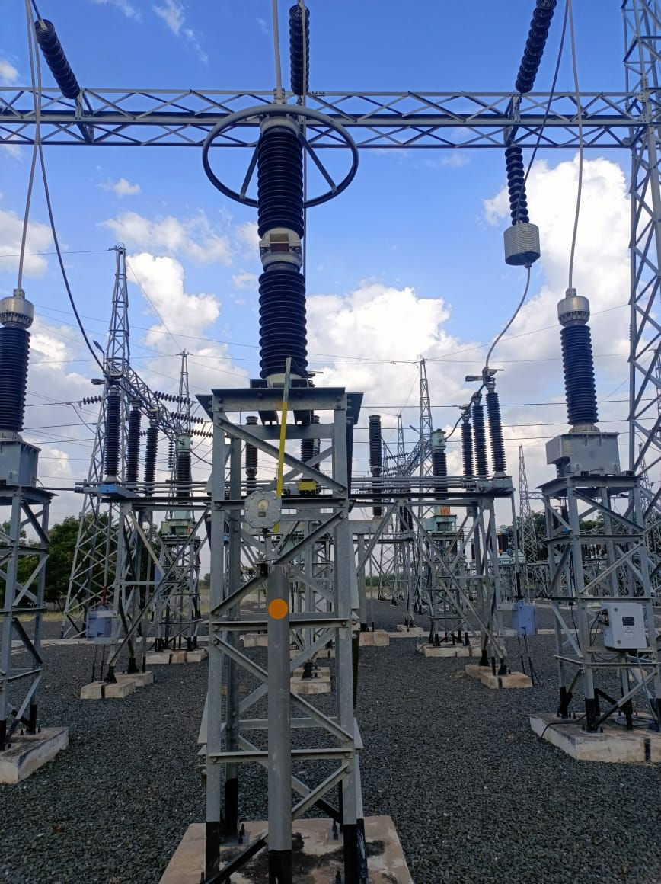
Lighting arrestor :
It is a device used for protection of equipment from high voltages
and lighting surges.
It is made of non linear resistive material which do not allows
high voltage to pass through it and allows the high voltage to
pass through it to earth. Fig – 2 : Lighting Arrestor
The zinc oxide lighting arrestors range used in substation is : 10 KA, 120 KV.

Slide 10
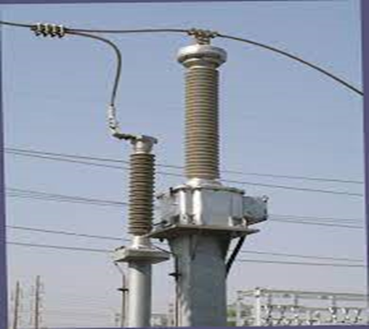
Capacitance voltage transformer (CVT) :
It steps down high voltage input signals and provide low voltage signals which can easily measure through measuring instrument.
It is used for filtering high frequency communication signals from power frequency i.e, 50 Hz which may harm equipment present in substation.
The specifications are :
Highest system voltage KV (rms) : 145 KV
System fault level KA (rms) : 31.5 KA
Rated lighting impulse voltage : 650 KV
Rated voltage factor : 1.5 for 30 sec & 1.2 continuous Fig – 3 : CVT

Slide 11
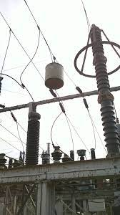
Wave traps :
A line trap, also known as wave trap, or high-frequency stopper, is a maintenance-free parallel resonant circuit, mounted inline on high-voltage (HV) AC transmission power lines to prevent the transmission of high frequency (40 kHz to 1000 kHz) carrier signals of power line communication to unwanted destinations.
The rating of wave trap used is :
Type : Suspension
Inductance : 0.2 mH
Capacity : 630 A
Blocking band : 250 – 500 KHz Fig – 4 : Wave trap

Slide 12
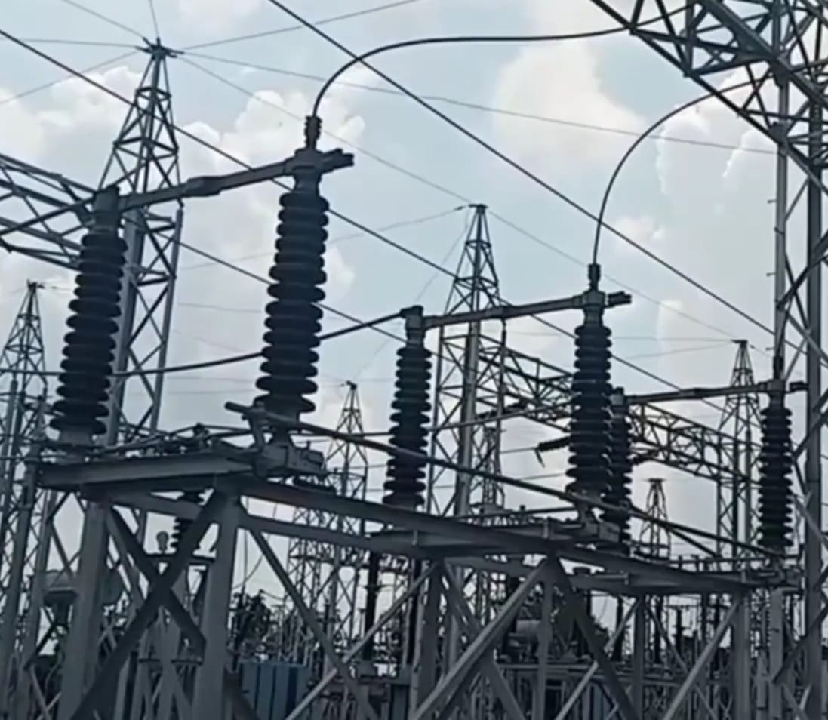
Isolator :
Isolator is a manually operated mechanical switch that isolates the faulty section of substation. It is used to separate faulty section for repair from a healthy section in order to avoid the occurrence of severe faults. It is also called disconnector or disconnecting switch.
The rating of isolator is :
Off – load isolator : 800 A (132 KV side)
400 A (33 KV side)
Fig – 5 : Isolator

Slide 13
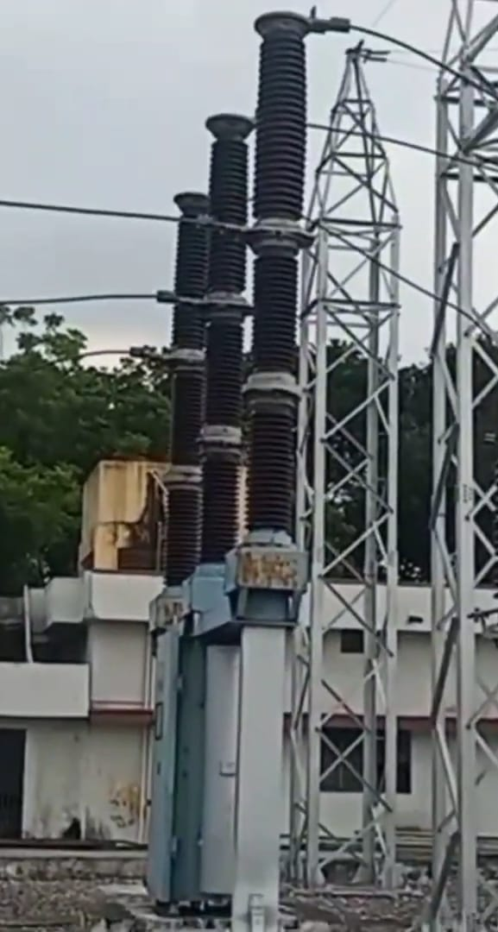
Circuit Breaker :
A circuit breaker is defined as a switching device that can be operated manually or automatically for controlling and protecting an electrical power system. It consists of two main contacts: a fixed contact and a moving contact. The contacts are normally closed and allow current to flow through the circuit. When a fault occurs, such as a short circuit or an overload, the contacts are separated by a mechanism that releases stored potential energy. This mechanism can be spring-operated, pneumatic, hydraulic, or magnetic.
Fig – 6 : Circuit breaker

Slide 14
The ratings of circuit breaker are
For 132 KV side SF6 circuit breaker is used :
Rated lighting impulse withstand voltage : 650 KV
Rated short circuit breaking current : 31.5 KA
Rated operating pressure : 15 kg/cm^2 – g
Rated duration of short circuit current : 31.5 KA for 3 sec
Rated voltage : 145 KV
Rated normal current : 3150 A
Rated gas pressure : 5 kg/cm^2 - g
For 33 KV side vacuum circuit breaker is used :
Rated normal current : 1250 A
Rated normal voltage : 36 KV
Short circuit braking current : 25 KA
Short time current : 25 KA for 3 sec

Slide 15
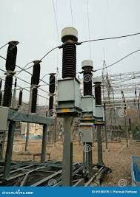
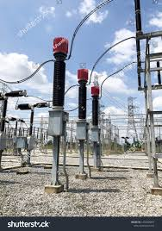
Current transformer :
It is used to measure current across transmission line to check how much current flowing through it.
The ratings are : 400/1 A (132 KV side)
300/1 A (33 KV side) Fig - 7 : Current transformer
Potential transformer :
It is used to measure voltage across the transmission line and it is
connected at the end of bus bars.
The ratings are : 132 KV/ 110 V
33 KV/ 110 V Fig - 8 : Potential transformer

Slide 16
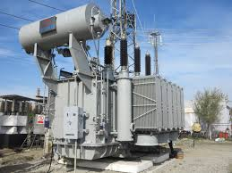
Power Transformer :
Power transformer is defined as a transformer that operates with high voltages and currents in the power system network. It is mainly used to increase or decrease the voltage level between the generator and the distribution circuits. A power transformer has two or more windings that are magnetically coupled through a core. A varying current in one winding creates a varying magnetic flux in the core, which induces a varying voltage in the other windings. The ratio of the voltages in the primary and secondary windings
depends on the number of turns in each winding.
Fig – 9 : Power Transformer

Slide 17
The ratings of power transformer are
1) Rating : 31.5 MVA
Rated voltage ( HV) : 132 KV
Rated voltage (LV) : 33 KV
Rated current (HV) : 137.77 A
Rated current (LV) : 551.10 A
Temperature rise oil : 50 C
Temperature rise winding : 55 C
Type of cooling : ONAF
2) Rating : 16 MVA
Voltage at (HV / LV) : 132/33 KV
Line current at HV side : 69.981 VA
Line current at LV side : 279.527 A
Temperature rise oil over : 40 C
Temperature rise winding over : 45 C
Type of cooling : ONAF

Slide 18
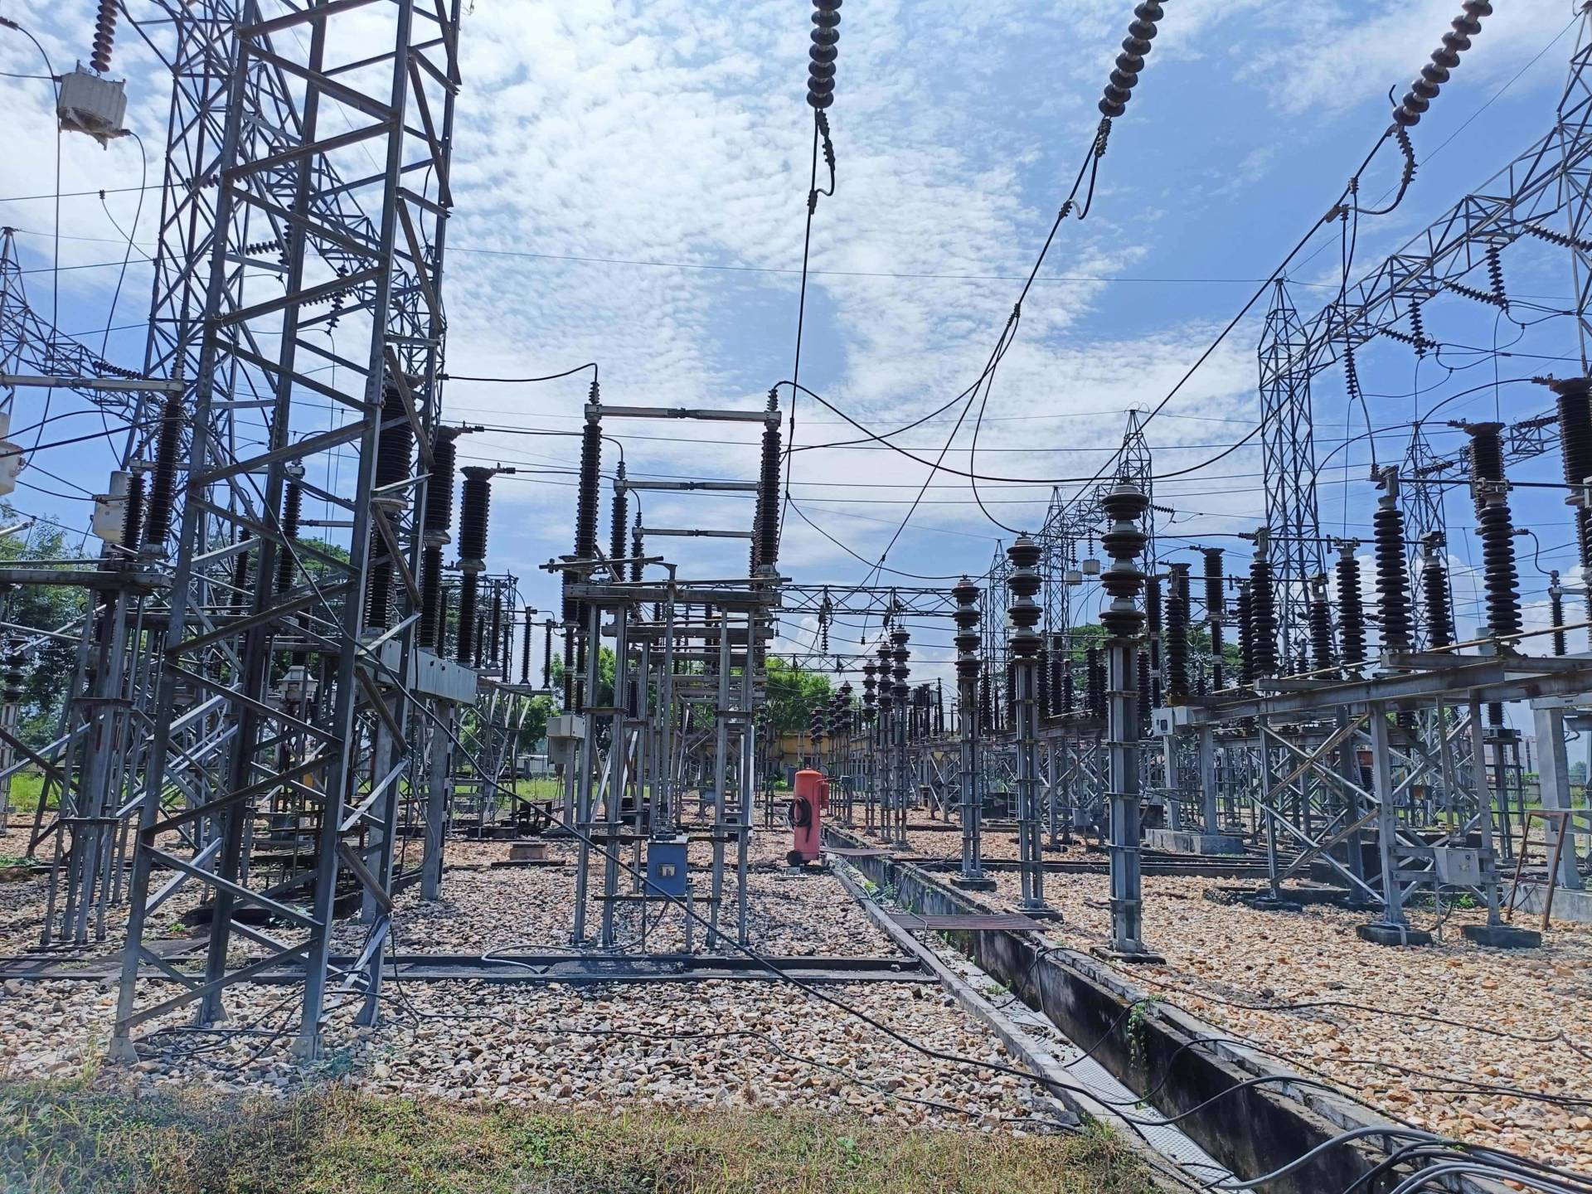
Bus bars :
An electrical bus bar is defined as a conductor or a group of conductor used for collecting electric power from the incoming feeders and distributes them to the outgoing feeders. In other words, it is a type of electrical junction in which all the incoming and outgoing electrical current meets. Thus, the electrical bus bar collects the electric power at one location.
There are two buses of rating 132 KV and 33 KV.
Fig – 10 : Bus bar

Slide 19
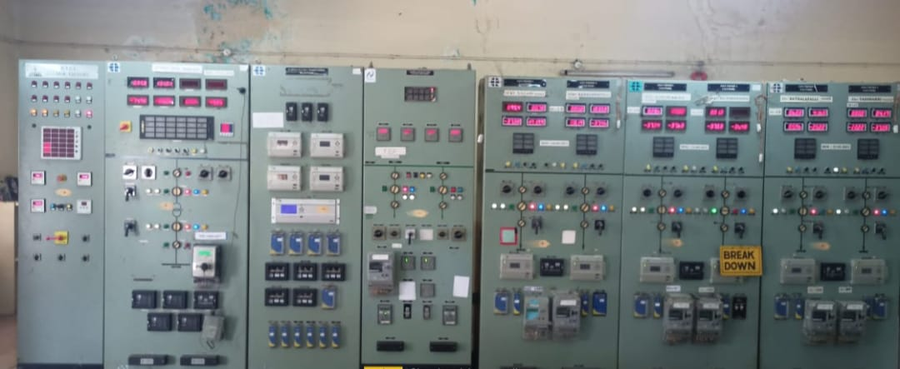
Control room :
It is a room in which all equipment present in substation are controlled and a personnel will supervise the control room and take care of it.
It is helpful in detecting faults by sitting in that room and not to be in field of substation.
The relay panels are also present in control room itself. So if a fault occurs relay panel will gives alarm or sound and trips the circuit.
Fig – 11 : Control room

Slide 20
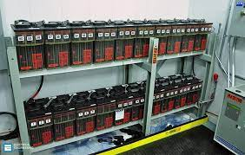
Battery room :
Primarily we will see applications & main components of the DC supply system that is Battery bank,
DC supply system in an electrical substation has a very important role in keeping the substation’s brains on. Hence DC supply system keeps all the protection, communication, control, and measurement devices running in the substation.
Fig – 12 : Batteries

Slide 21
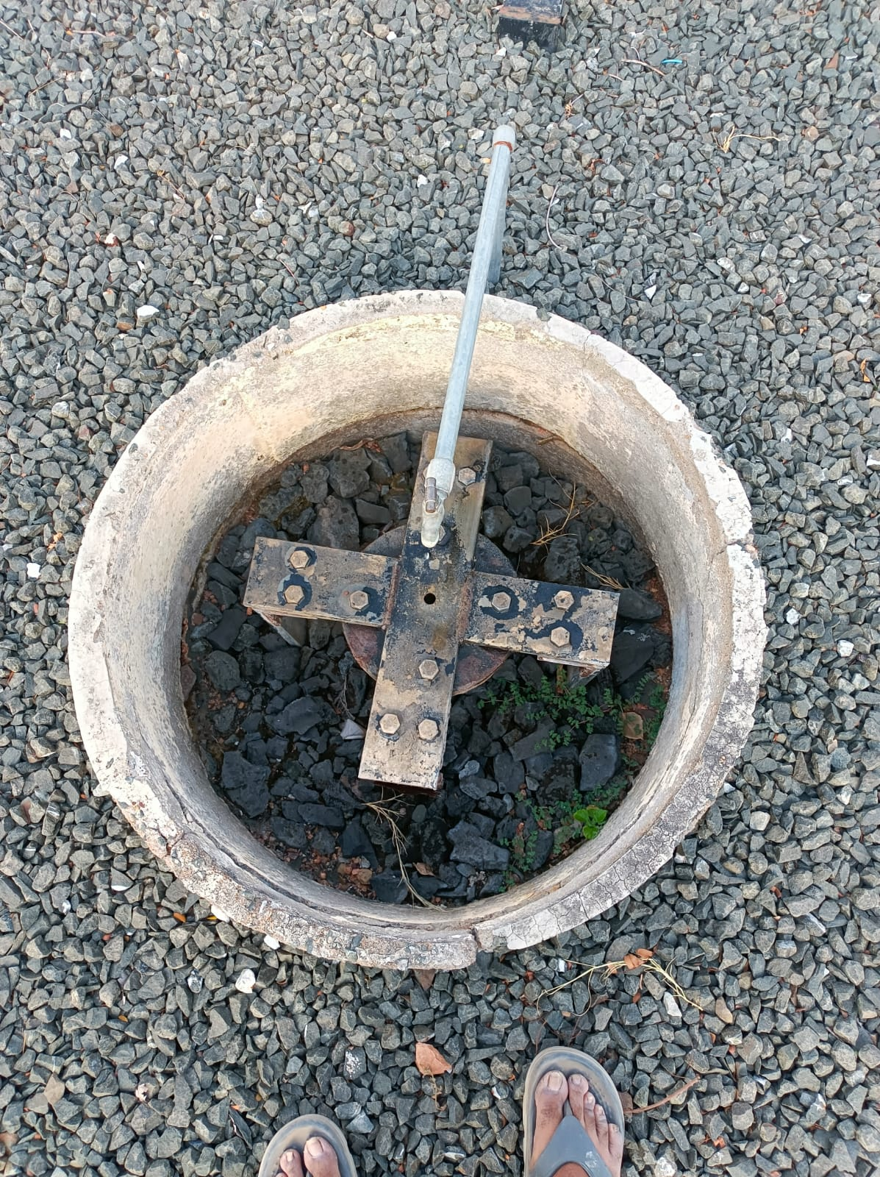
Earthing :
Earthing plays important role in protecting substation from leakage currents and by absorbing voltages and currents produced due to lighting surges in to earth such that protecting equipment and personnel life present in substation. In this substation they placed earth pits for each bay and at transformer for protection of personnel and equipment in substation.
They used 100x18 GI pipe at upper side for connections into earth and then below it they used 75x8 GI pipe for making leakage currents to pass through it.
An earth wire passes on each tower of transmission lines for
protection of transmission lines from lighting surges.
Fig – 13 : Earth pit present in substation

Slide 22
CONCLUSION :
During the short-term internship at AP TRANSCO 132/33 KV substation, Banaganapally, a comprehensive understanding of the significance of substations in power system networks and their functions was obtained. Thorough analysis was conducted on the operation of every component within the substation, both in theoretical and practical settings, along with the protective measures implemented for safeguarding the substation and its equipment.

Slide 23
THANK YOU

