Slide 1
Bluestock Mutual Fund Analytics Capstone
Author: Venky Jada
Bluestock Internship Project

Slide 2
Problem Statement
Large mutual fund datasets are difficult to analyze.
Investors need insights on risk, returns, and trends.

Slide 3
Project Objectives
Build ETL pipeline
Perform EDA
Analyze fund performance
Study investor behavior
Calculate risk metrics
Build dashboards

Slide 4
Data Sources
fund_master_clean.csv
nav_history_clean.csv
scheme_performance_clean.csv
investor_transactions_clean.csv
monthly_sip_inflows_clean.csv
category_inflows_clean.csv
benchmark_indices_clean.csv
portfolio_holdings_clean.csv

Slide 5
System Architecture
CSV Files
↓
Python ETL
↓
SQLite
↓
Analytics
↓
Power BI Dashboard

Slide 6
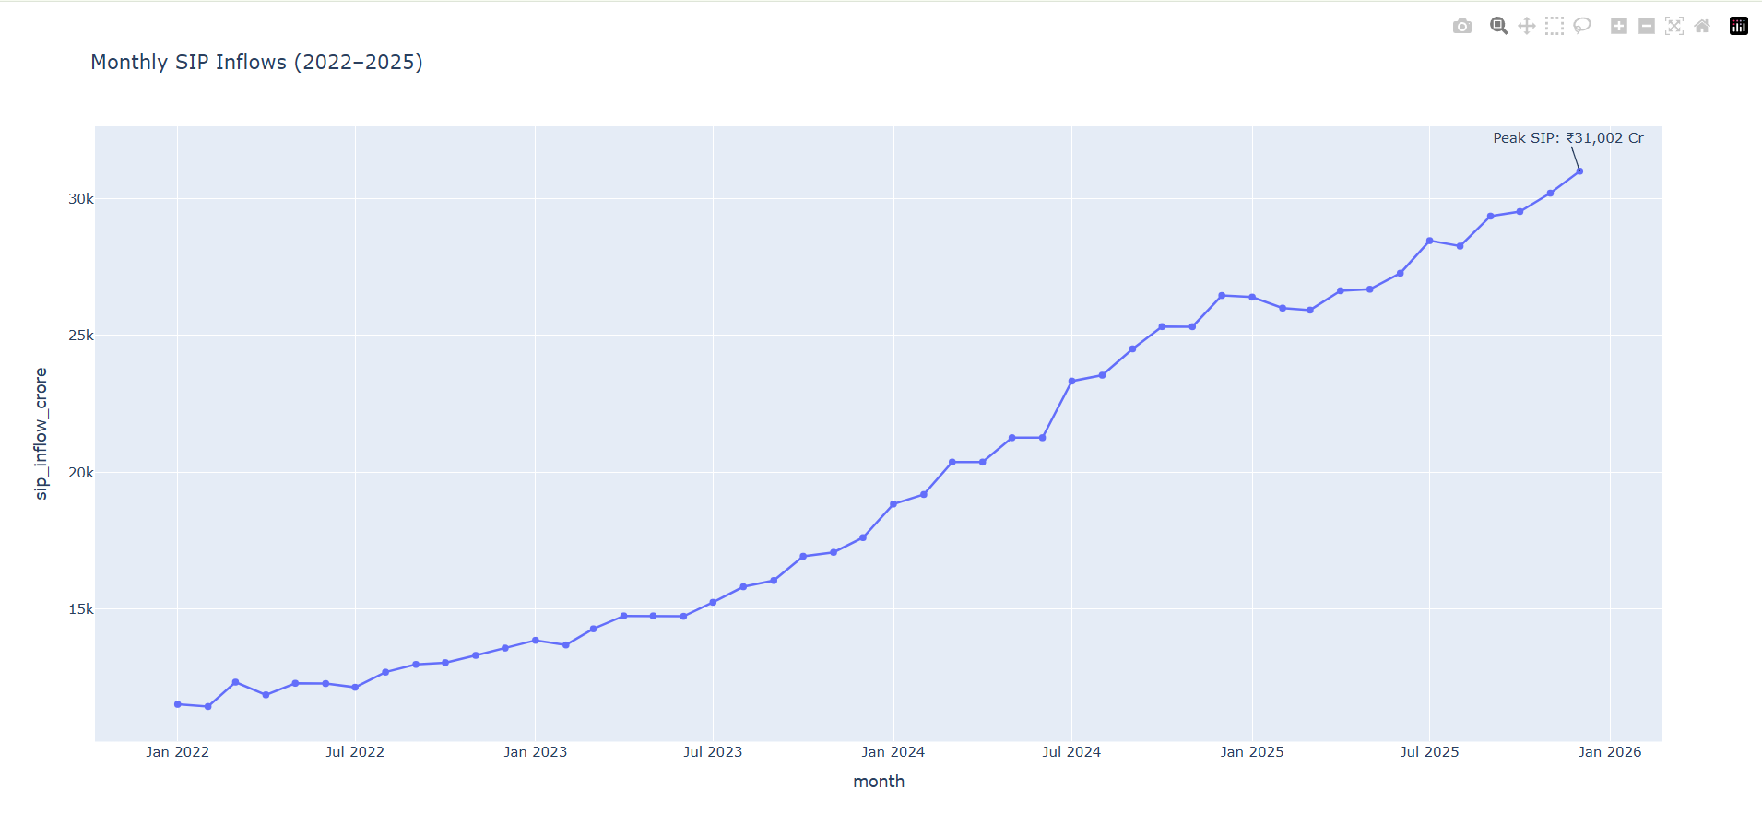
EDA Highlights (1)
SIP Trend

Slide 7
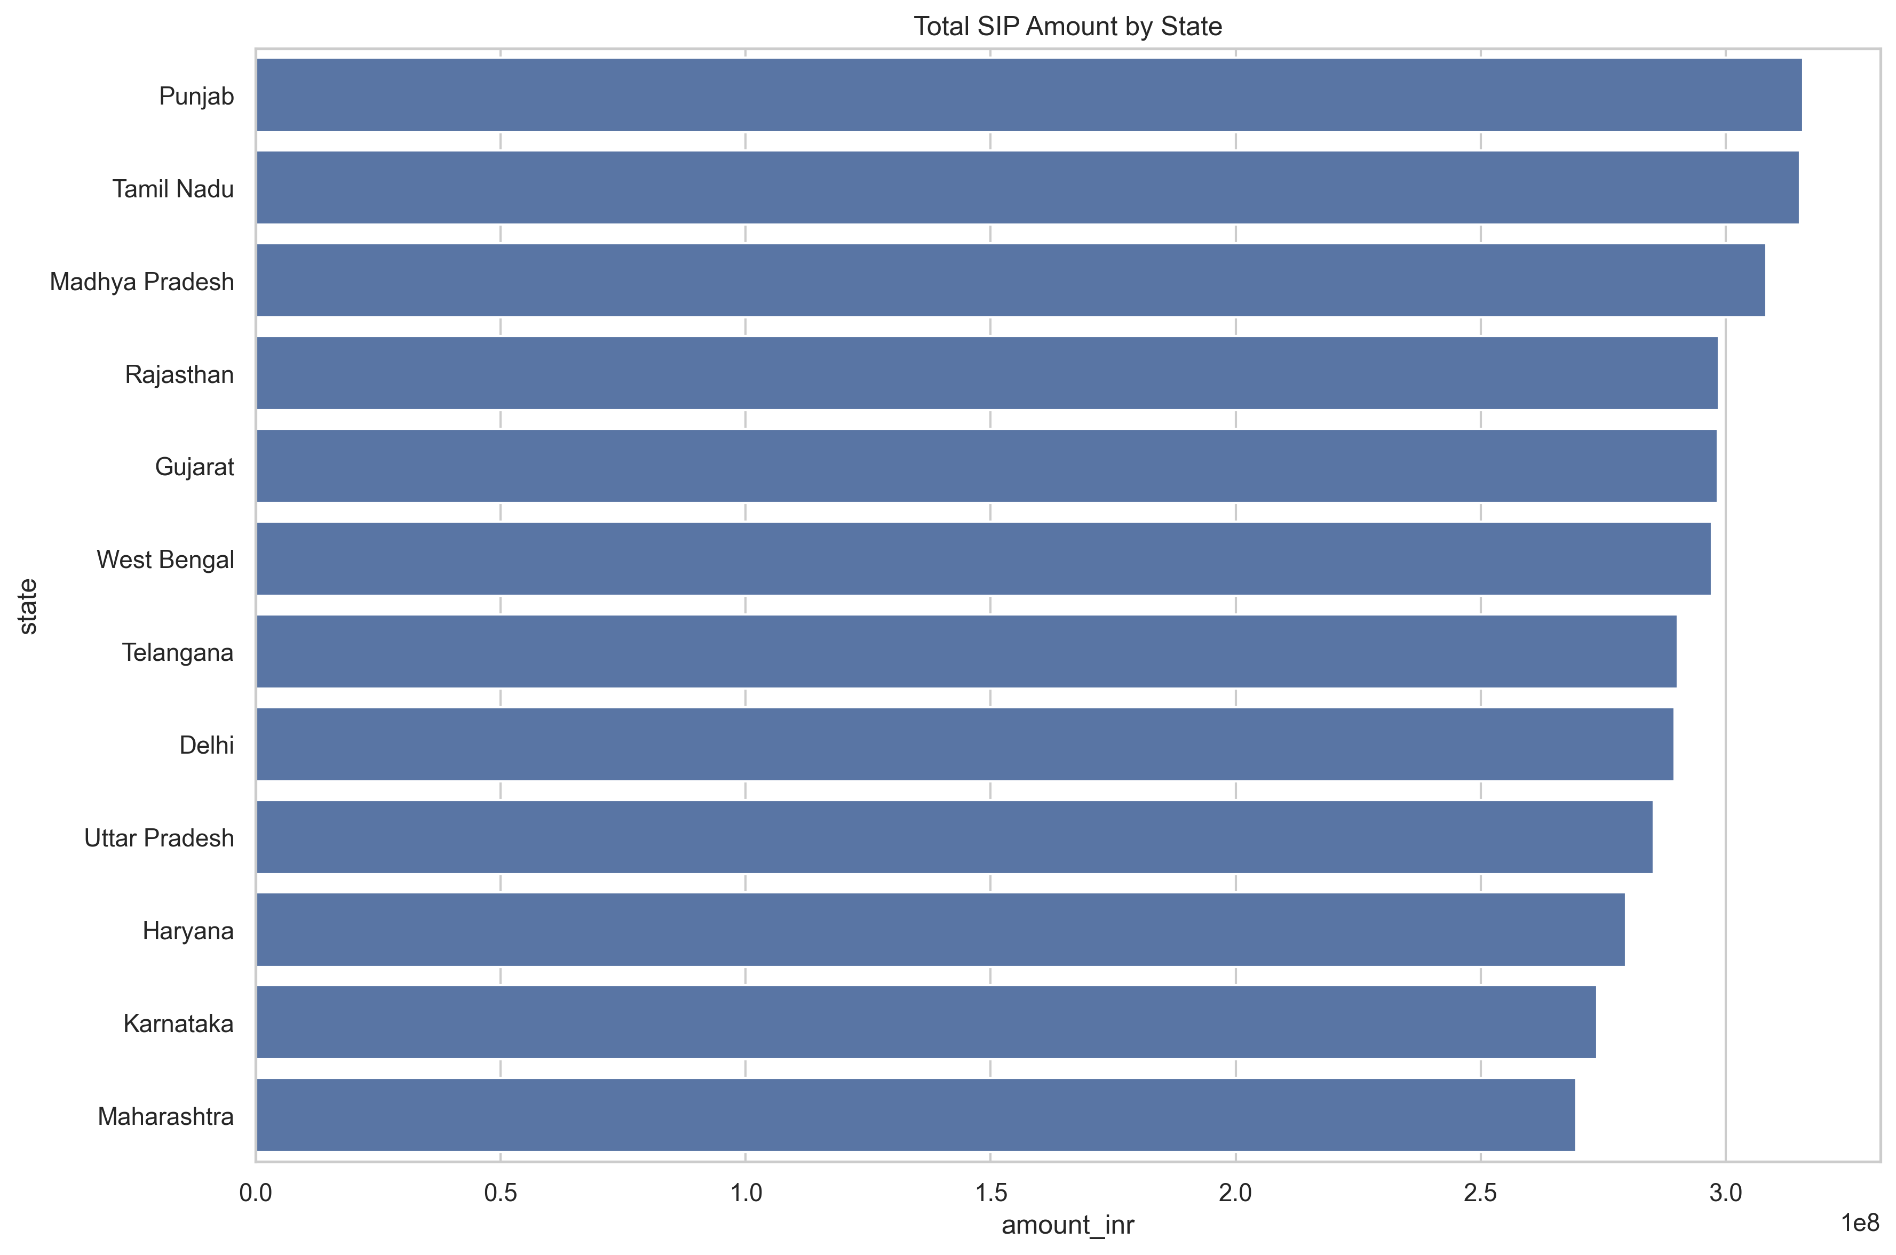
State-wise SIP

Slide 8
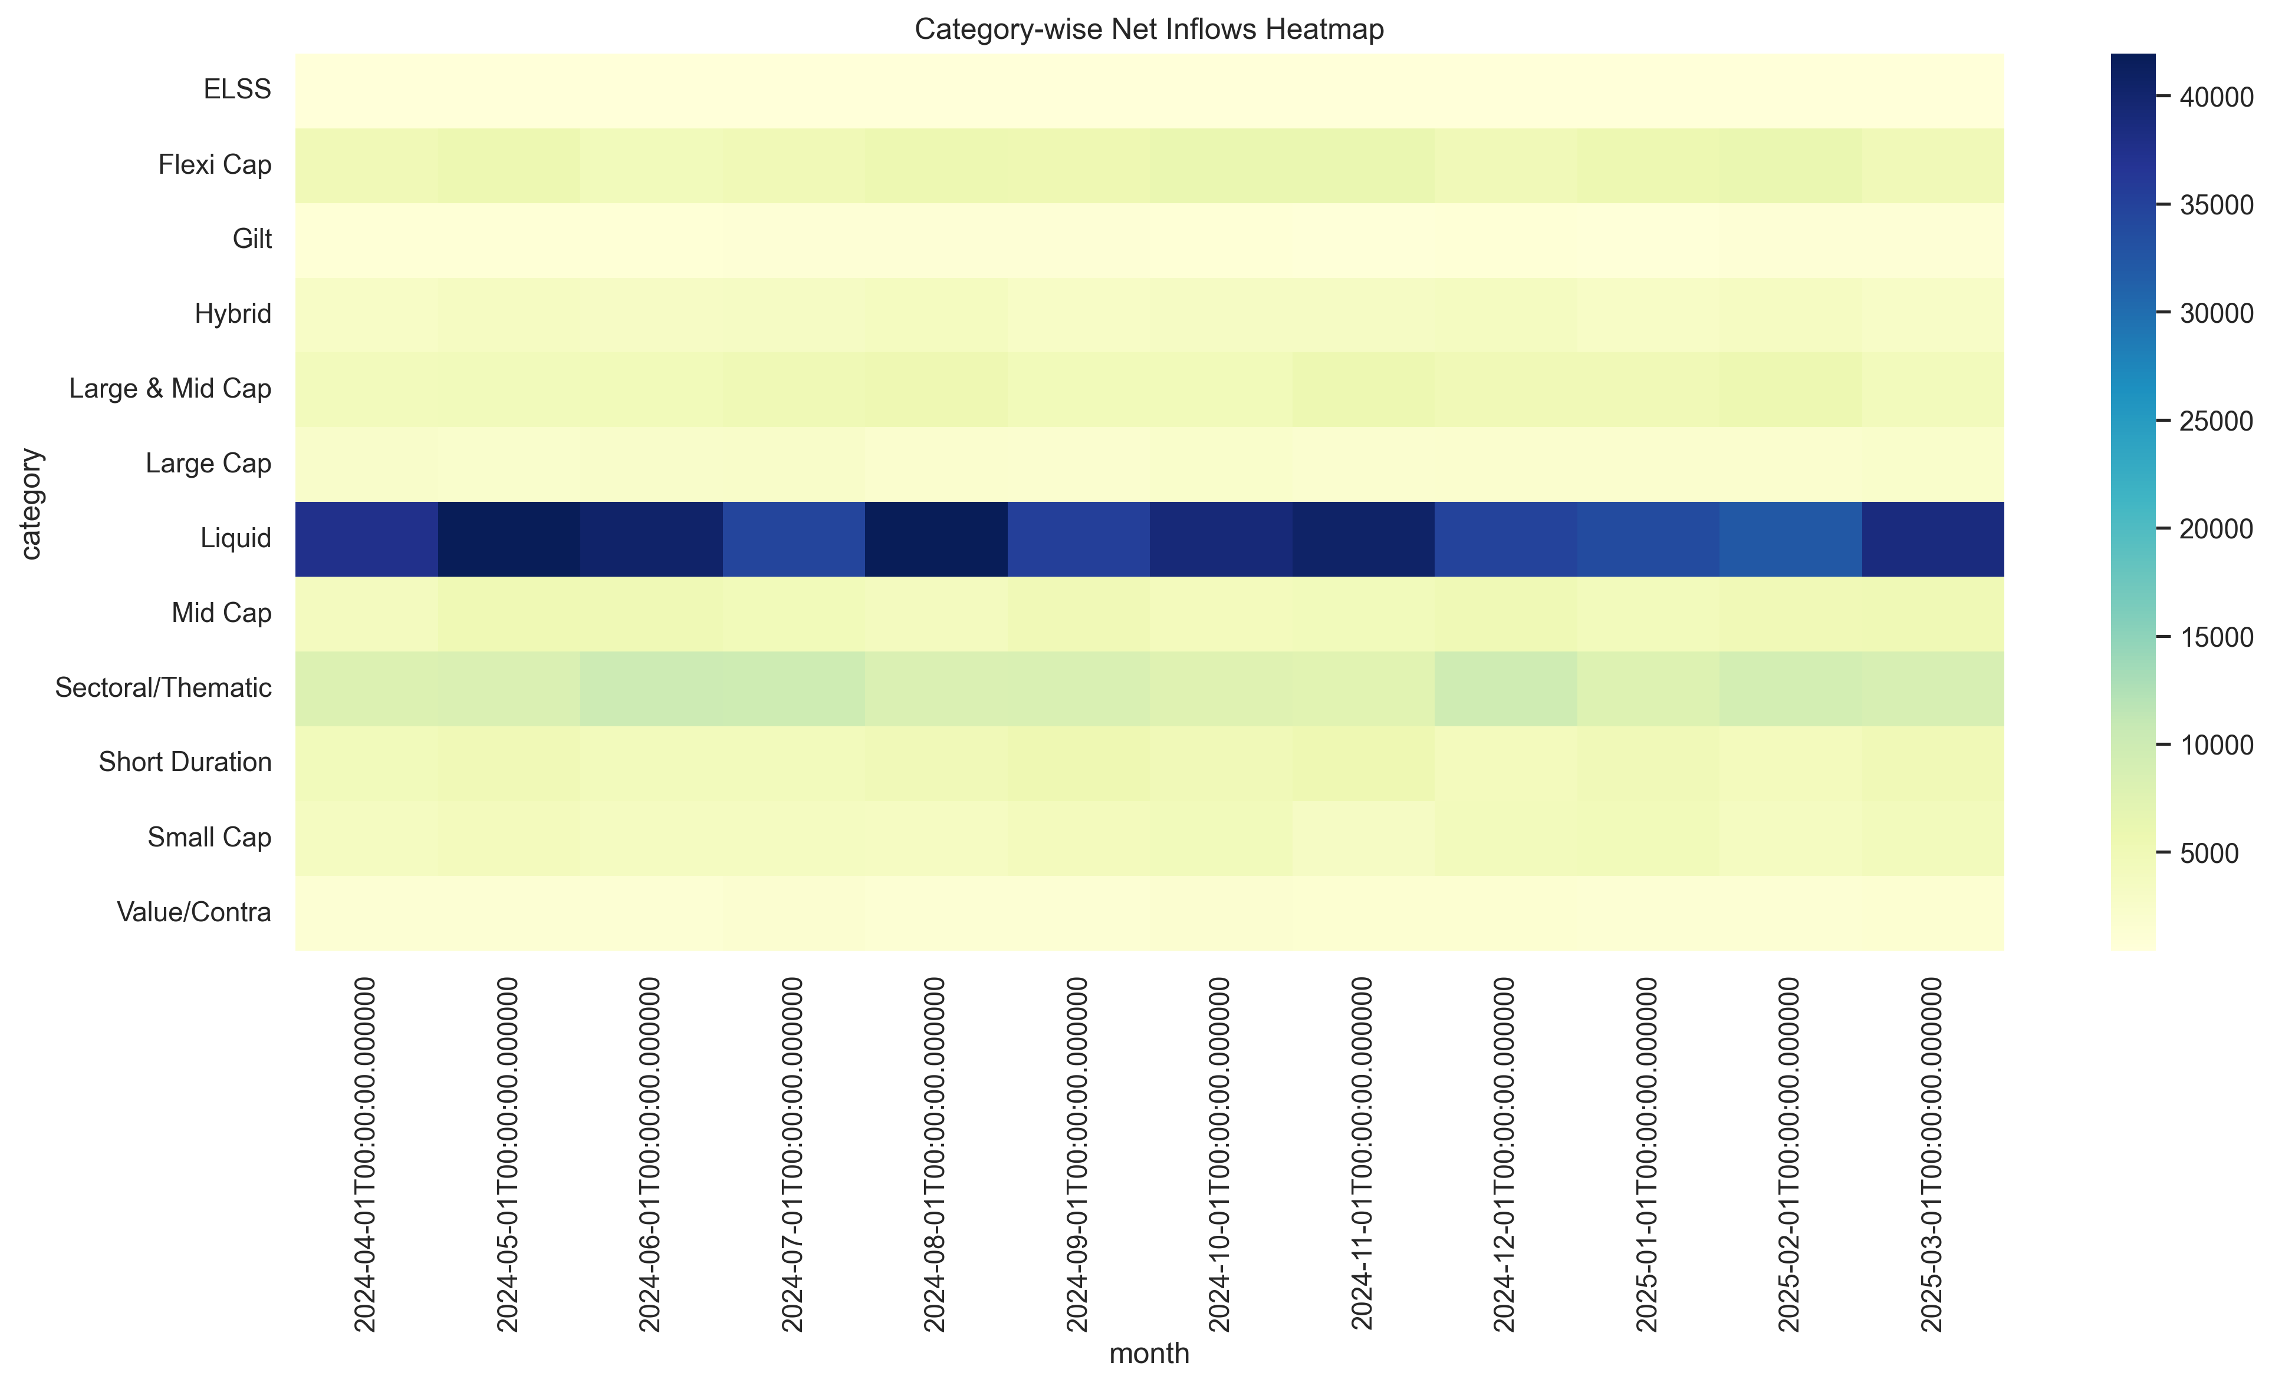
EDA Highlights (2)
Category Heatmap

Slide 9
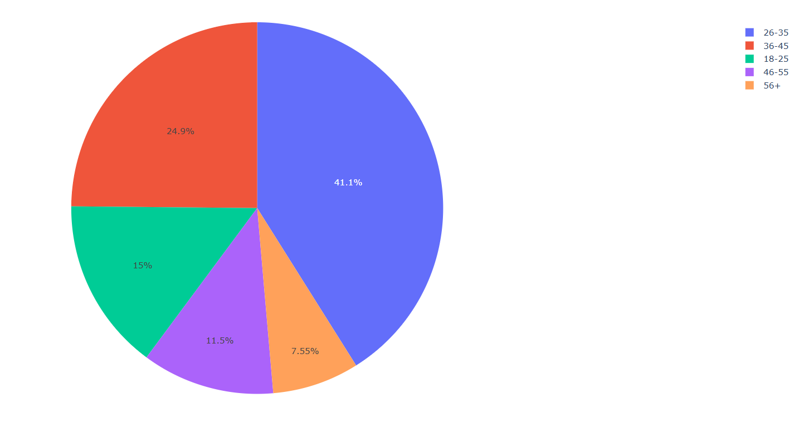
Investor Age Distribution

Slide 10
Performance Analytics (1)
Alpha
Beta
Sharpe Ratio
Sortino Ratio

Slide 11
Performance Analytics (2)
VaR
CVaR
Rolling Sharpe Ratio
Fund Recommender

Slide 12
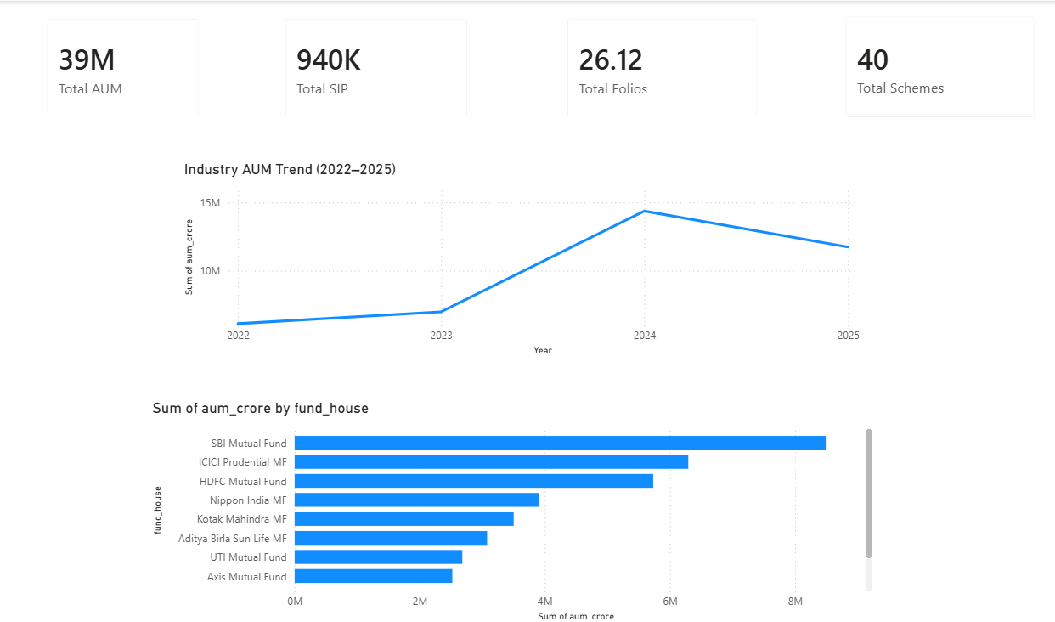
Dashboard Screenshots (1)
Industry Overview

Slide 13
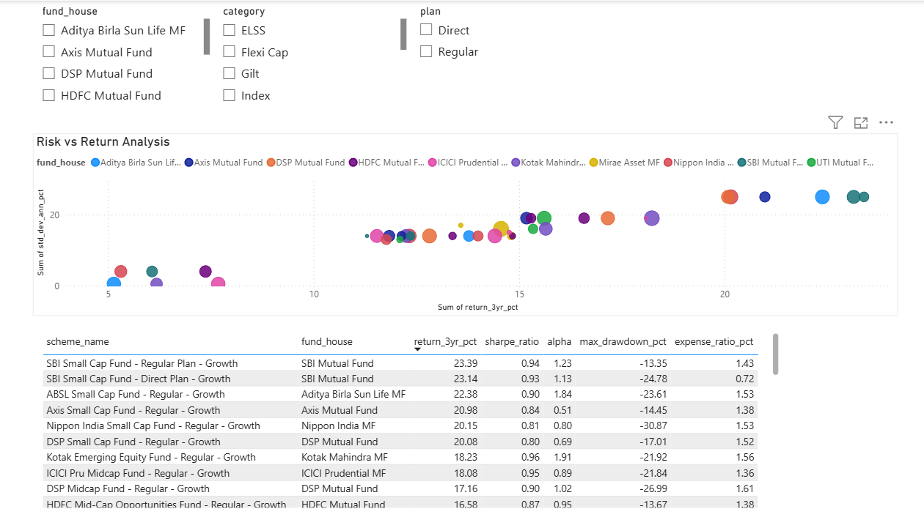
Fund Performance

Slide 14
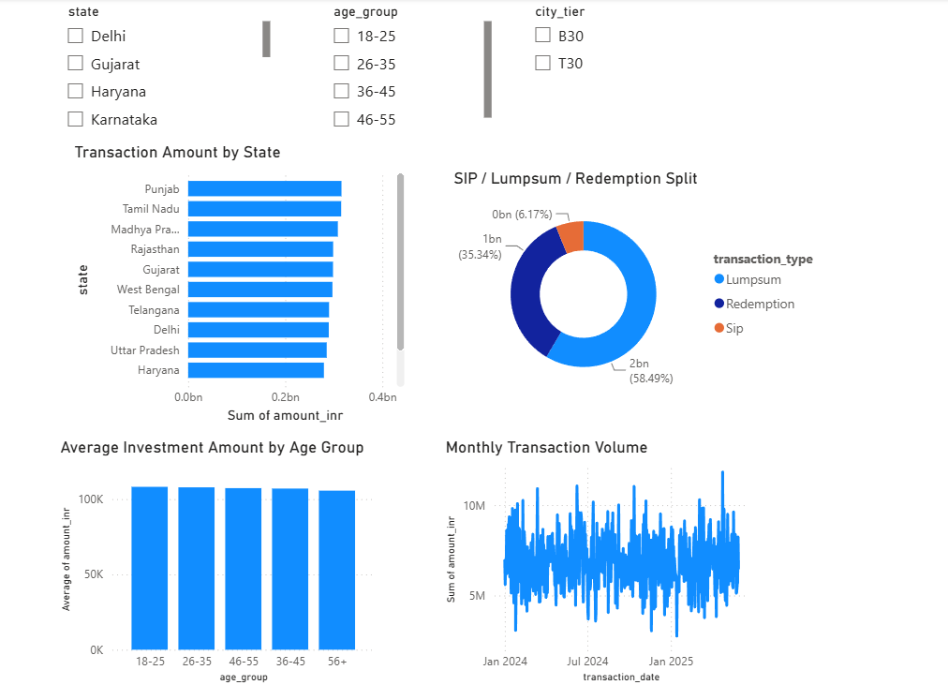
Dashboard Screenshots (2)
Investor Analytics

Slide 15
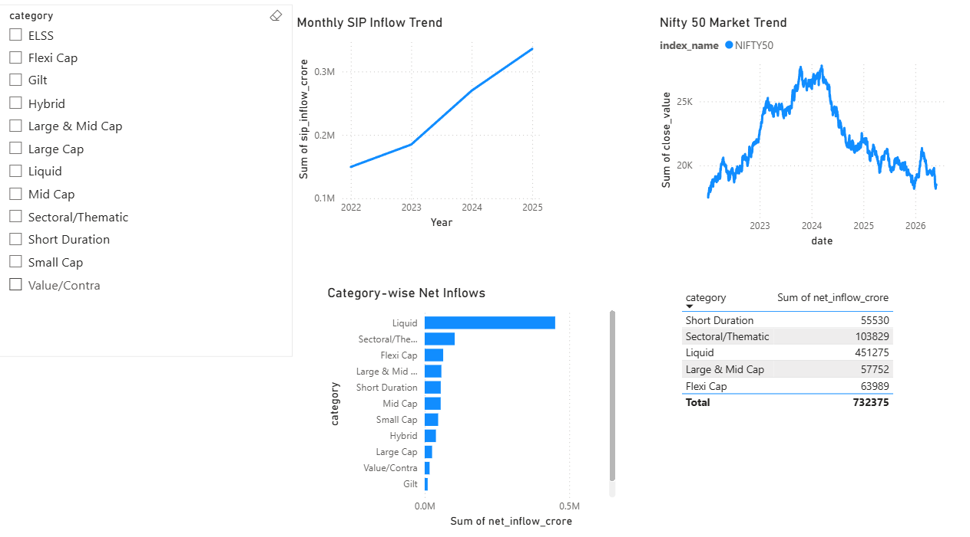
SIP & Market Trends

Slide 16
Key Findings
SIP inflows increased steadily.
Small-cap funds generated high returns with higher risk.
Many investors were flagged as SIP at-risk.
Equity categories received the highest inflows.
Risk-adjusted performance varied across schemes.

Slide 17
Thank You

