Slide 1


OWASP ZAP
Project Id - PTID-CSPP-FEB-26-340
Project done by
VenkatASUBRAMANIAM R
RV PARTHIBAN
SAKTHIVEL G
HARI VIKRAM

Slide 2
VULNERABILITY
In cybersecurity, a vulnerability is a weakness or flaw in a system, network, application, or process that an attacker can exploit to gain unauthorized access, steal data, or disrupt operations.
Types of vulnerabilities:
Software Vulnerabilities(e.g., Bugs, SQLi, XSS).
Network vulnerabilities(e.g., open ports, weak wifi security, misconfigured firewall).
Human Vulnerabilities(e.g., weak passwords, phishing emails).
System/Configuration Vulnerabilities(e.g., Default credentials, outdated software, missing security patches).

Slide 3
OWASP ZAP
OWASP ZAP (Zed Attack Proxy) is an open-source web application security testing tool.
It is used to identify vulnerabilities in web applications such as XSS, SQL Injection, broken authentication and session-related issues.
ZAP supports both manual testing and automated scanning for security analysis.
It helps security professionals, students and ethical hackers to analyze and test web application security.
In this project, OWASP ZAP was used to scan the DVWA (Damn Vulnerable Web Application) environment and detect security weaknesses.

Slide 4
OWASP SCAN TYPES
Manual Explore (Used to browse the target web application through ZAP).
Spider (Automatically discovers pages, links and input fields in the web application).
Active Scan (Performs attacks on the target to identify vulnerabilities like XSS and SQL Injection).
Passive Scan (Analyzes traffic without sending harmful payloads to the application).
History Tab (Stores all captured requests and responses during testing).

Slide 5
Sites Tree (Displays the structure of the target website and its pages).
Alerts Tab (Shows detected vulnerabilities with severity levels such as Low, Medium, and High).
Forced User Mode (Ensures scanning is performed as an authenticated user).
Context (Defines the target scope and authentication settings for the application).
Authentication (Used to configure login handling for authenticated scanning).

Slide 6
DOCKER
Docker is a containerization platform used to run applications in isolated environments.
It helps in deploying applications quickly without complex installation steps.
Docker ensures the application runs consistently across different systems.
In this project, Docker was used to deploy the DVWA environment for security testing.
It provides a safe and controlled lab setup for vulnerability assessment.
Docker images simplify the process of setting up testing applications.

Slide 7
DOCKER AND OWASP ZAP SETUP
Docker was used to deploy the DVWA application in a controlled local environment. Setup includes:
Docker Desktop (used to run the application container).
DVWA (used as the vulnerable web application for testing).
OWASP ZAP (used to analyze and scan the application for security vulnerabilities).
The setup was completed by running DVWA inside Docker, after deployment the application was accessed through the local browser. OWASP ZAP was then used to configure authentication, capture requests, and perform vulnerability scanning.

Slide 8
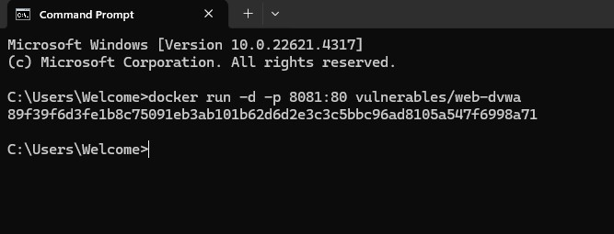
DVWA DEPLOYMENT
The command docker run -d -p 8081:80 vulnerables/web-dvwa was used to start the DVWA container in detached mode.
Port 8081 on the local machine was mapped to port 80 inside the container to access the web application through the browser.
After execution, the DVWA application was successfully hosted locally and used for security testing.

Slide 9
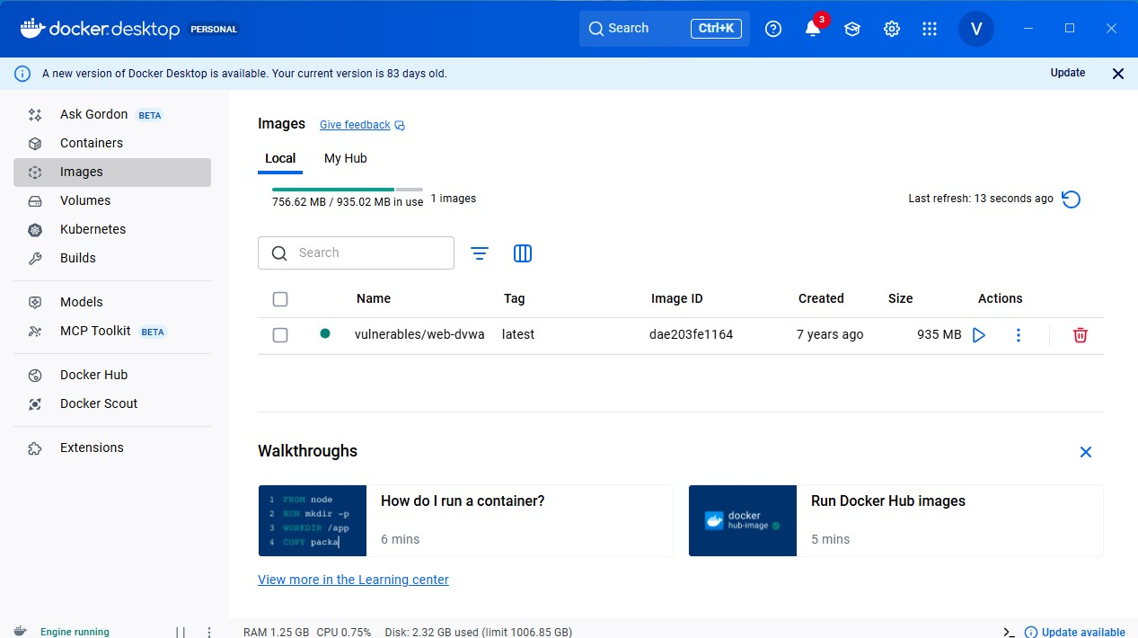
DOCKER AND LOCAL DEPLOYMENT
Docker Desktop was used to manage and run the DVWA application in a local testing environment.
The setup includes the Docker Desktop platform, the required Docker image, and the local container deployment.
The image vulnerables/web-dvwa was pulled and executed to host the vulnerable web application.
After successful deployment, the application was accessed locally through the browser for OWASP ZAP testing. .

Slide 10
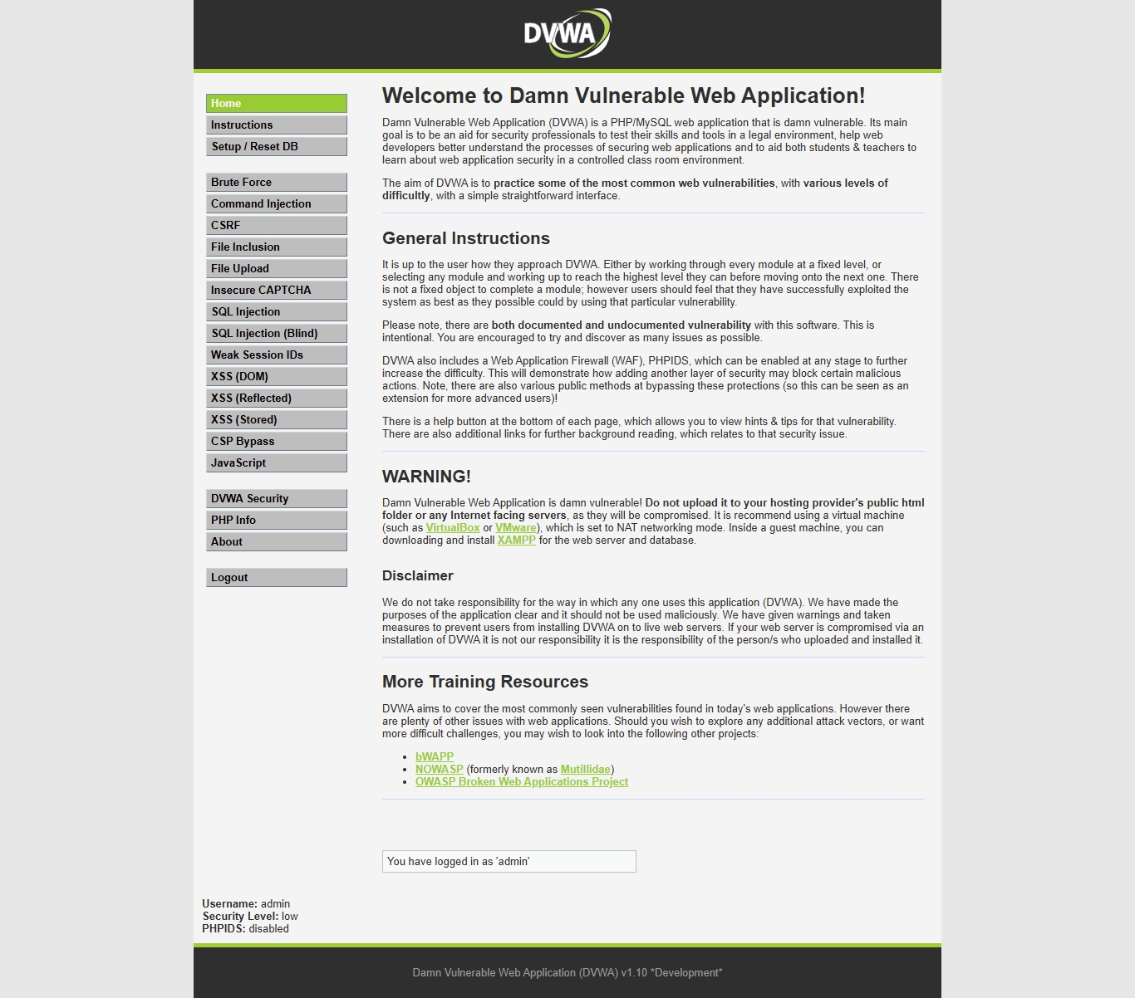
Open DVWA in the browser using the local URL: http://127.0.0.1:8081
Login credentials: admin / password.
Set DVWA Security Level to LOW before testing.

Slide 11
DVWA BROWSER
DVWA (Damn Vulnerable Web Application) opened in the browser through the local Docker environment.
The home page provides access to multiple vulnerable modules used for web application security testing.
Users can log in with the configured credentials and select the required security level before testing.
This application was used as the target environment for performing vulnerability analysis using OWASP ZAP.

Slide 12
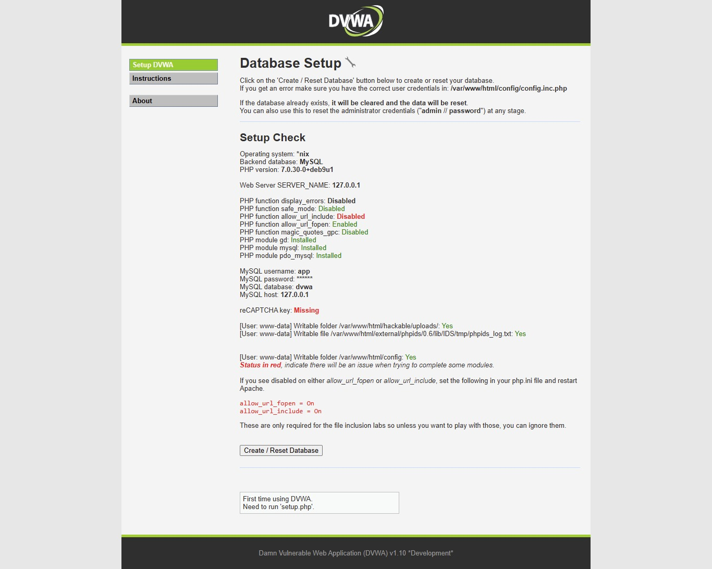
DVWA SETUP
The setup includes the DVWA web application, Apache web server, and MySQL database running inside the container.
The application was accessed through the local browser using the Docker-hosted URL.
After deployment, the default credentials were used to log in and the security level was configured for vulnerability testing.

Slide 13
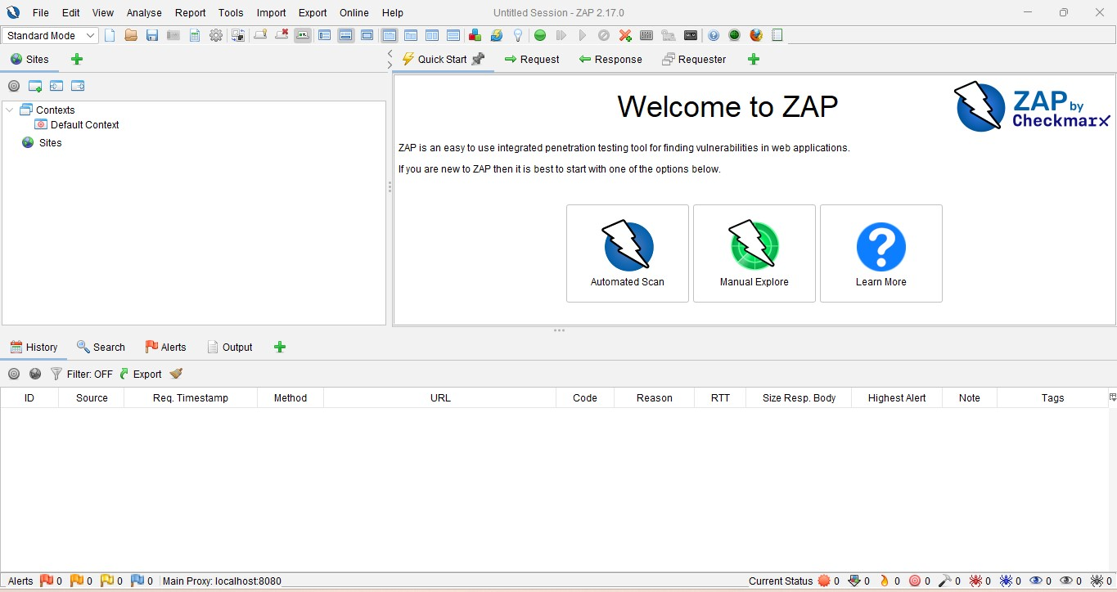
Launch OWASP ZAP and choose Manual Explore.
Enter target URL: http://127.0.0.1:8081
Enable the option: Launch Browser
This starts a browser session proxied through ZAP.

Slide 14
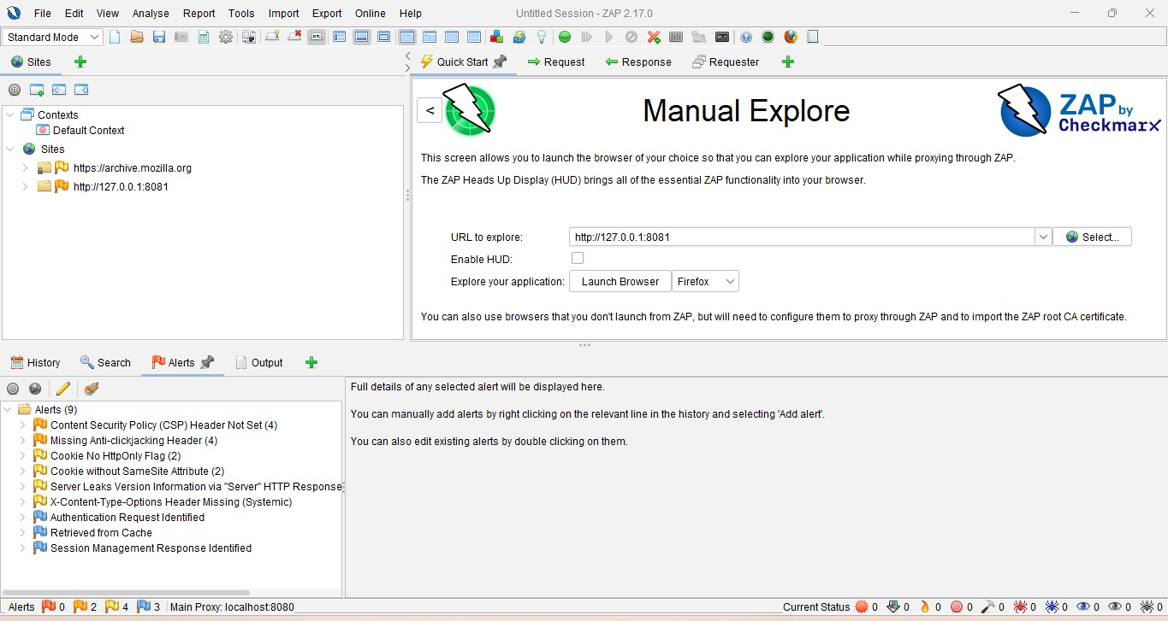
MANUAL EXPLORE IN ZAP
The target application URL was entered in ZAP to begin manual exploration.
This allowed the application to open through the ZAP browser for traffic monitoring.
It helped capture requests, responses, and application paths.
This step was used before performing authenticated vulnerability scanning.

Slide 15
Login must be performed inside the ZAP launched browser.
Do not use normal Chrome or external browser.
This allows ZAP to capture:
Session details.
Cookies.
Authentication flow.

Slide 16
In the Sites panel, right-click the DVWA target site.
Select: Include in Context → New Context.
Create context name: DVWAContext.
This helps ZAP identify authenticated application scope.

Slide 17
Navigate to Context → Authentication.
Choose: Form-based Authentication.
Set Login URL:http://127.0.0.1:8081/login.php.
This tells ZAP how DVWA login works.

Slide 18
Go to the History tab in ZAP.
Find the DVWA login request after authentication.
Right-click the login request.
Select: Flag as Context → Authentication Request

Slide 19
Go to Context → Users.
Create a user with the DVWA credentials.
Username: admin
Password: password
This allows authenticated scanning.

Slide 20
Click the User / Forced User Mode icon on the top bar.
Enable Forced User Mode.
This ensures all requests are sent as the authenticated user.

Slide 21
Right-click the target site inside ZAP.
Choose: Attack → Active Scan
ZAP now scans authenticated DVWA pages and vulnerabilities.

Slide 22
ZAP SCAN REPORT
ZAP by Checkmarx Scanning Report.html
Above attached a zap scan report link, please look the report by ctrl+click to follow the link.

Slide 23
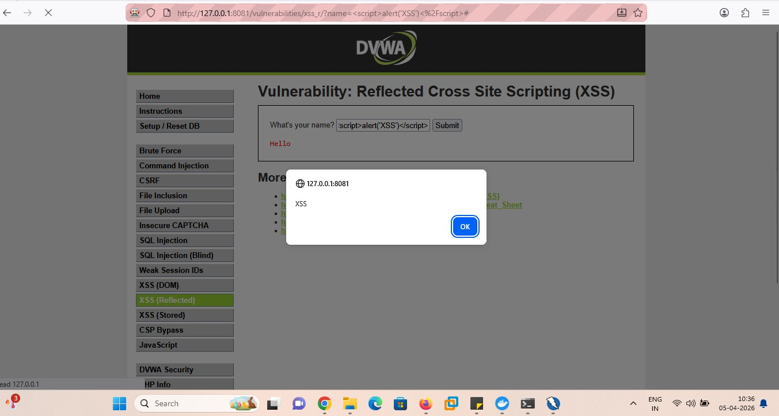
ZAP successfully scans authenticated DVWA pages.
Detected areas include:
• SQL Injection pages
• XSS pages
• Authenticated sections
Result includes HIGH severity vulnerability findings.

Slide 24
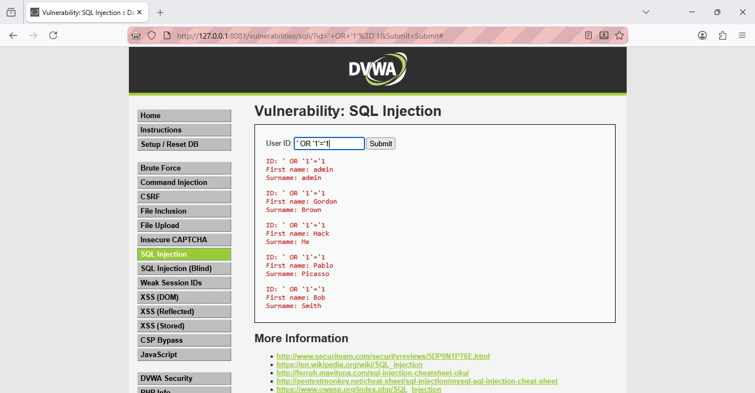
DVWA SQL INJECTION
SQL Injection uses malicious input to alter backend SQL queries.
Improper input validation can lead to unauthorized data access.
DVWA is used to demonstrate this vulnerability safely.
This helps understand the importance of secure database query handling.

Slide 25
MISSING CSP VULNERABILITY
A web application does not include the Content-Security-Policy header, browser has no restrictions on loading/executing content.
Without CSP attackers can inject malicious scripts, steal cookies/session data, redirect users to fake pages.
It impacts on session hijacking, sensitive data theft, phishing attacks, website defacement, malware injection.

Slide 26
MISSING X-FRAME-OPTIONS VULNERABILITY
X-Frame-options is a security HTTP response header.
It Controls whether a page can be loaded inside an <iframe> and prevent clickjacking attacks.
Missing x-frame–options header or misconfigured it leads to the website embedded in attacker’s page.
Attacker creates a malicious webpage, loads victim site inside an invisible iframe and tricks user into clicking by buttons, links , transactions.
It leads to gain unauthorized actions (e.g., money transfer), account takeover, changing user settings, data theft and like/share fraud on social media.

Slide 27
COOKIE WITHOUT HTTPONLY FLAG VULNERABILITY
The vulnerability occurs when cookies are set without httpOnly flag.
JavaScript can access cookies using document.cookie.
By using malicious javaScript, it send victim’s cookie to attacker.
It leads to session hijacking, account takeover, unauthorized access, data theft.

Slide 28
CVSS SCORE LEVELS
Score Range | Severity Level | Meaning
0 | None | No Risk
0.1-3.9 | Low | Minor Impact
4.0-6.9 | Medium | Moderate Risk
7.0-8.9 | High | Serious Vulnerability
9.0-10.0 | Critical | Severe, urgent fix required

Slide 29
CONCLUSION
The DVWA + ZAP setup demonstrates practical web vulnerability testing.
Manual exploration, authentication handling, and active scanning were completed successfully.
This project helps understand real-world detection of XSS and other web vulnerabilities.

Slide 30

Thank You!

