Slide 1

Visualization of start-ups data

Slide 2
Start-up
The term startup refers to a company in the first stages of operations. Startups are founded by one or more entrepreneurs who want to develop a product or service for which they believe there is demand. These companies generally start with high costs and limited revenue, which is why they look for capital from a variety of sources such as venture capitalists.
We have some raw data of some the startups from different countries where we are going to crunch the data to get some useful insights.
This is “Dummy wireframe” before building the actual visualization to get some estimates and idea about the data.

Slide 3
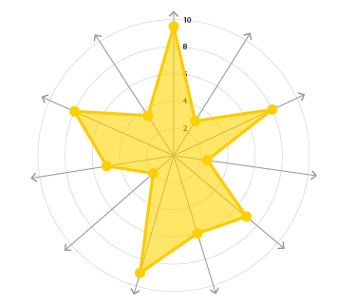
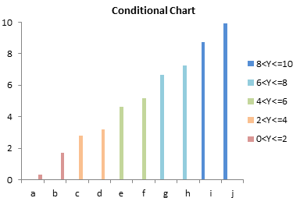
1)Top 10 Themes by count of startups
2) Radar chart showing Top 10 Tier 1 investors
with highest number of startups
By the help of this chart we can have a look at
top 10 themes of start-ups like fintech, travel apps etc..
We can know the trend in themes of start-ups.
With this radar chart we are going to know the
Top 10 tier 1 investors with highest number of
start-ups.

Slide 4
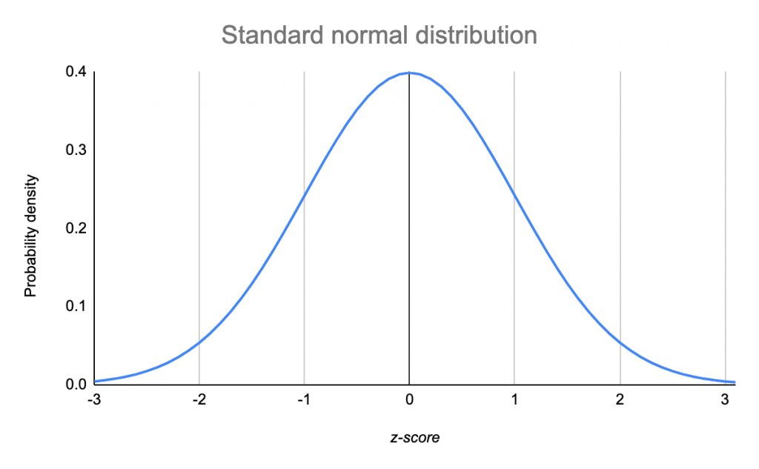
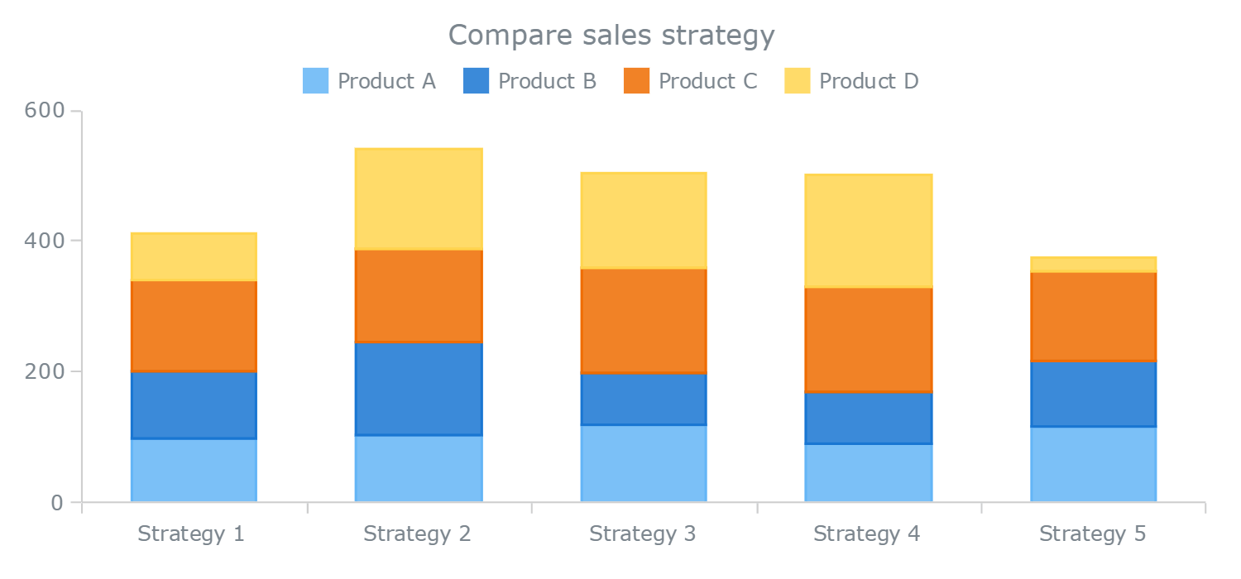
5) Z- Score for investment data that is
greater than 3.5
6) Stacked Bar chart showing Top 5 countries
by series of funding
Z Score tells us how far from the mean distribution ( Country or a start-up )
With the help of this chart we going to know
the series of funding's of the start-ups

Slide 5
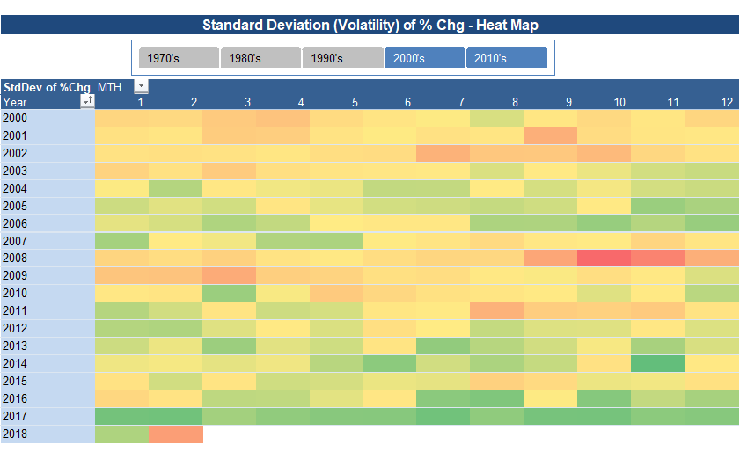
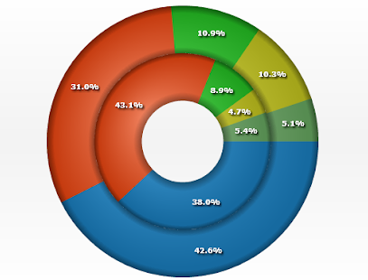
7)Heat Map between themes and sector, themes
8) Donut charts for top 5 countries showing
their respective top 8 sectors
Heat maps shows the highest number of start-ups with
darker colour and low with light colours by sectors and
themes
Donut chart shows us the percentage of start-ups
in each sector of top 5 countries

Slide 6
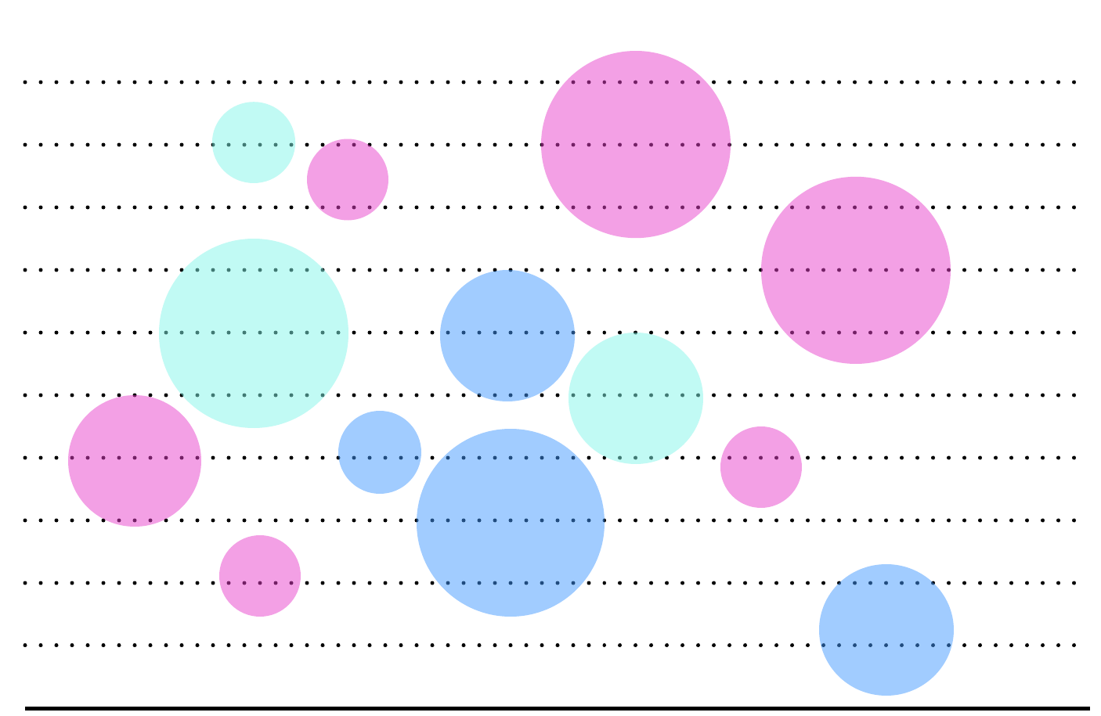
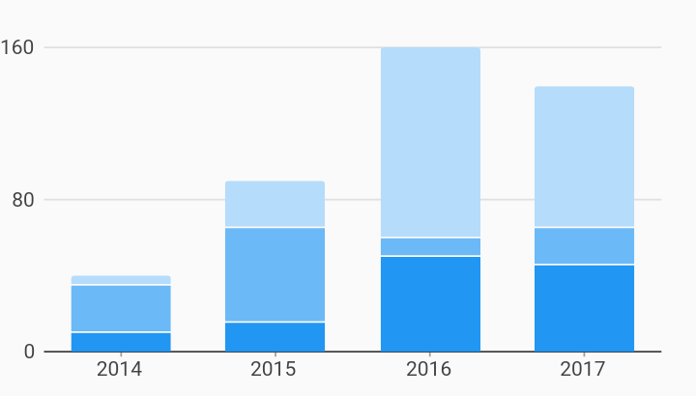
9) Bubble chart for count of Start-ups divided
into three stages.
10) vertical stacked bar chart for top 5 themes
their count of Start-ups by top 5 countries.
This Bubble chart shows the count of start-ups divided
Into three stages seed and early , middle and later stages
This chart shows the top 5 themes and top 5
countries by the count of start-ups

Slide 7
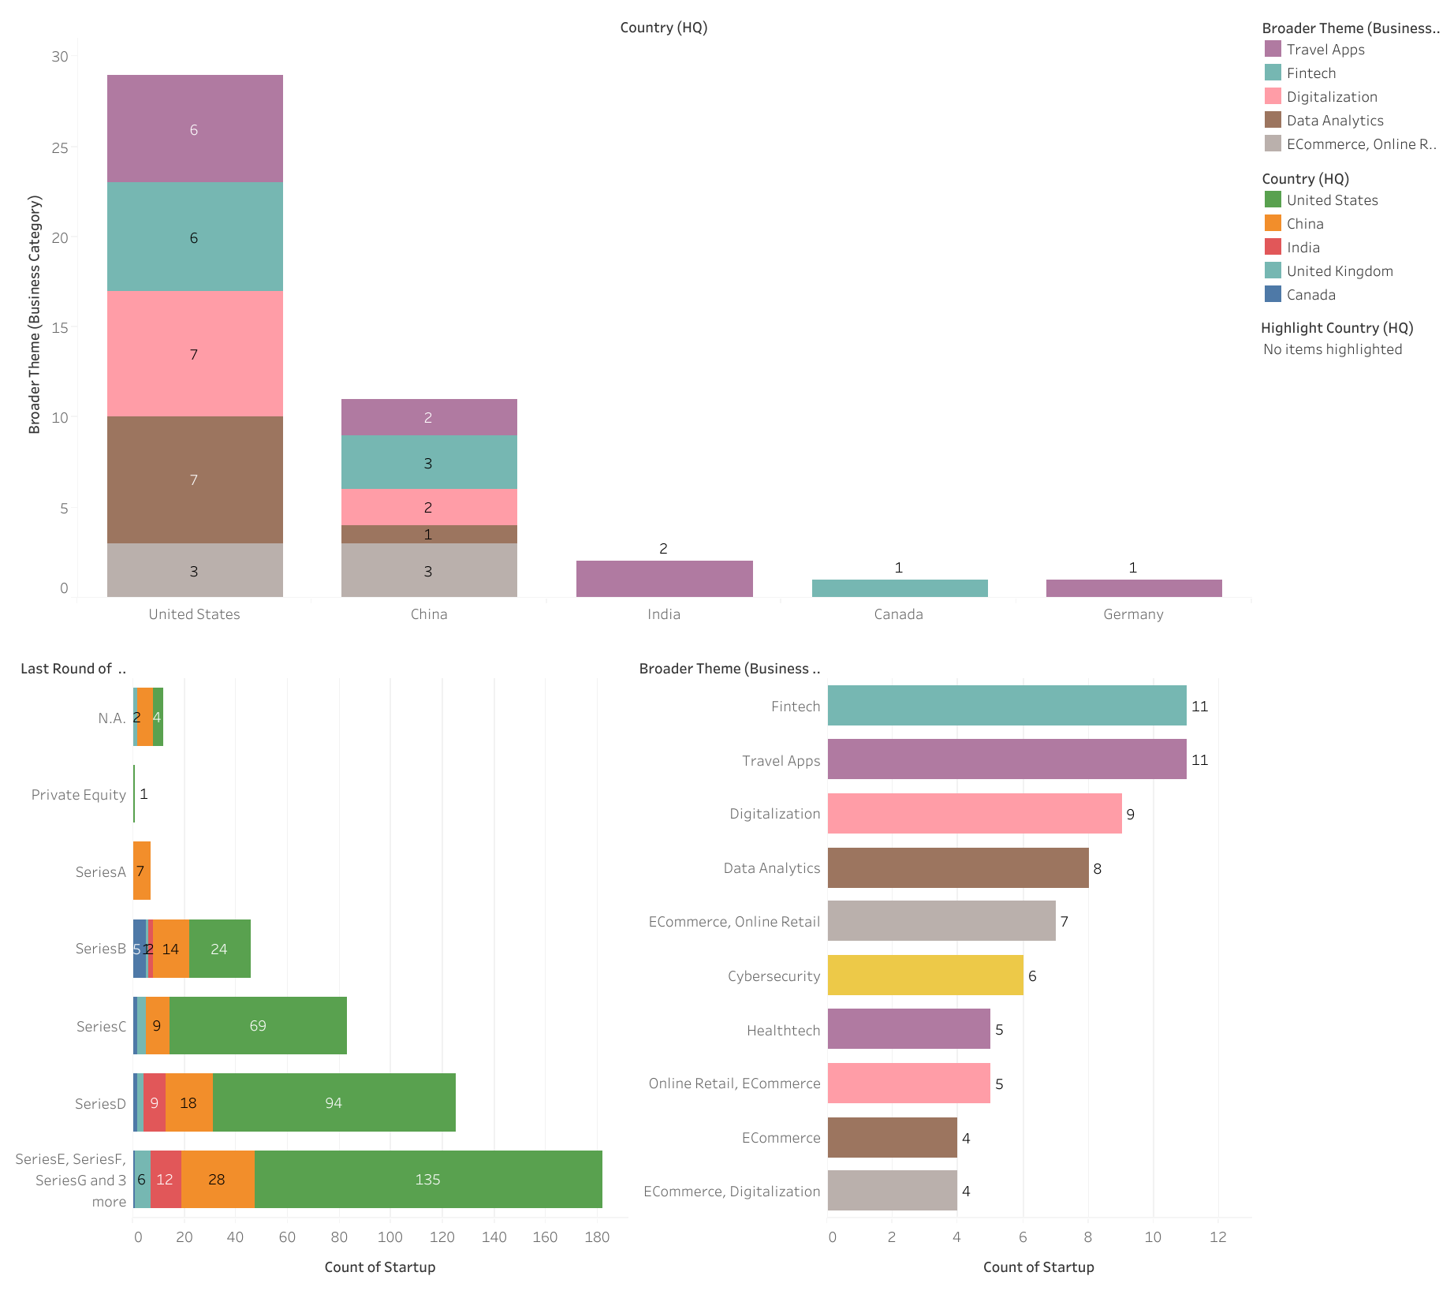
Dashboard for POC

Slide 8
From above dashboard we can say that :
Top countries are more investing in start-ups.
There some top themes of start-ups where they are running successful.
We can also see that for top 5 countries the series of funding for start-ups is high and in later stages of funding.
In the upcoming years the funding will also rise and the number of start-ups will also increase.
We can see USA china and India are highly investing in start-ups.
The investors are also increasing day by day.
Many start-ups are in later and middle stages than early stages.
So I conclude from given data that investing in start-ups and the growth of start-ups are rising.

Slide 9

Thank you
Namala Venkatesh.

