Slide 1


Major Project External Presentation
FreshGuard: Freshness-Aware Adaptive Retrieval-Augmented Generation with a Learned Retrieval Gate and Statement Verification
Team No:
Student Name : J. Sai Teja Guide Name : Mohammad Arshad
HT.No : 23EG106C22 Designation : Assistant Professor
Student Name : P. Supriya
HT.No : 23EG106C52
Student Name : Sk. Mubeena
HT.No : 23EG106C58
Student Name : U. Venkatesh
HT.No : 23EG106C63

Slide 2
Contents
S.No | Title | Slide No
1 | Abstract | 3
2 | Introduction | 4
3 | Literature Survey | 5
4 | Objectives | 7
5 | Problem Statement | 8
6 | Methodology | 9
7 | Implementation | 14
8 | Results | 16
9 | Discussion | 19
10 | Conclusion and Future Work | 20
11 | Reference | 21

Slide 3
Abstract
• Large language models answer fluently even when their built-in knowledge is out of date, and standard RAG retrieves evidence for every query — paying latency and cost even when the model already knows the answer.
• FreshGuard is an adaptive RAG system that places two learned gates around generation:
– Freshness gate: a learned estimator predicts the probability that the model’s knowledge is stale for a query and retrieves only when that probability — or low self-confidence — crosses a threshold.
– Verification gate: every answer is split into atomic statements, each checked against the evidence and labelled supported, unsupported, or contradicted; hallucinations are corrected or flagged, with a calibrated confidence score and cited sources.
• Built on LangChain and a FAISS vector store; fully offline and deterministic by default; a FastAPI service with a web UI, query history, feedback, admin configuration, and an evaluation module.
• Results: 100% retrieval-decision accuracy, perfect factuality on in-scope queries, F1 = 1.00 for hallucination detection, and expected calibration error (ECE) = 0.10 — while skipping retrieval for queries whose answers are stable.
• The complete implementation is reproducible and passed its entire automated test suite across twelve consecutive runs.
• Main weakness: evaluation is on a small controlled benchmark — broadening the freshness estimator with real query logs (e.g. FreshQA) is the key next step.
02/05/2026
FreshGuard: Freshness-Aware Adaptive RAG
3

Slide 4
Introduction
• LLMs encode a vast amount of world knowledge in their parameters, but that knowledge is frozen at training time.
• For questions whose answers change over time — sports results, prices, policy rates, the latest hardware — parametric memory is quickly outdated, yet the model still gives fluent, confident, and often wrong answers [8], [9].
• RAG [1] mitigates this by grounding answers in retrieved documents, but standard RAG retrieves for every query:
– Wasteful for the large fraction of questions — definitions, physical constants, stable facts — the model already answers correctly.
– It can even degrade answers by injecting irrelevant context [10].
• Two questions matter in a practical system: when should we retrieve, and how do we know the final answer is trustworthy?
• Our goal: an adaptive system that retrieves only when the model’s knowledge is likely stale, then verifies every claim against the evidence before showing the answer — with a freshness indicator, a confidence meter, per-claim labels, and cited, dated sources.
02/05/2026
FreshGuard: Freshness-Aware Adaptive RAG
4

Slide 5
Literature Survey
• Retrieval-augmented generation — Lewis et al. [1]: couple a parametric generator with a non-parametric retriever; dense passage retrieval [2] indexed with FAISS [3], or sparse BM25 [13]; these retrieve unconditionally.
• Adaptive and active retrieval:
– Self-RAG [6]: trains a model to decide when to retrieve and to critique its own output with reflection tokens.
– FLARE [7]: retrieves actively during generation when the model is uncertain.
– Mallen et al. [10]: retrieval helps mainly for less-popular, long-tail facts.
• Knowledge freshness — RealTimeQA [8] and FreshLLMs / FreshQA [9]: time-sensitive questions are a systematic failure mode; search augmentation helps.
• Hallucination detection and factuality:
– Survey of hallucination in NLG [4]; SelfCheckGPT [5] detects by sampling consistency; FACTScore [11] decomposes text into atomic facts.
• Calibration — Guo et al. [12]: calibration of modern neural networks; we report expected calibration error for our fused score.
02/05/2026
FreshGuard: Freshness-Aware Adaptive RAG
5

Slide 6
Literature Survey – Research Gap
• Retrieval is unconditional: standard RAG pays latency and cost on every query, even stable ones the model already answers correctly.
• Freshness is usually handled with fixed time-decay heuristics, not a learned, calibrated, per-query decision.
• Gaps this project addresses:
– A learned, feature-augmented freshness estimator that replaces fixed time-decay rules with a calibrated probability, deciding before generation whether to retrieve.
– An adaptive retrieve-or-skip policy that combines freshness and model self-confidence.
– Lightweight, offline statement-level verification that flags unsupported and contradicted claims — including entity-swap and numeric-mismatch hallucinations — and acts on them in-line.
– A single fused confidence score (evidence support + relevance + freshness alignment) presented with per-claim support and cited, dated sources.
– A complete, reproducible, fully tested artifact — not an offline-only detector that merely reports scores.
02/05/2026
FreshGuard: Freshness-Aware Adaptive RAG
6

Slide 7
Objectives
• Build a preprocessing stage that cleans and normalises the query, classifies its topic, and flags time-sensitivity using temporal cues and recent-year mentions.
• Train a learned freshness estimator that predicts the probability the model’s parametric knowledge is stale for a query.
• Implement an adaptive retrieve-or-skip policy combining freshness and model self-confidence, with administrator-configurable thresholds.
• Implement offline, deterministic retrieval over a LangChain / FAISS index with a recency-weighted ranking score.
• Design statement-level verification that labels each claim supported / unsupported / contradicted and corrects or flags hallucinations.
• Emit a calibrated confidence score and present answers with a freshness badge, a confidence meter, per-claim labels, and cited sources.
• Deliver a complete FastAPI and web application with history, feedback, admin configuration, and an evaluation module — and report results honestly, including limitations.
02/05/2026
FreshGuard: Freshness-Aware Adaptive RAG
7

Slide 8
Problem Statement
• Standard RAG systems ground answers in retrieved documents, but:
– Retrieve for every query: latency and cost are paid even for stable facts the model already knows, and irrelevant context can degrade the answer.
– No freshness decision: there is no explicit, learned judgement of whether the model’s knowledge is likely stale for a query.
– Unverified answers: the generated answer is shown as-is, even when a claim is unsupported or contradicts the evidence.
– No evidence for the reader: users are not shown which statement is supported by which source, nor how fresh the sources are.
• Need: a system that (1) decides when to retrieve from a learned freshness estimate plus model confidence, (2) retrieves with recency-aware ranking only when warranted, (3) verifies every statement against the evidence and corrects or flags hallucinations, and (4) presents a calibrated, cited answer with per-claim support labels and a freshness indicator.
02/05/2026
FreshGuard: Freshness-Aware Adaptive RAG
8

Slide 9
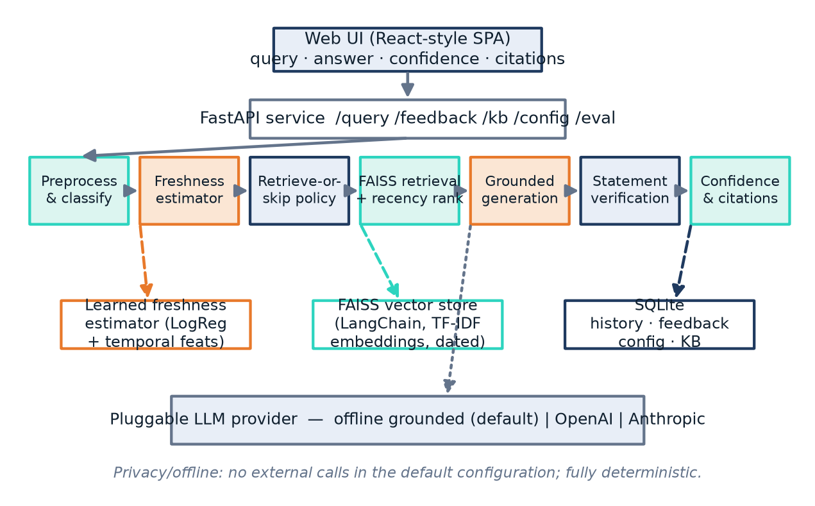
Methodology – System Architecture
• Web client → FastAPI service → FreshGuard pipeline → a structured response rendered as an answer with a confidence meter, a freshness badge, per-claim verification, and cited sources.
• Supported by a learned freshness estimator, a LangChain / FAISS vector store of dated documents, and a SQLite store for history, feedback, configuration, and the managed knowledge base.
• The LLM is a pluggable provider — an offline grounded generator by default (deterministic, no external services), with OpenAI or Anthropic adapters selectable by configuration.
02/05/2026
FreshGuard: Freshness-Aware Adaptive RAG
9

Slide 10
Methodology – Preprocessing and Freshness Estimation
• Preprocessing: the query is cleaned and normalised, classified by topic (sports, finance, technology, science, geography, politics), and flagged time-sensitive using temporal cues and explicit recent-year mentions.
• Learned freshness estimator g(q) ∈ [0, 1] predicts the probability that parametric knowledge is stale — replacing fixed time-decay heuristics with a calibrated probability.
• A logistic-regression classifier over a feature union:
– word uni/bi-gram TF–IDF;
– character n-gram TF–IDF (robust to spelling and morphology);
– explicit temporal features: temporal-keyword counts, event/price-keyword counts, static-cue counts, number of year mentions, a recent-year indicator (≥ 2020), and query length.
• Trained on a synthesised, seeded dataset of time-sensitive and timeless query templates — reproducible; it separates the two classes cleanly around the operating threshold τ = 0.55.
02/05/2026
FreshGuard: Freshness-Aware Adaptive RAG
10

Slide 11
Methodology – Adaptive Retrieve-or-Skip and Ranking
• Adaptive policy: with freshness g(q) and model self-confidence c(q), FreshGuard retrieves iff g(q) ≥ τ or c(q) < τc; otherwise it answers directly from parametric knowledge, saving a retrieval round-trip. Both thresholds are administrator-configurable.
• When retrieval triggers, the query is embedded and matched against a FAISS index built through LangChain.
• Offline and deterministic: embeddings are unit-normalised TF–IDF vectors, so inner-product search equals cosine similarity; the seam for a transformer encoder or a live web-search source is preserved.
• Recency-aware ranking: score(d) = rel(q, d) · (0.6 + 0.4·ρ(d)), ρ(d) = 0.5^(Δd / h), where Δd is the document’s age in years and h a half-life — among comparably relevant documents, fresher ones rank higher.
02/05/2026
FreshGuard: Freshness-Aware Adaptive RAG
11

Slide 12
Methodology – Grounded Generation
• A pluggable generator produces an answer grounded in the retrieved evidence.
• The default offline generator composes the answer from the evidence sentences most relevant to the query.
• Its parametric memory contains only timeless facts, modelling a knowledge cutoff — so time-sensitive queries genuinely require retrieval, precisely the case the freshness gate is designed to catch.
• OpenAI or Anthropic adapters can be selected by configuration behind the same interface, without changing the pipeline.
02/05/2026
FreshGuard: Freshness-Aware Adaptive RAG
12

Slide 13
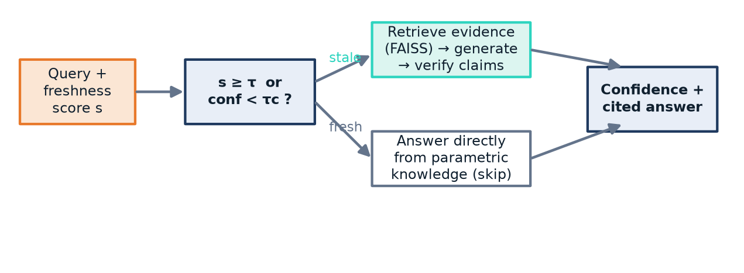
Methodology – Statement-Level Verification and Confidence
• Each answer is split into atomic statements; for every statement the maximum content overlap with any evidence sentence is computed and a label assigned:
– supported — the claim’s content is covered by the evidence;
– unsupported — largely absent, including when it names an entity the evidence never mentions;
– contradicted — a negation flip, a numeric mismatch, or an entity swap (e.g. “France won” against evidence that Argentina won, defeating France).
• Corrective action: unsupported statements are removed and contradicted statements are flagged to the user — in-line.
• Confidence fuses three signals: conf = 0.5·s_sup + 0.3·r̄ + 0.2·a_fresh (fraction supported, mean evidence relevance, freshness alignment), reported as a percentage.
• The answer is shown with this confidence, a freshness indicator, per-claim support labels, and citations giving each source’s title, link, and date.
02/05/2026
FreshGuard: Freshness-Aware Adaptive RAG
13

Slide 14
Implementation – Technologies and Modules
• Python — a FastAPI service exposing endpoints for querying, feedback, history, administrative configuration (thresholds, provider, sources), knowledge-base management (add / update / remove), and evaluation.
• Retrieval: LangChain with a FAISS index; freshness estimator: scikit-learn; persistence: SQLite.
• Browser client: a single-page application rendering the confidence meter, badges, highlighted per-statement verification, citations, history, and a feedback control.
• Deterministic by design: fixed seeds, sorted tie-breaks, and an injectable reference time make outputs identical across runs — letting the automated suite act as a stable regression guard.
• Pluggable LLM provider: an offline grounded generator by default; OpenAI or Anthropic adapters by configuration.
02/05/2026
FreshGuard: Freshness-Aware Adaptive RAG
14

Slide 15
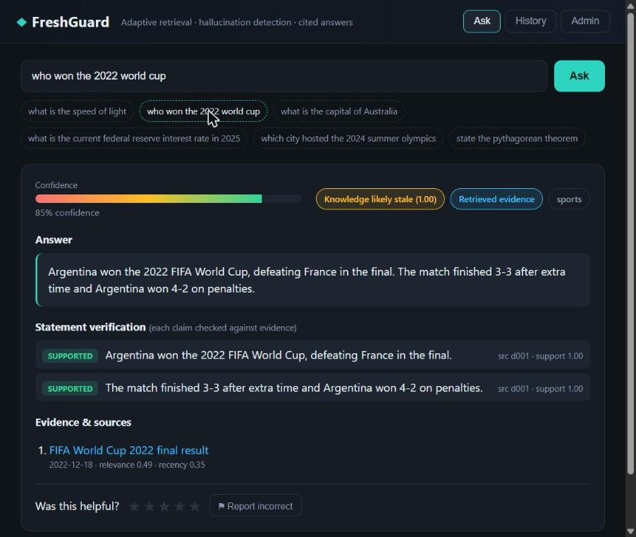
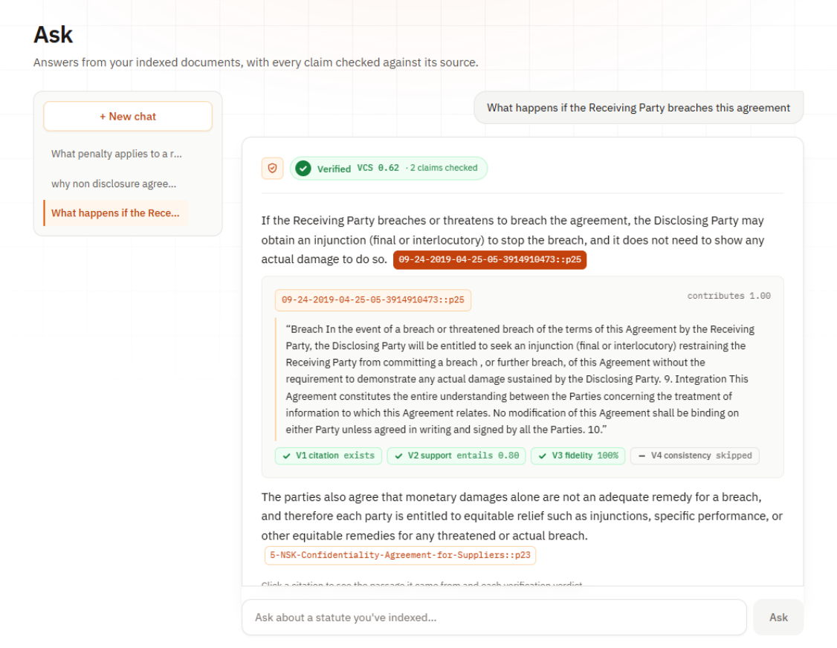
Implementation – Web Application
• Single-page interface: enter a query and receive a grounded answer with a confidence meter, freshness and retrieval badges, per-statement verification highlighting, and cited, dated sources.
• Additional views: query history, a feedback control, and administrative configuration (thresholds, provider, knowledge-base sources).
• Shown: a time-sensitive query answered with retrieval — confidence meter, freshness and retrieval badges, the grounded answer, per-statement verification, and cited sources with dates.
02/05/2026
FreshGuard: Freshness-Aware Adaptive RAG
15

Slide 16
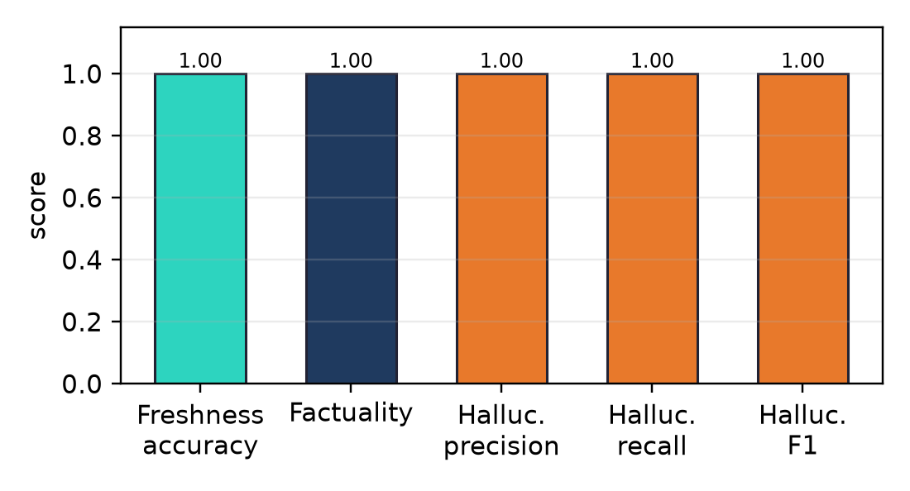
Results – Protocol, Freshness and Factuality
• Controlled benchmark: twelve queries (six static, six time-sensitive), each with a gold retrieval label and gold answer keywords; plus eight statement/evidence pairs (four faithful, four hallucinated) spanning entity-swap and numeric-mismatch errors.
• Metrics: freshness accuracy (retrieve/skip vs gold), factuality (gold fact present), hallucination precision / recall / F1, and expected calibration error (ECE).
• Freshness / retrieval-decision accuracy = 1.00 — the estimator chooses the correct action on all twelve queries.
• Factuality = 1.00 — every in-scope answer contains the gold fact.
• The evaluation module is part of the system and is exposed as an API endpoint.
02/05/2026
FreshGuard: Freshness-Aware Adaptive RAG
16

Slide 17
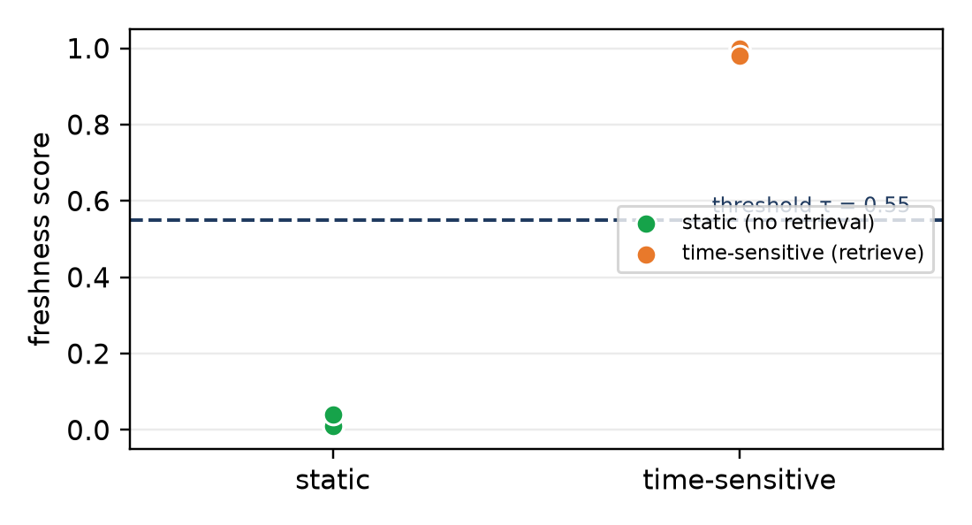
Results – Hallucination Detection and Calibration
• Hallucination detection is perfect on the benchmark: precision = recall = F1 = 1.00.
• All four hallucinations are caught — including both entity-swap cases — with no false positives.
• The fused confidence score is reasonably calibrated: ECE = 0.10 and mean confidence = 0.90 against perfect in-scope accuracy.
• The learned estimator separates static versus time-sensitive queries cleanly around the decision threshold τ = 0.55 (figure), confirming that a learned gate — not a heuristic — drives the retrieve/skip decision.
02/05/2026
FreshGuard: Freshness-Aware Adaptive RAG
17

Slide 18
Results – Cost of Adaptive Retrieval and Reproducibility
• Because fresh queries skip retrieval, FreshGuard avoids retrieval and ranking work on a large class of questions.
• Mean per-query latency: answering a fresh query directly is cheaper than forcing retrieval on it — even with the instant offline generator.
• The gap widens with any real retriever or hosted LLM, where a skipped query avoids a network round-trip, re-ranking, and longer grounded generation.
• Reproducibility: the complete automated suite — 41 unit, end-to-end, API, and evaluation tests — passed on twelve consecutive executions with identical outputs.
• Determinism lets the suite act as a regression guard and reproduces every number reported in this work.
02/05/2026
FreshGuard: Freshness-Aware Adaptive RAG
18

Slide 19
Discussion – Limitations and Responsible AI
• Small, controlled benchmark: the scores exercise the mechanism and show correct end-to-end behaviour, not state-of-the-art accuracy.
• The default offline generator and TF–IDF embeddings keep the system deterministic and dependency-light; a production deployment would substitute a hosted LLM and a dense encoder through the existing seams.
• Bag-of-words verification cannot resolve every semantic contradiction — the entity-swap and numeric-mismatch rules target the most common and damaging patterns; an NLI model could drop in behind the same interface.
• The freshness estimator is trained on synthesised templates; broadening it with real query logs such as FreshQA is future work.
• Responsible AI:
– Every answer carries a confidence score, a freshness badge, per-claim labels, and cited, dated sources — judgement stays with a reader who can check the source.
– Offline and deterministic by default; no data leaves the machine unless a hosted provider is explicitly configured.
– Failures and limits are reported alongside successes.
02/05/2026
FreshGuard: Freshness-Aware Adaptive RAG
19

Slide 20
Conclusion and Future Work
• Two learned gates — a freshness gate that decides when to retrieve and a verification gate that checks every claim — turn a standard RAG pipeline into one that is both efficient and trustworthy.
• FreshGuard retrieves only when the model’s knowledge is likely stale, grounds and verifies its answers, corrects or flags hallucinations, and presents a calibrated, cited result.
• On the controlled benchmark: 100% retrieval-decision accuracy, perfect in-scope factuality, F1 = 1.00 for hallucination detection, and ECE = 0.10; fully reproducible across twelve runs.
• Future work:
– Broaden the freshness estimator with real query logs (FreshQA) and richer temporal features.
– Swap in a dense encoder and a hosted LLM through the existing provider and embedding seams.
– Replace bag-of-words verification with a natural-language-inference model behind the same interface.
– Larger-scale evaluation and principled calibration of the freshness and confidence thresholds.
02/05/2026
FreshGuard: Freshness-Aware Adaptive RAG
20

Slide 21
References (IEEE Format)
[1] P. Lewis et al., “Retrieval-augmented generation for knowledge-intensive NLP tasks”, Advances in Neural Information Processing Systems (NeurIPS), vol. 33, pp. 9459–9474, 2020.
[2] V. Karpukhin et al., “Dense passage retrieval for open-domain question answering”, Proc. EMNLP, pp. 6769–6781, 2020.
[3] J. Johnson, M. Douze and H. Jégou, “Billion-scale similarity search with GPUs”, IEEE Transactions on Big Data, vol. 7, no. 3, pp. 535–547, 2021.
[4] Z. Ji et al., “Survey of hallucination in natural language generation”, ACM Computing Surveys, vol. 55, no. 12, pp. 1–38, 2023.
[5] P. Manakul, A. Liusie and M. J. F. Gales, “SelfCheckGPT: Zero-resource black-box hallucination detection for generative LLMs”, Proc. EMNLP, pp. 9004–9017, 2023.
[6] A. Asai et al., “Self-RAG: Learning to retrieve, generate, and critique through self-reflection”, Proc. ICLR, 2024.
[7] Z. Jiang et al., “Active retrieval augmented generation”, Proc. EMNLP, pp. 7969–7992, 2023.
[8] J. Kasai et al., “RealTime QA: What’s the answer right now?”, Advances in Neural Information Processing Systems (NeurIPS), vol. 36, 2023.
[9] T. Vu et al., “FreshLLMs: Refreshing large language models with search engine augmentation”, Findings of ACL, 2024.
[10] A. Mallen et al., “When not to trust language models: Investigating the effectiveness of parametric and non-parametric memories”, Proc. ACL, pp. 9802–9822, 2023.

Slide 22
References (IEEE Format)
[11] S. Min et al., “FACTSCORE: Fine-grained atomic evaluation of factual precision in long-form text generation”, Proc. EMNLP, pp. 12076–12100, 2023.
[12] C. Guo, G. Pleiss, Y. Sun and K. Q. Weinberger, “On calibration of modern neural networks”, Proc. ICML, pp. 1321–1330, 2017.
[13] S. Robertson and H. Zaragoza, “The probabilistic relevance framework: BM25 and beyond”, Foundations and Trends in Information Retrieval, vol. 3, no. 4, pp. 333–389, 2009.
[14] F. Pedregosa et al., “Scikit-learn: Machine learning in Python”, Journal of Machine Learning Research, vol. 12, pp. 2825–2830, 2011.
[15] H. Chase, “LangChain: Building applications with LLMs through composability”, 2022. [Online]. Available: https://github.com/langchain-ai/langchain
02/05/2026
FreshGuard: Freshness-Aware Adaptive RAG
22

