Slide 1
Time Travel and Fail-safe by Janardhan Bandi

Slide 2
Agenda
Time Travel
Retention Period
Querying historical data
Restoring Objects
Fail Safe
Continuous Data Protection Life Cycle

Slide 3
Time Travel
Snowflake Time Travel enables accessing historical data (i.e. data that has been changed or deleted) at any point within a defined period.
Restoring data-related objects (tables, schemas, and databases) that might have been accidentally or intentionally deleted.
Query data in the past that has since been updated or deleted.
Duplicating and backing up data from key points in the past.
Analyzing data usage/manipulation over specified periods of time.
No need to enable Time Travel, it is automatically enabled.

Slide 4
Retention Period
Retention is the key component of Time Travel.
It specifies the number of days for which this historical data is preserved.
For Standard Edition, the retention period is 1 day, can set it to 0.
For Enterprise and higher editions it is 90 days, can set it any thing between 0-90 days.
Default is 1, we can set this period at the time of creation of object or can alter later.
A retention period of 0 days for any object means disabling Time Travel for the object.
We can change the retention period by using ALTER command.
Higher retention period, the higher storage cost.

Slide 5
Querying Historical Data
3 Ways to query historical data
At specified timestamp
At some time ago
Before executing any statement/query

Slide 6
Querying Historical Data
1. Below query selects historical data from a table at the specified timestamp:
select * from my_table at(timestamp => 'Fri, 01 May 2015 16:20:00 -0700'::timestamp_tz);
2. Below query selects historical data from a table as of 5 minutes ago:
select * from my_table at(offset => -60*5);
3. Below query selects historical data that present in the table before executing the query specified by query id
select * from my_table before(statement => '8e5d0ca9-005e-44e6-b858-a8f5b37c5726');

Slide 7
Restoring Objects
When a table, schema, or database is dropped, it is not immediately removed from the system.
Instead, it is retained for the data retention period for the object, during which time the object can be restored.
After retention period is completed, we can’t restore the objects.
UNDROP TABLE ‘TABLE_NAME’
UNDROP SCHEMA ‘SCHEMA_NAME’
UNDROP DATABASE ‘DATABASE_NAME’

Slide 8
Fail-safe
Fail-safe provides a 7-day period during which historical data may be recoverable by Snowflake.
This period starts immediately after the Time Travel retention period ends.
We can't query or restore the Fail-safe data.
We need to contact Snowflake Support to restore the data during Fail-safe period.
Data recovery through Fail-safe may take several hours to several days to complete.
After Fail-safe period is over, there is no other way to recover the data.

Slide 9
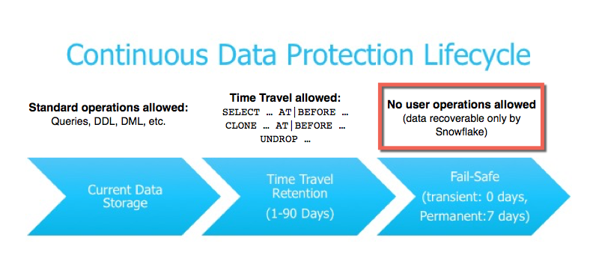
Continuous Data Protection Life Cycle

Slide 10
Thank You

