Slide 1
Secure Data Sharing by Janardhan Bandi

Slide 2
Data Sharing
Data can be shared securely.
Can share data to other snowflake users and to non-snowflake users as well.
For non-snowflake users, we have to create a reader account and share the data.
Provider – Who is sharing the data by creating share object.
Consumer – Who is consuming or using the shared data.
Shared data can be consumed by consumers own compute resources.

Slide 3
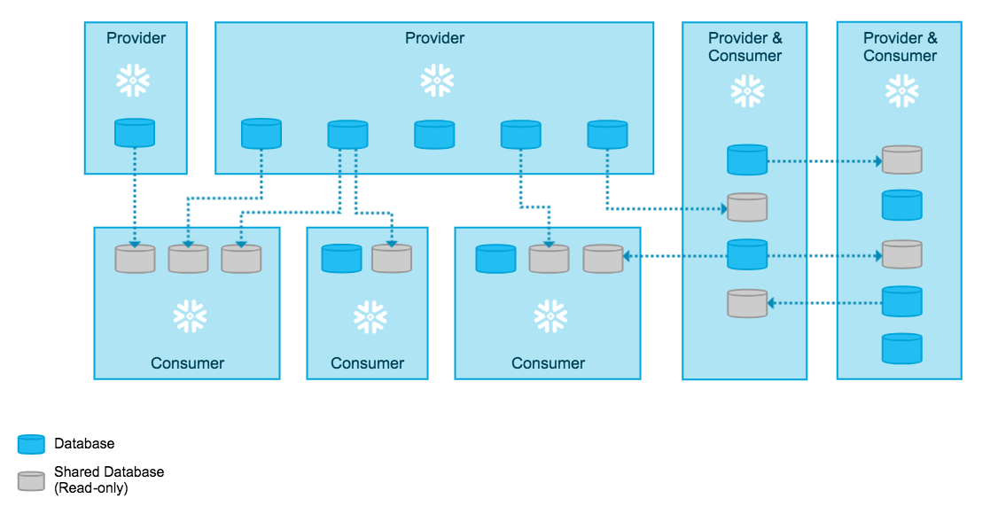
Data Sharing

Slide 4
What objects can be shared?
What is a share?
Shares are named database objects that contains all of the information required to share a database like the object grants and consumer account details.
All below objects can be shared with other account users.
Tables
External tables
Secure views
Secure materialized views
Secure UDFs

Slide 5
Reader Accounts
Data sharing is only supported between Snowflake accounts.
If we want to share data with non-snowflake users, we can create reader accounts for them.
Reader accounts (known as “read-only accounts”) provide a quick, easy, and cost-effective way to share data without requiring the consumer to become a Snowflake customer.
Each reader account belongs to the provider account that created it.
Readers can't perform any DML operations, they will have only select access.
Billing will be calculated in Provider's account itself.

Slide 6
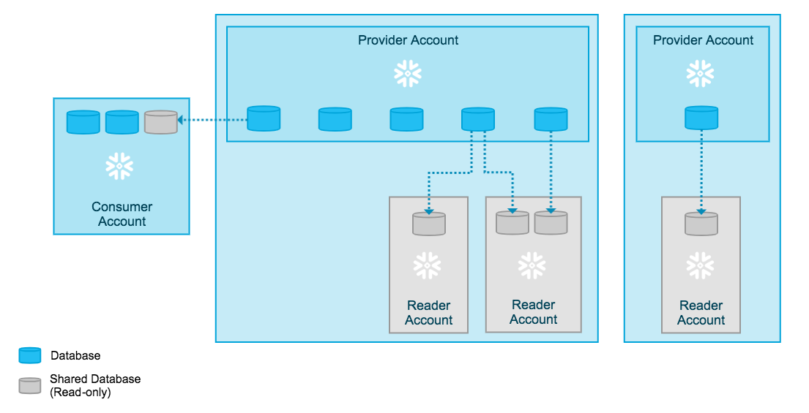
Reader Account

Slide 7
Thank You

