Slide 1
Scheduling in Snowflake using Tasks by Janardhan Bandi

Slide 2
Agenda
What is Task?
How to create a task?
Altering a Task
Using Cron
DAG of Tasks
Task history
Troubleshooting Tasks

Slide 3
What is a Task?
We use tasks for scheduling in Snowflake.
We can schedule
SQL queries
Stored procedures
Tasks can be combined with streams for implementing the continuous change data captures(CDC).
We can maintain a DAG of tasks to keep the dependencies between tasks.
Tasks require compute resources to execute SQL code, we can choose either of
Snowflake managed compute resources(Serverless)
User managed (Virtual warehouses)

Slide 4
How to create a Task?
By using CREATE TASK Command we can create tasks.
CREATE OR REPLACE TASK task_name
WAREHOUSE = ‘warehouse name’
SCHEDULE = ‘Time or Cron’
AFTER dep_task_name
AS
SQL Statement;
SQL Statement can be a query or a call to stored procedure.

Slide 5
Altering a Task?
By using ALTER TASK command, you can
Add or remove dependency
Change the warehouse
Change the schedule
Modify the SQL statement
Add/Remove/Modify the comments
Suspend or Resume tasks
Examples:
ALTER TASK task_dept ADD AFTER task_emp;
ALTER TASK task_dept REMOVE AFTER task_emp;
ALTER TASK emp_task SET SCHEDULE = ‘5 minutes’;
ALTER TASK emp_task SUSPEND;

Slide 6
Sample Tasks
// Task to run a query for every 10 minutes
CREATE OR REPLACE TASK CUSTOMER_INSERT
WAREHOUSE = COMPUTE_WH
SCHEDULE = ‘10 MINUTE'
AS
INSERT INTO CUSTOMERS(CREATE_DATE) VALUES(CURRENT_TIMESTAMP);
// Task to call a store proc every day at 9.30 UTC
CREATE OR REPLACE TASK CUSTOMER_INSERT
WAREHOUSE = MYOWN_WH
SCHEDULE = 'USING CRON 30 9 * * * UTC'
AS
CALL PROC_EMPL_DATA_LOAD();

Slide 7
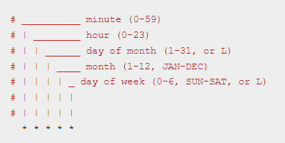
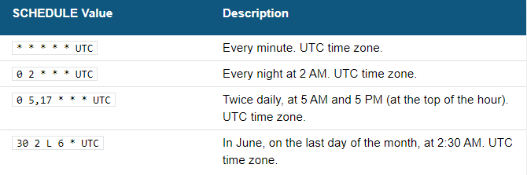
Using Cron

Slide 8
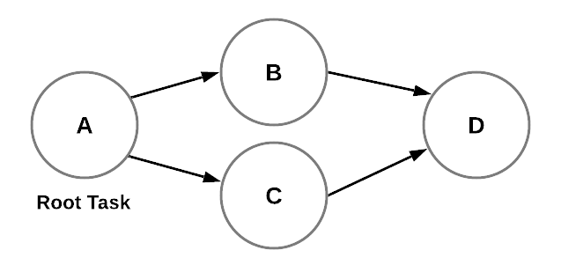
DAG of Tasks
DAG – Directed Acyclic Graph
To maintain dependencies between tasks
A root task followed by child tasks
Just schedule root task, child tasks will be executed in order.

Slide 9
DAG of Tasks
CREATE OR REPLACE TASK TASK_A
WAREHOUSE = COMPUTE_WH
SCHEDULE = 'USING CRON 30 9 * * * UTC'
AS ‘SQL Query 1’;
CREATE OR REPLACE TASK TASK_B
WAREHOUSE = COMPUTE_WH
AFTER TASK_A
AS ‘SQL Query 2’;
CREATE OR REPLACE TASK TASK_C
WAREHOUSE = COMPUTE_WH
AFTER TASK_A
AS ‘SQL Query 3’;
CREATE OR REPLACE TASK TASK_D
WAREHOUSE = COMPUTE_WH
AS ‘SQL Query 4’;
ALTER TASK TASK_D ADD AFTER TASK_B;
ALTER TASK TASK_D ADD AFTER TASK_C;

Slide 10
Task History
We can check task history from information schema table TASK_HISTORY.
// To see all tasks history with last executed task first
select * from table(information_schema.task_history())
order by scheduled_time desc;
// To see results of a specific task in last 6 hours
select * from table(information_schema.task_history(
scheduled_time_range_start =>dateadd('hour’,-6,current_timestamp()),
task_name => ‘Task Name'));
// To see results in a given time period
select * from table(information_schema.task_history(
scheduled_time_range_start=>to_timestamp_ltz(‘2022-07-17 10:00:00.000 -0700'),
scheduled_time_range_end=>to_timestamp_ltz(‘2022-07-17 11:00:00.000 -0700')));

Slide 11
Troubleshooting Tasks
If your task is not running as per schedule, check below things..
Step 1: Verify the Task status, it should be like ‘started’, if it is in ‘suspended’ state, resume it by using alter command.
Step 2: Check the Task history and check execution state, if it is in ‘failed’ state, take the query id and check the failure reason.
Step 3: Verify the Permissions Granted to the Task Owner, Owner should have access to database, schema, tables and warehouses.
Step 4: Verify the Condition (Only for Streams): check SYSTEM$STREAM_HAS_DATA , stream may not have data changes to process.

Slide 12
Thank You

