Slide 1
Streams in Snowflake by Janardhan Bandi

Slide 2
Agenda
What is a stream?
Metadata of streams (Stream Columns)
How a stream works?
Consuming data from streams
Types of Streams

Slide 3
What is a Stream?
A stream object records DML changes made to tables including inserts, updates, and deletes.
Also Stream stores metadata about each change, so that actions can be taken using this metadata.
We call this process as change data capture (CDC).
Streams tracks all row level changes to a source table using offset but doesn't store the changed data.
Once these changes are consumed by the Target table, this offset moves to the next point.
Streams can be combined with tasks to set continuous data pipelines.
Snowpipe + Stream + Task ➔ Continuous Data Load.

Slide 4
Metadata of Streams
Along with the changes made to the source table, Streams maintain 3 metadata fields.
1. METADATA$ACTION: Indicates the DML operation (INSERT, DELETE) recorded.
2. METADATA$ISUPDATE: Indicates whether the operation was part of an UPDATE statement. Updates to rows in the source object are represented as a pair of DELETE and INSERT records in the stream with a metadata column METADATA$ISUPDATE values set to TRUE.
3. METADATA$ROW_ID: Specifies the unique and immutable ID for the row, which can be used to track changes to specific rows over time.

Slide 5
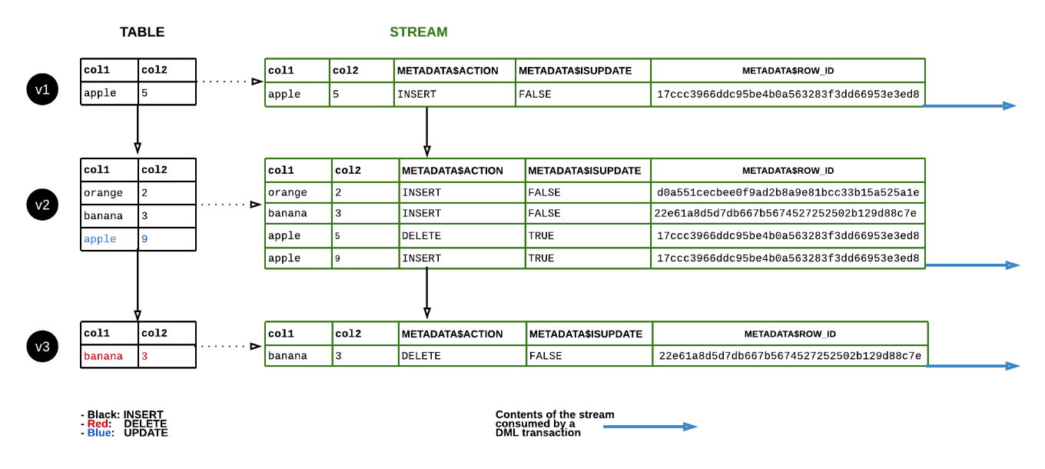
How a Stream works? or Data flow in a Stream

Slide 6
Consuming data from Streams
We use merge statement for consuming the changes from stream and applying the same on Target tables.
// To identify Insert records
WHERE metadata$action = 'INSERT AND metadata$isupdate = 'FALSE’;
// To identify Update records
WHERE metadata$action = 'INSERT' AND metadata$isupdate = 'TRUE’;
To identify Delete records
WHERE metadata$action = 'DELETE' AND metadata$isupdate = 'FALSE’;
Note: If we want to consume these changes to multiple tables then we have to create multiple streams.

Slide 7
Types of Streams
1. Standard Streams: A Standard stream tracks all DML changes to the source object, including inserts, updates, and deletes (including table truncates).
CREATE OR REPLACE STREAM my_stream ON TABLE my_table;
2. Append-only Streams: An Append-only stream tracks row inserts only. Update and delete operations (including table truncates) are not recorded.
CREATE OR REPLACE STREAM my_stream ON TABLE my_table APPEND_ONLY = TRUE;
3. Insert-only Streams: Supported for External tables only. An insert-only stream tracks row inserts only. They do not record delete operations.
CREATE OR REPLACE STREAM my_stream ON EXTERNAL TABLE my_table INSERT_ONLY = TRUE;

Slide 8
Thank You

