Slide 1
Snowflake Editions by Janardhan Bandi

Slide 2
Editions
4 Editions:
Standard Edition
Enterprise Edition
Business Critical Edition
Virtual Private Snowflake(VPS)
Cost is dependent on the edition we are choosing
Most of the organizations choose either Enterprise or Business Critical

Slide 3
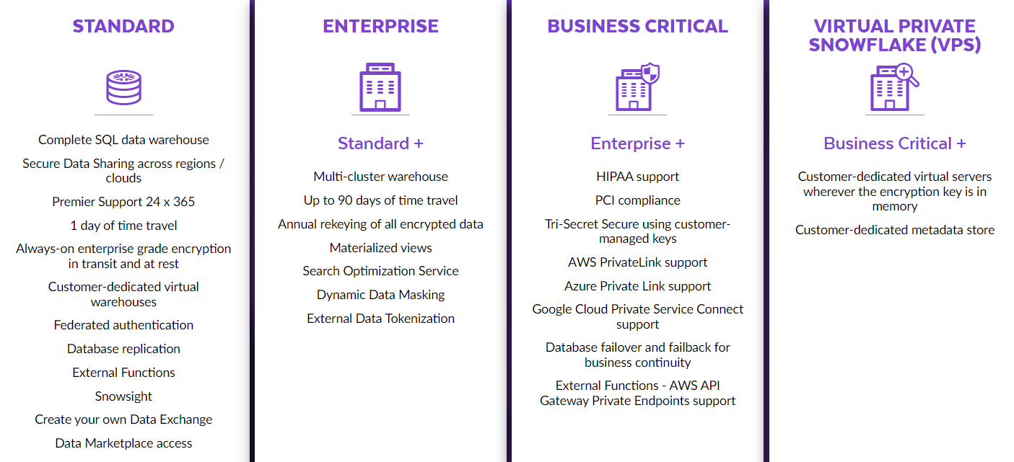

Slide 4
Feature / Edition Matrix
Refer below snowflake documentation to know the features supported by each edition in detail.
https://docs.snowflake.com/en/user-guide/intro-editions.html#release-management

