Slide 1
Access Control in Snowflake by Janardhan Bandi

Slide 2
Agenda
What is Access Control
Key Concepts of Access Control
Objects Hierarchy
Roles in Snowflake
System Defined Roles
Role Hierarchy
Custom Roles

Slide 3
Access Control in Snowflake
What is Access Control?
Access control determines who can access database objects and perform operations on specific objects in Snowflake.
Snowflake supports and combines both of below access control models.
Discretionary Access Control (DAC): Each object has an owner, who can in turn grant access to that object.
Role-based Access Control (RBAC): Access privileges are assigned to roles, which are in turn assigned to users.

Slide 4
Key Concepts
Below are the key concepts of Snowflake Access Control mechanism.
Securable object: An entity to which access can be granted. Tables, schemas, views etc.
Role: An entity to which privileges can be granted. Roles are in turn assigned to users. Note that roles can also be assigned to other roles, creating a role hierarchy.
Privilege: It is level of access that can be granted to any object. Like select, create, drop, insert etc.
User: Specifies the people or system to whom the access granted.

Slide 5
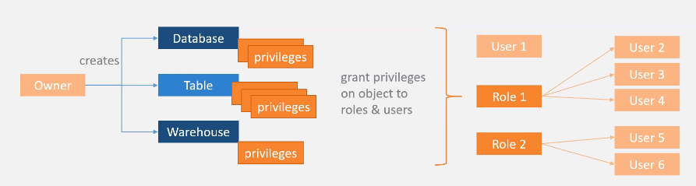
Key Concepts

Slide 6
Privileges
Privilege | Usage
SELECT | Execute a SELECT statement on the table.
INSERT | Execute an INSERT query on the table.
UPDATE | Execute an UPDATE query on the table.
TRUNCATE | Execute a TRUNCATE query on the table.
DELETE | Execute a DELETE query on the table.
ALL [ PRIVILEGES] | Grant all privileges, except OWNERSHIP, on the table.
OWNERSHIP | Grant full control over a table.

Slide 7
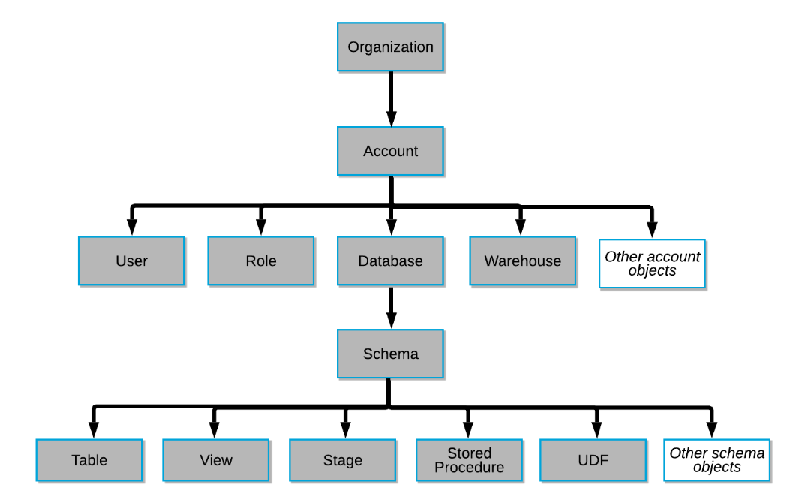
Object Hierarchy

Slide 8
Roles in Snowflake
Roles are the entities to which privileges on securable objects can be granted and revoked.
Roles are assigned to users to allow them to perform actions required for business functions
A user can be assigned multiple roles. This allows users to switch roles.
On Snowflake web UI window the top right corner shows which Role is currently we are using.
Two types of roles
System defined roles
Custom roles

Slide 9
System Defined Roles
1. ORGADMIN (Organization Administrator):
Role that manages operations at the organization level. More specifically, this role:
Can create accounts in the organization.
Can view all accounts in the organization (using SHOW ORGANIZATION ACCOUNTS) as well as all regions enabled for the organization (using SHOW REGIONS).
Can view usage information across the organization.
2. ACCOUNTADMIN (Account Administrator):
It is the top-level role in the system.
Only Account Admin can see all account related things like usage, billing, users, roles, sessions and reader account details.
Should be granted only to a limited number of users in your account.
Can enable multi factor authentication.
Encapsulates the SYSADMIN and SECURITYADMIN system-defined roles.

Slide 10
System Defined Roles
3. SECURITYADMIN (Security Administrator):
Role that can manage any object grant globally,
Can create, monitor, and manage users and roles.
Limited access to Account tab.
Inherits the privileges of the USERADMIN role via the system role hierarchy.
4. USERADMIN (User and Role Administrator):
Role that is dedicated to user and role management only.
This role is granted the CREATE USER and CREATE ROLE security privileges.
Can create users and roles in the account.

Slide 11
System Defined Roles
5. SYSADMIN (System Administrator):
Role that has privileges to create warehouses and databases and other objects in an account.
This role also has the ability to grant privileges on warehouses, databases, and other objects to other roles.
All custom roles are assigned to the SYSADMIN role.
6. PUBLIC:
Automatically granted to every user and every role in your account.
The objects owned by the role are, by definition, available to every other user and role in the account.
This role is typically used in cases where all users have all access to the objects.

Slide 12
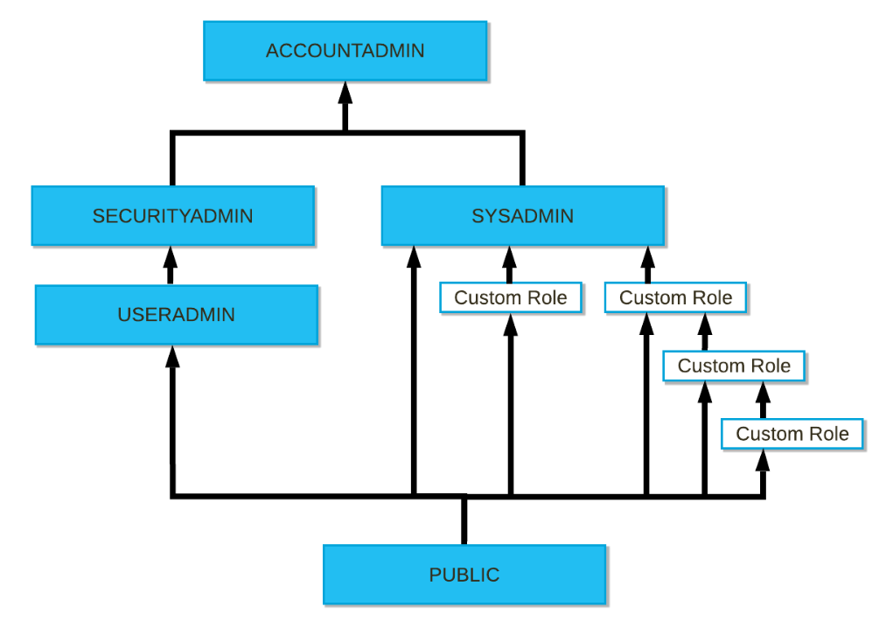
Role Hierarchy

Slide 13
Custom Roles
Custom roles can be created by the USERADMIN role (or a higher role) as well as by any role to which the CREATE ROLE privilege has been granted.
By default, a newly-created role is not assigned to any user, nor granted to any other role.
Snowflake recommends creating a hierarchy of custom roles, with the top-most custom role assigned to the system role SYSADMIN. This will allow system administrators to manage all objects in the account.
If custom role is not assigned to SYSADMIN through a role hierarchy, the system administrators will not be able to manage the objects owned by that role. Only SECURITYADMIN can view the objects and modify their access grants.

Slide 14
Thank You

