Slide 1
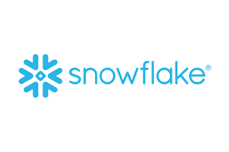
Why Snowflake?
By
Janardhan Bandi

Slide 2
What is Snowflake?
Snowflake is a cloud based data warehousing solution, Founded in 2012.
Snowflake offers data storage and analytics services.
Snowflake does not have their own infrastructure.
It runs on Amazon S3, Microsoft Azure, and the Google Cloud platform.
Snowflake runs completely on cloud infrastructure.
Available as Software-as-a-Service.

Slide 3
Why Snowflake?
Pay for what you use model.
It is a cloud platform, no Infrastructure cost.
Snowflake is more than a Datawarehouse.
It also helps in some transformations, create data pipes, create visual dashboard etc.
High scalability.
Data recovery, backup, sharing, masking.
Can analyze the data present in external files.
Easy integration with Data Visualization/Reporting tolls.

Slide 4
Traditional WH Vs Snowflake
Feature | Traditional WH | Snowflake
Infrastructure cost | yes | No Infrastructure cost
Handle semi structure data | Need ETL tools | Snowflake can process
Data loading and unloading | Need ETL tools | Can be done by using “COPY”
Scalability | Not an easy task | Highly Scalable (support Scale-up and Scale-out)
Database Administration | Highly Required | In-built performance optimization with its micro partitions and cluster keys

Slide 5
Traditional WH Vs Snowflake
Feature | Traditional WH | Snowflake
Data Backup | Need additional storage | Easy and no cost with “Cloning”
Data Recovery | Difficult | Very easy with “Time Travel”
Data Sharing | Difficult | Easy with Data Sharing feature
Change Data Capture | Need ETL tools | Can be done by using “Streams”
Scheduling | Tools required | Can schedule by using “Tasks”

Slide 6
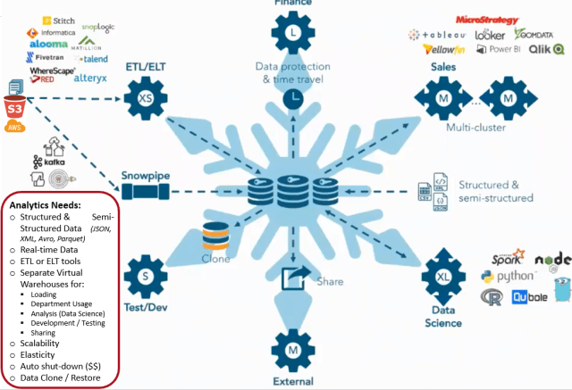

Slide 7
Prerequisites
Database knowledge
SQL

Slide 8
Thank You!

