Slide 1
Data Loading in Snowflake by Janardhan Bandi

Slide 2
Agenda
Load Types
Bulk Loading v/s Continuous Loading
Copy Command
Transforming Data

Slide 3
Load Types
Bulk loading using Copy
Continuous loading using Snowpipe

Slide 4
Bulk Loading Using the COPY Command
This option enables loading batches of data from files already available in cloud storage(External Stages)
We have to create Storage Integration objects to extract data from these cloud storages.
(Or)
Copying data files from a local machine to an Internal Stage(i.e. Snowflake) before loading the data into table.
Bulk loading uses virtual warehouses
Users are required to size the warehouse appropriately to accommodate expected loads using the COPY command.

Slide 5
Continuous Loading Using Snowpipe
Designed to load small volumes of data (i.e. micro-batches) and incrementally make them available for analysis.
Live or real time data
Snowpipe loads data within minutes after files are added to a stage and submitted for ingestion.
This ensures users have the latest data for business analysis.
Snowpipe uses compute resources provided by Snowflake, It is a serverless task and there will be separate charge for these serverless tasks.
The COPY statement in the pipe definition supports the same COPY transformation options as when bulk loading data.

Slide 6
COPY Command
COPY INTO TABLENAME
FROM @STAGE
file_format= (…)
files = (filename1, filename2 …)
(or)
pattern = ‘.*filepattern.*’
other_optional_props ;

Slide 7
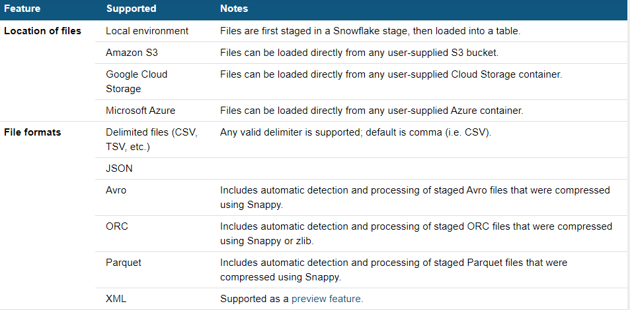
COPY Command

Slide 8
Other ways to load Data
By using ETL tools like
Matellion
Datastage
Informatica
Hevo
Azure Data Factory
Azure Synapse etc

Slide 9
Simple Transformations During Data Load
Snowflake supports transforming data while loading it into a table using the COPY command. Options include:
Column reordering
Column omission
String operations
Other functions
Sequence numbers
Auto increment fields

Slide 10
Thank You

