Slide 1
Stats & ML Capstone Project
-Venkatesh Dhairyashil Vandekar

Slide 2
Objective
-To Predict whether a customer will make a purchase or not
Understanding Dataset:
Dataset has 1 lakh data points and 15 feature column
Out of 15 feature columns half of the feature column are categorical
4 feature columns have null values (Annual_Income, Customer_Satisfaction, Loyalty_Points, Monthly_Expenditure)
- 5 feature columns have extreme negative values(Age, Annual_Income, Number_of_Children, Credit_Score, Internet_Usage_Hours_per_Week)

Slide 3
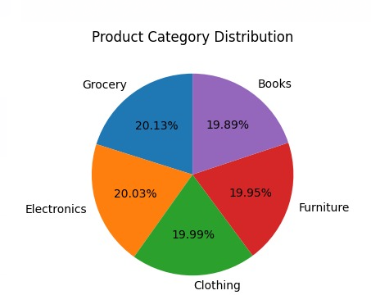
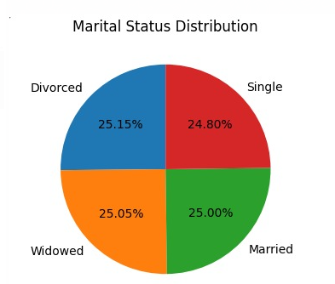
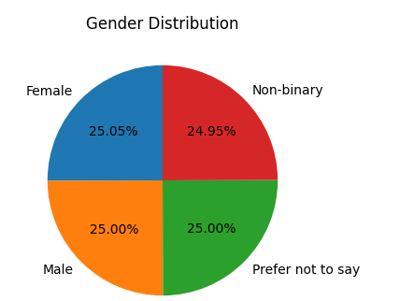
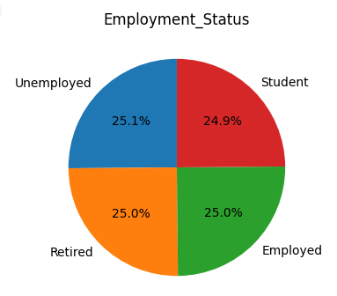
Understanding Dataset:
Categorical column are evenly distributed

Slide 4
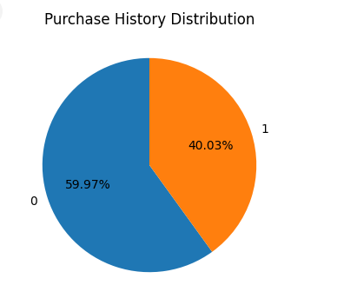
Target Variable Y
- In this case the target variable is Purchase_History
We can see that only 40 percent people have bought
Handling Negative values
Median is chosen to replace the negative values because,
Mean is negative due to extreme negative values
Handling Null values
Median is chosen to replace the null values
Few Other Observations
1.] People who's Monthly Income is LESS than Monthly Expenditure = 692. Decided to ignore this column as the magnitude of such people is very less
2.] Children who's age is less than 18 and NOT Single = 1948. After observing these people, they have a Annual Salary, each one of them has at least 1 child, 70% of them own a home so it’s a strong possibility that age is incorrectly added. Replaced such age with median
3.] Customer who are repeated = 5341. Decided to Ignore them has its hardly 5 Percent of data

Slide 5
Getting the data Ready
Splitted the data in x and y.
Did label encoding on x
Splited x,y into train & test using sklearns, train_test_split
Performed standard scaler on x-train and x-test

Slide 6
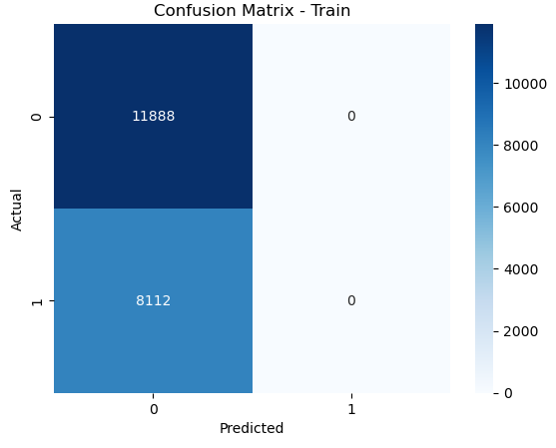
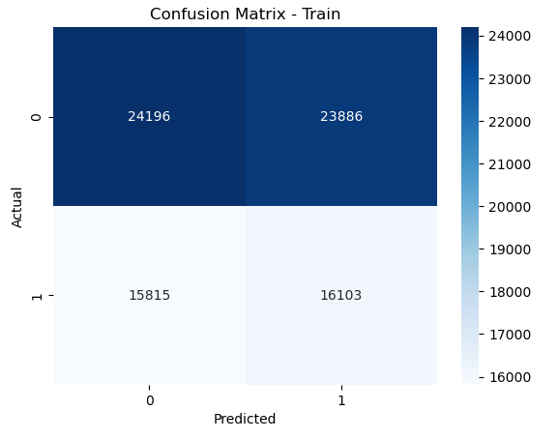
Logistic Regression - Gini
01-We can see that for test and train TP and FP is 0
02-Train accuracy is 60.1% and test accuracy is 59.4%
03-There can be class imbalance inbalance in data which needs to be fixed
04-Tried using LogisticRegression(class_weight='balanced’)
A-We can see that for test and train TP and FP is NO LONGER 0.
B-However Accuracy has reduced Train accuracy is 50.3%
and test accuracy is 49.8%

Slide 7
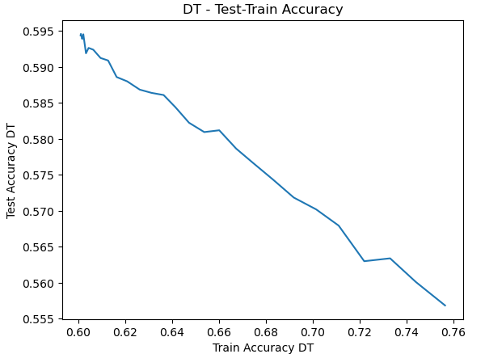
DecisionTreeClassifier - Gini
In Decision Tree As max depth is increasing, train accuracy is increasing TP and FP values are no longer zero
However test accuracy is going down, as max depth is increasing

Slide 8
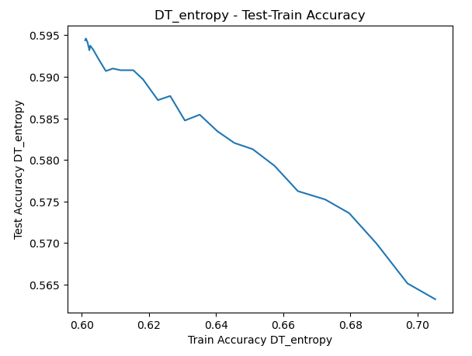
DecisionTreeClassifier – Entropy
In Decision Tree As max depth is increasing, train accuracy is increasing TP and FP values are no longer zero()
However test accuracy is going down, as max depth is increasing

Slide 9
Adaboost
Train accuracy 0.5025997254689905 is and Test accuracy is 0.4874242934051144
RandomForestClassifier
For n_estimator=1 Train Accuracy is 8242375 and Test Accuracy is 0.5212
As n_estimator increases Train Accuracy is increased but Test Accuracy keeps on fluctuating at the same range

Slide 10
Conclusion
We can say that DT(Gini/Entropy) with max_depth 1 is giving train_accuracy of 60.1% and test_accuracy of 59.4% which is more that rest of the models.

