Slide 1
Classification of Organic and Inorganic Waste using Neural Networks
PROJECT STAGE-II

Slide 2
Problem Statement :
Rapid urbanization and population growth lead to increased waste generation, putting additional pressure on existing waste management systems
Inefficient management of waste poses a great threat to environment and the waste when dumped in nature can have serious impact on health of humans as well as animals.
Categorization of waste materials plays a crucial role in recycling and sorting of materials that need to be processed further for decomposition.
But the manual sorting is time consuming , error – prone and lead to improper waste disposal thus, there is a need for a waste classifier that can categorize diverse waste materials.

Slide 3
Abstract :
The identification of organic and inorganic materials plays a crucial role in waste management and recycling processes. a classifier system needs to be developed to effectively distinguish between organic and inorganic materials using machine learning techniques and neural networks. For training the classifier, a large dataset of labelled waste samples is collected, encompassing a wide range of organic and inorganic materials commonly found in waste streams.
The system's performance is evaluates using rigorous validation methods, including cross-validation, and testing with unseen waste samples. The methodology for identifying organic-inorganic materials using CNN involves collecting a comprehensive dataset of spectral and compositional data. Relevant features are extracted, and the data is pre-processed to handle missing values, normalize features, and remove noise.

Slide 4
Existing Systems:
The existed model of waste classifier employed machine learning algorithms, such as decision trees random forests, to train models for waste classification. These algorithms were trained using labelled data, where waste items were manually categorized into different classes.
Disadvantages of Existing System :
1. Limited Dataset Size: The availability of labelled waste data for training the models was limited in the old model. This constrained the accuracy and generalizability of the waste classifier. The models often faced challenges when presented with unseen waste
2.Lack of Deep Learning: The use of deep learning methods, such as convolutional neural networks (CNNs), was limited in the old model of waste classifier. Deep learning techniques have since demonstrated superior performance in various computer vision tasks, including waste classification, due to their ability to automatically learn hierarchical representations from data.
3.Limited Real-time Processing: The old model of waste classifier had limitations in real-time processing capabilities. The classification process often required manual intervention or batch processing, leading to delays in decision-making and waste sorting processes.

Slide 5
Proposed System :
The new model of waste classifier using AI refers to more recent and advanced approaches that leverage artificial intelligence techniques for waste classification. These models incorporate state-of-the-art machine learning algorithms, deep learning methods, and computer vision techniques to achieve accurate and efficient waste classification. Here is a brief description of the new model of waste classifier using AI:
• Advantages of Proposed System
1. Deep Learning and Convolutional Neural Networks (CNNs): The new model heavily relies on deep learning methods, particularly CNNs, for waste classification. CNNs can automatically learn hierarchical features from waste item images, enabling more accurate and robust classification performance.
2. Transfer Learning: Transfer learning is widely used in the new model to leverage pre-trained CNN models that have been trained on large-scale image datasets, such as ImageNet. By fine- tuning these pre-trained models on waste classification tasks with a smaller labelled dataset, the new model can achieve better performance with less training data.
3. Large Labelled Datasets: The new model benefits from larger and more diverse labelled datasets for training. These datasets contain a wide variety of waste items, covering different categories and variations in waste characteristics. The availability of such datasets helps improve the model's ability to generalize and accurately classify a broader range of waste materials.

Slide 6
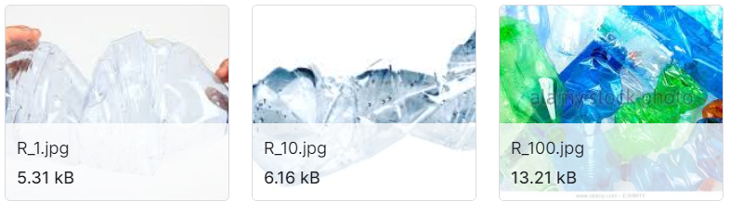
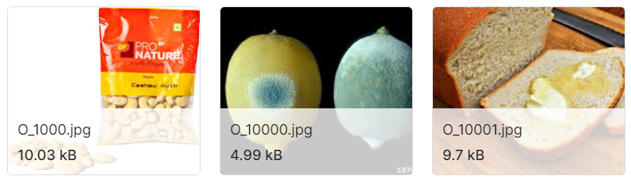
DATASET :
The dataset is a collection of 24,705 images of solid household waste, categorised into two classes: organic (13,880) and recyclable (10,825) . The data is a restructured and represented version of the original dataset by Sashaank Sekar available at https://www.kaggle.com/techsash/waste-classification-data.
Sample data :

Slide 7
Methodology :
The system is mainly based on Convolutional Neural Network(CNN) consisting of four major layers:
i)Convolution layer
ii)Pooling layer
iii)Activation layer
iv)Fully connected layer.
CNN has two components:
1) Feature Extraction :
Features are detected when network performs a series of convolution and pooling operations.
2) Classification Part :
Extracted features are given to fully connected layer which acts as a classifier.

Slide 8
Sequence Diagram :
Input dataset
Preprocessing
Feature Selection
Classification
Clustering
Prediction
Output

Slide 9
REQUIREMENTS
Development Platform : Windows
IDE : Jupyter Notebook, Python.
Libraries : Tensorflow, Keras, Matplotlib, Numpy, Pandas

Slide 10
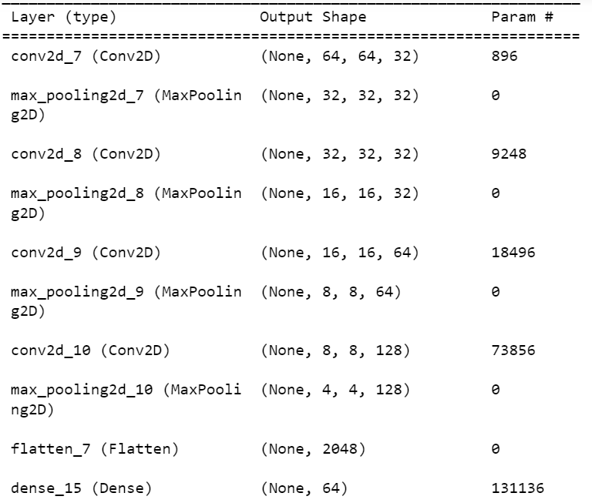
Implementation :
The CNN model to Identify Organic and Inorganic materials in construct as follows with the help of sequential model as shown in figure.

Slide 11
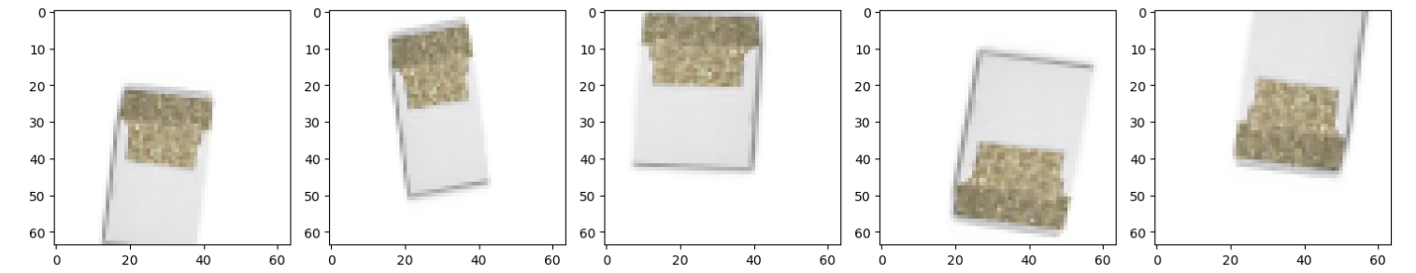
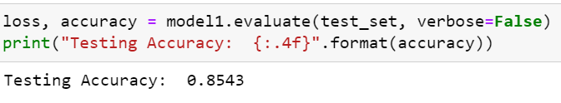
Data Augumentation :
Using ImageDataUsing ImageDataGenerator to create a transformation that rescales the images and applied data augmentation as well. Generate augumentation only for train data while validation data are only rescaling ones.
Keras ImageDataGenerator class provides a quick and easy way to augment of our images. It provides many of different augmentation techniques like standardization, shifts, rotation, flips, brightness change etc. Now set our dataset into train, test and validation data.
The CNN model gave the accuracy as shown

Slide 12
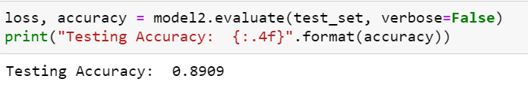
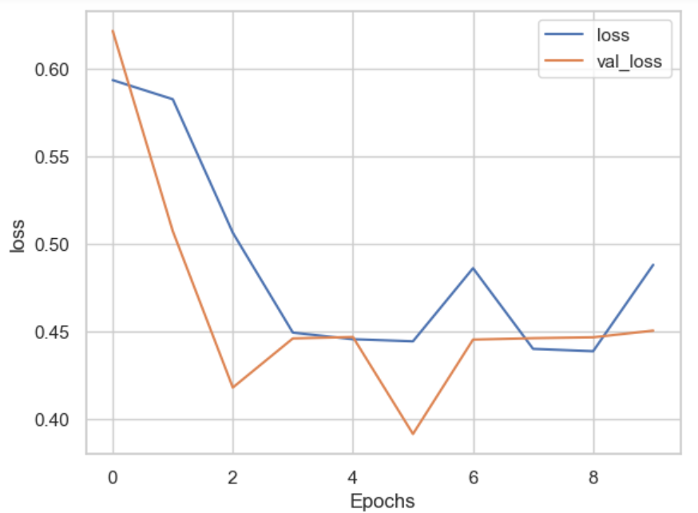
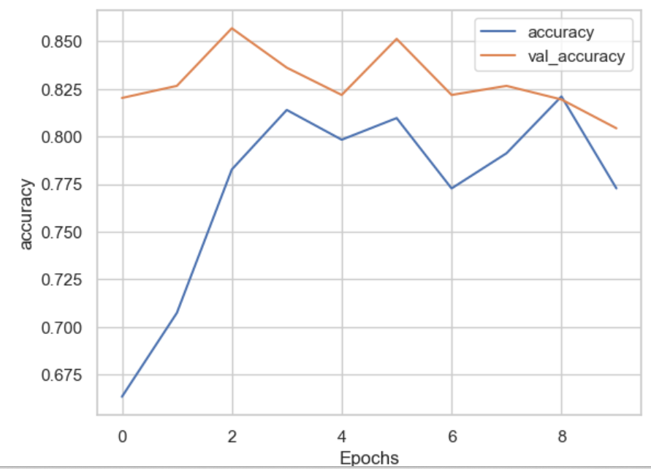
MobileNetV2: MobileNetV2 is a convolutional neural network architecture designed for mobile and embedded vision applications. It was developed by researchers at Google, and it builds upon the success of the original MobileNet architecture, aiming to improve both the efficiency and performance of deep neural networks for mobile devices.
Although MobileNetV2 is an efficient model it cannot produce the desired results.
By fine tuning the our basic model we achieved an accuracy of

Slide 13
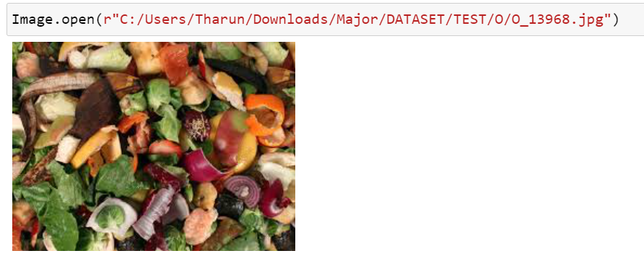
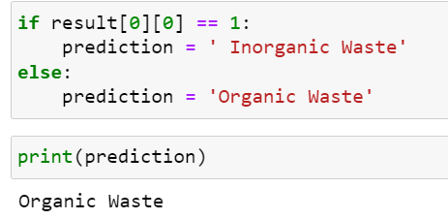
Result :

Slide 14
Refernces
[1]Pratami, S., Hertati, L., Puspitawati, L., Gantino, R., & Ilyas, M. (2021). Teknologi Inovasi Pengolahan Limbah Plastik Menjadi Produk UMKM Guna Menopang Ekonomi Keluarga Dalam Mencerdaskan Keterampilan Masyarakat. In GLOBAL ABDIMAS: Jurnal Pengabdian Masyarakat (Vol. 1, Issue 1, pp. 1– 11). Perkumpulan Intelektual Madani Indonesia. https://doi.org/10.51577/globalabdimas.v1i1.59
[2]G. Hinton et al., "Deep Neural Networks for Acoustic Modeling in Speech Recognition: The Shared Views of Four Research Groups," in IEEE Signal Processing Magazine, vol. 29, no. 6, pp. 82-97, Nov. 2012, doi: 10.1109/MSP.2012.2205597
[3]Chollet, F. (2017). Xception: Deep learning with depthwise separable convolutions. In Proceedings of the IEEE conference on computer vision and pattern recognition (pp. 1251-1258).

Slide 15
[4] Olugboja Adedeji, Zenghui Wang, Intelligent Waste Classification System Using Deep Learning Convolutional Neural Network, Procedia Manufacturing, Volume 35, 2019, Pages 607-612, ISSN 2351-9789, https://doi.org/10.1016/j.promfg.2019.05.086.
[6] Zhang, Y., Xie, X., Cui, C., Liu, D., & Huang, B. (2021). Machine learning meets high- throughput experiments in inorganic materials synthesis: Recent advances and future perspectives. Journal of Materials Chemistry A, 9(45), 25463-25480.
[7] Huan, T. D., Mannodi-Kanakkithodi, A., Balachandran, P. V., & Lookman, T. (2020). Machine learning for molecular and materials science. Nature, 586(7829), 210-219

Slide 16
THANK YOU

