Slide 1

A Presentation on
E-Gas Sewa
UUUUnder The Guidance of Mr.Santhosh Mali
Presented by:
Venmathi.V,
Indumathy.S,
Preetha.S

Slide 2
Introduction
The E-Gas service is an online service provided to the common people for online booking of gas and checking of the delivery details related to it.
Complaints /feedback question is answer by the administrator and report is also maintained by the administrator.
For our system of E-GAS BOOKING SYSTEM, we have focused on booking ,check status of booking, cancellation ,changing mobile numbers,etc...

Slide 3
Software used:
HTML
CSS
JavaScript
Core Java
IDE used :
Eclipse

Slide 4
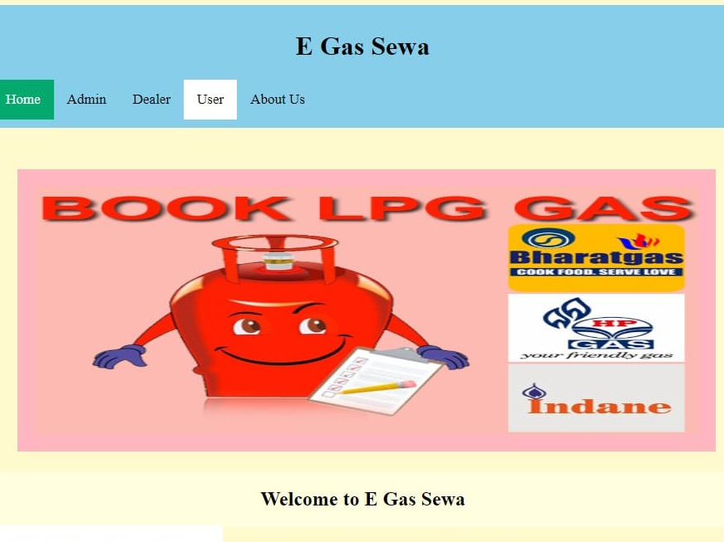
Home Page

Slide 5
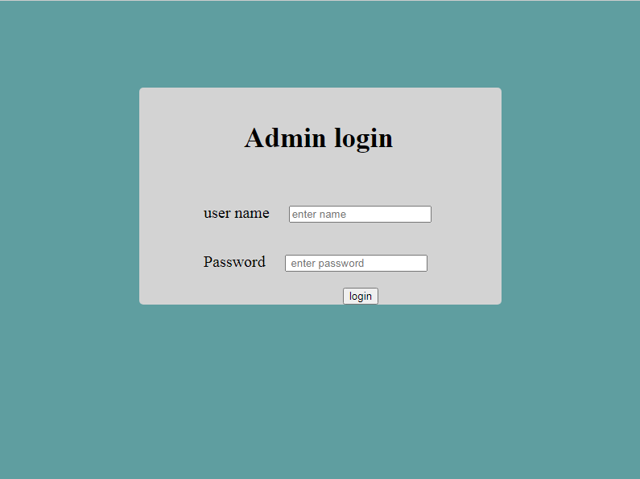
Admin Login

Slide 6
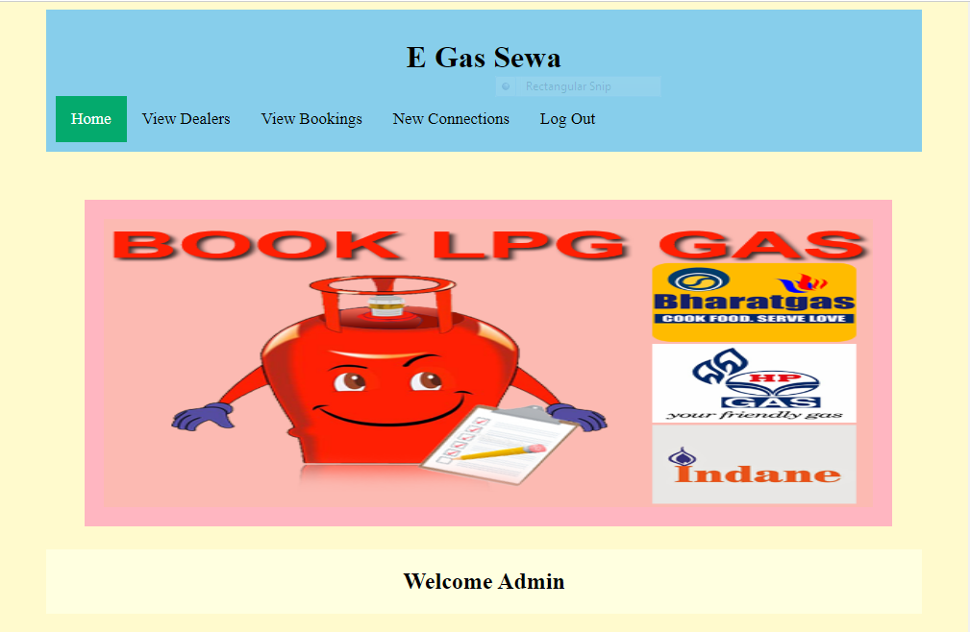
Admin Page

Slide 7
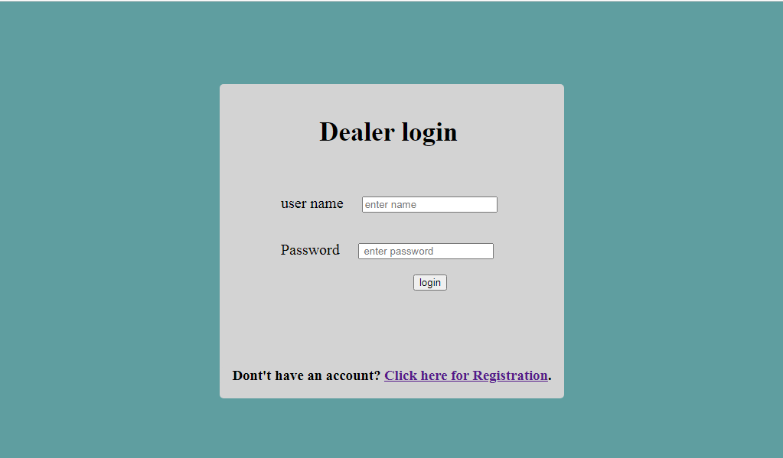
Dealer Login

Slide 8
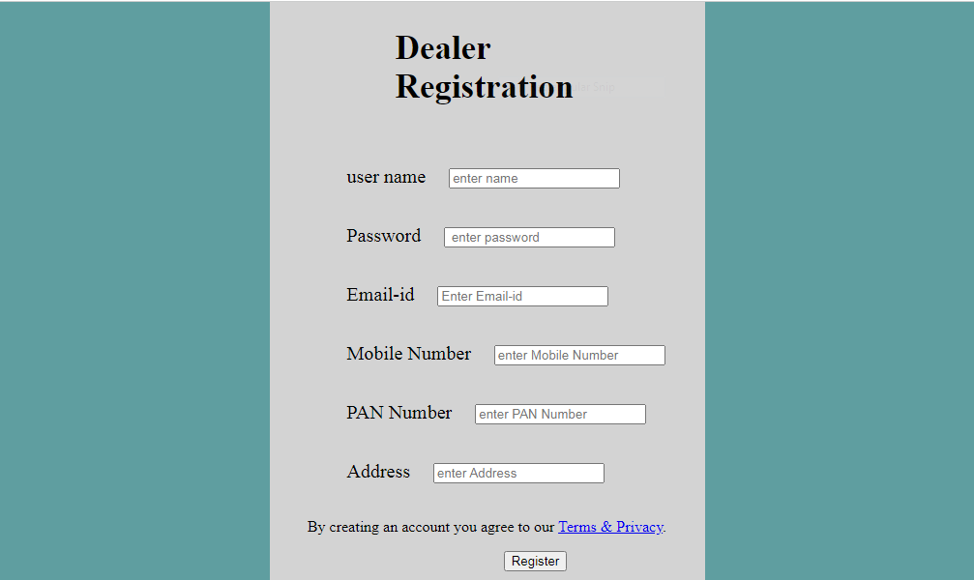
Dealer Registration

Slide 9
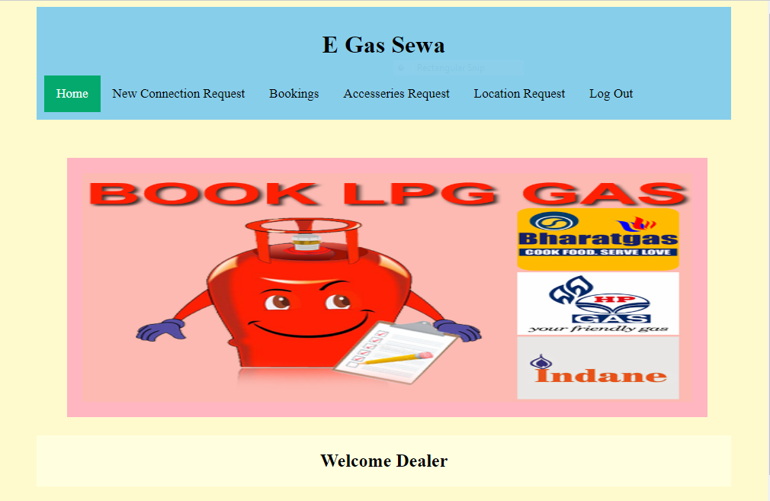
Dealer Page

Slide 10
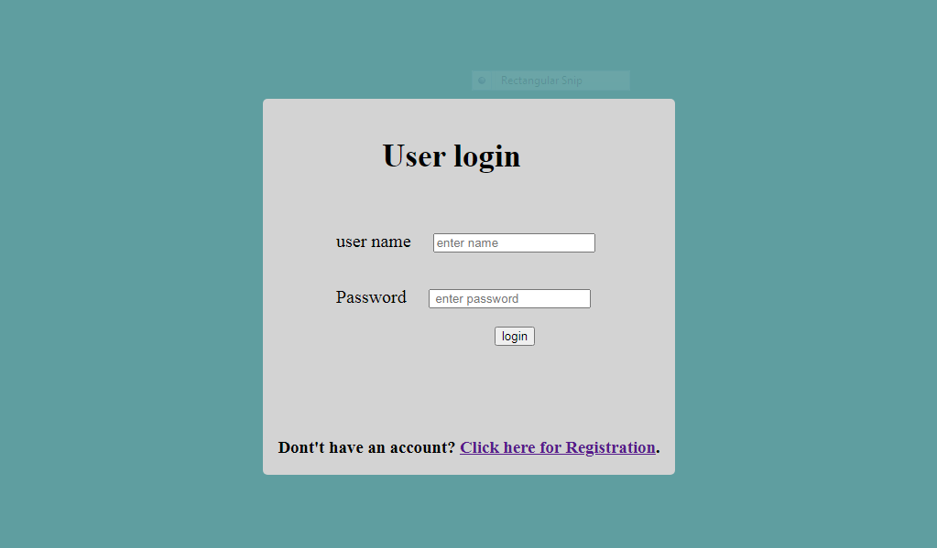
User Login

Slide 11
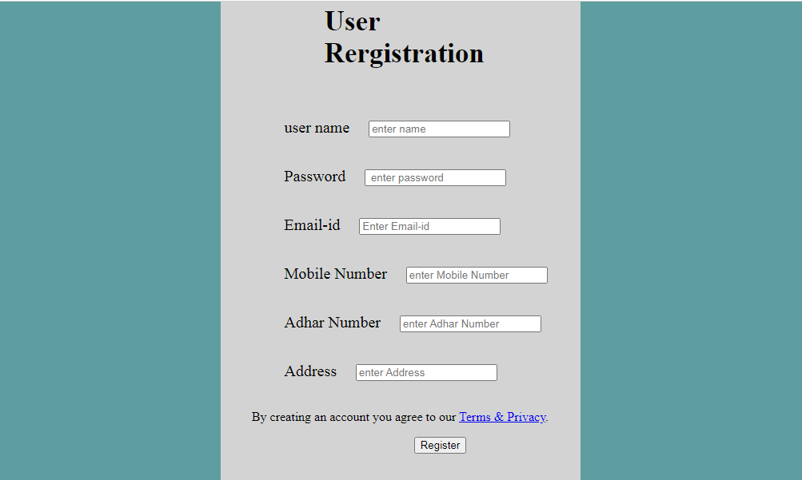
User Registration

Slide 12

User Page

Slide 13
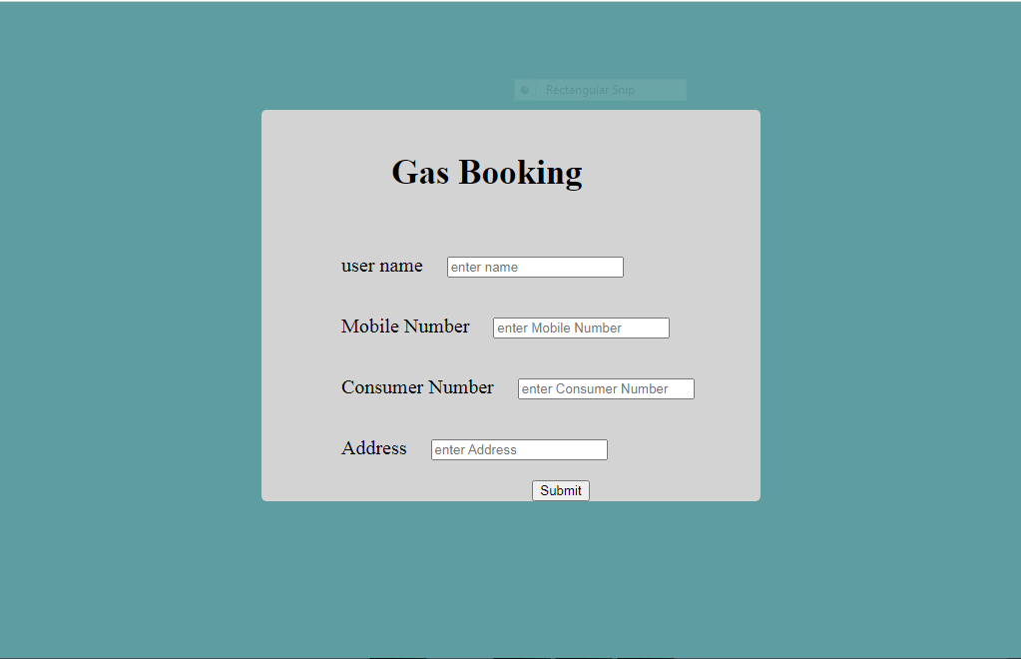
User Gas Booking

Slide 14
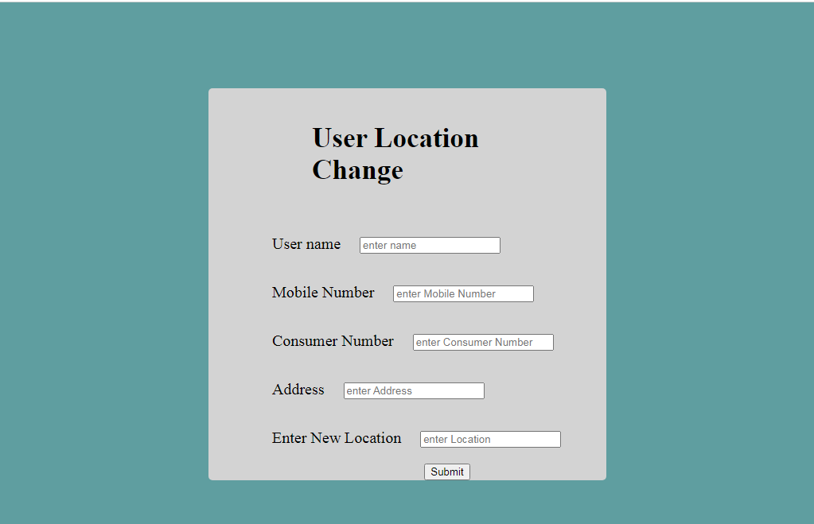
User Location Change Request

Slide 15
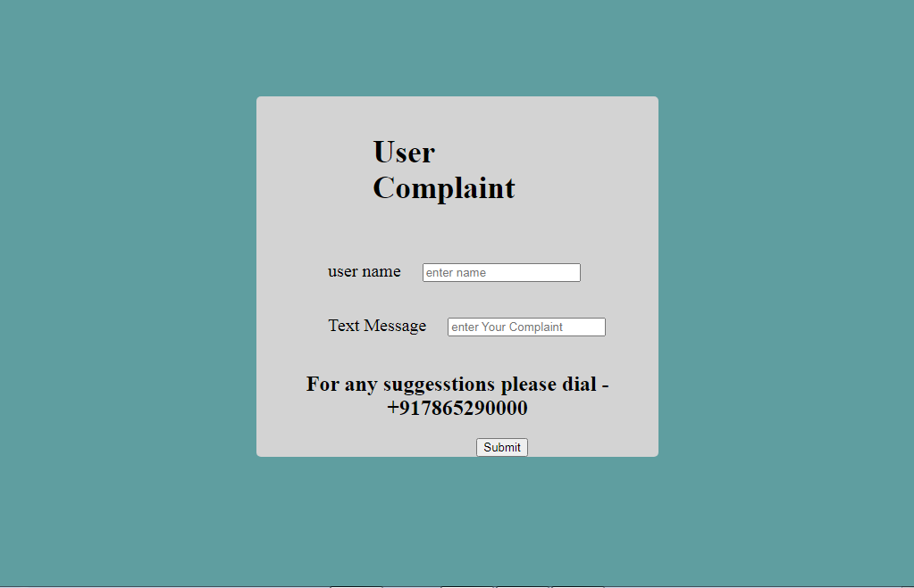
User Complaint

Slide 16
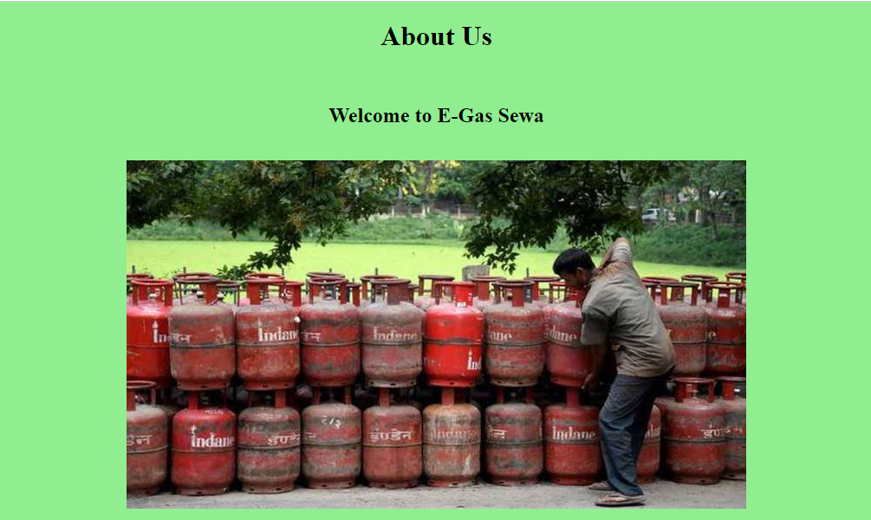
About Us

Slide 17
Advantages
Time management
User friendly
Separate profile for Dealer and user

Slide 18
Brief Description
The E-Gas service is an online service provided to the common people for online booking of gas and checking of the delivery details related to it.
Many new features are included under it which makes it to its perfection like confirmation message will be send after the booking process, Cancelation of the booking within in a particular time period.
Complaints /feedback question is answer by the administrator and report is also maintained by the administrator.
For our system of E-GAS BOOKING SYSTEM, we have focused on costumer roles, authority relationship, information requirements and interpersonal relationship etc. things to make our system more appropriate.

Slide 19
Thank You

