Slide 1



SHEHER
E-Learning platform

Slide 2
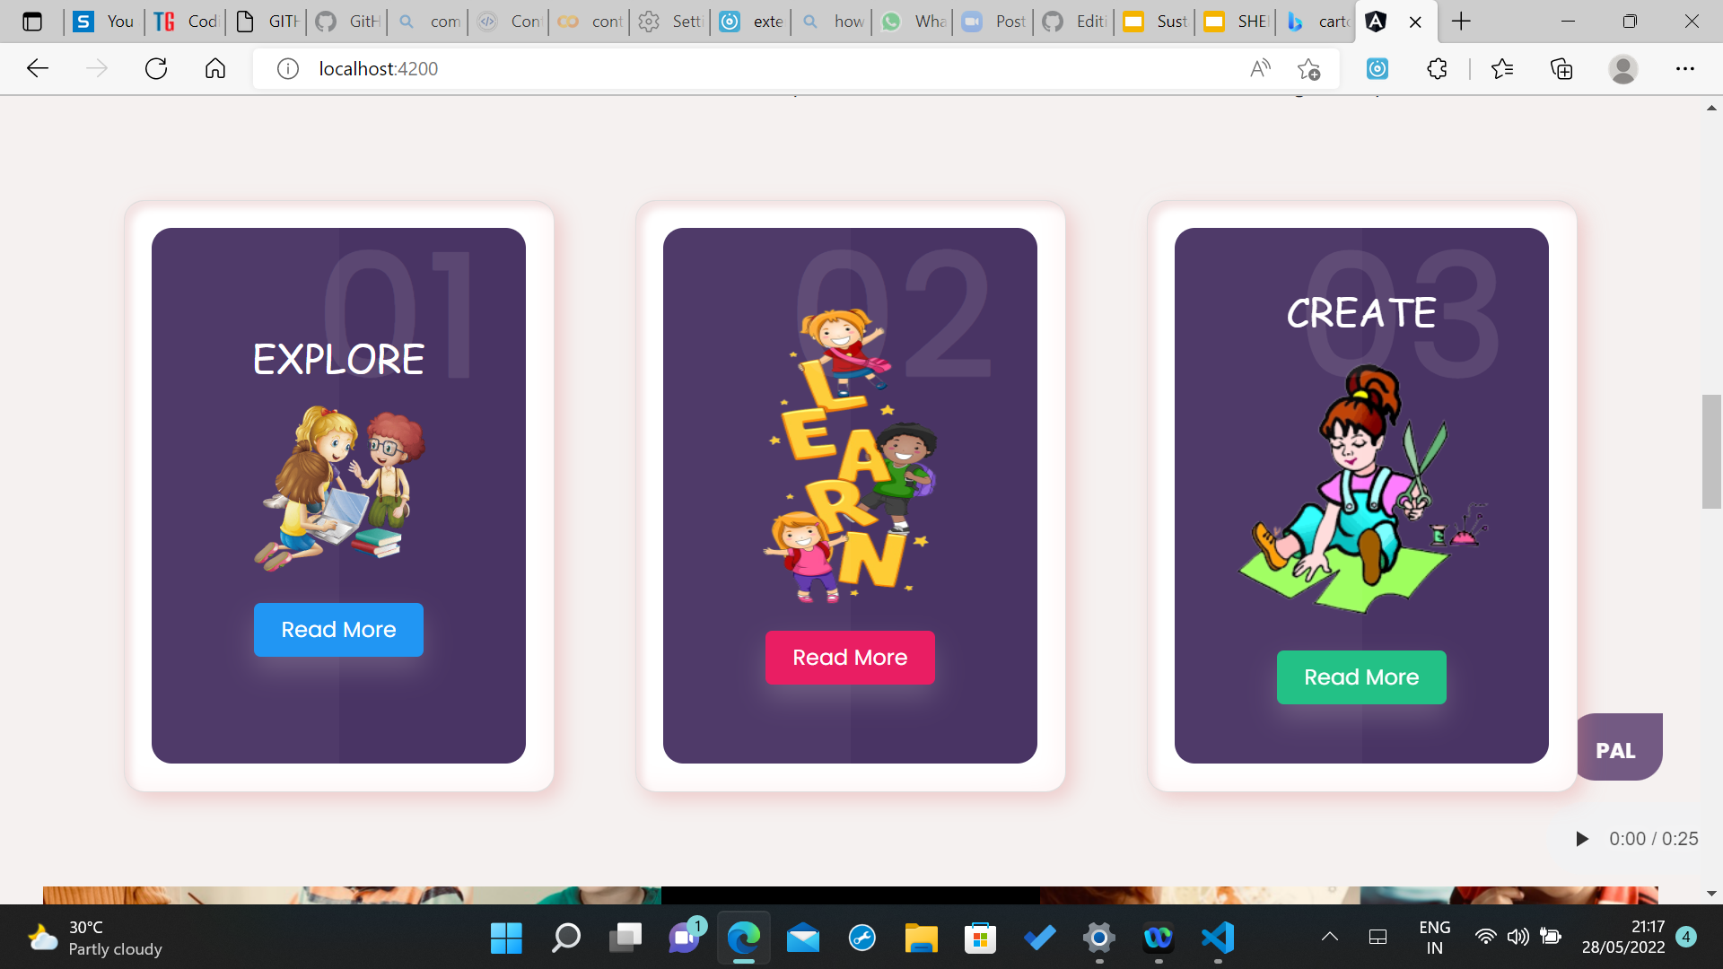
MISSION
Every girl needs education as an individual to make their life better, brighter, and smarter.
We believe in “YOU CAN’T BUILD A GREAT BUILDING ON A WEAK FOUNDATION”.
In Order to improve women health, empowerment and so on base should be stronger.
We follow EXPLORE, LEARN & CREATE

Slide 3

TECHNOLOGIES
Angular
Nodejs
Microsoft Azure ML Services
Cloud
Comments filtering
MongoDB
Python

Slide 4
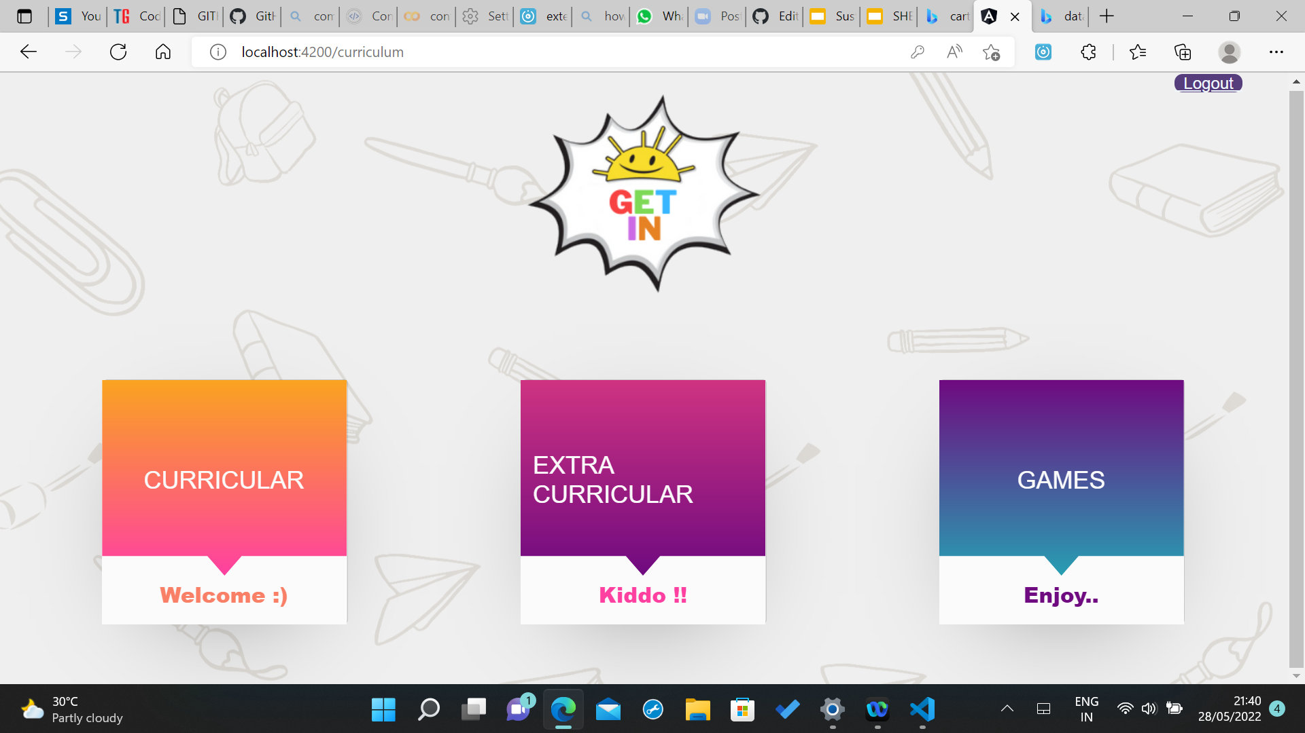
FEATURES
Academic curriculum - Categorized based on grades, Quizzes, so on.
Extracurricular Activities - Arts, Morals, dancing, singing, so on.
Games - to improve cognitive skills & concentration.

Slide 5
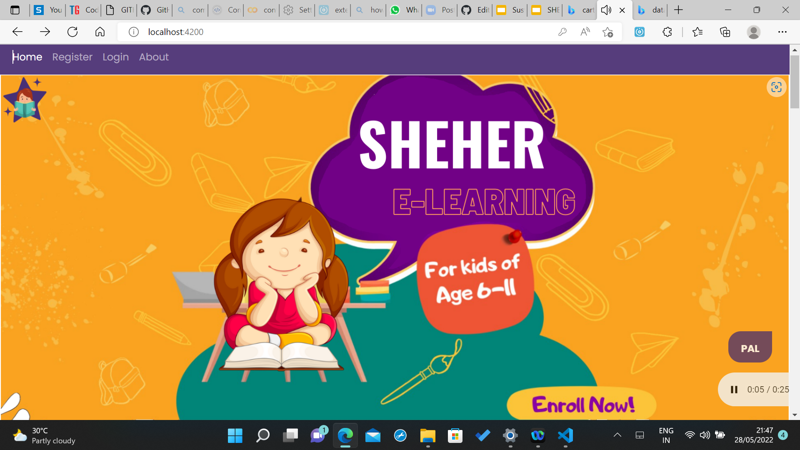
ADDITIONAL FEATURES
Non-profit e-learning platform
Music - to enhance mood
ChatBot - for Interaction
Security Key for Games
Validation for Registration
Students can mail their work
Latest work of students is displayed on homepage.

Slide 6

References
Machine Learning Tutorial for Beginners: What is, Basics of ML (guru99.com)
Angular - EXPLORE ANGULAR RESOURCES
MongoDB - Environment (tutorialspoint.com)
Collaborative Filtering - ML - GeeksforGeeks

Slide 7

YouTube link:
https://youtu.be/QaLNSgTMtjE
Team:
Vennamaneni Anusha
Gnapana Vallaty
Nafiya Siddiqi

